Slide 1


STAGED DEVELOPMENT TOOL (SDT)
FOR NATIONAL PUBLIC HEALTH INSTITUTES
Revised February 2021
Notes:
Staged Development Tool (SDT) for National Public Health Institutes (NPHIs)
The notes accompanying the slides provide additional details about the SDT and its use.
The SDT was developed by the U.S. Centers for Disease Control and Prevention (CDC) and the International Association of National Public Health Institutes (IANPHI) with the assistance of a consultative group of NPHI leaders from around the world. It is designed to help NPHIs assess their capacities and identify gaps, prioritize gaps, and plan for how to move to a higher level of functioning. It is based in part on the CYPRESS methodology developed by Deloitte Consulting, USA. Over the years, several changes were made to the SDT, for example, addition of new Discussion Guides and adaptation for virtual use. This slide-set was revised in February 2021.

Slide 2


Topics
Maturity models and Discussion Guides
SDT workshops
SDT steps
Notes:
This slide-set contains a brief overview of the SDT. This slide-set does not contain sufficient information for an untrained individual to run an SDT workshop. A successful workshop requires facilitation by someone with in-depth understanding of the SDT. If you are interested in having an SDT workshop, please contact CDC or IANPHI (see last slide) for further information.

Slide 3
Maturity Models
The conceptual framework of the SDT is the maturity model
A maturity model describes stages of development: Basic, Developing, Advanced, and Leading Edge
The SDT helps NPHIs apply maturity models to topics or areas that are a priority for the NPHI
Basic
Advanced
Leading Edge
Developing
Notes:
The maturity model is based on the idea that for a given topic, NPHIs exhibit different stages of “maturity” or development. By providing examples of what these different maturity stages “look like,” the SDT process provokes in-depth conversations, in which participants clarify their current stage in a given topical area, their desired stage, and major gaps that need to be addressed to move to the desired stage.

Slide 4
Discussion Guides (DGs)
30 DGs have been designed specifically for NPHIs
  11 cover internal-facing topics, such as leadership and management and internal communication
  19 cover external-facing topics, such as surveillance and multi-sectoral collaborations
All 30 DGs are available in English, French, Spanish, and Portuguese at ianphi.org/tools-resources/sdt.html
The DGs describe what an NPHI might "look like" at the different maturity stages:
  Basic
  Developing
  Advanced
  Leading Edge
Notes:
Often, NPHI planning focuses on Core Public Health Functions. However, sometimes internal issues, such as leadership and management or issues related to the NPHI workforce, are major barriers to accomplishing public health functions. Therefore, the SDT includes Discussion Guides (DGs) that relate to internal-facing issues, such as leadership and management, and external-facing issues, like surveillance.

Slide 5
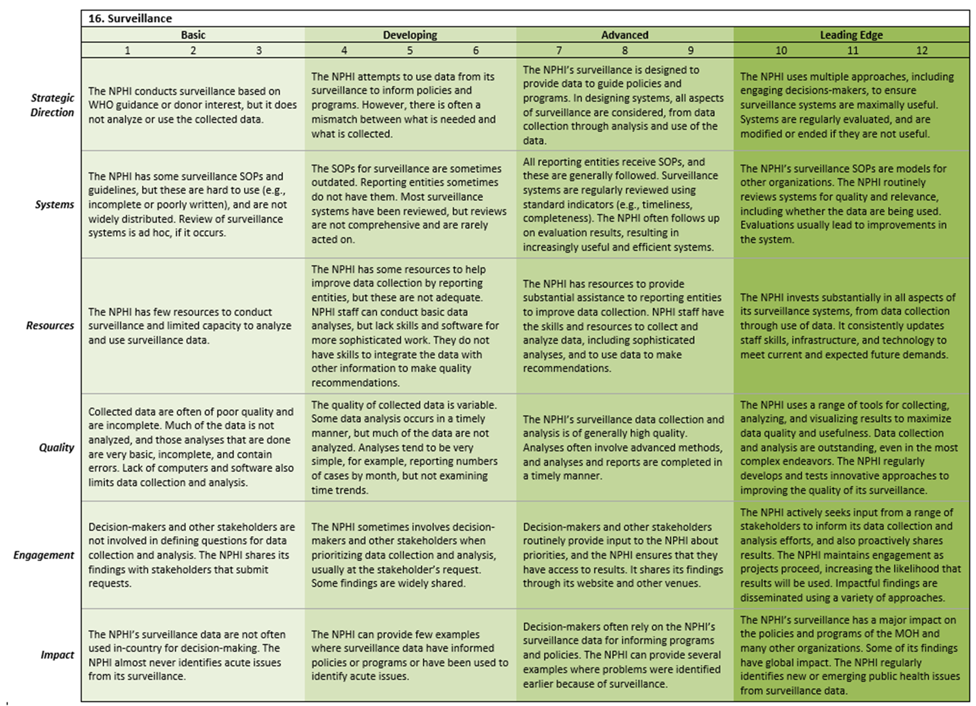
Discussion Guide Example
Notes:
This is a picture of the Surveillance Discussion Guide.
The DG content is divided into four columns, one for each of the developmental stages (Basic, Developing, Advanced, Leading Edge). Each DG also contains six rows, which we call "Domains." The six Domains reflect factors, like Strategic Direction and Resources, that contribute to NPHI's achieving their desired futures. Typically, discussions start with participants discussing the overall stage of the NPHI on that DG, and then they get into detail about each of the Domains.
The numeric scores under each stage provide the option for facilitators to encourage more detailed discussion about the current and desired status in each of the Domains. The actual scores are less important than the discussion that is prompted as participants justify their responses.

Slide 6
Discussion Guides: Domains
There are 6 SDT Domains – each is a row in the DG. They are:
  Strategic Direction: Are priorities clear and strategic?
  Systems: Does the NPHI have the necessary tools, processes, etc. to accomplish its work?
  Resources: Are human and material resources adequate?
  Quality: Is quality measured and are standards met?
  Engagement: Are the key stakeholders engaged with the NPHI and helping it achieve its goals?
  Impact: For internal-facing DGs: Is the NPHI operating effectively? For external-facing DGs: Is the NPHI contributing to better health?
Notes:
Each of the DGs has the same structure, with the 4 developmental stages defining the columns and the 6 Domains defining the rows. The slide above provides abbreviated definitions of the Domains.
The more complete definitions that were used in developing the DGs are:
Strategic Direction: Degree to which the NPHI works strategically in setting priorities and in allocating and using resources, including staff time
Systems: Degree to which the NPHI has systems, processes, and tools that enable it to carry out the described effort
Resources: Degree to which the NPHI has assets (e.g., staff capacity, supplies, transportation, infrastructure) to support the described effort
Quality: Degree to which the NPHI is able to carry out the described effort in a high-quality manner.
An additional component for external-facing DGs is: Degree to which the NPHI supports quality in the efforts of those contributing to the achievement of the described effort (e.g., subnational entities, stakeholders, partners)
Engagement:
Internal-facing only: Degree to which staff are committed to contributing to the NPHI’s vision and goals. Degree to which staff contribute to improving the NPHI’s strategies or performance
External-facing only: Degree to which stakeholders (partners, beneficiaries, contributors, donors, sub-national actors, and communities) are invited to provide input or feedback, or are engaged by the NPHI as partners/advisors
Impact:
Internal-facing only: Degree to which the NPHI is able to perform or achieve results
External-facing only: Degree to which the NPHI is able to perform or achieve its goals and deliver high-quality products and services. Extent to which the products and services have an impact on public health

Slide 7
SDT Workshops
SDT workshops can be either in-person (if circumstances allow) or virtual
  In-person workshops: typically 3 days and 5-8 DGs
  Virtual sessions: typically up to 5 hours per session, including breaks, with number of DGs depending on a variety of factors
Whether in-person or virtual, it is best to have an SDT-trained facilitator and recorder manage the process and record key information on the SDT forms
Notes:
The SDT was originally designed to be conducted as an in-person workshop over several days. With the COVID-19 pandemic and other logistical challenges, IANPHI and CDC have adapted the SDT to provide a virtual option as well.
In-person workshops typically last 3 days and cover 5-8 DGs. Virtual sessions typically last around 5 hours, including breaks. Virtual workshops take longer for a variety of reasons. Technical issues include limited bandwidth for some participants and disruptions (e.g., pets, family members, phone calls, visitors), since often people are working from sub-optimal locations. Without being in a shared space, it is harder for the facilitator and participants to know when discussion of a particular topic has reached a natural end. It can be hard to determine if all who want to contribute to a particular discussion topic have had their opportunity; therefore, the discussion may be more repetitive or recursive than in an in-person setting.

Slide 8

Preparing for a Workshop
In planning an SDT workshop, careful thought is required to decide on the best DGs to use and select the right participants
No special preparation or document development is needed on the part of participants
  The SDT relies on the knowledge and experiences of participants and their combined wisdom
The roles of the facilitator and recorder are to:
  Guide the participants to thoroughly assess the situation and underlying issues before coming up with "solutions"
  Capture and organize input
Notes:
Planning a workshop requires thoughtful consideration about which DGs to use and who to invite. CDC and IANPHI can help leadership define which DGs will address their priorities and what mix of individuals will be best able to develop a plan that is likely to be implemented and achieve the desired impact.
The SDT does not require significant up-front efforts from participants. It relies on what they know and think to create a plan they can "own."
An issue frequently encountered during planning is that participants decide on courses of action before they thoroughly understand the underlying issues. For example, if data quality is poor, a common "solution" is to do training. However, if the people collecting data do not have time to ensure quality or turn over quickly, training may not solve the problem.

Slide 9
The SDT Process Involves 3 Steps
1. ASSESS
2. PRIORITIZE
3. PLAN
During assessment, the DGs are used to prompt discussion
  A good assessment is critical for a good plan
  The facilitator uses the DGs to help participants "dig deep"
Issues for follow-up are then prioritized
The final step is to identify specific next steps for the priority efforts
Notes:
Because the DGs are designed for NPHIs, they include details that reflect the capacities and experiences of NPHIs from around the world. Particularly for NPHIs that are new or are at earlier stages of development, the content under Advanced and Leading Edge stages may suggest activities and options they had not previously considered. Depending on the workshop, planning may stop at defining next steps for follow-up on priority areas or may include full work-planning for specific projects.

Slide 10
Step 1: Assessment
Participants use the DG to assess the NPHI's overall current stage and the stage it would like to be in some time period, e.g., a year
Participants next discuss Domain-by-Domain
  The DGs help participants identify specific gaps and ways to move forward
The discussion is recorded on the Assessment Form
Notes:
The Assessment Form is used to capture the key points from discussion. It has places for the current and desired stages for the NPHI as a whole at the top, and places to capture more detailed information about the various Domains in the table.
Note to recorders: Remember to customize the form so that it works for your preferred approaches. This includes changing column widths; setting margins for best display on a screen; and, if you intend to use bullets, setting up indents and other features.

Slide 11
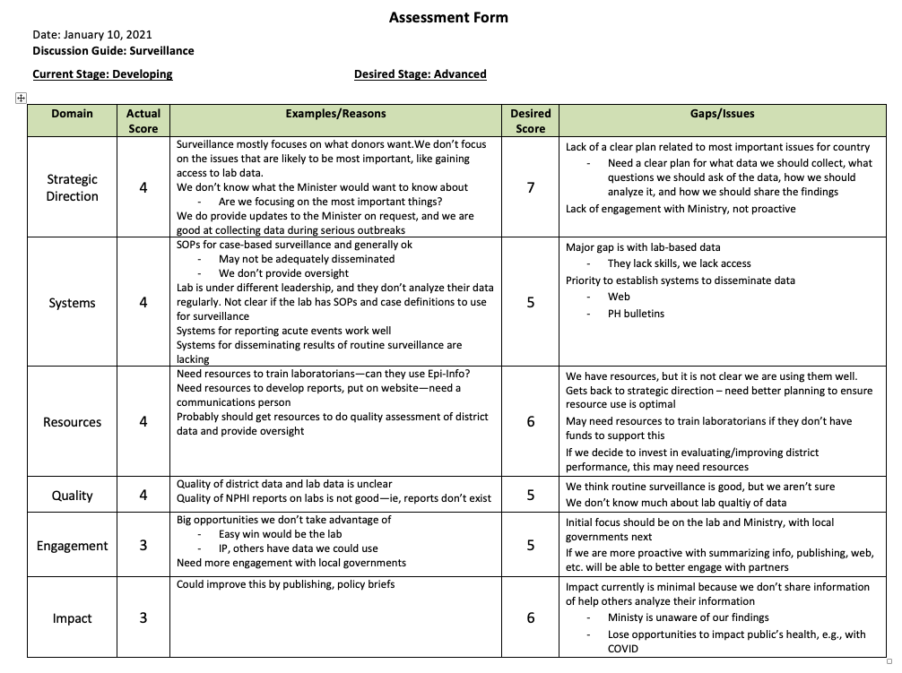
Assessment Form: Example
Notes:
This is an example of a completed Assessment Form. This NPHI is currently in the "Developing" Stage, and it aims to be "Advanced" in a year. Participants have agreed on scores for each of the Domains and identified some of the gaps and issues that need to be addressed to move from their current scores in each Domain to their desired scores.

Slide 12
The Next Steps Form
The Next Steps Form is used for SDT Steps 2 and 3
It includes:
  Gaps and issues from Assessment
  Description – details about the gaps that will help define next steps
  Next Steps – specific actions to be taken after the workshop
Notes:
During a break, the facilitator and recorder organize the information collected on the Assessment Form into categories or "buckets" to make the remaining discussion easier. Similar topics discussed under different Domains are placed together. The "description" includes information discussed during the Assessment step that might be useful in identifying the next steps. If next steps have already been identified for some items, they can be placed in the Next Steps column.

Slide 13
Moving to Prioritization and Planning
Participants take a break after Assessment, while the facilitator and recorder organize the Assessment Form information onto the Next Steps Form
  Ideas about issues that cut across more than one Domain are consolidated
Notes:
This slide shows a partially completed Next Steps Form, such as might be generated during the break by the facilitator and recorder. More information will be needed to develop a robust plan. The recorder has chosen to put an item into the Next Steps column for further discussion if this is a priority.

Slide 14
Participants Review Next Steps Form
The group discusses each item in the Gaps and Issues column and fills in details needed to make a good plan
  Is more information needed to understand the gaps keeping the NPHI from the desired stages?
  Will addressing the identified gaps have the desired effect; are there important issues missing?
Notes:
After the break, the group reviews the Next Steps Form. After a quick overview by the facilitator, the group discusses each item in the Gaps and Issues column to ensure common understanding and add information that may be critical in the Prioritization step. Next steps that arise at any time during the discussions can be captured in the Next Steps column.

Slide 15
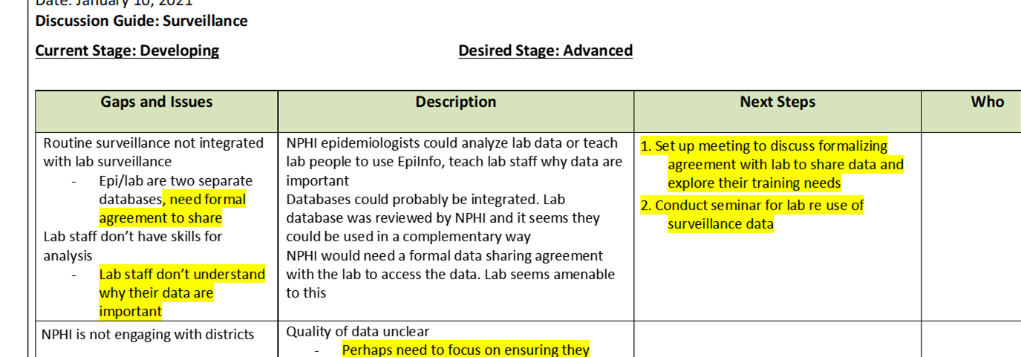
Step 2: Prioritize
The group then reviews the Gaps and Issues column, issue by issue
They identify priorities, and the recorder highlights them
Once all the gaps and issues are discussed, the highlighted items are reviewed
  Did the priorities get captured? Is anything missing? Should anything come off?
Notes:
If new gaps and issues are identified, these can be added. It is also possible that some gaps and issues will be found to be too broad. For example, a gap may be split into two, one of which is a priority and one of which is not.

Slide 16
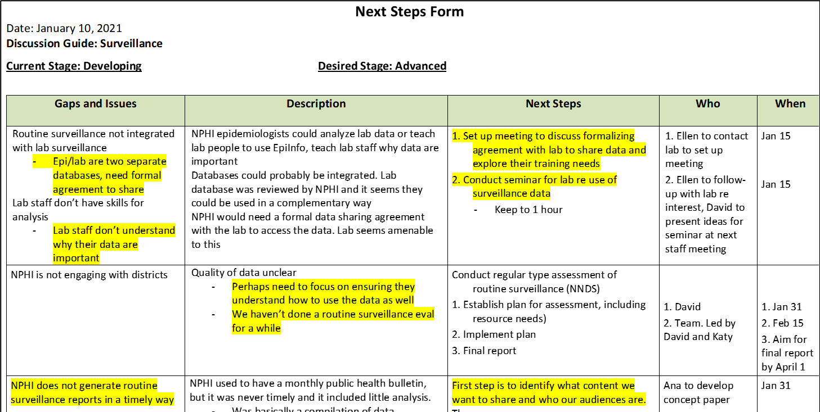
Step 3: Planning
Next steps – including who is responsible and a timeline – are described for all priorities
Notes:
In this next part of the SDT process, participants develop plans for their highest priorities. It is critical to clearly define who is responsible for which actions, and the timeline for achieving them. If work-planning does not immediately follow prioritization, some NPHIs may choose to conduct work-planning during the subsequent weeks.

Slide 17
Finally, Identify the Low-Hanging Fruit
Low-hanging fruit are activities that can be done relatively easily and will have high impact
First, the Next Steps are reviewed. Are any of these low-hanging fruit?
Then, additional ideas can be generated
  These ideas may not be specific to the Discussion Guide used in the workshop, but are easy wins to consider pursuing
  Each low-hanging fruit should have a next steps plan: who is responsible, and what is the timeline
Notes:
Often, participants have additional ideas beyond those in the DG topic about high-priority activities that could achieve results quickly. Capturing these and developing next steps may not help the NPHI achieve a higher stage in the area covered by the DG, but it can help the NPHI achieve a higher overall level of functioning and/or effectiveness

Slide 18
Before Ending, Review the Plans
If the NPHI addresses the priorities, will it make the desired progress towards achieving the desired stage?
Are additional resources needed? What is the plan for obtaining them?
Are the next steps clear? Do all key staff understand their roles in carrying the plan forward?
How will progress be monitored?
Notes:
A potential pitfall in any planning is that participants develop detailed plans for what is easy to do, but not necessarily what is most impactful. Before declaring the plan complete, it is essential to review it to determine if it is likely to have the desired impact, and to revise it if necessary.

Slide 19

Good Luck to You As You Move Towards Your Preferred Future
If you have any comments or questions about this material, please contact:
  U.S. CDC’s NPHI Program: nphisdt@cdc.gov
  IANPHI: info@ianphi.org

