Slide 1


Staged Development Tool (SDT)
Background and Description
Revised 2024
Notes:
Staged Development Tool (SDT) for National Public Health Institutes (NPHIs)
The notes pages for this SDT PowerPoint complement what is in the slides.
The SDT was developed by the U.S. Centers for Disease Control and Prevention (CDC) and the International Association of National Public Health Institutes (IANPHI) with the assistance of a consultative group of NPHI leaders from around the world. It is designed to help NPHIs assess their capacities and plan for how to move to a higher level of functioning.
The SDT was launched in 2017 and has been used not just by NPHIs, but also by Ministries of Health and other organizations throughout the world. The 2024 revision to the website, slide-set, and materials responds to needs identified by NPHIs, for example, by including a Discussion Guide on noncommunicable diseases, and incorporates ideas from experiences from the use of the SDT in countries around the world.

Slide 2
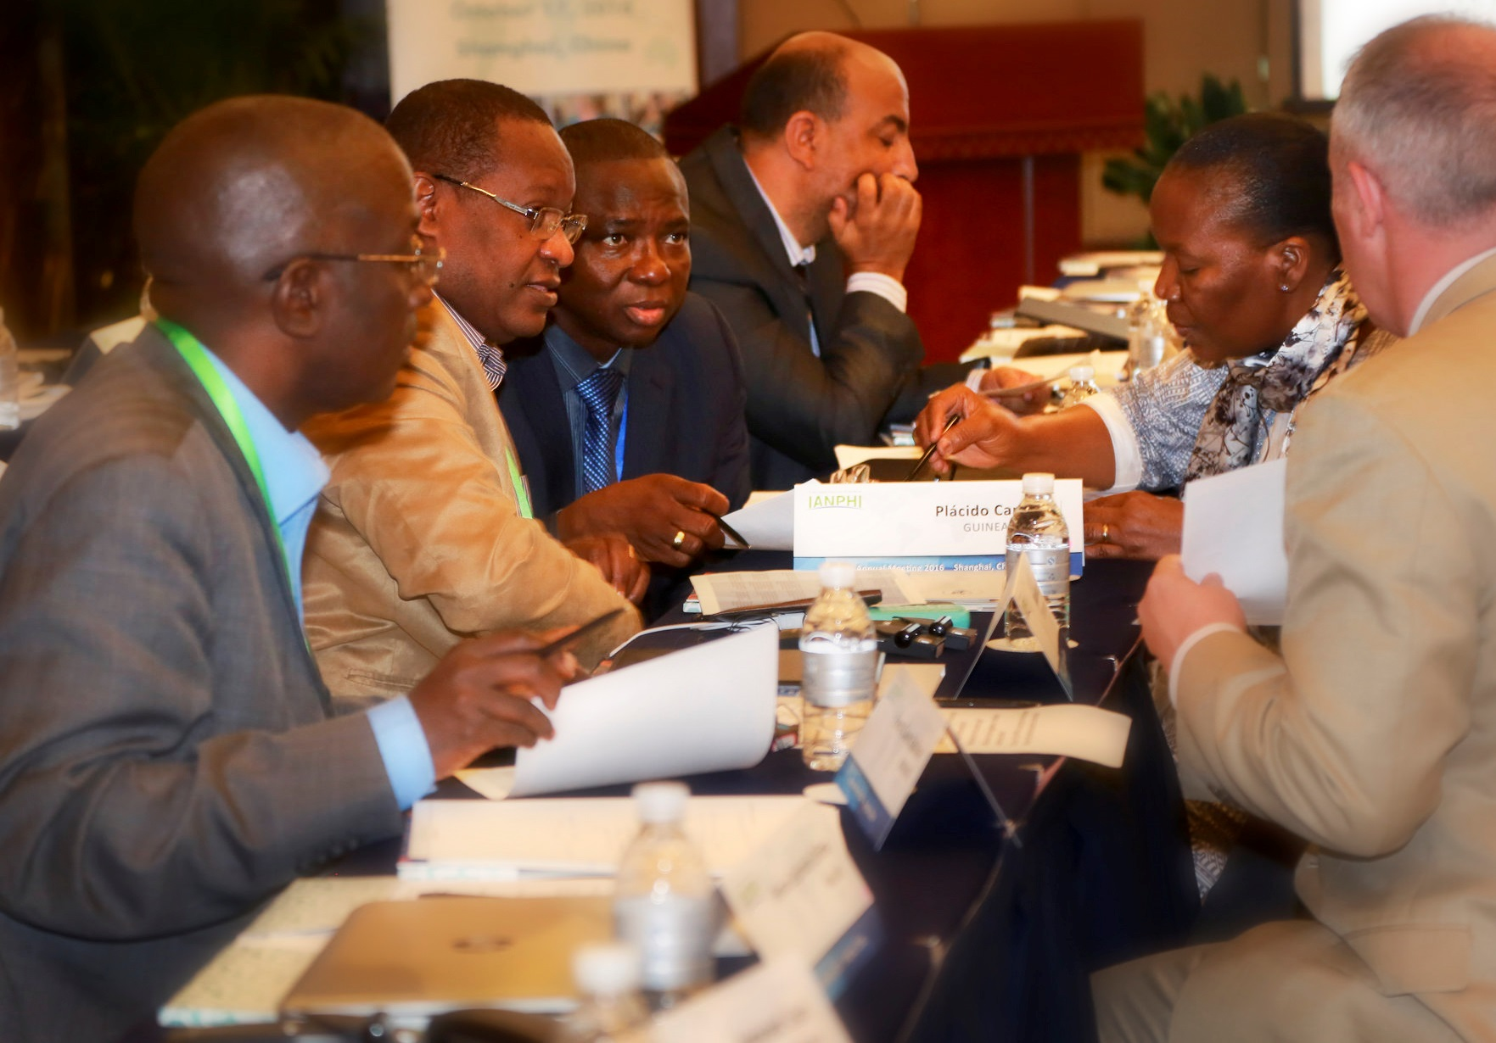
Topics
Maturity Models and Discussion Guides
SDT Workshops
Other Ways to Use Discussion Guides and the SDT
Notes:
This slide lists the topics covered in this presentation.

Slide 3
Maturity Models
The conceptual framework of the SDT is the maturity model
A maturity model describes stages of development: Basic, Developing, Advanced, and Leading Edge
NPHIs use the SDT to assess their current and desired stages of development in priority areas and create plans to achieve their desired stages
Basic
Advanced
Leading Edge
Developing
Notes:
Maturity models are based on the idea that for a given topic or priority area – such as leadership and management, or surveillance – NPHIs exhibit different stages of “maturity” or development. By providing examples of what these different maturity stages “look like,” the Discussion Guides encourage in-depth conversations that lead to plans for how to move to the desired stages.

Slide 4
Discussion Guides (DGs)
DGs have been designed specifically for NPHIs
They cover
  Internal-facing topics, such as leadership and management, and internal communication
  External-facing topics, such as surveillance, multi-sectoral collaborations
    A “generic” Discussion Guide can be modified for use with topics not on the current list, such as injuries or mental health
Notes:
Often, NPHI planning focuses on public health functions. However, sometimes internal issues, such as leadership and management or the NPHI’s infrastructure, are major barriers to accomplishing public health functions. Therefore, the SDT includes Discussion Guides that relate to internal-facing issues, such as leadership and management, and external-facing issues, such as surveillance.
Most external-facing Discussion Guides relate to capacities, such as surveillance or emergency preparedness and response. In response to requests, a Discussion Guide was developed for noncommunicable diseases. A generic Discussion Guide is provided that can be adapted to address issues not currently included, such as injuries or mental health.
The Discussion Guides provide specific examples of attributes and capacities NPHIs might have at different developmental stages. By providing examples of what the four maturity stages look like, Discussion Guides provide a basis for in-depth conversations.

Slide 5
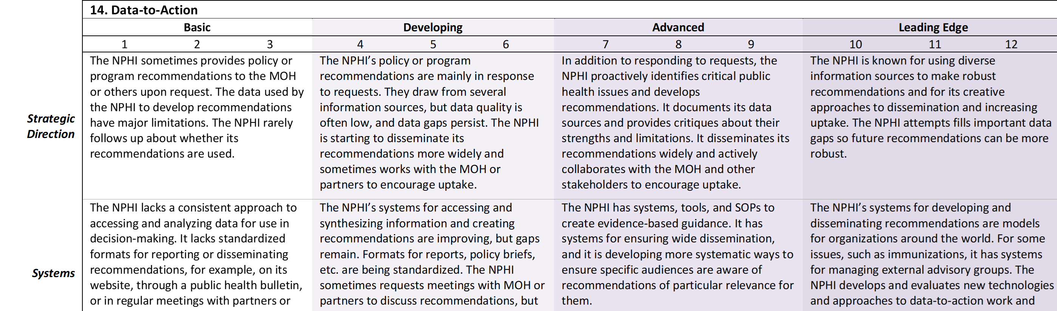
Discussion Guides
Title
Four columns, one for each of the stages
  Numeric scores allow for more nuanced discussion about the SDT’s stage along the continuum
Each of the columns contains descriptions covering 6 domains:
Strategic Direction
Systems
Resources
Quality
Engagement
Impact
Notes:
Each of the Discussion Guides has the same structure. The title is at the top. There are 4 Stages that define the columns. They range from Basic at the left to Leading Edge at the right. Each stage is further subdivided with numeric scores. Disagreements about numeric scores often help participants delve deeply into the reasons they agree or disagree. The six domains define the rows. They are listed alongside the table, on the left side. Each rectangle in the table includes ideas about what an NPHI might “look like” – specific attributes and capacities they might have – in that domain and at that stage. Descriptions of the domains are on the next slide.

Slide 6
Discussion Guides: Domains
There are 6 SDT domains – each is a row in the Discussion Guide
  Strategic Direction: Are priorities clear and strategic?
  Systems: Does the NPHI have the necessary tools, processes, etc. to accomplish its work?
  Resources: Are human and material resources adequate?
  Quality: Is quality measured and are standards met?
  Engagement: Are the key stakeholders engaged with the NPHI and helping it achieve its goals?
  Impact: For internal-facing Discussion Guides: Is the NPHI operating effectively? For external-facing Discussion Guides: Is the NPHI contributing to better health?
Notes:
The slide above provides a simplified version of what is covered in each domain. The detailed domain definitions are:
Strategic Direction: Degree to which the NPHI works strategically in setting priorities and in allocating and using resources, including staff time
Systems: Degree to which the NPHI has systems, processes, and tools that enable it to carry out the described effort
Resources: Degree to which the NPHI has assets (e.g., staff capacity, supplies, transportation, infrastructure) to support the described effort
Quality: Degree to which the NPHI is able to carry out the described effort in a high-quality manner.
An additional component for external-facing Discussion Guidess is: Degree to which the NPHI supports quality in the efforts of those contributing to the achievement of the described effort (e.g., subnational entities, stakeholders, partners)
Engagement:
Internal-facing only: Degree to which staff are committed to contributing to the NPHI’s vision and goals. Degree to which staff contribute to improving the NPHI’s strategies or performance
External-facing only: Degree to which stakeholders (partners, beneficiaries, contributors, donors, sub-national actors, and communities) are invited to provide input or feedback, or are engaged by the NPHI as partners/advisors
Impact:
Internal-facing only: Degree to which the NPHI is able to perform or achieve results
External-facing only: Degree to which the NPHI is able to perform or achieve its goals and deliver high-quality products and services. Extent to which the products and services have an impact on public health

Slide 7
Using the SDT
The complete SDT process involves a workshop
  Usually led by a neutral, SDT-trained facilitator and recorder
  Results in a detailed plan that will lead the NPHI to a higher stage of development
The SDT Discussion Guides can also be used in an informal manner
  Discussion Guide content can be used by the NPHI or groups within the NPHI as a basis for discussions about existing and desired attributes and capacities
Notes:
The Discussion Guides are designed to prompt reflection, both about the current stage and attributes and capacities that are desired. Using the Discussion Guides in a structured workshop typically results in a plan for specific actions. Because of the detailed content of the Discussion Guides, when used informally they can also provide new insights and ideas about what might be possible and achievable.

Slide 8
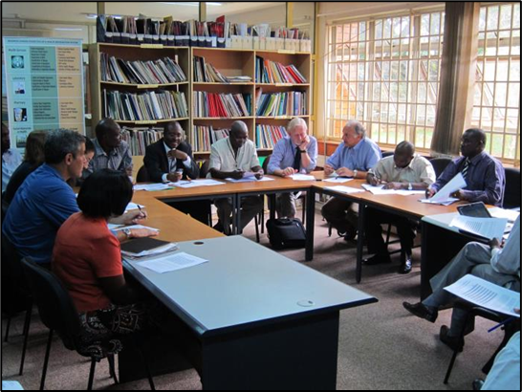
SDT Workshops
Notes:
SDT Workshops have been used in many countries for NPHI planning. They are best conducted by external facilitators and recorders who are trained in the SDT. The facilitator serves as a neutral party who helps the participants implement the SDT process. The facilitator uses a variety of techniques to help participants “dig deep” to understand the issues they need to address to reach the desired stage. The recorder captures the discussion in real time.

Slide 9
SDT Workshops
Preferably facilitated by a team – a facilitator and a recorder – trained on SDT
  In-person is best, to encourage conversation
  Can also be conducted virtually or using a hybrid approach
Best used by an established group that will remain in existence long enough to implement the plans, such as
  An NPHI
  A department in an NPHI
  Sections of the Ministry of Health that are being brought together to create the NPHI
Notes:
The SDT is a highly interactive process, so it works best when participants can sit with each other for the discussions. However, it has successfully been conducted virtually and with hybrid approaches.
The SDT is designed for use in groups that can be clearly defined, which makes it easier to have robust discussions about the group’s capacities and how to achieve a higher stage. When the borders of the group in the workshop are not clear, it can be more difficult to define the group’s current capacities and stage of development and barriers to moving to the next stage. It can also be harder to get commitments to a shared plan and ensure the plan is carried out.

Slide 10
SDT WorkshopS Involve 3 Steps
Assess
Prioritize
Plan
During assessment, the Discussion Guides are used to prompt discussion
Issues for follow-up are then prioritized
The final step is to identify specific next steps for the priority efforts
Notes:
SDT workshops use a 3-step process. The first step is assessment of the current and desired stages, as well as identifying what is keeping the NPHI from achieving the desired stage. The second is prioritization, and the third is planning. The results of SDT planning are a roadmap to building capacity and increasing impact in areas the NPHI considers a priority.

Slide 11

Step 1: Assessment
Participants first read the Discussion Guide silently
They then discuss the NPHI's overall current stage
  The initial determination of overall stage provides a starting place for the more in-depth discussion to follow
They then discuss the NPHI domain-by-domain
  The recorder captures the discussion on the Assessment Form
Notes:
The Assessment Form is used to capture the key points from discussion. It has places for the current and desired stages for the NPHI as a whole at the top, and places to capture more detailed information about the various domains in the table.

Slide 12
Step 1: Assessment
The initial discussion of the overall stage of the NPHI is brief, focused on getting a general sense of the NPHI’s stage
This is followed by in-depth probing and discussion. Going domain-by-domain, participants:
  Discuss the current score in that domain, providing detailed justifications for their proposed scoring
  Identify the score they would like to achieve within a defined timeframe, e.g., a year
  Identify the reasons that are not at the desired score, probing for the underlying issues
Key points are recorded on the Assessment Form
After all the domains are discussed, participants revisit their estimate of the overall current and define the desired score, which are also recorded
Notes:
The assessment is meant to be driven by the participants. The facilitator uses the Discussion Guide to prompt thoughtful exchange of ideas and information.

Slide 13
Example: Assessment Form
This is an example of ideas that might be recorded on an Assessment Form during discussion, using the Discussion Guide on Surveillance
This country is “Developing” and wants to be “Advanced” by the end of the year
Note that several issues have arisen that will be discussed as other domains are explored in more depth
Notes:
This is an example of what might have been captured on the Assessment Form for the Strategic Direction domain using the Discussion Guide about Surveillance. You can see that this NPHI is hoping to go from a score of 4 to 7 in a year, and they have identified issues they need to address to get there. Some of the items captured in the right-hand column will be priorities, but some will not. Some may need further discussion to ensure explore whether addressing them will result in the desired improvements or whether there are underlying issues that are more critical.

Slide 14
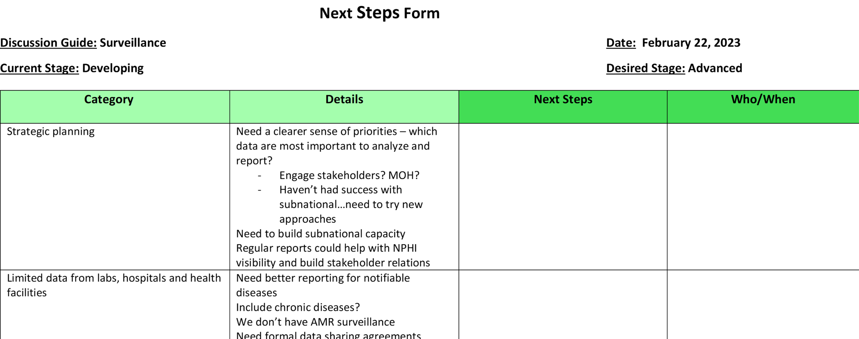
Transition
During a break, the facilitator and recorders organize Assessment Form information into categories on the Next Steps Form
Categories should be designed to group related ideas to make prioritization and planning easier
All ideas generated during Assessment should appear on the Next Steps Form, either in the Category column or in Details
Notes:
The Assessment typically results in many ideas. Because the discussion is free-flowing, related ideas may appear under different domains. During the break, the facilitator and recorder group these ideas into categories that they believe are consistent with how the group is thinking about the issues. For example, using the Surveillance Discussion Guide, ideas about data integration or about subnational reporting to the NPHI might have been raised in several domains (e.g., Resources, Systems, Engagement, and Impact). These ideas can be consolidated into categories, as shown above.

Slide 15

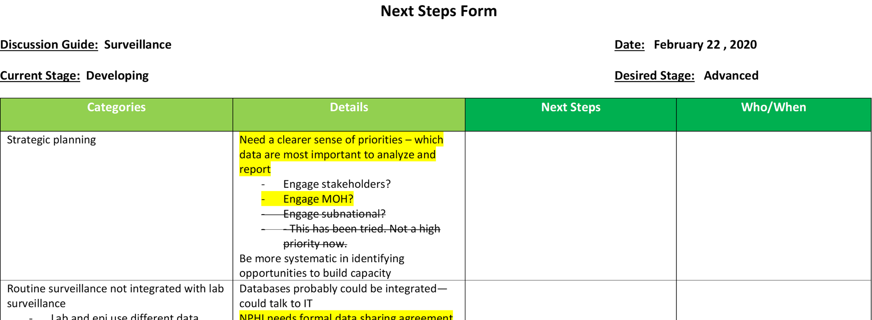
Step 2: Prioritization
When participants return, the facilitator reviews the information on the Next Steps Form
Often, some issues need to be explored further to clarify what is keeping the NPHI from reaching the desired stage
Participants select the most important items for follow up (highlighted) and those that are lower priority for now (crossed out)
Notes:
During prioritization, the recorder can cross out issues deemed low priority and highlight those that are deemed important. Some issues will be modified based on further probing.

Slide 16

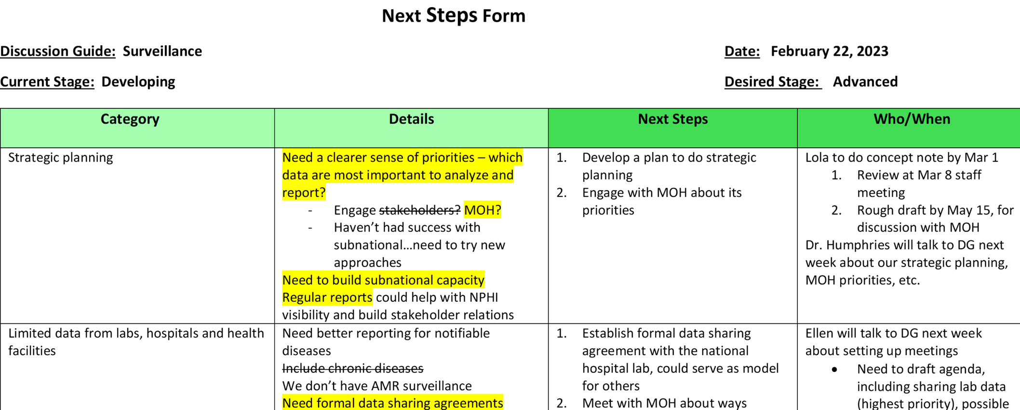
Step 3: Planning
Participants identify the action steps for the priorities, including milestones and due dates, and who is responsible for each step
Although not on the form, the follow-up plan should include regular check-ins and updates
Notes:
In this next part of the SDT process, participants develop plans for their highest priorities. It is critical to clearly define who is responsible for which actions, and the timeline for achieving them. If work-planning does not immediately follow prioritization, some NPHIs may choose to conduct work-planning during the subsequent weeks.
Note that planning using the SDT is meant to be flexible. In this example the group has put timelines in with milestones and noted where it will need to consult with leadership before proceeding to map out detailed next steps (although a timeframe for that consultation is given).

Slide 17
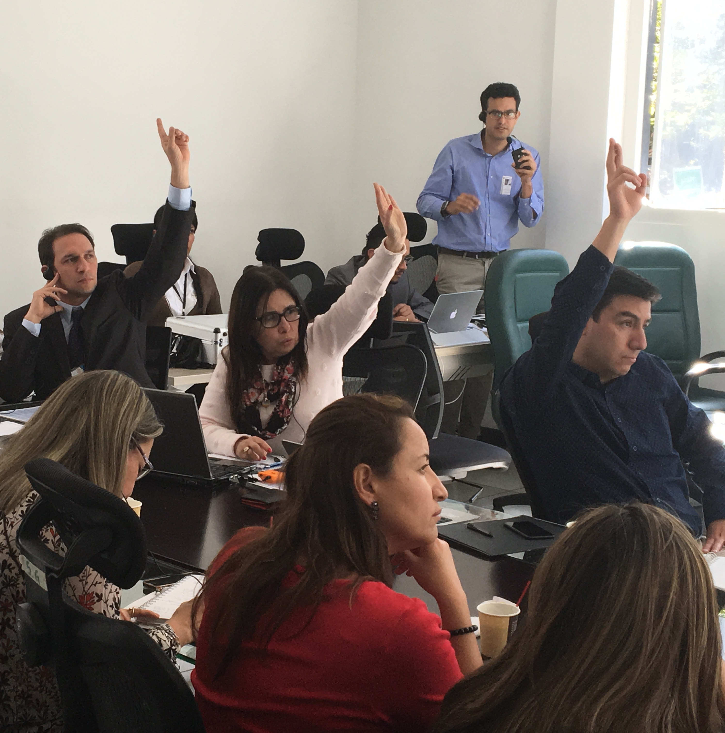
Identify Easy Wins
Easy wins are activities that can be done relatively easily or quickly and will be impactful
  Some of the next steps discussed already on the Next Steps Form will be easy wins
  Sometimes participants have ideas for easy wins that are not related to the Discussion Guide being discussed. It is important to probe for these and capture them as well
Notes:
Often, participants have additional ideas about high-priority activities that could achieve results quickly on issues not covered by the Discussion Guide under discussion. Capturing these and developing next steps may help the NPHI achieve a higher overall level of functioning and/or effectiveness.
Image: SDT Colombia (July 2017)

Slide 18
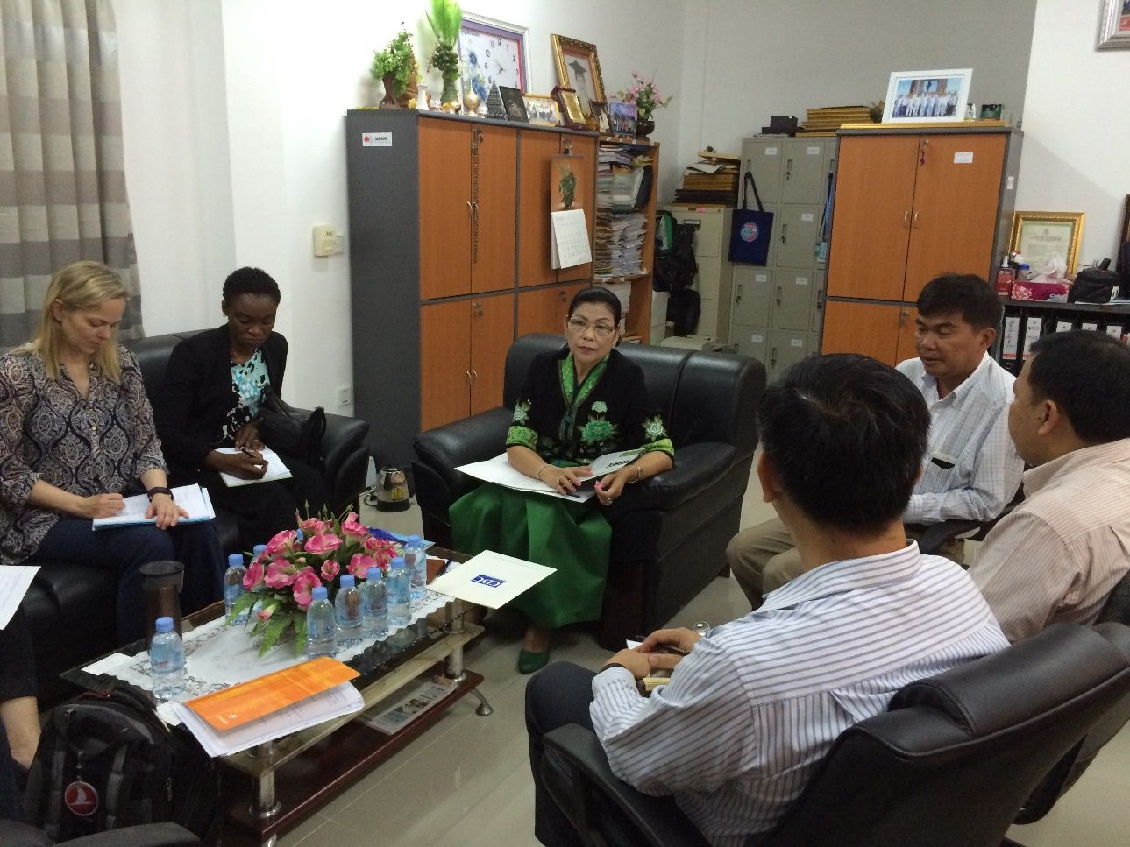
When Done Planning, Review the Plans
If the NPHI completes the workplan, will it make the desired progress towards achieving the desired stage?
Are additional resources needed? What is the plan for obtaining them?
Does leadership understand and support the plan?
Do all NPHI staff understand their roles in carrying the plan forward?
How will progress be monitored?
Notes:
A potential pitfall in any planning is that participants develop detailed plans for what is easy to do, but not necessarily what is most impactful. Before declaring the plan complete, it is essential to review it to determine if it is likely to have the desired impact, and to revise it if necessary.
Image: NPHI / IANPHI Cambodia Visit (May 2016)

Slide 19
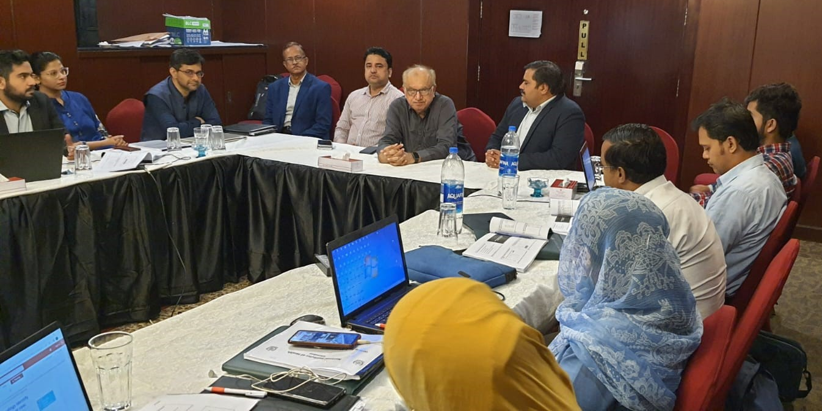
Other Ways to Use Discussion Guides and the SDT
Notes:
The Discussion Guides and SDT are flexible tools that can be adapted for different needs. It is expected that any SDT discussions will focus on the most relevant aspects of Discussion Guides and minimize time spent on those that are not as important. In fact, facilitators will often modify Discussion Guides to change the term “NPHI” to the name of the group using the Discussion Guide or take out specific items that will not be part of the discussion.
Image: Writing for PHB Workshop – Karachi, Pakistan (September 2022)

Slide 20
Examples of Other Ways to use
the Discussion Guides
The Discussion Guides have been used in less formal settings, for example, to prompt discussion during planning or staff meetings
Nine African countries participated in peer-to-peer workshops about noncommunicable diseases (NCDs) using a simplified SDT process combined with a WHO tool
A modified version of the SDT is a component of the NCD Capacity Assessment and Planning (N-CAP) Process (https://www.tephinet.org/noncommunicable-diseases-capacity-assessment-and-planning-process)
Notes:
The Discussion Guides have been successfully used informally to prompt discussion. Sometimes this has been in meetings convened for this purpose; other times they have been part of a staff meeting agenda.
Several groups have used modifications of the SDT to discuss noncommunicable diseases. For example, Germany’s Robert Koch Institute (RKI), in conjunction with Africa CDC, adapted the SDT for use in two peer-to-peer workshops on surveillance systems for NCDs and mental health. These workshops, which used the adapted SDT and a detailed WHO tool, included a total of nine African countries.
The N-CAP Process, which includes a workshop whose structure is based on the SDT, has been conducted in Jordan, Iraq, and a province in Pakistan.

Slide 21
Good Luck with Planning
Using the SDT!!!
If you have any questions, please contact us
Please also let us know about your experiences using the SDT or Discussion Guides
We look forward to hearing from you
IANPHI
info@ianphi.org
International Association of National Public Health Institutes (IANPHI) SDT Website
CDC
NPHIProgram@cdc.gov
National Public Health Institutes (NPHIs) | Global Health Protection | CDC

