Slide 1
Dr. Tomofumi SONE, MD, MPH, DrMedSci President, National Institute of Public Health, Ministry of Health, Labour and Welfare, JAPAN
PANEL 4: RESILIENT HEALTH SYSTEMS
Roles of NPHIs in resilient health systems

Slide 2
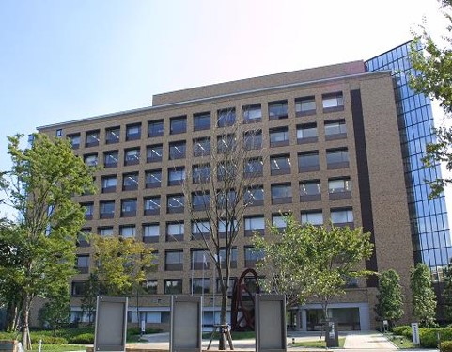
Outline of NIPH, Japan
The mission of NIPH is training of personnel of public health, environmental health and social welfare, and research on these areas.
6 Research Managing Directors, 8 research departments/centers and 1 admin. department
Three WHO Collaborating Centres; Integrated People-Centred Service Delivery, Community Water Supply and Sanitation, and Tobacco Testing and Research

Slide 3
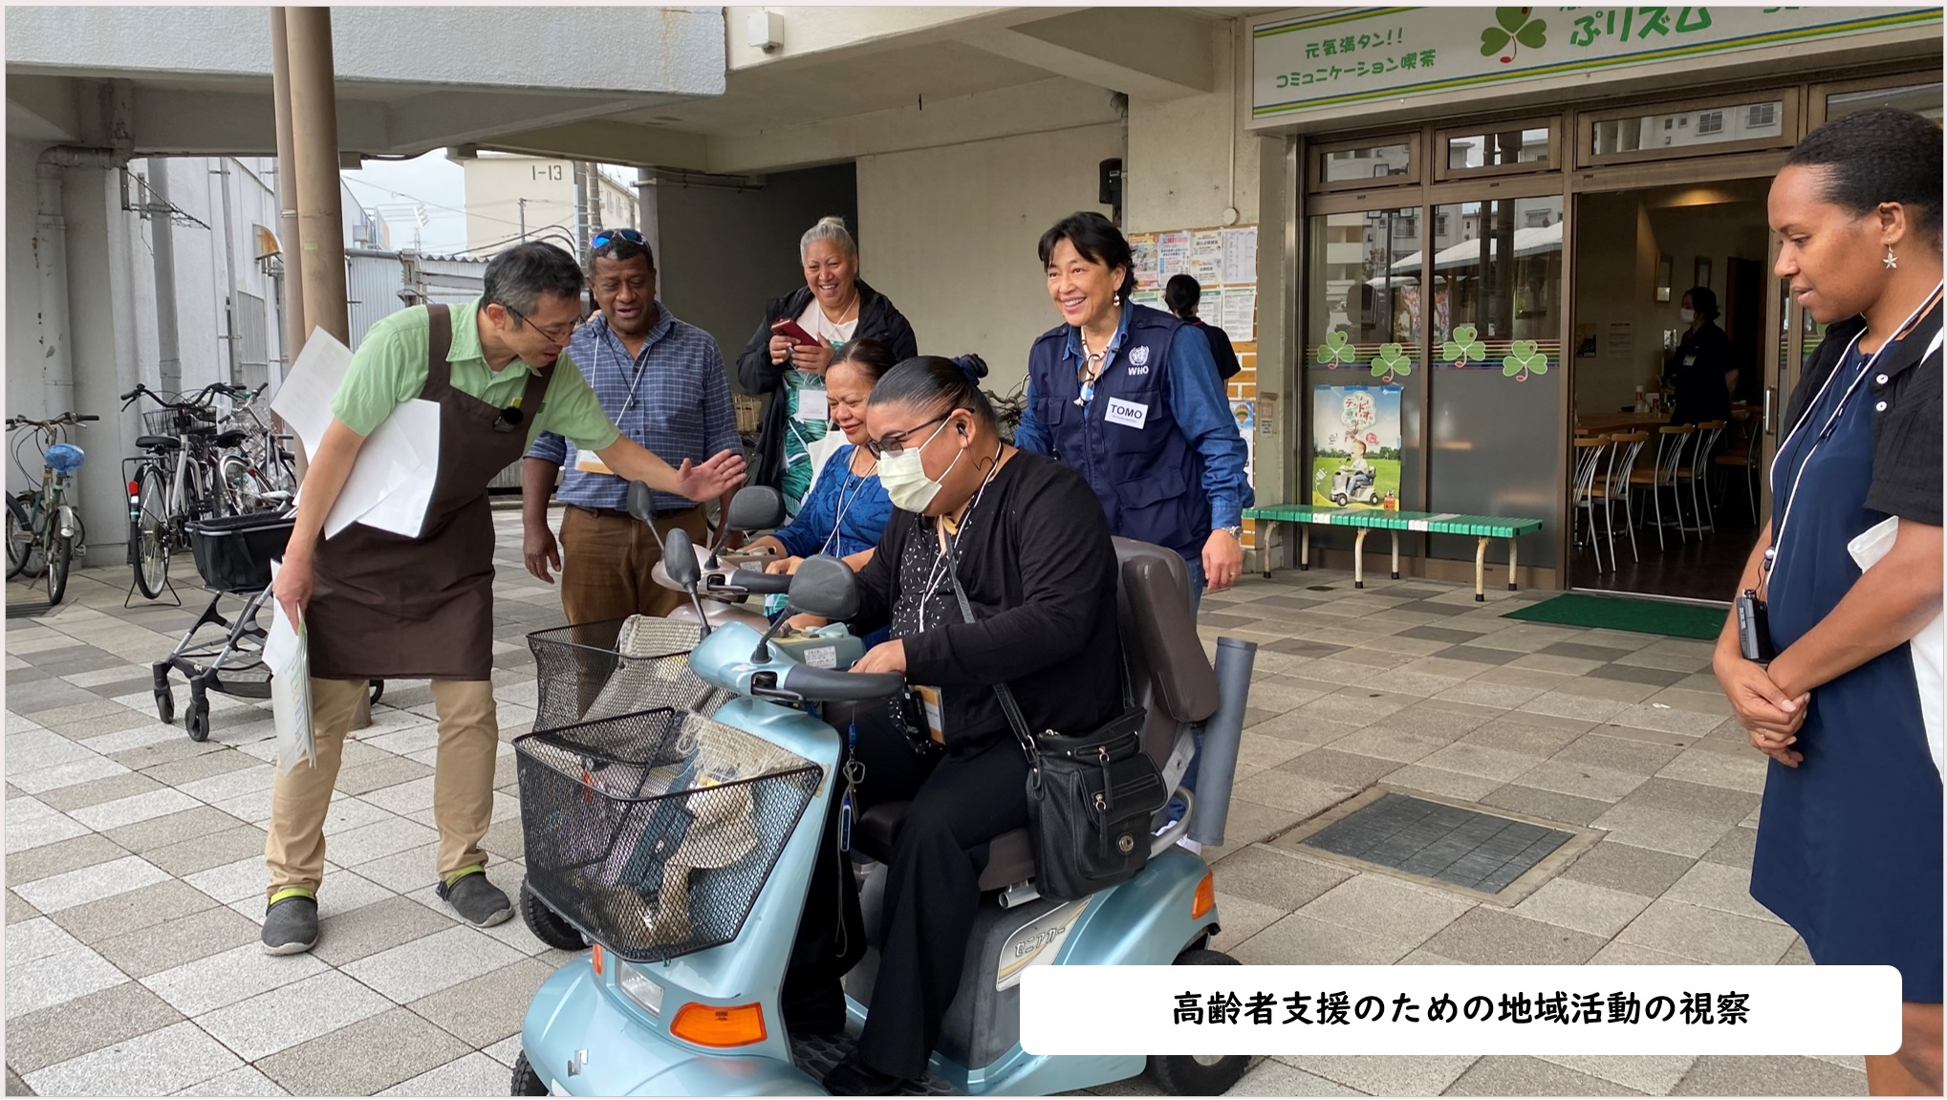
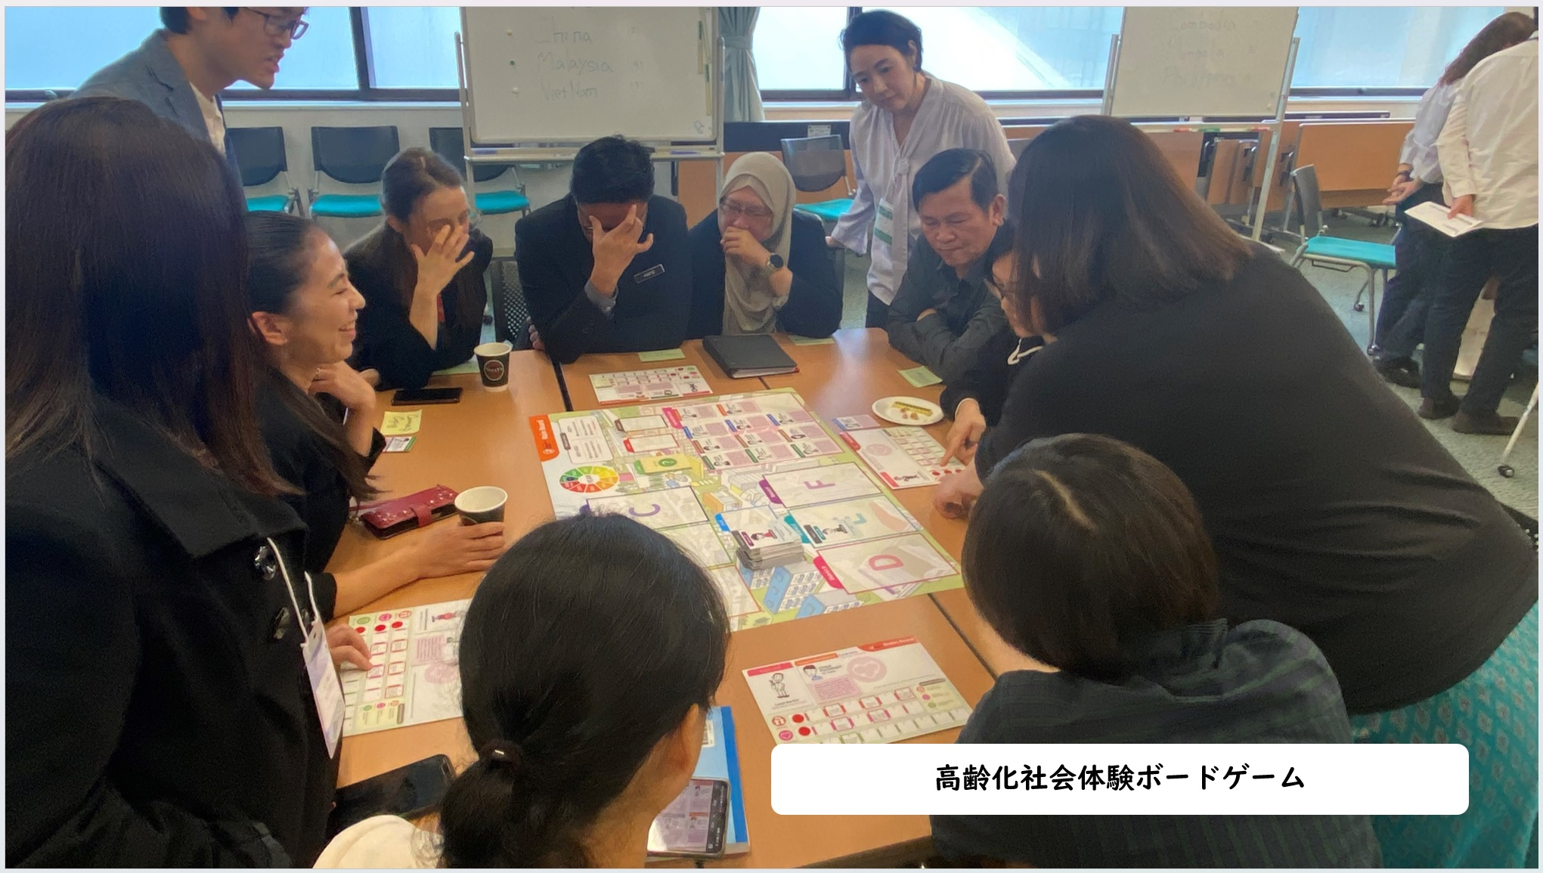
NIPH’s contribution to capacity building of public health personnel
7 long courses and over 40 short courses (domestic)
For public health personnel of the local governments
Approximately 1500 trainees annually
More than 56,000 graduates since 2002
All courses are free of charge.
Co-hosting international courses with JICA (Japan International Cooperation Agency) on UHC and policy development, and with WHO Western Pacific Regional Office on NCDs and ageing
Online, In-person, and Mixed courses

Slide 4
Universal Health Insurance System in Japan
Since 1961
Covering all the people in Japan
Fee-for-service payment
DPC (Diagnosis Procedure Combination system) is partly adapted.
National Medical Fee Schedule
- Unified pricing (one price) for each service and medicine
- No difference in payment between public and private institutions
- Revised every two years by Central Social Insurance Medical Council (CSIMC) of the Ministry of Health, Labour and Welfare

Slide 5
Summary of new Cost Effectiveness Evaluation System in Japan
Started in April 2019
Medicines, Medical devices and Cell and Gene therapies
After the approval, products are reimbursed under health insurance scheme in accordance with current pricing rules. The price may be adjusted after cost effectiveness evaluation.
Products with large expected annual sales or prominently high price are subject to evaluation.
Products only for rare diseases or children are exemption from evaluation.
The price will be adjusted when ICER exceeds JPY 5 million /QALY. (JPY 7.5 million/QALY for such products as anti-cancer drugs.)

Slide 6
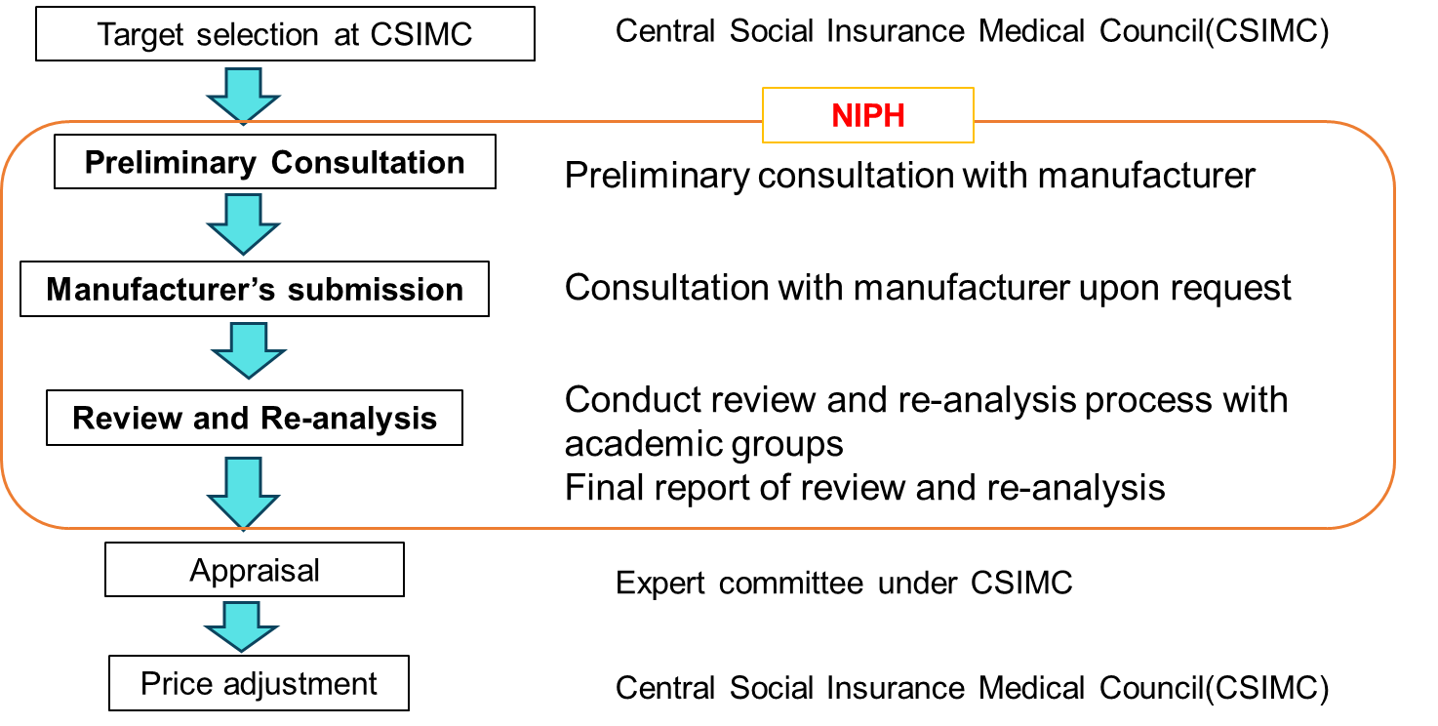
Flow of cost effectiveness evaluation and the role of NIPH

Slide 7
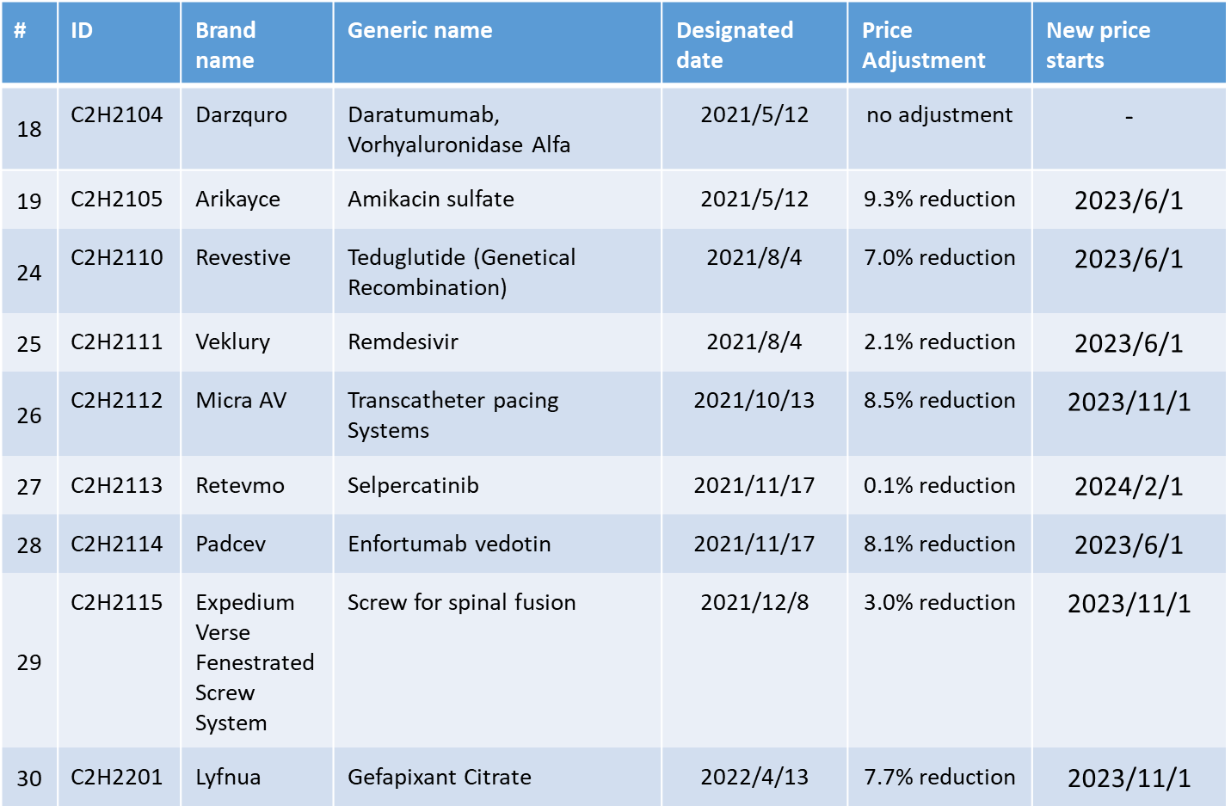
Price Adjustment based on Cost Effectiveness Evaluation

Slide 8
History of National Health Promotion Plan in Japan
1978
1978~ 1st National Health Promotion Plan
Improving health checkups, developing municipal health centers,
securing manpower such as public health nurses
1988
1988~ 2nd National Health Promotion Plan
~ Active 80 health plan ~
Establishment of exercise guidelines, promotion of health promotion facilities, etc.
2000
2000~ 3rd National Health Promotion Plan
~ Health Japan 21 ~
Emphasis on primary prevention
Setting specific goals and evaluating them
2003
Health Promotion Act
2007
Midterm evaluation
2011
Final evaluation
Smart-life project
2013
2013~ 4th National Health Promotion Plan
~ Health Japan 21 (2nd term) ~
Extending healthy life expectancy, reducing health
disparities, improvements of lifestyles and social environment
2018
Midterm evaluation
2022
Final evaluation
2024
2024~ 5th National Health Promotion Plan
~ Health Japan 21 (3rd term) ~
2035

Slide 9
Capacity building and technical assistance for Health Promotion Plans both at national and local level by NIPH
National level
= NIPH
Training programs for health promotion
Management leaders of prefectural governments
Prefectural level
Training programs in each prefectural government
・・・・
Municipal level
Health professionals in municipal governments

Slide 10
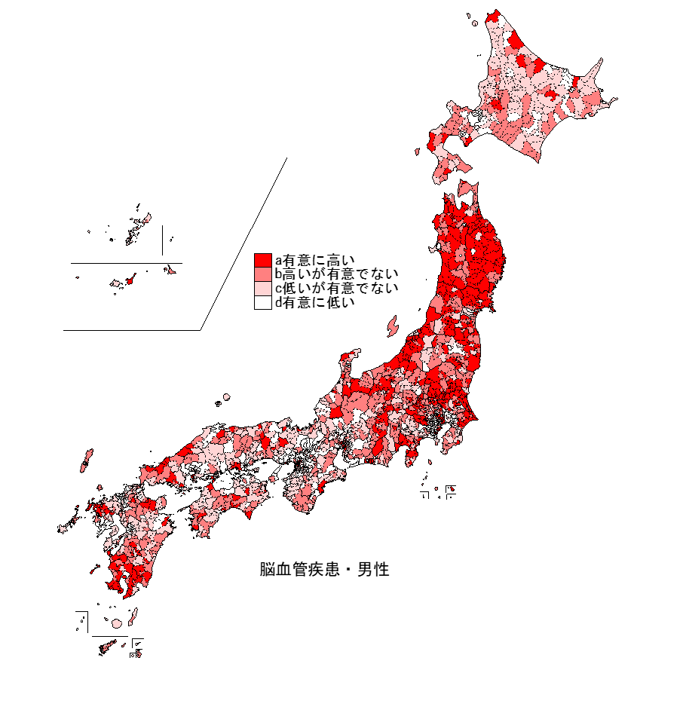
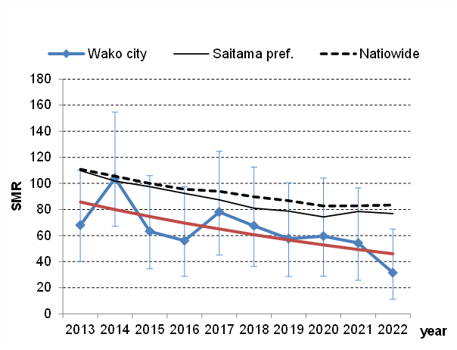
Providing visualized health data for local governments
Comparison of secular trends in SMR between municipalities, prefecture, and nationwide
Cause-specific SMR by municipalities
(For 18 causes in 1718 municipalities)
Cerebrovascular Disease (male)
Significantly high
High
Low
Significantly low
Cerebrovascular Disease (male)

Slide 11
NIPH contributes to the generation of scientific evidence for policy development and implementation at the national level. NIPH is required to play a leading role in Universal Health Coverage and NCD control and prevention.
To implement national policies nationwide, it is essential to increase the capacity of public health personnel in local governments. Capacity building for them through training is the most important role of NIPH as a national institution.
Technical support for local governments to implement policies in line with their actual circumstances is also important, and NIPH can make greater contribution, especially in terms of data analysis and visualization of results.
Through training and technical support, NIPH acts as a bridge between national and local government policy implementation, which is important for maintaining resilient health systems.
Roles of NPHIs in resilient health systems
-from NIPH Japan’s experience-

Slide 12
Resource allocation to generate scientific evidence for policy development and implementation
Capacity building of public health personnel in the local governments to ensure policy implementation on the front line
Bridging between national and local government policy implementation, which is important for maintaining resilient health systems
Three key interventions the G20 Ministers Working Group on Health should consider

Slide 13
Thank you for your attention!
https://www.niph.go.jp/en/information-en/
Acknowledgements: This presentation has been supported by Dr. Takashi Fukuda, Center for Outcomes Research and Economic Evaluation for Health, and Dr. Tetsuji Yokoyama, Department of Health Promotion, NIPH Japan.

