Slide 1
Resilient Health Systems: National to subnational approaches
Dr. Sarah Viehbeck
Chief Science Officer and Vice-President, Data, Surveillance and Foresight
Branch, Public Health Agency of Canada, Canada

Slide 2
Key messages
From intense disruption(s), innovation(s) can emerge
A (health) system of systems can benefit from defining system elements (essential functions) and what makes a system high performing
Resilience can be demonstrated and reinforced across national and subnational levels through joined up intentions, actions, practices, technical collaboration, and capabilities

Slide 3
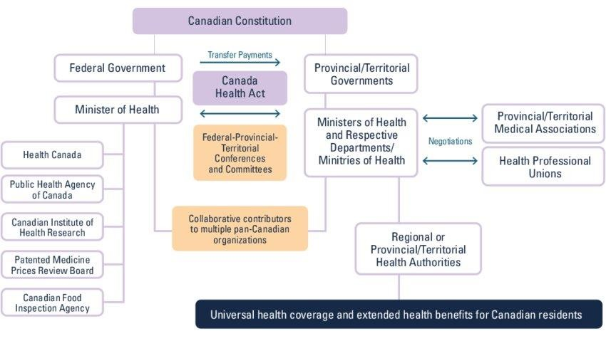
Canada’s Health System is distributed across jurisdictions
Canada has a distributed health system model and public health is organized differently within Canada’s 13 provincial/territorial (P/T) jurisdictions.
PHAC and other federal partners play a leadership role through funding, convening, regulation/legislation, targeted programming, and collaboration

Slide 4
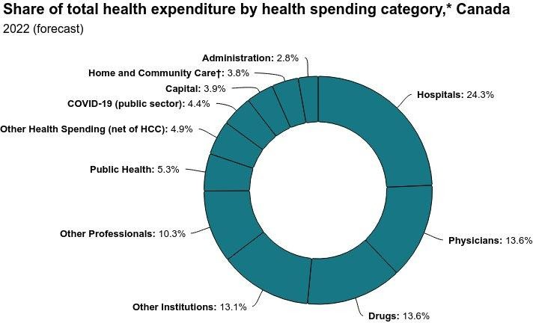
Public health accounts for
~5% of health
expenditures in Canada

Slide 5
Emerging from disruption:
The Public Health Agency of Canada at 20
The Agency was formed through legislation that included the provision for the Chief Public Health Officer to “provide the Minister and the President with public health advice that is developed on a scientific basis.“

Slide 6
COVID-19 as another (very extreme) case of disruption
The COVID-19 pandemic represented a large-scale disruption of systems – An increase in complexity and frequency of emergencies has resulted in government(s) responding to concurrent and consecutive challenges (e.g., Mpox, Highly Pathogenic Avian Influenza, wildfires, conflicts)
Such disruption(s) has shown us how to behave like a system (or a system of systems), displaying
properties such as …
Organization
Interconnectivity and boundary spanning
Emergence and Innovation
Adaptability
Feedback

Slide 7
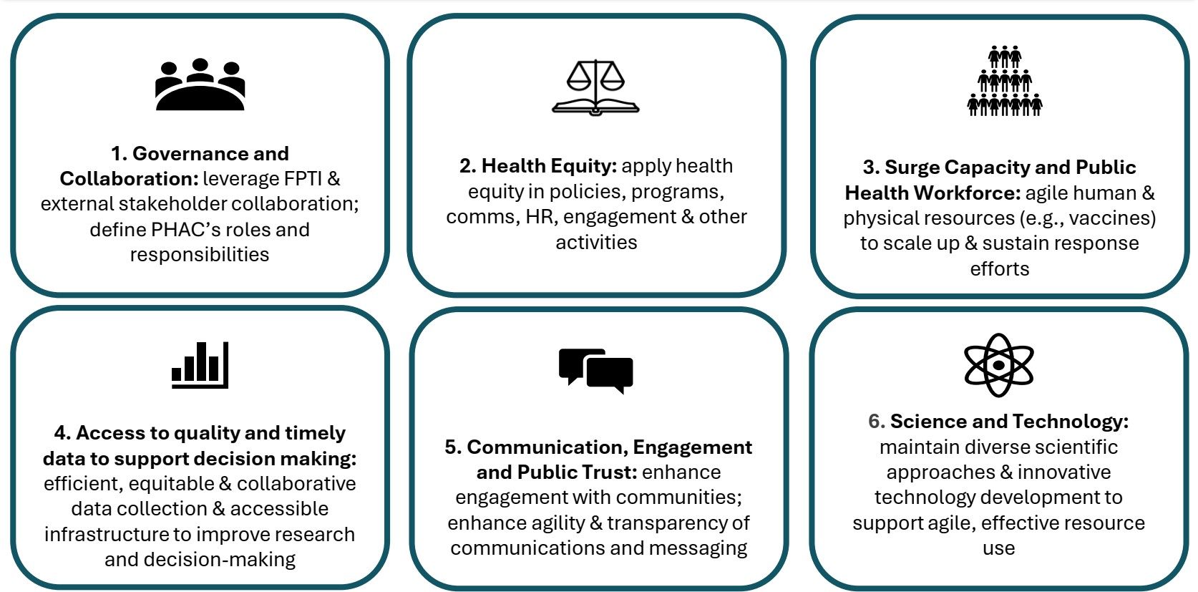
Many lessons learned and …

Slide 8
…many challenges to resilience
Health system surge capacity
Declining and inequitable health outcomes
Multisectoral action
Thinking beyond health
Training Initiatives
Workforce burnout
Data maturity
Delayed intelligence for decision-making

Slide 9
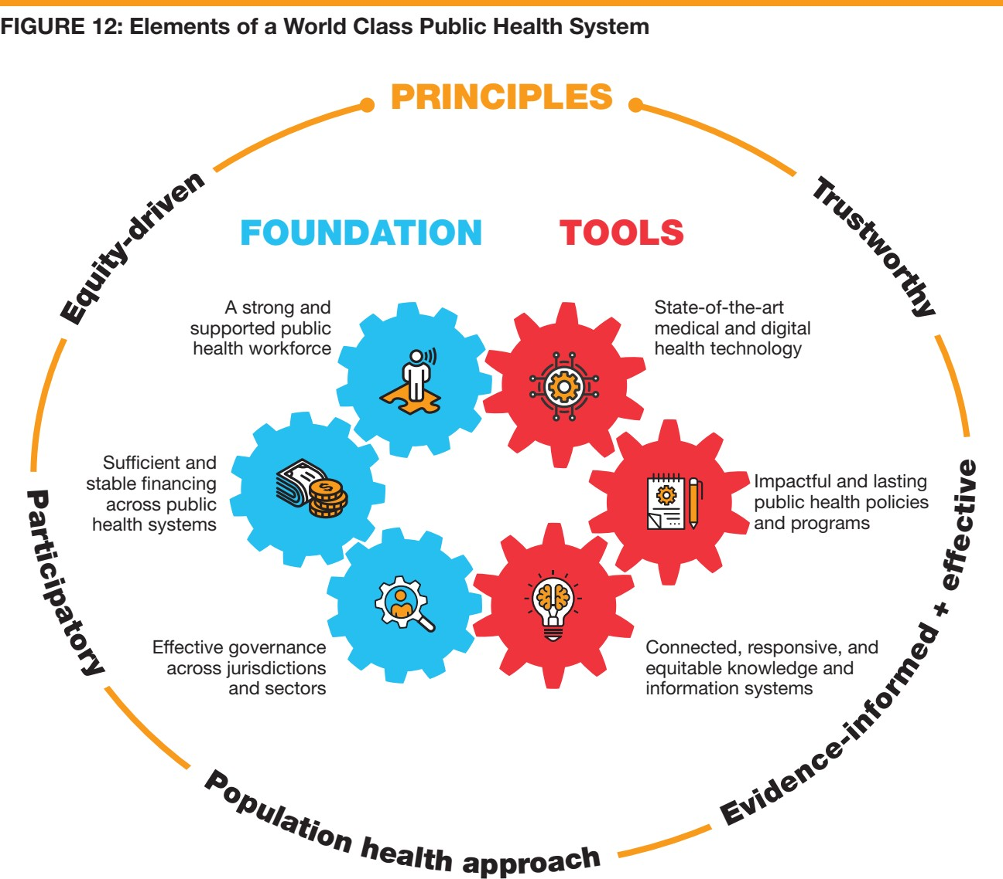
Defining public health systems
"A collection of organizations with a primary mandate to improve population health through the core public health functions, including population health assessment, health protection, health surveillance, disease and injury prevention, health promotion, and emergency preparedness and response"
(Supporting the development of public health system performance indicators (naohealthobservatory.ca))
…and measuring performance

Slide 10
Structure
Process
Outcomes
Organization and governance (including workforce)
Establishment of innovative partnerships with priority population communities and organizations (AU, US) Legal frameworks (AU, US)
Enhancement of the public health workforce availability and distribution (AU)
Culturally and linguistically appropriate programs and services (US)
Increased evaluation of local initiatives, policies, and
regulations (US)
Regular revision of existing PH laws and evaluate the effect(US)
Increased investment in workforce roles and capacities, and skills (AU)
Public opinion (AU)
Building blocks/enabling
functions
Health system financing
Annual PH expenditures, revenue scores, budgets over time (AU, EN, US)
Increase in investments in preventive health as a % of total health expenditure (AU)
Public Health Intelligence
List surveillance systems used and the types of data being monitored (US)
Ensure access to resources for early detection, investigations, containment, and mitigation of health hazards (US)
Conduct and update community health assessments (US)
Health Protection
Reduce environmental health risk factors (EN)
# of public water systems by calendar year that had any environmental violations (US)
Monitoring and distribution close to real-time air
quality information (AU)
Increase green spaces to reduce urban heat and support the use of public spaces (AU, EN)
% MMR vaccination coverage for one dose (2 years old) (EN)
Monitoring of lead in water in schools, and monitoring and adjustment of water fluoridation (US)
% Reduction in the incidence of communicable diseases, containment of outbreaks (AU, EN)
% Morbidity and mortality due to environmental causes (EN, US)
Lower intakes of energy-dense, nutrient poor foods
and drinks (AU, EN, US)
Lead exposure in children (EN)
Indicators by Core Public Health Function
Disease and injury prevention
Elimination of remaining tobacco-related advertising, promotion, and sponsorship (AU
Adoption of healthy behaviors, screening programs (AU, EN)
Reduction in smoking rates (AU, EN, US)
Reduction in the incidence of preventable diseases and injuries (AU, EN, US)
Reduction in suicide rate (AU, EN, US)
Number of ED visits due to asthma (US, EN), and by top ranking causes (US)
Health promotion
Safer walking and cycling infrastructure (AU, EN)
Participation rates in health promotion activities (AU) Improved health literacy through education campaigns for parents (AU)
Health-adjusted life expectancy (HALE); and life- expectancy (AU, EN).
Total Disability Adjusted Life Years (AU)
Emergency preparedness and response
Existence of emergency response plans and coordination mechanisms (AU, US)
Existence and implementation of evidence-based approaches to identify, address and mitigate the impacts of climate change on the health system (AU)
Ensure conducting After Action Reports (US) Training exercises (US)
Environmental incidents (fire, airborne, person, drinking water, indoor air (EN)
Excess mortality during heat periods (EN)

Slide 12
…and measuring performance
As part of operationalizing the FPT Action Plan, the Public Health Data Steering Committee endorsed a 12-month workplan, whereby CIHI will play a leading role in one of four priority areas (supporting role in several others – more details in Annex):
o “Leading the development of a set of public health system indicators to ensure readiness of Canada's public health system through consistent measurement, communication and visibility to Canadians.”

Slide 13
Resilience through shared strategy and commitments: Biomanufacturing and Life Sciences

Slide 14
Resilience through shared strategy and commitments: Pan- Canadian Health Data Charter
Based on advice from an Expert Advisory Group on Health Data, which recommended establishing common principles “inspired
by the universal human rights to health, to benefit from science, and to non-discrimination and equity, and founded on the five
principles of public administration, comprehensiveness, universality, portability, and accessibility (Canada Health Act).”
To honour the duty to put people and populations at the core of all decisions about the disclosure, access and use of health information, the Pan Canadian Health Data Charter requires:
1. Person-centric health information design to ensure that health data follows the individual across points of care to support
individual, clinical, and analytical access and use while respecting individual privacy with regard to the handling of their information under existing privacy legislation.
2. Inclusion of diverse members of the public, patients, communities and other partners in culturally integrated health
information system development and oversight.
Commitment to support First Nations, Inuit and Métis data sovereignty and Indigenous-led governance frameworks.
Common standards for terminology, health data design, stewardship, interoperability, access, and portability.
The quality, security and privacy of health data to maximize benefits, build trust, and reduce harm to individuals and
populations.
6. Timely availability and accessibility of meaningful and comprehensive health data to individuals, decision makers, the health
workforce, and researchers to support an individual’s health needs, quality health programs and services, population and
public health, and research.
The ethical use of health data to support decision making, policies, programs, services, statistics, and research for better health outcomes , while respecting the importance of open science and being open-by-design.
Data-driven social and technological innovation through partnership, invention, discovery, value creation and international best practice.
Literacy regarding health data, health data analysis and digital methods for the public, decision-makers, the health workforce, and researchers.
Harmonization of health data governance, oversight, and policy in areas jointly agreed to by FPT governments for pan- Canadian coordination

Slide 15
…and action
It's essential to recognize the significance of effective data management. It forms the backbone of our ability to collect, analyze, and interpret health-related data for timely decision-making.
Through FPT collaboration we are implementing standards, modernizing infrastructure, formalizing data-sharing agreements and building capacity to achieve:
Data cohesion through the adoption of standards and guidelines to enable comparability
Interoperable and updated infrastructure
Modernized public health data sharing agreement for the data sharing needs of public health in the digital age

Slide 16
Resilience through joined up approaches

Slide 17
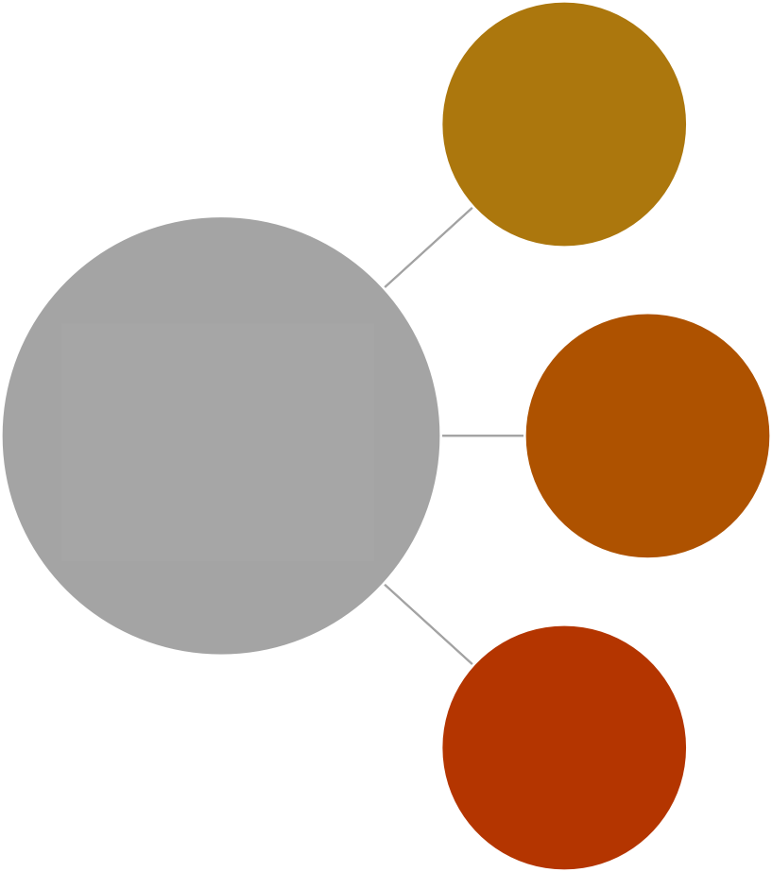
Resilience through shared capabilities
A scalable service that employs and places public health officers in jurisdictions across Canada to address both ongoing and emerging health priorities
Canadian Public Health Service
Field services programs enable the Agency to drive progress on Federal priority areas, while providing critical support to partners
They increase our technical surge capacity for
Office of public health field services and training
A two year, accredited, field- based training program in applied epidemiology where participants are mobilized to investigate and respond to urgent public health problems
complex and overlapping emergencies, by
Canadian Field Epidemiology Program
boosting up our pool of deployment-ready staff
They enable us to tackle specific existing gaps in the public health workforce
They allow us to set and drive concrete work on
federal priorities
Interactive adult learning that develops the competencies needed to prepare for and respond to public health events and emergencies
Training and development unit
They enable us to implement cohesive
pan-Canadian public health action

Slide 18
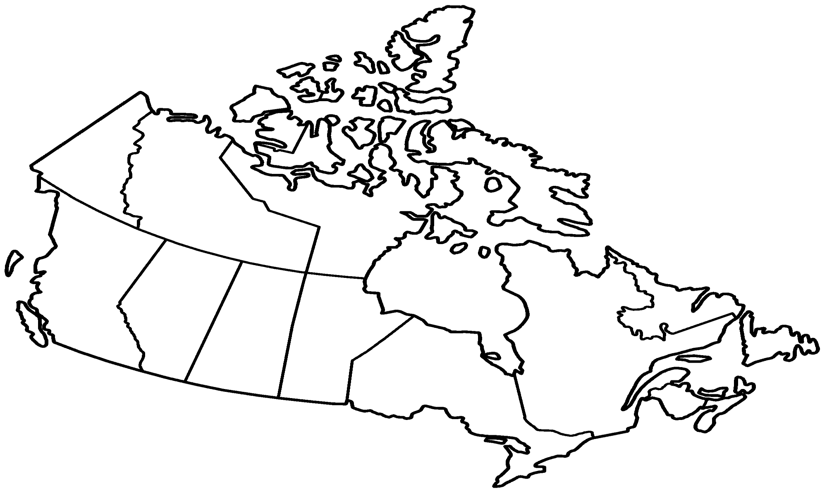
2
LEGEND |  |  | 1 |  |  | 2
Canadian Field Epidemiology Program (n=10) | 4
Canadian Public Health Service (CPHS) (n=25) STBBI Field Surveillance Officer Program (n=6) Laboratory Liaison Technical Officer (LLTO) Program (n=7) Genomics Liaison Technical Officer (GLTO) Program (n=16) | 2 1 1 3 | 3 1 1 3 |  | 1 3 1 1 | 1 1 2 |  |  |  |  |  | 2 1 |  |  | 22 1 1
 |  |  |  | 2 |  | 3 | 2 | 1 | 1 | 2 |  | 3 1 2 1 | 1 1 1 | 2

Slide 19
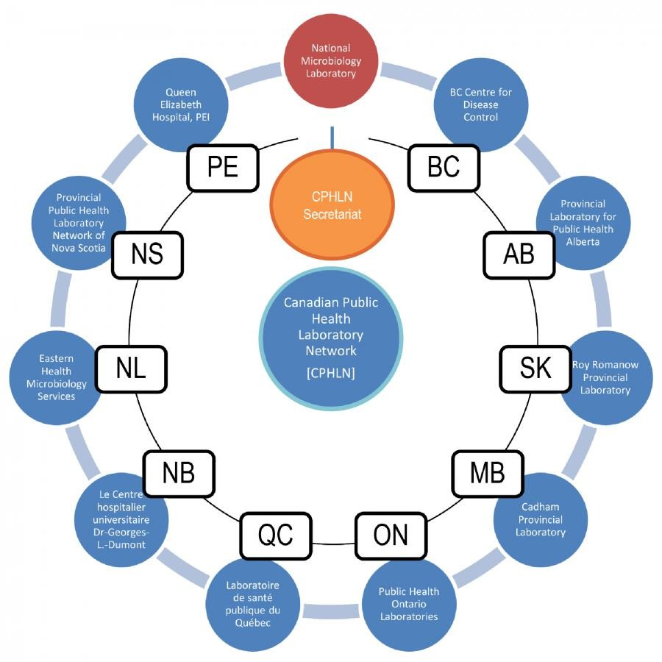

Slide 21
Continued participation and support for multilateral/international organisations, initiatives:
WHO’s central coordinating role to strengthen the Global
Health Architecture
Successful adoption of the amendments to the IHR
Ongoing negotiations of the pandemic instrument
Sustained investment:
Global fund, pandemic fund, GAVI, other global health initiatives
Sharing of information, lessons, research, expertise, technical collaboration
Resilience cannot be achieved alone...

Slide 22
Obrigada |Thank you

