Slide 1

Dr Natalie Mayet
Deputy Director
National Institute for Communicable Disease
South Africa
MULTI-SECTORAL SURVEILLANCE
FOR
PREVENTION

Slide 2
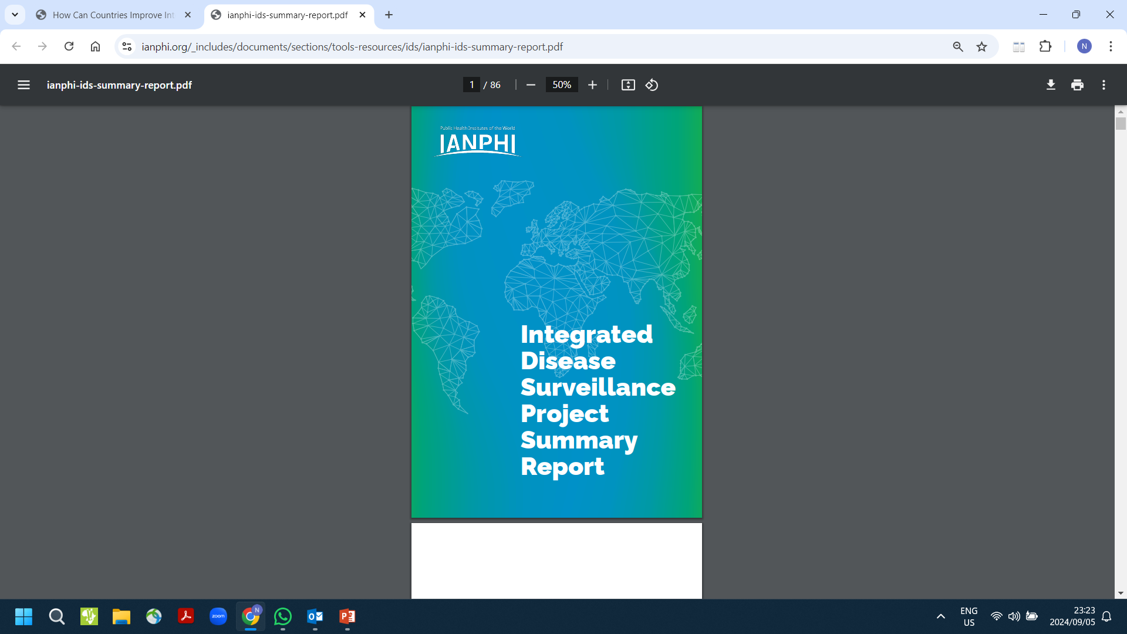
Defining concept of multi-sectoral surveillance for prevention
Coherent, well-integrated, IDS systems needs an “all-of-government” approach
characterized by broad commitment with, and from, the entire political system
Deliberate collaboration among various stakeholder groups
    government
    state sectors – tourism, transport, environment, economy
    civil society
    private sector
    fields of expertise
    disciplines
    …..et.al
Lack of a collective understanding of IDS
Debates regarding the IDSR strategy and the disease surveillance ecosystem-
aspects of policy, culture, systems, infrastructure, processes, social determinants
Multi-sectoral surveillance allows cross-cutting, adaptive programming
Brings efficacy to jointly achieve collective policy outcomes
Notes:
. A systematic scoping review of the literature on IDS 2. A survey of 110 IANPHI member NPHIs in 95 countries 3. “Deep dive” case studies in three high-income countries (HIC) [Canada, England, and Sweden] and four lower middle-income countries (LMIC) [Malawi, Mozambique, Pakistan, and Uganda]

Slide 3
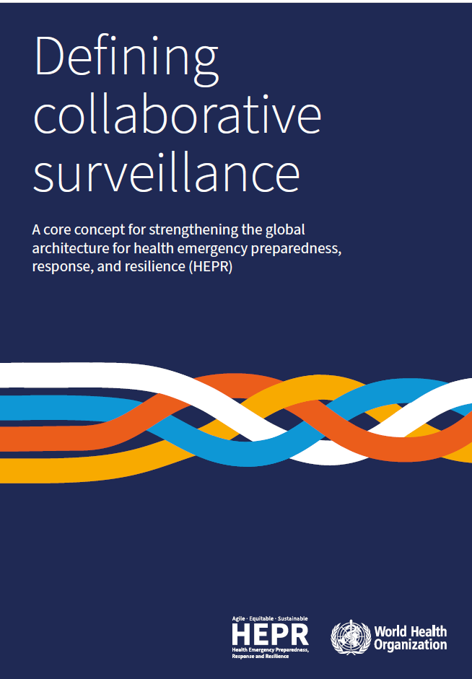
Collaborative surveillance
The systematic strengthening of capacity and collaboration among
diverse stakeholders, both within and beyond the health sector, with the ultimate goal of enhancing public health intelligence and improving evidence for decision‑making.
The separation of surveillance activities into silos (between hazards and sectors) has largely been driven by financing priorities, with 60% of current funding for surveillance coming from disease-specific
programmes and disease-focused funders
https://www.who.int/publications/i/item/9789240074064

Slide 4
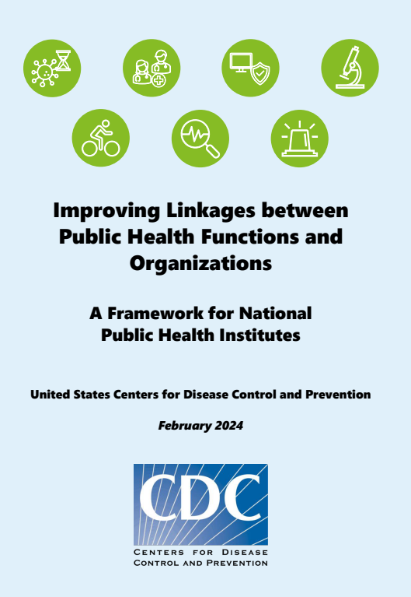
Linkages -foundation for multi-sectoral surveillance
Tactical
Functional, multi-functional, multi-sectoral , multilevel stakeholder mapping of NPHI
Who are we serving ?
patients
taxpayers
customers with expectations
consumers
citizens
care providers
Analysis of contributions
https://ianphi.org/_includes/documents/sections/tools-resources/all-frameworks/us-cdc-publichealth-linkages-framework.pdf

Slide 5
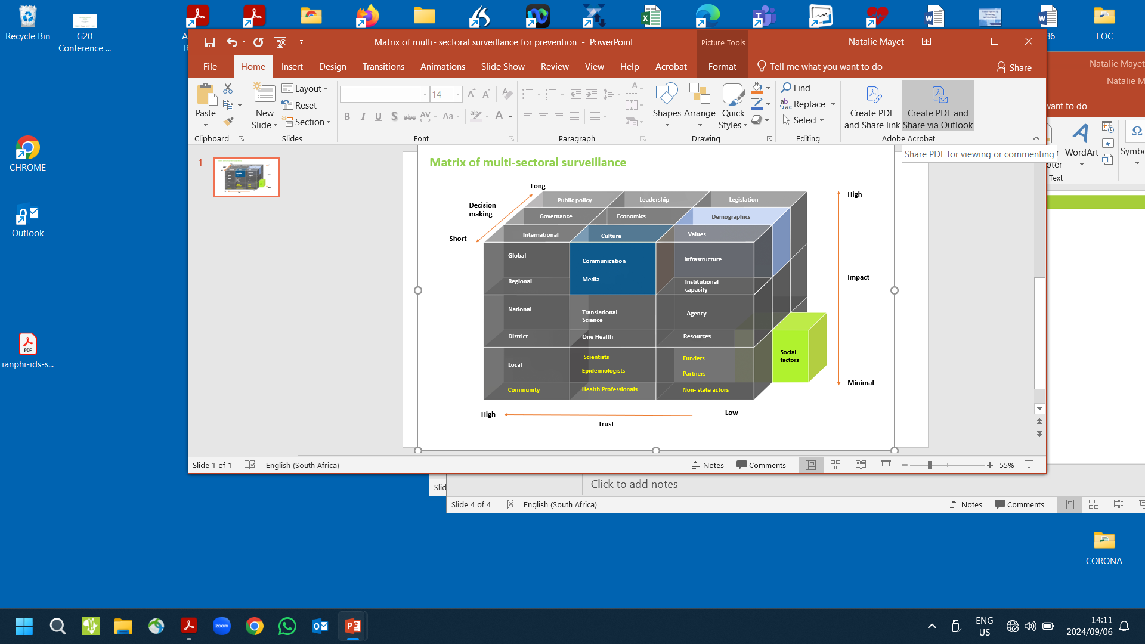

Slide 6
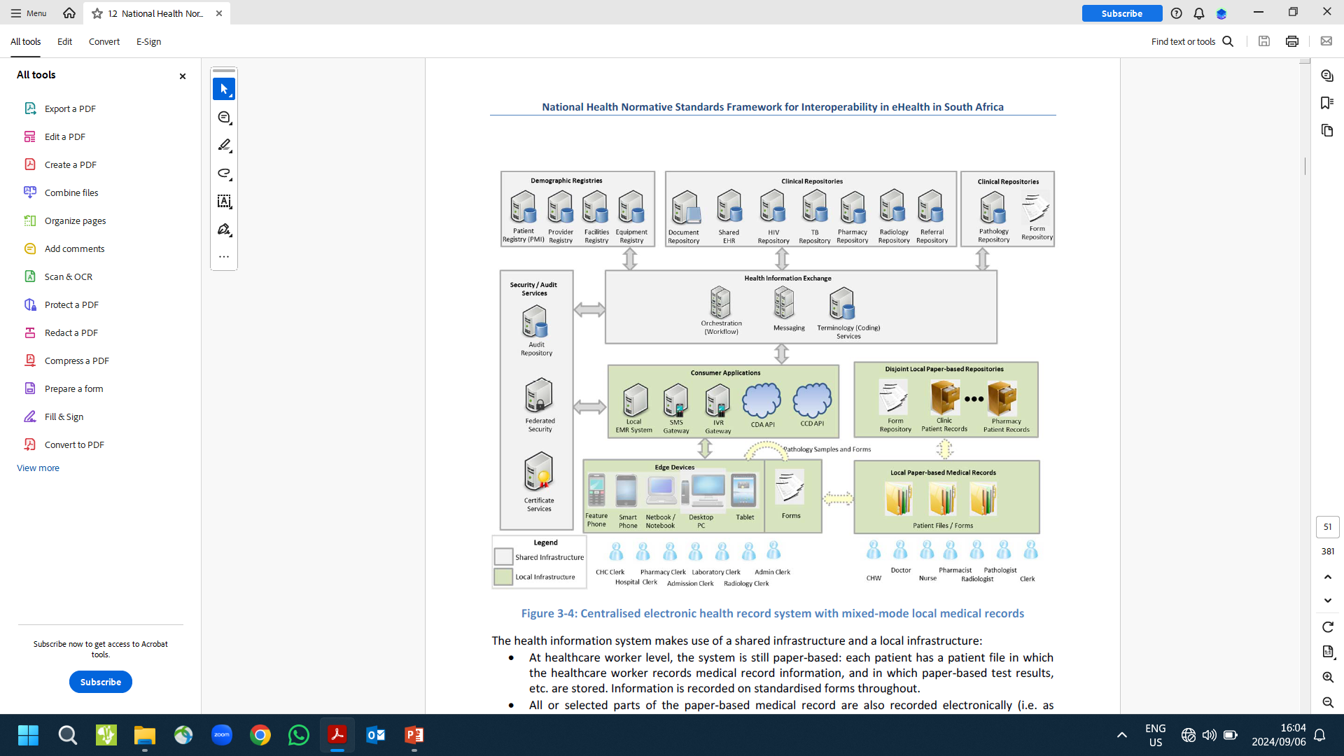

Slide 7
Solutions to poly crises
Intentional purposeful
Disease to health surveillance
Incorporate multiple social parameters
NPHI as conduit – well functioning and resourced
Define domains for multi-sectoral surveillance at all levels
- link malnutrition & price evolution on basic staple food indices
- household food security
- mental health of health professionals
- link at facility level with quality of care & care practices,
- wash dimensions
- health as link to peace
- burns surveillance and energy poverty
- housing and TB

Slide 8
7 Guiding principles what? who ? why? when? where? how?
Legality
Legitimate functions corresponding to organisational structure
Necessity
Proportionality / representation
Safeguards – ethics/ confidentiality / transparency
Non-discrimination – equity
Platform for engagement – trust, delivery on joint expectations

Slide 9
Embracing deep or radical uncertainty therefore calls for a second “epistemological break” to shift from a management of risks approach to one that seeks to assure the resilience of complex adaptive systems in the face of such uncertainty (Fath et al (2015), Schoon and van der Leeuw (2015)).38 In this view, the current efforts aimed at measuring, managing and supervising climate-related risks will only make sense if they take place within a much broader evolution involving coordination with monetary and fiscal authorities, as well as broader societal changes such as a better integration of sustainability into financial and economic decision-making
World Bank
Green Swan
Report
The green swan , Central banking and financial stability in the age of climate change
Patrick BOLTON - Morgan DESPRES - Luiz Awazu PEREIRA DA SILVA, Frédéric SAMAMA - Romain SVARTZMAN, January 2020

Slide 10
Recommendations
1. Advance legal framework – NPHI/ Offices of President
2. Unique global patient identifier e.g. ID or passport number
3. Rapidly accelerate resourcing to build human resource capacity :
  Data to policy measure implementation of evidence based policy briefs as a performance indicator at local level
  Social anthropologists , CHW/ Social Surveillance Officers
  1 x epidemiologist per district
  Diplomacy training, crucial conversations

Slide 11
Thank you!

