Slide 1

Haftom Taame, MPH
Principal Programme Officer- NPHI
Africa CDC
ESSENTIAL PUBLIC HEALTH FUNCTIONS TO STRENGTHEN HEALTH SYSTEMS

Slide 2
Health System Strengthening
  Health System is an organizational structure comprising of organizations, institutions, people, resources and actions whose primary purpose is to improve, restore, or maintain health.
  Health System Strengthening is an array of initiatives, strategies, or activities that improves one or more of the core functions of the Health System Building Blocks.
  “A well-functioning health system working in harmony is built on having trained and motivated health workers, a well-maintained infrastructure, and a reliable supply of medicines and technologies, backed by adequate funding, strong health plans and evidence-based policies.” WHO
  When health system is strong, it is resilient under pressure and leads to greater health security.
Source: Application of the essential public health functions: an integrated and comprehensive approach to public health. Geneva: World Health Organization; 2024. Licence: CC BY-NC-SA 3.0 IGO.
Notes:
The International Association of National Public Health Institutes was first envisioned in 2001 by Jeffrey Koplan former director of CDC and Pekka Puska (director general of Finland’s National Institute of Public Health and Welfare – THL ) and chartered in 2006. IANPHI was initially supported through grants from the Rockefeller Foundation and the Bill & Melinda Gates Foundation.
Professional and independent network of NPHIs, or “CDC’s of the world”, which provides a unique forum for peer-to-peer support and strategic exchanges amongst directors and senior staff
IANPHI’s mission is to collectively build public health capacity by connecting and strengthening NPHIs worldwide
The IANPHI Annual Meeting is the only worldwide forum where NPHI directors and partners come together to establish and strengthen relationships and share ideas and best practices on areas of mutual concern

Slide 3
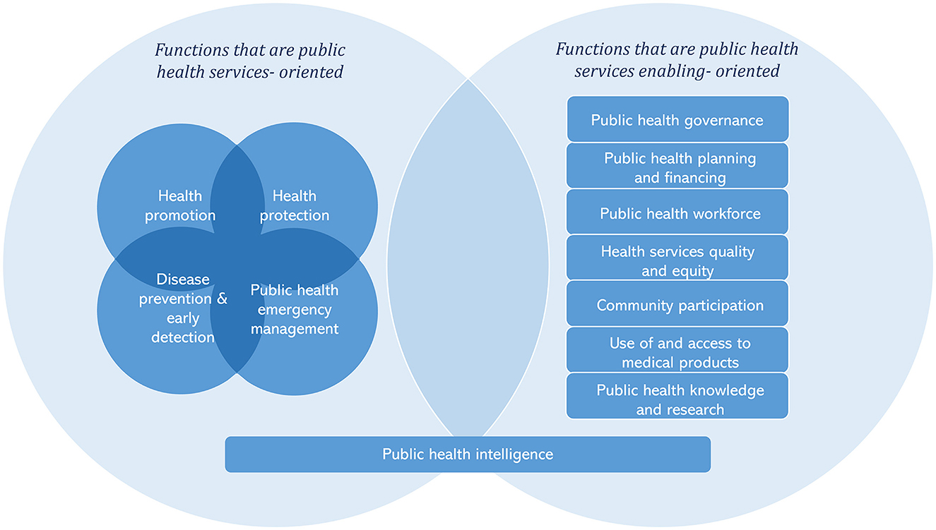
Unified List of Essential Public Health Functions
Fundamental interdependent activities, both within and beyond the health sector, that are required to ensure comprehensive delivery of public health health decisions and policies.
The resolution of World Health Assembly (WHA) 69.1 identified “Essential Public Health Functions(EPHF) as the most cost-effective, comprehensive and sustainable way to enhance populations and individuals’ health and reduce the burden of diseases.”
Figure source: Yu Zhang, et al. Towards applying the essential public health functions for building health systems resilince: a renewed list and key enablers for operationalozation

Slide 4
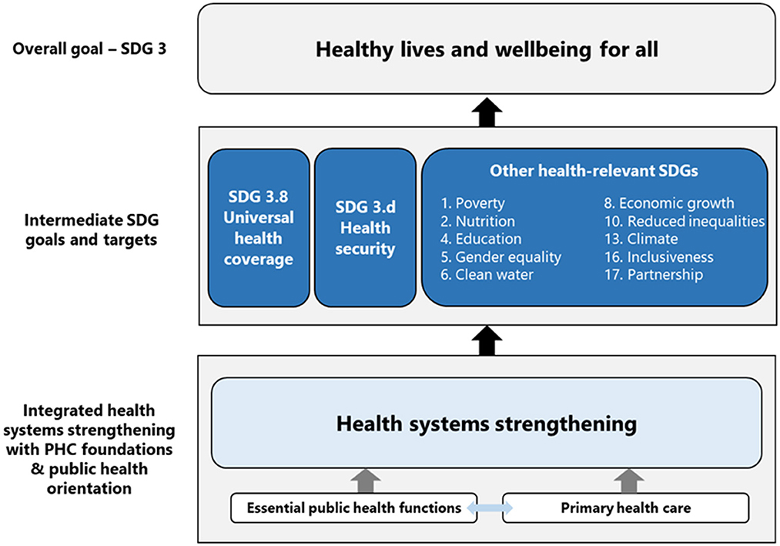
EPHFs to build Health System Resilience
Applying EPHFs supports to achieve health-related goals including universal health coverage, health security, and other health-related SDG goals.
Health systems with strong primary health care at their core have lower health costs, better population health, higher patient satisfaction, fewer unnecessary hospital admissions and greater socioeconomic equity.
Figure source: Yu Zhang, et al. Towards applying the essential public health functions for building health systems resilince: a renewed list and key enablers for operationalozation

Slide 5
EPHFs to build Health System Resilience
To enhance public health with EPHFs, it's crucial to maintain strong, high-level political commitment.
    Incorporate EPHFs into health laws, health policies, strategies, and plans; allocating funding for EPHFs in multi-year budgets;
    Set up an institutional arangement to guide, coordinate, and oversee the implementation of EPHFs, among other measures.
    One of the institutional arrangements is establishing a National Public Health Institute (NPHI)
  Organizing public health leadership and expertise within an NPHI can support to improve the efficiency of the implementation of public health functions and improve public health stewardship and accountability.
  EPHFs provide guidance for defining the scope and functions of NPHIs
Notes:
The International Association of National Public Health Institutes was first envisioned in 2001 by Jeffrey Koplan former director of CDC and Pekka Puska (director general of Finland’s National Institute of Public Health and Welfare – THL ) and chartered in 2006. IANPHI was initially supported through grants from the Rockefeller Foundation and the Bill & Melinda Gates Foundation.
Professional and independent network of NPHIs, or “CDC’s of the world”, which provides a unique forum for peer-to-peer support and strategic exchanges amongst directors and senior staff
IANPHI’s mission is to collectively build public health capacity by connecting and strengthening NPHIs worldwide
The IANPHI Annual Meeting is the only worldwide forum where NPHI directors and partners come together to establish and strengthen relationships and share ideas and best practices on areas of mutual concern

Slide 6
EPHF 3: Public Health Stewardship
Subfunction 3.1: Advocating public health-oriented planning, policies and strategies
Subfunction 3.2: Strengthening institutional public health structures for the coordination, integration and delivery of public health functions and services in the health and other sectors
Subfunction 3.3: Developing, monitoring and evaluating public health regulations and laws that act as formal, regulatory, institutional frameworks for public health governance, functions and services
Subfunction 3.4: Maintaining and applying public health ethics and values in governance

Slide 7
Core Functions of NPHIs
National Public Health Institutes are science-based autonomous government institutions established by a legal framework to coordinate and lead core public health functions at national level.
  Population Health and Health-Related Indicators
  Public Health Laboratory and Surveillance Systems, and Emergency Preparedness and Response
  Disease Prevention and Health Promotion
  Advocacy, Communication, and Social Mobilization
  Policies and Plans that Support Individual and Community Health Efforts
  Health Protection and Support for Regulation and Enforcement
  Evaluation and Promotion of Equitable Access to Services
  Public Health Workforce Development
  Evaluation, Prevention, and Control of Public Health Issues in Clinical Settings
  Research in Public Health

Slide 8
Benefits of NPHIs
Increase efficiency of outbreak detection and emergency response by bringing together similar functions into one organization and removing redundancy and organizational barriers
Increase effectiveness by linking key components of public health functions
Develop human and physical capacities
Provide a coordination mechanism for collaborative projects focused on national priorities and to bring together stakeholders wishing to tackle multiple aspects of a public health problem
Develop science based policies, monitoring and responding to changing patterns and determinants of health and disease

Slide 9
Key interventions for the G20 Ministers Working Group on Health to consider
Incorporate EPHFs into health laws, health policies, strategies, and plans.
  Set up an institutional arangement to guide, coordinate, and oversee the implementation of EPHFs, among other measures.
  Advocate for sustained political commitment, increased funding, improved infrastructure, and resources to support the functions of NPHIs.

Slide 10
Thank you!

