Slide 1





Equity and Health
Global Public Health Equity in Emergency Response
Essential Public and Emergency Health Workforce
Primary Health Care and Health System Strengthening
Mozambique-Democratic Republic of Congo-Brazil-South Africa
China –UK-Italy- France-UK-USA-India-Russia
Africa-CDC-IANPHI- WHO (PAHO&AFRO)

Slide 2
Content
Key Take Away Messages-Joint-Unified Leadership-IANPHI-FICOCRUZ-G2020
History- Common Language-Culture-Humanity-Solidarity
Defining Public Health →Essential Public Health Functions
WHO-->Defining Health Systems & Health System Goals
Defining Primary Health Care-8 Elements & Values –Equity and Health for All
PHC-Lessons Past to Future
WHO Health System Framework: Building Blocks
Essential Public Health Work Force-Road Map and Investment
Public Health Emergency and Pandemic Response-Mozambique-DRC-South Africa and G20
Universal Health Coverage and Progress to SDG3-2030- Urgent Need for PHC
Next Unified-Brazil Leadership and Legacy G20 steps as IANPHI- MOH-Africa CDC-FIOCRUZ-NPHI-WHO in NPHI-HSS-PHC-UHC

Slide 3
Common Language- Different History- Culture-One Powerful Humanity-Solidarity-Fraternity
Network of National Public Health Institutes
Primary Health Care and District Health Systems and Health for All-Equity- Equality-Fraternity-Liberty (Freedom)
Red Cross Volunteers- Community Health Workers& and Community Health Systems
PHC teams – outreach to the village- Geography –Social Mobilization
Unified Health Systems- Health System Strengthening –Health System Resilience
(Sistema Único de Saúde) (SUS)
Pandemic, Epidemic -Emergency,(Disaster) Preparedness and Response

Slide 4
Definition& Key Elements of Primary Health Care
.Primary Health Care is essential health care made universally accessible to individuals and families in the community by means acceptable to them, through their full participation, and at a cost that the community and country can afford. It forms an integral part both of the country's health system of which it is the nucleus and of the overall social and economic development of the community
8 element of Primary Health Care
8.1. Education concerning prevailing health problems and the methods of identifying, preventing and controlling them→ Positive Life Style Package-Model (HEALTH PROMOTION)
8.2. Promotion of food supply and proper nutrition→ Under and Overnutrition
8.3. Adequate supply of safe water and basic sanitation→ Environmental Health, Climate Mitigation
8.4. Maternal and child health care including family planning→ School, Youth- Elderly& Ageing
8.5. Immunization against major infectious diseases
8.6. Prevention and control of locally endemic diseases→ CDC & NCD
8.7. Treatment of common diseases and injuries→ Rehabilitation & Palliative care
8.8. Provision of essential drugs,→ vaccine, diagnostic and health technology

Slide 5
Constitutions and Acts: Protection and Rights of People to Health
Health is a right of all and an obligation of the State, guaranteed by socio-economic policies which seek to the reduction of the risk of disease and of other grievances and to the universal and equal access to the actions and services in its promotion, protection and recuperation.
Constitution of Brazil-1988
Constitution of South Africa-1996
The right to have access to health care services is a basic human right guaranteed by the Constitution. Section 27 of the Constitution provides that everyone has the right to have access to health care services, including reproductive health care services and no one may be refused emergency medical treatment. The Constitution and the National Health Act 61 of 2003 (as amended) envisage a single health system for South Africa. However, in addition to public health care a number of private health care service providers exist in country. The State uses a means t

Slide 6
Public Health and Essential Public Health Function
Public Health (PH) is defined as "the science and art of promoting healthy behavior and lifestyles, preventing diseases, disorders, and injury, and protecting health and wellbeing along the life course and prolonging the life of individuals and population groups, through the organized efforts and informed choices of society, organizations, public and private organizations, communities, and individuals
•Essential public health functions (EPHFs) -a set of fundamental, interconnected and interdependent activities, that are required to ensure effective public health action

Slide 7
Essential public health functions- Primary Health Care Population Health Vs Patient Health-Hospitals
-an integrated and comprehensive approach to public health &PHC
Public Health Service Delivery-Prevention & Promotion & Control & Elimination
Public Health Architecture- Structure & Systems & Institutions
Public Health Leadership, Governance and Management
Essential Public Health Work Force
Health Observatory-Situation Room- PHEC-Integrated Disease/Public Health Surveillance, Health Information, Surveys, Operational Research, Monitoring and Evaluation-Report& Publication . (Digital Health) (Health Observatory)
Epidemic-Pandemic-Emergency/ Disaster: Forecasting. Prevention, Preparedness, Early Warning, Rapid Response
Health Protection: Public Health Regulations and Laws- IHR-Pandemic Treaty
Public Health Programming, Reviews and Evaluations

Slide 8
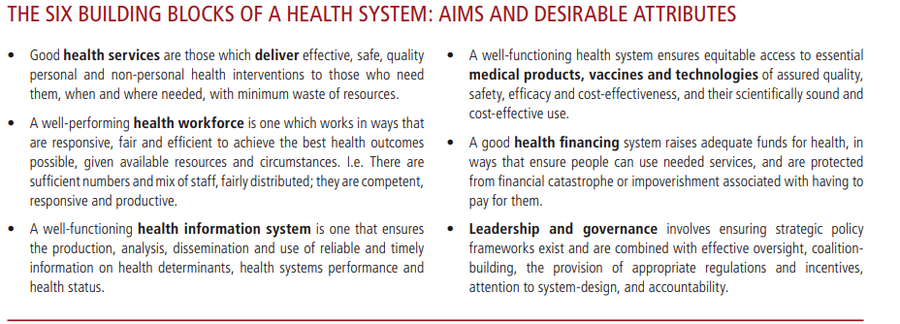
Six-Health System Building Blocks

Slide 9
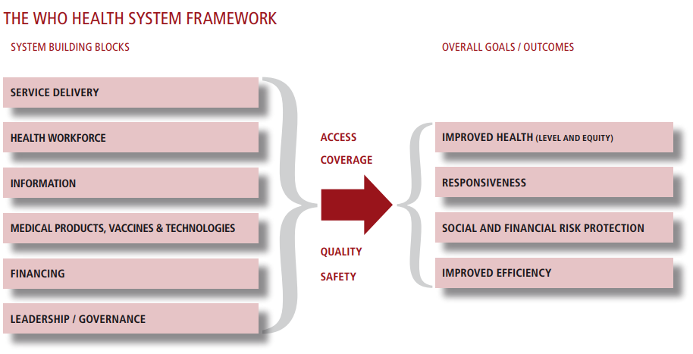
WHO Health System Framework

Slide 10
Defining Health Systems
-->A health system consists of all organizations, people, and actions whose primary intent is to promote, restore, or maintain health.
This includes efforts to influence determinants of health as well as more direct health-improving activities.
A health system is, therefore, more than the pyramid of publicly owned facilities that deliver personal health services
Health systems strengthening (HSS) includes the strategies, responses, and activities that are designed to sustainably improve the performance of a country's health system.
WHO 2007
STRENGTHENING HEALTH SYSTEMS
TO IMPROVE HEALTH OUTCOMES
WHO’S FRAMEWORK FOR ACTION

Slide 11
Health System Goals
→Health systems have multiple goals or outcomes.
The World Health Report 2000 defined overall health system outcomes or goals as:-
Improving health and health equity, in ways that are responsive, financially fair, and make the best (effective), or most efficient, use of available resources.
There are also important intermediate goals: the route from inputs to health outcomes is through achieving:-
Greater access to and coverage for effective health interventions, without compromising efforts to ensure provider quality and safety.

Slide 12
Vision on Essential Public Health Work Force
A strengthened essential public health workforce in every country; delivering all the essential public health functions including emergency preparedness and response
Oriented and with competencies and skills to dynamic/changing needs and demands of NPHI, Primary Health Care, and the National Health Systems Strengthening

Slide 13
WHO-Public Health Work Force-Road Map
For countries aiming to strengthen their public health workforce, including those charged with emergency response, the Roadmap theory of change entails a focus on three action areas (figure 1):
Defining Essential Public Health Functions and Subfunctions to be tailored to health system needs;
Delivering Competency-Based Public Health Education to build or strengthen the requisite capacities; and
Mapping and Measuring Public Health Occupations to enable target setting, planning and monitoring.

Slide 14
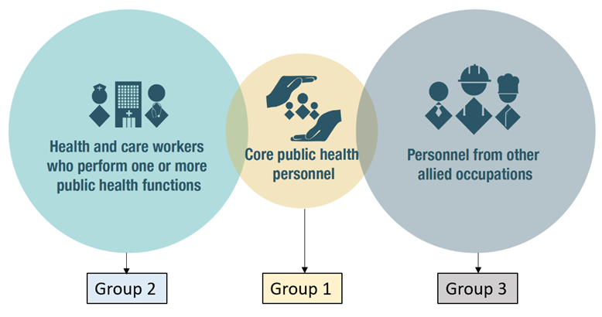
Defining an Essential Public Health Worker

Slide 15
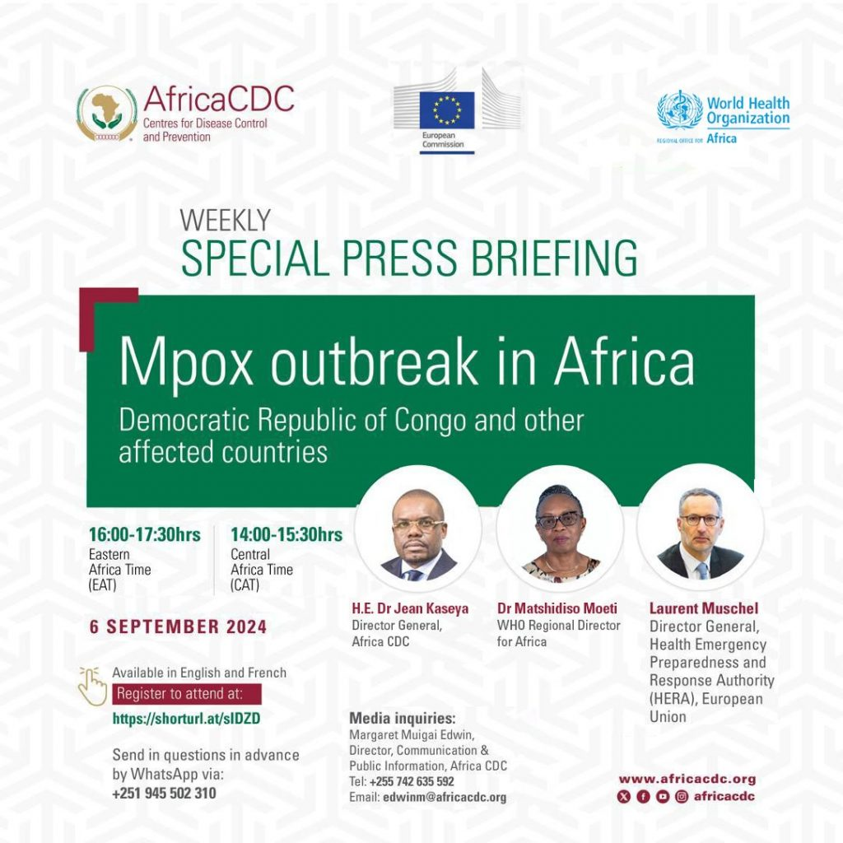
Mpox-STI-AIDS and History- August 2025
13th August 2024 Africa CDC declaration of Mpox-Continental Public Health Security (PHECS)
15th August 2024 WHO Global Declaration of Public Health Emergency of International Concern (PHEIC)

Slide 16
Cholera Africa Regional-Crises- Emergency July 2024

Slide 17
Universal Health Coverage Service Coverage Index
Measures Coverage of essential health services
Defined as the average coverage of essential services based on indicators from tracer interventions in:
-reproductive, maternal, newborn and child health 4;
-infectious diseases 4;
-non-communicable diseases 3;
-and service capacity and access 3.
UHC Service Coverage Index is computed as the geometric mean of 14 tracer indicators.
The Index is reported as a unitless measure on a scale of 0 to 100

Slide 18
Conceptual relationships between CHE and Health Systems building blocks and UHC Index
 | Health facility density
 | Health Workforce Density
 | Health Governance
CHE influences | Diagnostic capacity | All these influence the UHC Service Coverage Index
 | Essential medicines availability
 | Service delivery
 | Health information systems

Slide 19
Selected SADC countries and their respective UHC related indicators (Source WHO, WB data sets 2021/22)
Country | GDP Per Capita 2019 | GGHE D% | Health Exp per capita USD | Doctors, Nurses, Midwives | UHC Index
Botswana | 7960 | 15 | 457 | 34,3 | 55 Down
Malawi | 411 | 5,8 | 47 | 5,49 | 48 Level
Mozambique | 500 | 8,2 | 45 | 5,94 | 44 Level
Namibia | 5026 | 11 | 456 | 58,9 | 63 Level
South Africa | 6000 | 15 | 584 | 50 | 71 Level
United Republic of Tanzania | 1048 | 5,1 | 34 | 6,8 | 43 Up
Zambia | 1305 | 9,3 | 73 | 24,1 | 56 Up
Zimbabwe | 1316 | 5,2 | 63 | 23,1 | 55 Level

Slide 20
Selected OECD countries, others and their respective UHC related indicators (Source WHO, WB data sets 2021/22)
Jurisdiction | GGHE D% | Per capita | Doctors | Nurse/ Midwives | UHC Index
World | 11 |  | 17 | 37,7 | 68
WHO AFR |  |  | 2,6 | 11,3 | 40
USA | 21 | 12 550 | 26 | 132 | 86
UK | 22 | 5108 | 32 | 87 | 88
Australia | 19 | 7055 | 41 | 131 | 87
Canada | 20 | 6207 | 24 | 113 | 91
Zimbabwe | 5,2 | 63 | 1,7 | 21,4 | 55

Slide 21

Cholera Pandemic or Cholera Public Health Emergency

Slide 22
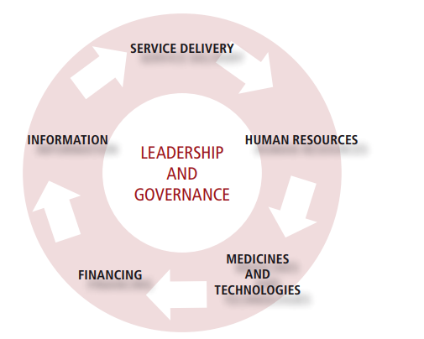
Global Public Health System Leadership, Governance and Management-Coordination-District-Province-National

Slide 23
NPHI&PHC-UHC-UNITY-SYNERGY- ALIGNMENT-Public Health Campaign-Hub& Nodes
Asks from G-20-G7-SADC-AU for Health Equity for NPHIs and HSS-PHC & UHC
Mozambique: IANPHI &Cholera-CDD&ENV-CM
DRC-IANPHI→HSS&PHC →and Mpox & Cholera.CDD & Measles-ARI&ENV-CM
South Africa-Ianphi& Measles-ARI
Brazil- FIOCRU, Measles-ARI
UK-Wales-Scotland- Health Security& Public Health-Measles-ARI
South-North-South-Institutional Collaboration and exchange and deployment of Essential public health Work Force

