Slide 1

Karen Hacker, MD, MPH
Director, National Center for Chronic Disease and Health Promotion, CDC
USA
Equity and Health
Tackling Social Determinants of Health

Slide 2
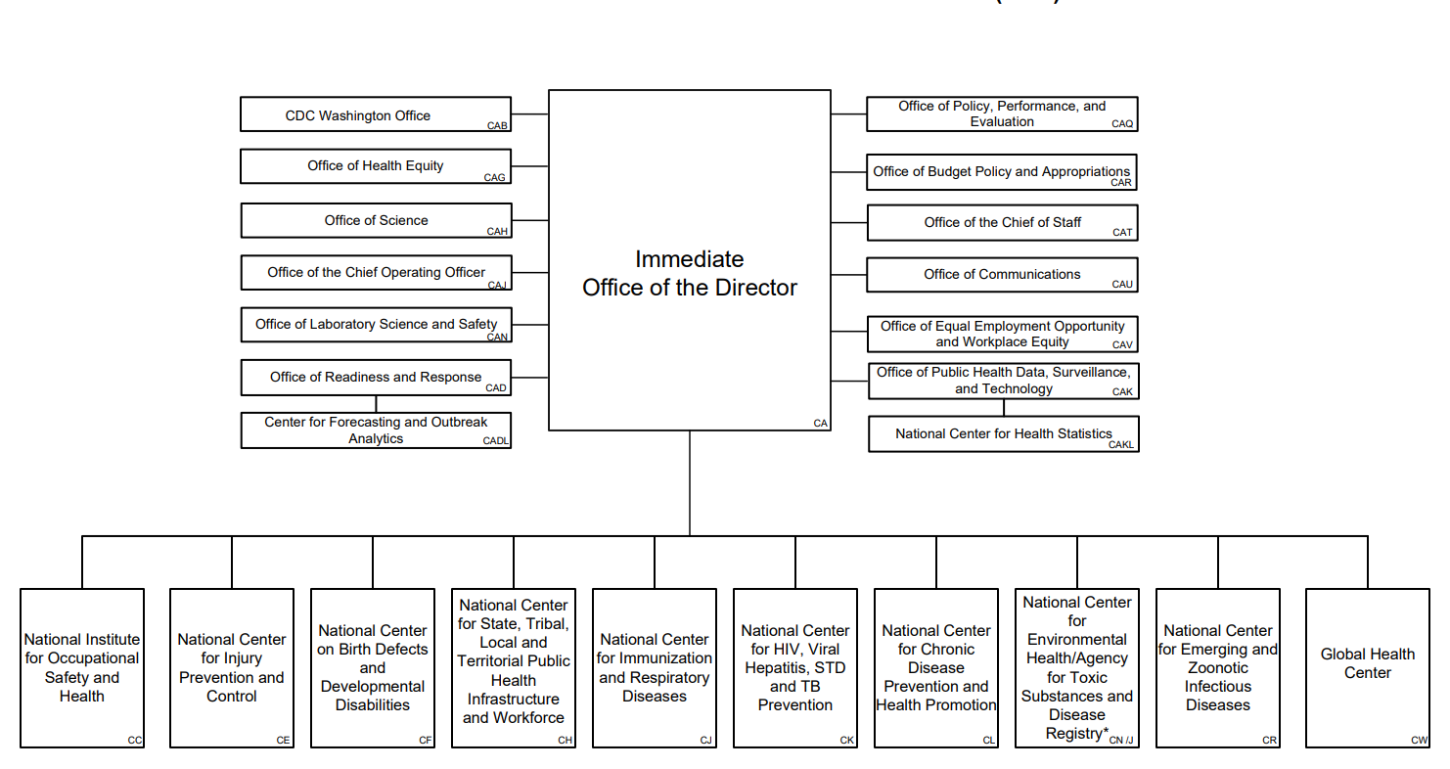
DEPARTMENT OF HEALTH AND HUMAN SERVICES
CENTERS FOR DISEASE CONTROL AND PREVENTION (CDC)

Slide 3
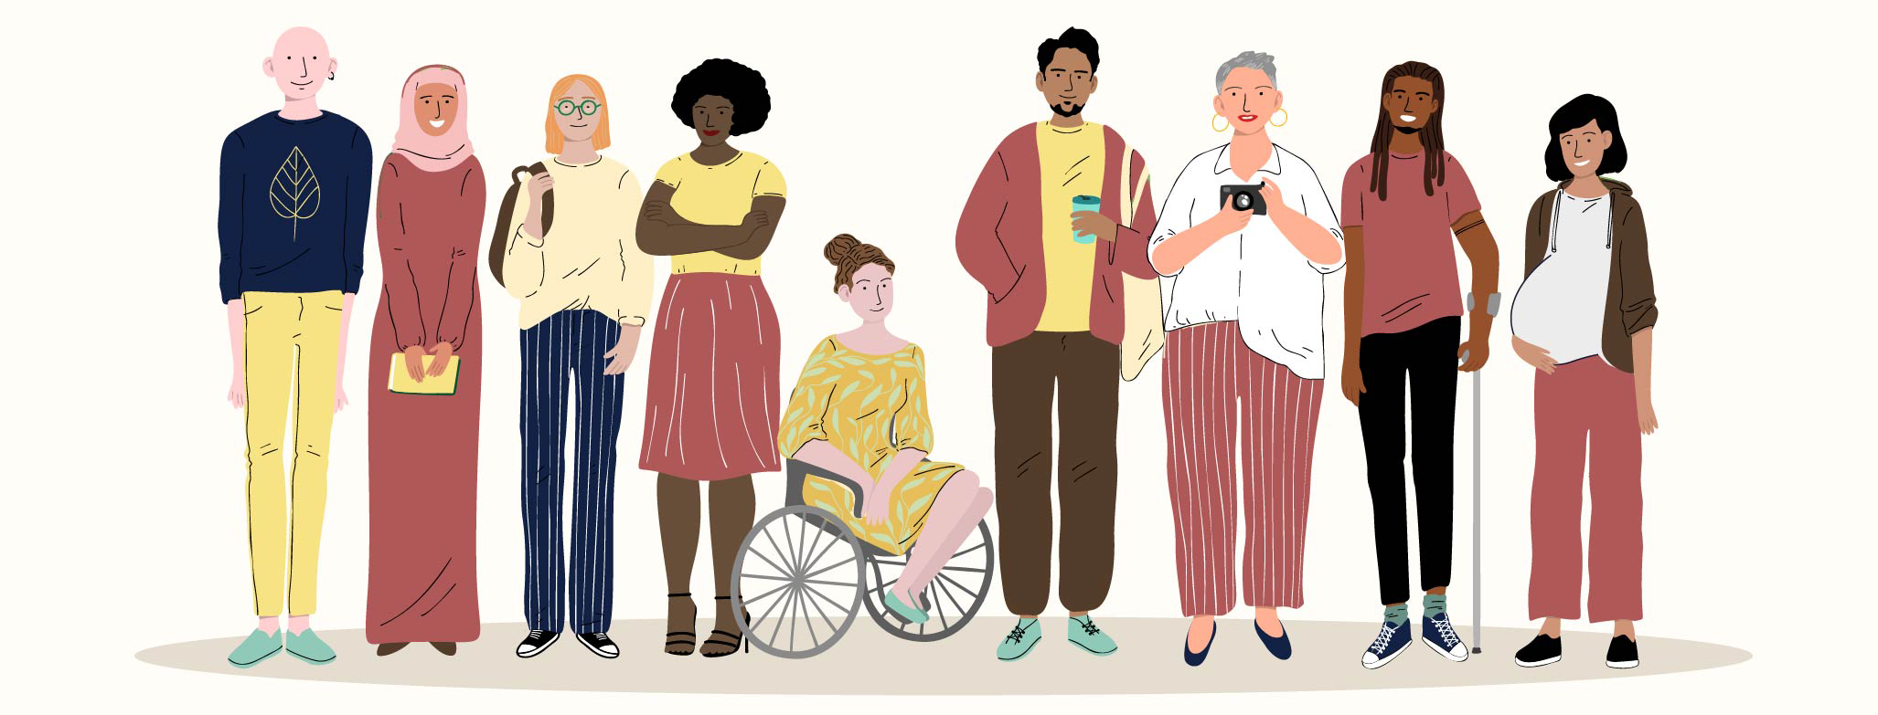
Health Disparities in the US
Health disparities result from multiple factors, including
  Poverty
  Geographic location
  Inadequate access to health care
  Individual and behavioral factors
  Educational inequalities

Slide 4

Health Equity &
Social Determinants
of Health
Health equity (HE) is the state in which everyone has a fair and just opportunity to attain their highest level of health.
When we refer to social determinants of health – or SDOH – we are speaking about the non-medical factors that influence health outcomes.

Slide 5
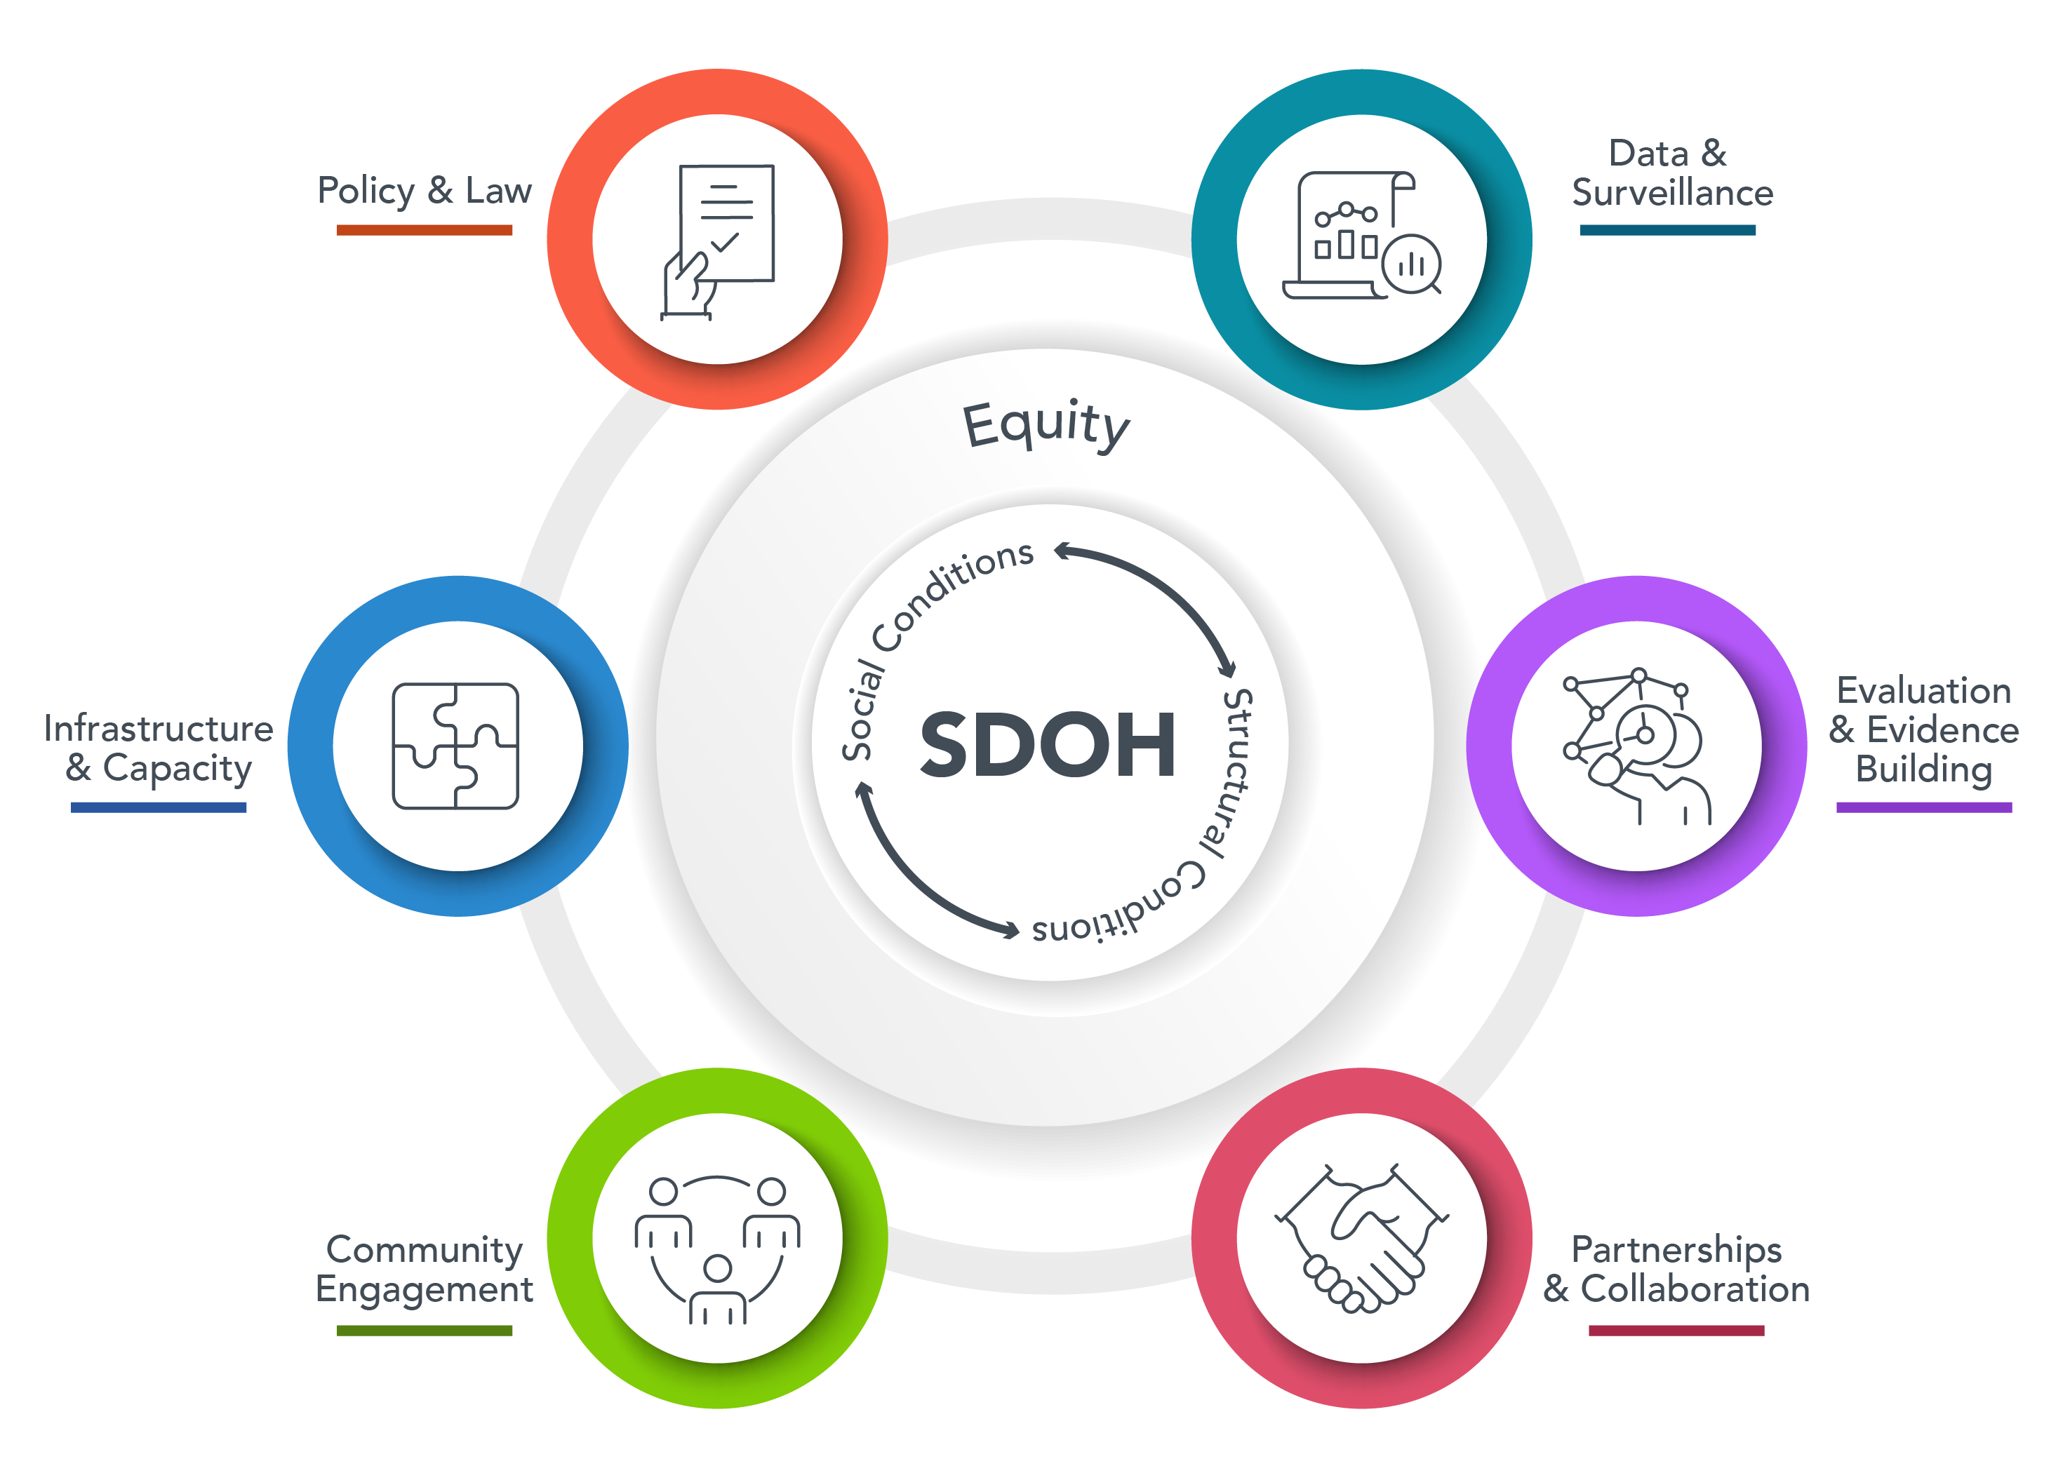
CDC SDOH FRAMEWORK

Slide 6











Approaches to Address SDOH
Healthy People 2030 SDOH
NCCDPHP’s SDOH Domains
Economic Stability
Help people earn steady incomes that allow them to meet their health needs.
Built Environment
Human-made surroundings that influence overall community health and people’s behaviors that drive health.
Education Access and Quality
Increase educational opportunities and help children and adolescents do well in school.
Community-Clinical Linkages
When people or groups have relationships that create a sense of belonging and being cared for, valued, and supported.
Health Care Access and Quality
Increase access to comprehensive, high-quality health care services.
Food and Nutrition Security
Having reliable access to enough high-quality food to avoid hunger and stay health.
Neighborhood and Built Environment
Create neighborhoods and environments that promote health and safety.
Social Connectedness
When people or groups have relationships that create a sense of belonging and being cared for, valued, and supported.
Tobacco-Free Policy
Population-based preventive measures to reduce tobacco use and tobacco-related illness and death.
Social and Community Context
Increase social and community support.
Sources: Social Determinants of Health - Healthy People 2030 | health.gov; NCCDPHP’s Approach to Social Determinants of Health | CDC

Slide 7











Examples of SDOH Activities and Programs
NCCDPHP Good Health and Wellness in Indian Country (GHWIC): 2014
White House Release of the U.S Playbook to Address SDOH: 2023
NCCDPHP High Obesity Program (HOP): 2014
NCCDPHP National Tobacco Control Program: 1999
NCCDPHP New Measures for Population Level Analysis and Community Estimates: 2023
1999 2024
NCCDPHP Racial and Ethnic Approach to Community Health (REACH): 1999
HHS Call to Action: Addressing Health-Related Social Needs in Communities Across the Nation: 2023
NCCDPHP State Physical Activity and Nutrition (SPAN): 2013
NCCDPHP Community Health Workers for COVID Response and Resilient Communities (CCR): 2021
NCCDPHP Behavioral Risk Factor Surveillance System (BRFSS) Social Determinants and Health Equity Module : 2022

Slide 8







Whole of Government Approach and Future CDC Efforts
HHS Advisory
Committee on SDOH
HUD & CDC
Cross-Agency Strategic Planning and Priority Setting
DoT & CDC
CMS & CDC
ACL & CDC

Slide 9
Thank you!
The findings and conclusions in this report are those of the authors and do not necessarily represent the official position of the Centers for Disease Control and Prevention.

