Slide 1
Mark Pearson, Deputy Director, Employment, Labour and Social Affairs OECD
Climate Change and AMR

Slide 2
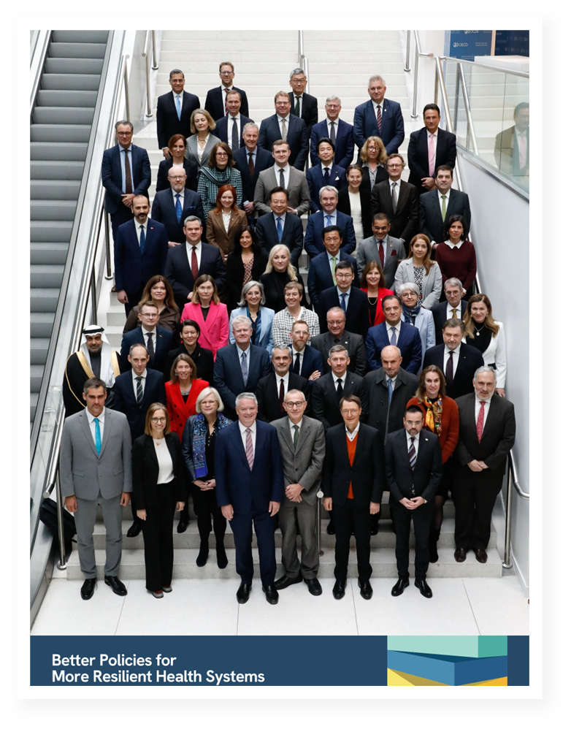
OECD Health Ministerial 2024
Ministerial and senior-level participation from over 40 countries, including 19 G20 members
Ministerial Declaration includes explicit call for further work on climate change
“WE CALL on the OECD…to assist in our effort to make our health systems climate neutral, and environmentally sustainable by developing a dashboard with robust measures”
Notes:
Let me briefly highlight the OECD’s overall commitment on the climate –health nexus at this year’s OECD Health Ministerial in January.
One of the major comparative advantages of the OECD is our ability to work cross-sectorally on challenges that require a broader response. Climate change is a prime example of this. Our work on health is bolstered by expertise from our colleagues in the Environment Directorate, in regional expertise, in the data and knowledge from the IEA. Moreover, we are able to bring the economic case and get the attention of those in government who hold the purse strings – to demonstrate that there is an economic – and not only health or environmental – benefit to investing in climate change adaptation and mitigation policies.
This means our focus on health is anchored in the overall challenge that climate change poses for the economy, people and the planet and that we are concentrated on identifying cross-policy solutions rather than looking more narrowly at direct health effects.
The next slides will take you through some examples of what I mean here.

Slide 3
Climate change damages health and working conditions
Heat exposure is rising
A high proportion of workers are exposed to high temperatures at work
Notes:
Let’s consider the impact of climate change on the labour market/workers. From our work in OECD countries, we see that the proportion of workers exposed to hot summer days has grown by 35%, or nearly eight percentage points, over the last two decades.
There is also a labour market cost to inaction. An upcoming analysis we conducted for the Employment Outlook we released earlier this summer found that one in seven workers reported heat-related discomfort – meaning they spend more than half of their working hours exposed to hot temperatures – in Europe and the United States. The regions where the proportion of workers exposed to high temperatures is higher than average are also the regions that are projected to experience the largest temperature increases by 2050.
Some occupations are especially hard hit. The occupations most exposed to heat discomfort are predominantly mid- and low-skilled. These occupations, which already experience higher heat discomfort, could become even more difficult to perform as temperatures continue to increase. And certain professions including healthcare workers, will be exposed to a double burden: they will be exposed to increasing temperatures, as they do a physical-intense work mostly outside and/or wear personal protective equipment which can unintendedly contribute to heat stress. And they will also be called to respond to more frequent extreme weather events and fires and face a higher influx of patients during heatwaves, leading to higher workload and stressful and physically demanding conditions.
The Lancet Countdown has estimated that 490 billion potential labour hours were lost in 2022 worldwide due to heat – an increase of more than 40% compared to the 1991-2000 average. They estimate that some $863 billion of income may have been lost worldwide due to heat in 2022. Potential income losses are highest in poor countries, with the potential income lost in low Human Development Index (HDI) countries exceeding 6% (6.1%) of GDP, and nearly 4% (3.8%) of GDP in countries with medium HDI.
Why does this matter? Heat exposure is well-recognised as an occupational health and safety risk. Heat-stress can interfere with how people perform physical tasks, complex cognitively demanding tasks, and even relatively simple routine tasks. In other words, we have ample evidence that heat stress lowers productivity, can increase the risk of work-related accidents – including fatal accidents – and can also impact how machinery and infrastructure operate.

Slide 4
Antibiotic Resistance Rates Are High And Rising In Two-Thirds of G20 Countries
Source: OECD (2023), Embracing a One Health Approach to Fight Antimicrobial Resistance, available at: oe.cd/amr-onehealth.
Notes:
Worsening AMR rates is another global health challenge in the context of climate change, and here the OECD has been at the forefront of international efforts to drive policy action.
Over the years, we have become a world leader in making the economic case for tackling major public health threats such as AMR and calculating the return on investment of scaling up policy action – not just in OECD countries but across the G20 economies and beyond.
Today, AMR rates in G20 are already high. In 2019, resistance proportions in G20 countries stood at 30%, substantially higher than the OECD average of around 20% in the same year. This means that today, one in every three bacterial infections occurring across G20 countries are caused by resistant microorganisms.
Going beyond simply interpreting averages reveals important differences across-countries. Our analysis shows that there is enormous variation in resistance proportions. For example, in 2019, the estimated average resistance proportion, across 12 antibiotic-bacterium pairs, was around 5 times higher in India (56.7%) than in the United Kingdom (10.8%).
Without stronger policy action, resistance proportions in G20 will remain high (at around 29%) and expected to rise in two-thirds of G20 countries by 2035. This means average resistance proportions in G20 countries are expected to remain substantially higher than the expected OECD average (19%) by 2035. A closer look at the data shows that:
In some G20 countries, such as India, Türkiye and Saudi Arabia, more than 40% of infections will be resistant, with an increase compared to current level.
In absolute terms, across G20 countries, China and Argentina could see the largest percentage point increases (2.7% and 2.4% rise respectively).
Resistance proportions for certain antibiotic-bacterium pairs are projected to remain dangerously high. For example, by 2035, it is projected that in G20 countries around half of infections due to A. baumannii could be resistant to either fluoroquinolones or carbapenems.
[NB: In case you get a question, methods for this calculation: We forecast the future antibiotic consumption and resistance rates using a combination of machine learning techniques making use of as much as possible publicly available, internationally comparable, while also incorporating uncertainty in the underlying data, models and assumptions.]

Slide 5
Unless We Take Action Now, Consumption Of Antibiotics Will Remain High
Human health
Animal health
Notes:
At OECD, we recently calculated the current and future antibiotic consumption patterns across 51 OECD, EU/EEA and G20 countries, as well as the health and economic burden of AMR.
Here are some of the key findings from our latest analysis on the burden of AMR:
AMR continues to threaten lives across the globe, with causing up to 4.95 million deaths every year (IHME, 2022). We calculated that in OECD countries, the annual death toll of AMR is as high as 78 thousand people.
The overuse and misuse of antibiotics remains one of the key drivers of AMR. Globally, consumption of antibiotics in humans has been increasing for the last 20 years, with antibiotic use in animal health far exceeding the use in human health.
When we look at the trends in the last two decades, in human health, G20 countries saw a rise in antibiotic use and converged towards OECD and EU/EEA levels. This trend was especially pronounced in G20 countries such as Brazil, China, India, Indonesia and Saudi Arabia, and it is partially due to increases in access to care in many G20 countries in recent years.
In animal health, veterinary antibiotic consumption in G20 declined but remained well-above the OECD levels (~1.7 times).
Our analysis demonstrate that unless we take action now, our heavy reliance on antibiotics will continue to be the reality for years to come.
In human health, in G20, antibiotic consumption is expected to rise slightly (+1.4%) by 2035 compared to the 2020 levels. In this period, OECD countries are projected to see a modest decline in their reliance on antibiotics in humans. But, there is still considerable inappropriate antibiotic use. While there is no systematic cross-country evidence on the levels of inappropriate antibiotic use in human health, with recent estimates range from 15% up to 60% [1].
In G20, antibiotic use in animal health is expected to remain stable by 2035, but OECD is forecasted to reduce its reliance on veterinary antibiotics in the same period. This could mean that by 2035, veterinary antimicrobial sales in G20 could correspond to double the OECD average.
(In case you get a question, methods for this calculation: We forecast the future antibiotic consumption and resistance rates using a combination of machine learning techniques making use of as much as possible publicly available, internationally comparable, while also incorporating uncertainty in the underlying data, models and assumptions.)
[1] Irfan, M. et al (2022), “Antimicrobial Resistance and Its Drivers—A Review”, Antibiotics, Vol. 11/10, p. 1362, Retrieved from https://doi.org/10.3390/antibiotics11101362

Slide 6
We Are Exhausting Our Antibiotic Arsenal
Across G20, resistance to last resort drugs increased by 58% in the last two decades
Notes: OECD analysis covers G20 countries for 12 antibiotic-bacterium combinations. Historical data go from 2005 to 2020, and forecasts start in 2021.
Source: OECD (2023), Embracing a One Health Approach to Fight Antimicrobial Resistance, available at: oe.cd/amr-onehealth.
Notes:
Reserve and last resort antibiotics are our back-up option should access antibiotics stop being effective. In G20, resistance to these antibiotics has been growing over the last 2 decades (between 2005-24), with a 22% rise in resistance to reserve antibiotics and 58% rise against last reserve antibiotics.
Resistance to access antibiotics has been estimated to remain stable but starting from significantly higher levels. This means that it has already become more difficult and costly to treat many illnesses such as pneumonia and bloodstream infections.
Unless we take robust policy action now, these trends are expected to persist in decades to come, threatening population health and straining health systems across G20 and beyond.
[NB: In case you get a question, examples of antibiotic-bug combinations included in the analysis above]:
Access antibiotics: Penicillin-resistant S. pneumoniae, MRSA, fluoroquinolone-resistant A. baumannii, and carbapenem-resistant A. baumannii.
Reserve antibiotics: E. coli and K. pneumoniae resistant to third-generation cephalosporins, E. coli resistant to fluoroquinolones, vancomycin-resistant E. faecalis, vancomycin-resistant E. faecium, and carbapenem-resistant P. aeruginosa.
Last-resort antibiotics: K. pneumoniae resistant to carbapenems and carbapenem-resistant E. coli.

Slide 7
We pay a high price for inaction
Every year, globally, we:
Spend nearly USD PPP 594 billion to treat resistant infections and their consequences
Lose nearly USD PPP 691 billion through reduced participation in the workforce and productivity at work
Sources: OECD analyses as featured in 1) Global Leaders Group on AMR (2024), Towards specific commitments and action in the response to antimicrobial resistance available at: Annex to the GLG Report: Towards specific commitments and action in the response to antimicrobial resistance (amrleaders.org) 2) OECD (2023), Embracing a One Health Approach to Fight Antimicrobial Resistance, available at: oe.cd/amr-onehealth.
Notes:
In recent years, we have also been expanding our work on AMR through building strategic collaborations with international partners such as the Quadripartite organisations (i.e. WHO, FAO, WOAH and UNEP), the World Bank and the Asian Infrastructure Investment Bank.
We are excited to see that the results of our joint work with the Quadripartite organisations and the World Bank will be made public prior to the United Nations General Assembly High Level Meeting on AMR in September, and will directly feed into building the next generation of AMR policy priorities.
Here are some of the key findings from our latest global analysis on the burden of AMR as part of our joint work with the Quadripartite organisations and the World Bank :
Our analysis showed, for the first time, that annually, AMR costs health systems across the world around USD 594 billion, adjusting for the differences in the purchasing power across countries. It is almost equivalent to the entire health expenditure in a country like Germany in 2022. AMR is costly to the health systems because patients suffering from resistant infections tend to require more complex and intensive care and stay in hospitals longer.
In addition to healthcare costs, AMR lowers economic productivity. This is because AMR depresses participation in the labour markets while increasing the number of days people miss work due to ill health and lowing people’s productivity while they are at work. Our analysis shows that the cost of AMR to the global economy is around USD PPP 691 billion every year due to the reductions in economic productivity.
(In case you get a question: The economic burden of AMR tends to be different across countries, reflecting the differences in the burden of infectious diseases, cost of healthcare, variation in medical treatment guidelines across countries, levels of salaries, and the strengthen of AMR surveillance systems.)

Slide 8
The Time for One Health Action is Now
Implementation of selected AMR policies in OECD, EU and G20 countries
Note: WHO considers that financing AMR action plans is the final stage of implementation.
Source: FAO, UNEP, WHO and WOAH (2023), Tracking Antimicrobial Resistance Country Self- Assessment Survey 2023, available at: https://amrcountryprogress.org/#/map-view.
Notes:
The outlook is worrying, but it’s not all bad news. Since the launch of the Global Action Plan to tackle AMR in 2015, there has been notable progress, globally, in the number of countries that are taking political and policy action: this includes developing a national action plan to fight AMR, and increasing recognition that One Health policy action is critical for the world to win this fight.
Nevertheless, in tracking global advancements in the development and implementation of AMR-relevant policies, our analysis of the latest Quartipartite AMR Self-Assessment Survey showed that there are still gaps in the implementation of AMR agenda. For instance, in 2022-23, about 92% (44/48) OECD, EU/EEA and G20 countries that reported data to the 2023 round of AMR Country Self-Assessment Survey developed their national action plans to tackle AMR.
But only a fraction (i.e., 11) of these countries incorporated financial provisions for the implementation of their AMR-NAPs into national action plans and budgets.
Our analysis of policy gaps also identified five priorities for policy action, including:
We need to strengthen the nationwide implementation of programmes for infection prevention and control in healthcare settings;
We need to support antimicrobial stewardship programs in line with international standards and best practices across human and animal health, as well as agri-food systems;
We need to ramp up investments to strengthen our surveillance systems to monitor AMR rates and antibiotic use across sectors;
We need to make sure that there is greater compliance with regulatory frameworks, especially to promote prudent use of antimicrobials in animals;
We need to increase R&D investments for new antibiotics, vaccines and diagnostics.

Slide 9
An Evidence-based One Health Policy Package To Fill Many Of The Current Policy Gaps
The policy package includes interventions across humans, animals and the environment
Implementing the One Health policy package would:
Cost around USD 46 billion per year;
Nearly halve the health and economic burden of AMR in LMICs;
Generate a return on investment of around USD 8 for every USD invested.
Around 23% of the investment is needed to develop new antibiotics, 23% for WASH, and the rest for stewardship and infection preventions and control priorities.
Sources: OECD analyses as featured in 1) Global Leaders Group on AMR (2024), Towards specific commitments and action in the response to antimicrobial resistance available at: Annex to the GLG Report: Towards specific commitments and action in the response to antimicrobial resistance (amrleaders.org) 2) OECD (2023), Embracing a One Health Approach to Fight Antimicrobial Resistance, available at: oe.cd/amr-onehealth.
Notes:
In our joint work with the Quarpartite organisations and the World Bank, we also calculated the cost of future investments needed at the global level to tackle AMR in line with a One Health approach, an approach promoting multisectoral policy action across human, animal and plant health, as well as agri-food systems and the environment.
This new analysis shows that globally, implementing such a policy package would require an investment of USD 46 billion per year over the period 2020-50. This corresponds to less than 0.5% of what we already spend on health worldwide.
We also show that the nearly one quarter of this investment (~23.3%) is needed to support research and development (R&D) efforts to develop novel antibiotics, followed by strengthening the implementation of WASH interventions, antibiotic stewardship programmes and infection prevention and control programmes across settings (e.g. implementing environmental hygiene and hand hygiene programmes in healthcare facilities, biosecurity practices in farms etc.)
Importantly, our analysis demonstrate that the one health policy package can nearly halve the health and economic burden of AMR in LMICs.
Investing in this package will pay big dividends. Every USD invested in this package is expected to return about USD 8 in every year of implementation.

Slide 10
OECD Contributes to the Global and Regional Efforts to Address Global Health Challenges
A global assessment of AMR burden
In collaboration with the Quadripartite organizations and the World Bank, we assessed the global burden of AMR and return-on-investment in One Health policies
Results will be presented prior to the UN General Assembly High-Level Meeting on AMR in September 2024
Assessing the burden of AMR in Brazil, China, India, Indonesia
In collaboration with the Asian Infrastructure Investment Bank (AIIB), we are currently evaluating the health and economic burden of AMR in Brazil, China, India and Indonesia
We will assess the effectiveness and cost-effectiveness of selected interventions aligned with the One Health approach
Benchmarking health systems policies to address climate change
Policy report assessing mitigation and adaptation policies adopted by health systems to address climate change and emissions to be release in 2025
Developing indicators to strengthen the climate-health nexus
Ongoing work to develop new indicators to measure 1) health impacts of climate change; 2) health systems contribution to emissions

Slide 11
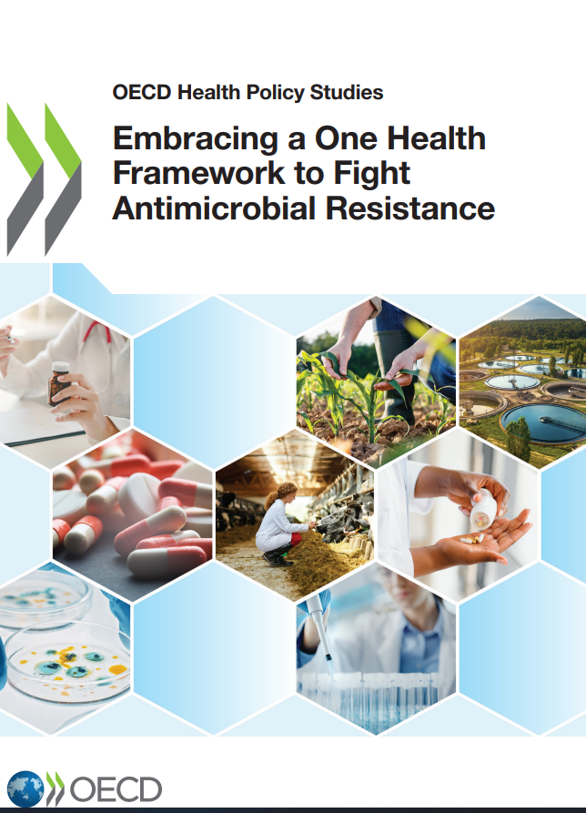
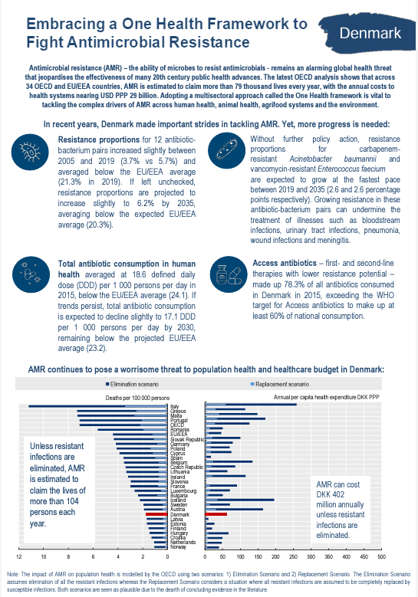
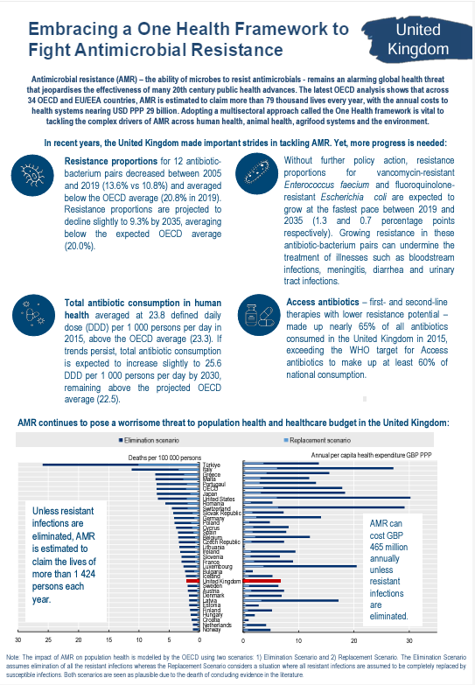
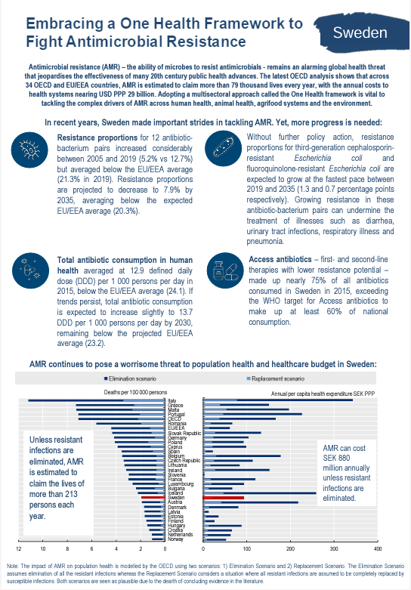
Find our AMR reports and country profiles online
https://oe.cd/amr-onehealth
Email us
Mark.Pearson@oecd.org

