Slide 1
Dr Sébastien DENYS Ianphi, Chair of the Committee on Climate Change and Health Director Environmental and Occupational Health Santé publique France
Engaging and supporting NPHIs as key climate actors

Slide 2
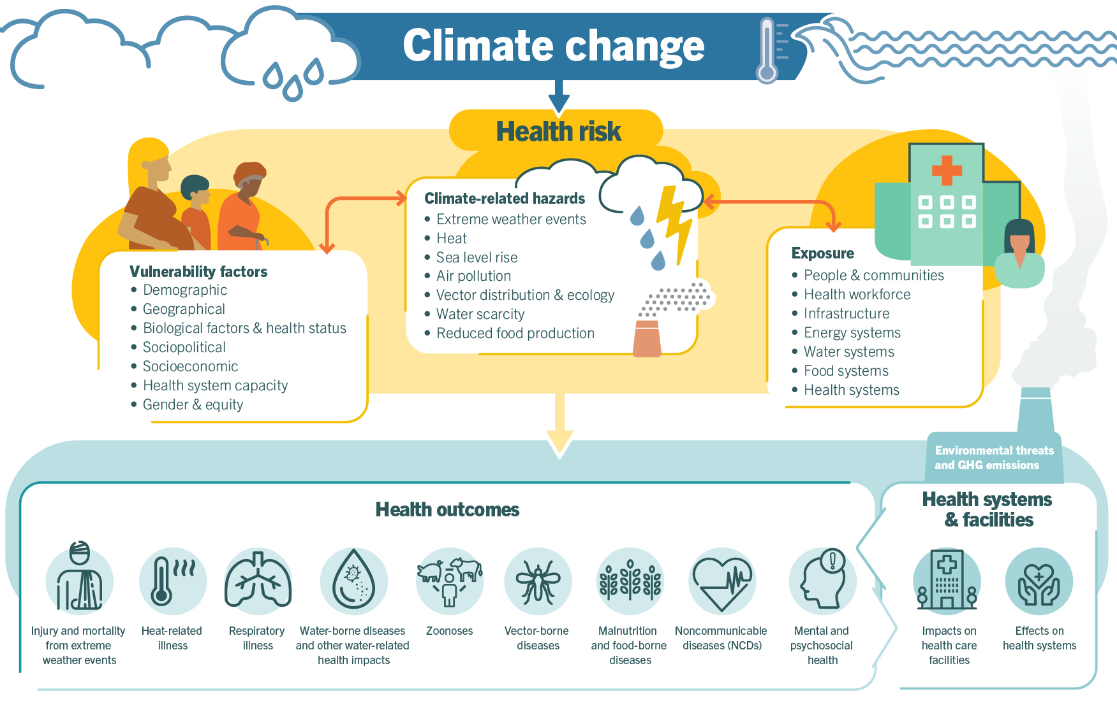
CLIMATE CHANGE : a challenging global health issue
Source : WHO

Slide 3
Heat and Public health Implication for NPHIs
Intensification of the heat and heatwaves worldwide (IPCC 2022)
increase in the frequency, intensity, geographical spread of hot days and heat waves
In France
between 2014 and 2023, 37,825 deaths were attributable to heat, and 28% of these deaths occurred during heat waves
between 2015 and 2019, the health impacts of heat waves (mortality, morbidity, restricted activities) represented more than 21 billions € of direct and indirect costs
In Europe
in 2023, 47 000 people died as result of high temperature (Gallo et al., 2024, Nature Medicine)
Special attention should be given to vulnerable population and social inequities
Crucial and urgent need for NPHIs to set up early warning system along with Meteorological Service and monitor and prevent heat impacts

Slide 4
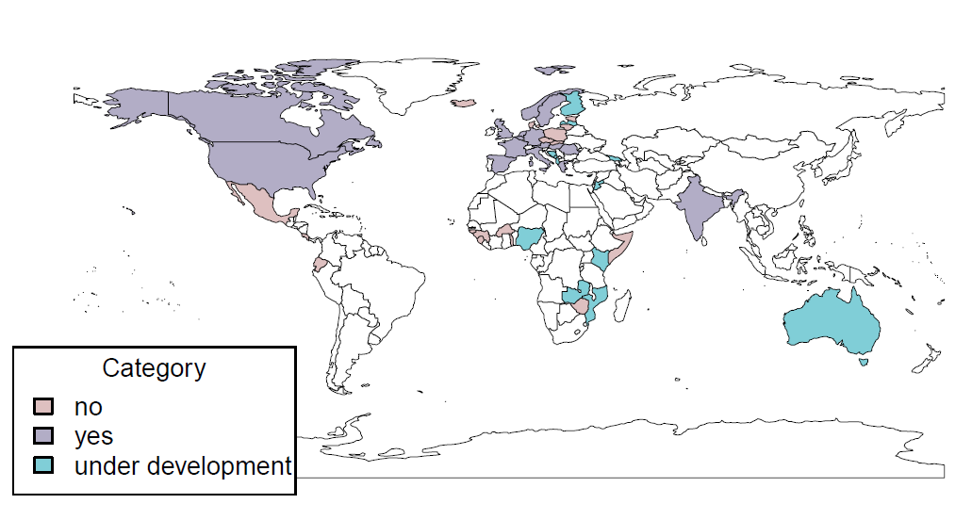
A real need to strengthen the involvement and capacities of NPHIs
Method
survey sent to 120 IANPHI members and 6 non-IANPHI members between May and July 2024
online form
49 complete and 10 incomplete responses
Among the respondents
only 18 NPHIs are monitoring heat impacts, 18 are currently developing a program, and 19 are not working on heat
7 NPHIs (in Europe, Africa and South America) did not identify heat as a priority
great diversity of methods, indicators, reporting… among the NPHIs monitoring the health impacts
Is your NPHI currently monitoring any heat-related health impacts?

Slide 5
Beyond heat, the essential role of NPHIs to tackle the health effects of CC
Climate change is a great public health opportunity and NPHIs are the cornerstone of public health practices
NPHIs have a unique scientific and institutional position to contribute to more efficient climate adaptation and mitigation research, policies and action
Action should be fostered by the health co-benefits of climate policies

Slide 6
IANPHI Commitments on CC and Health
Advocate for strengthening the capacity of NPHIs to contribute effectively to climate policies and action
Enhance capacity, competence and training through peer-to-peer support and knowledge sharing between NPHIs
Increase collaboration with international and regional organizations active in the fields of public health and climate change
Advocate for health in all policies that impact the climate
Support the greening of public health services
Monitor progress in the NPHIs’ involvement in climate change policies through key indicators

Slide 7
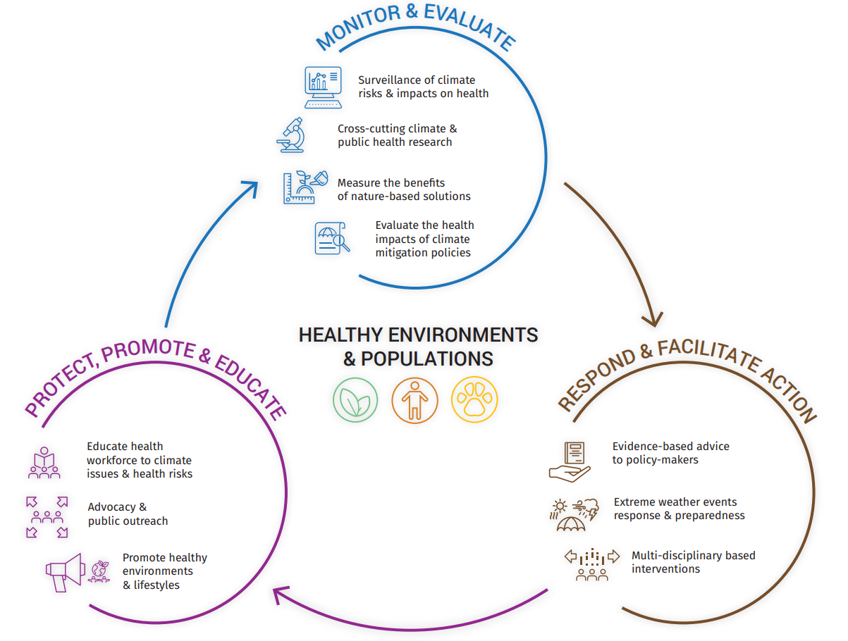
Climate change and health How can NPHIs contribute ? Declination of the essential public health functions Intersectoral advocacy

Slide 8
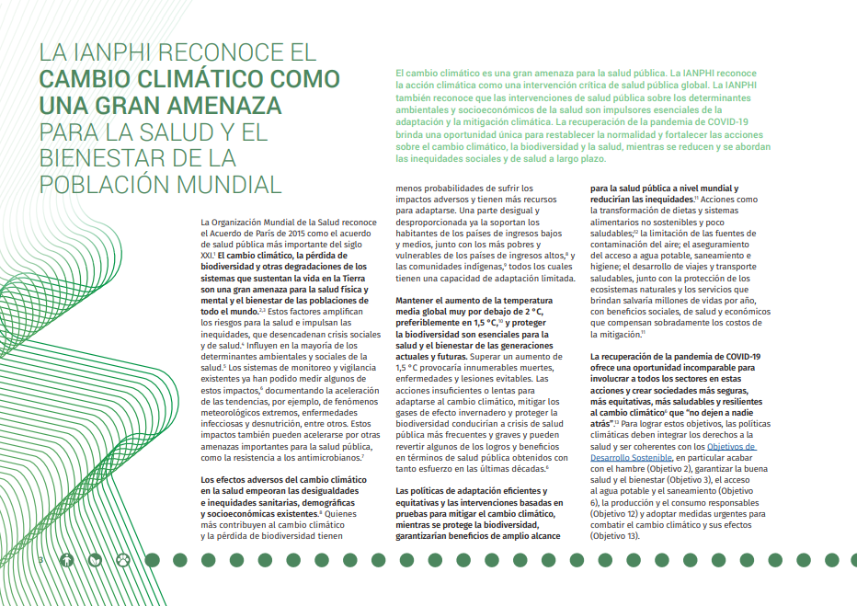
IANPHI Roadmap on climate change and health
Thank you!

