Slide 1
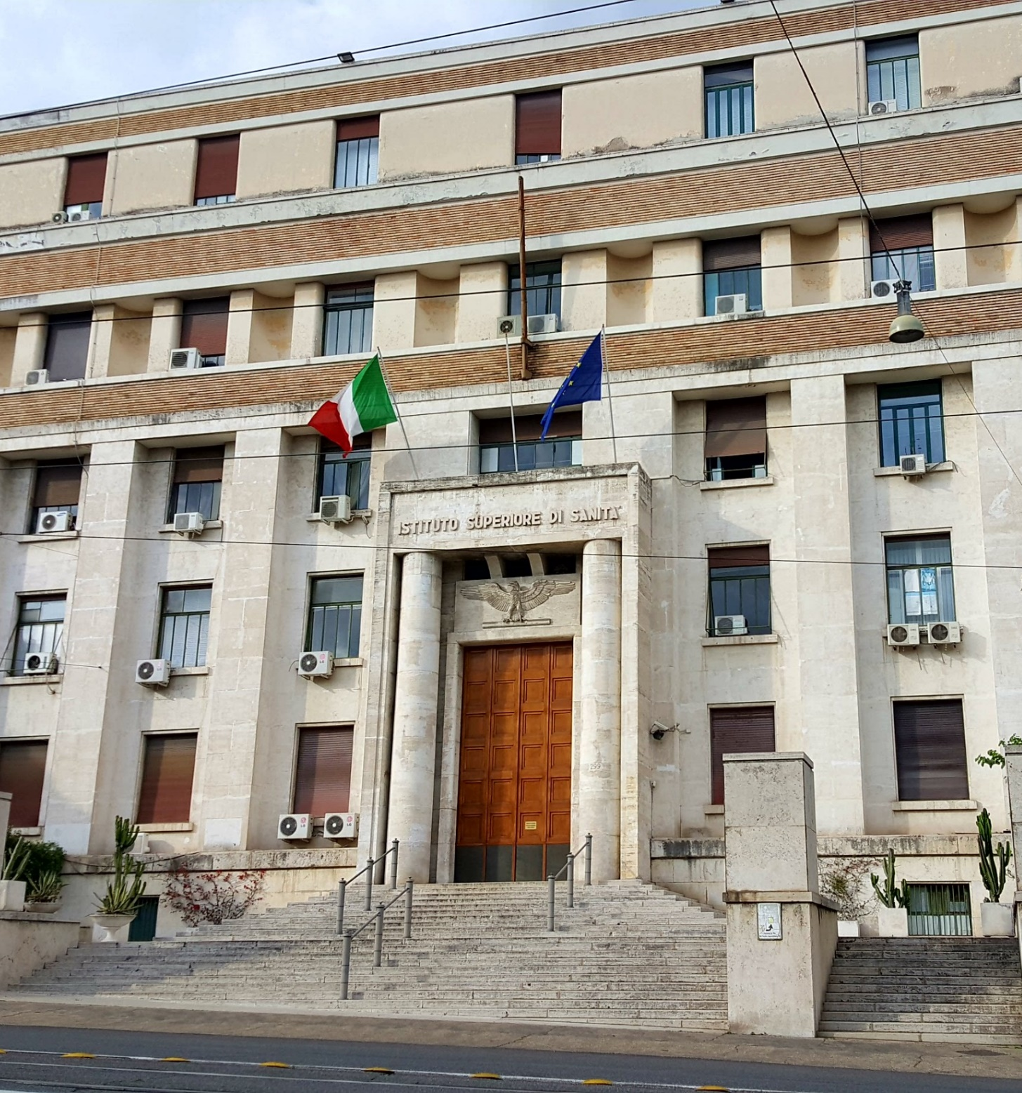

Climate change and health–
A public health imperative
Marco Martuzzi
Director,
Department of Environment and Health National Institute of Health (ISS)
Rome, Italy
www.iss.it/ambiente-e-salute

Slide 2
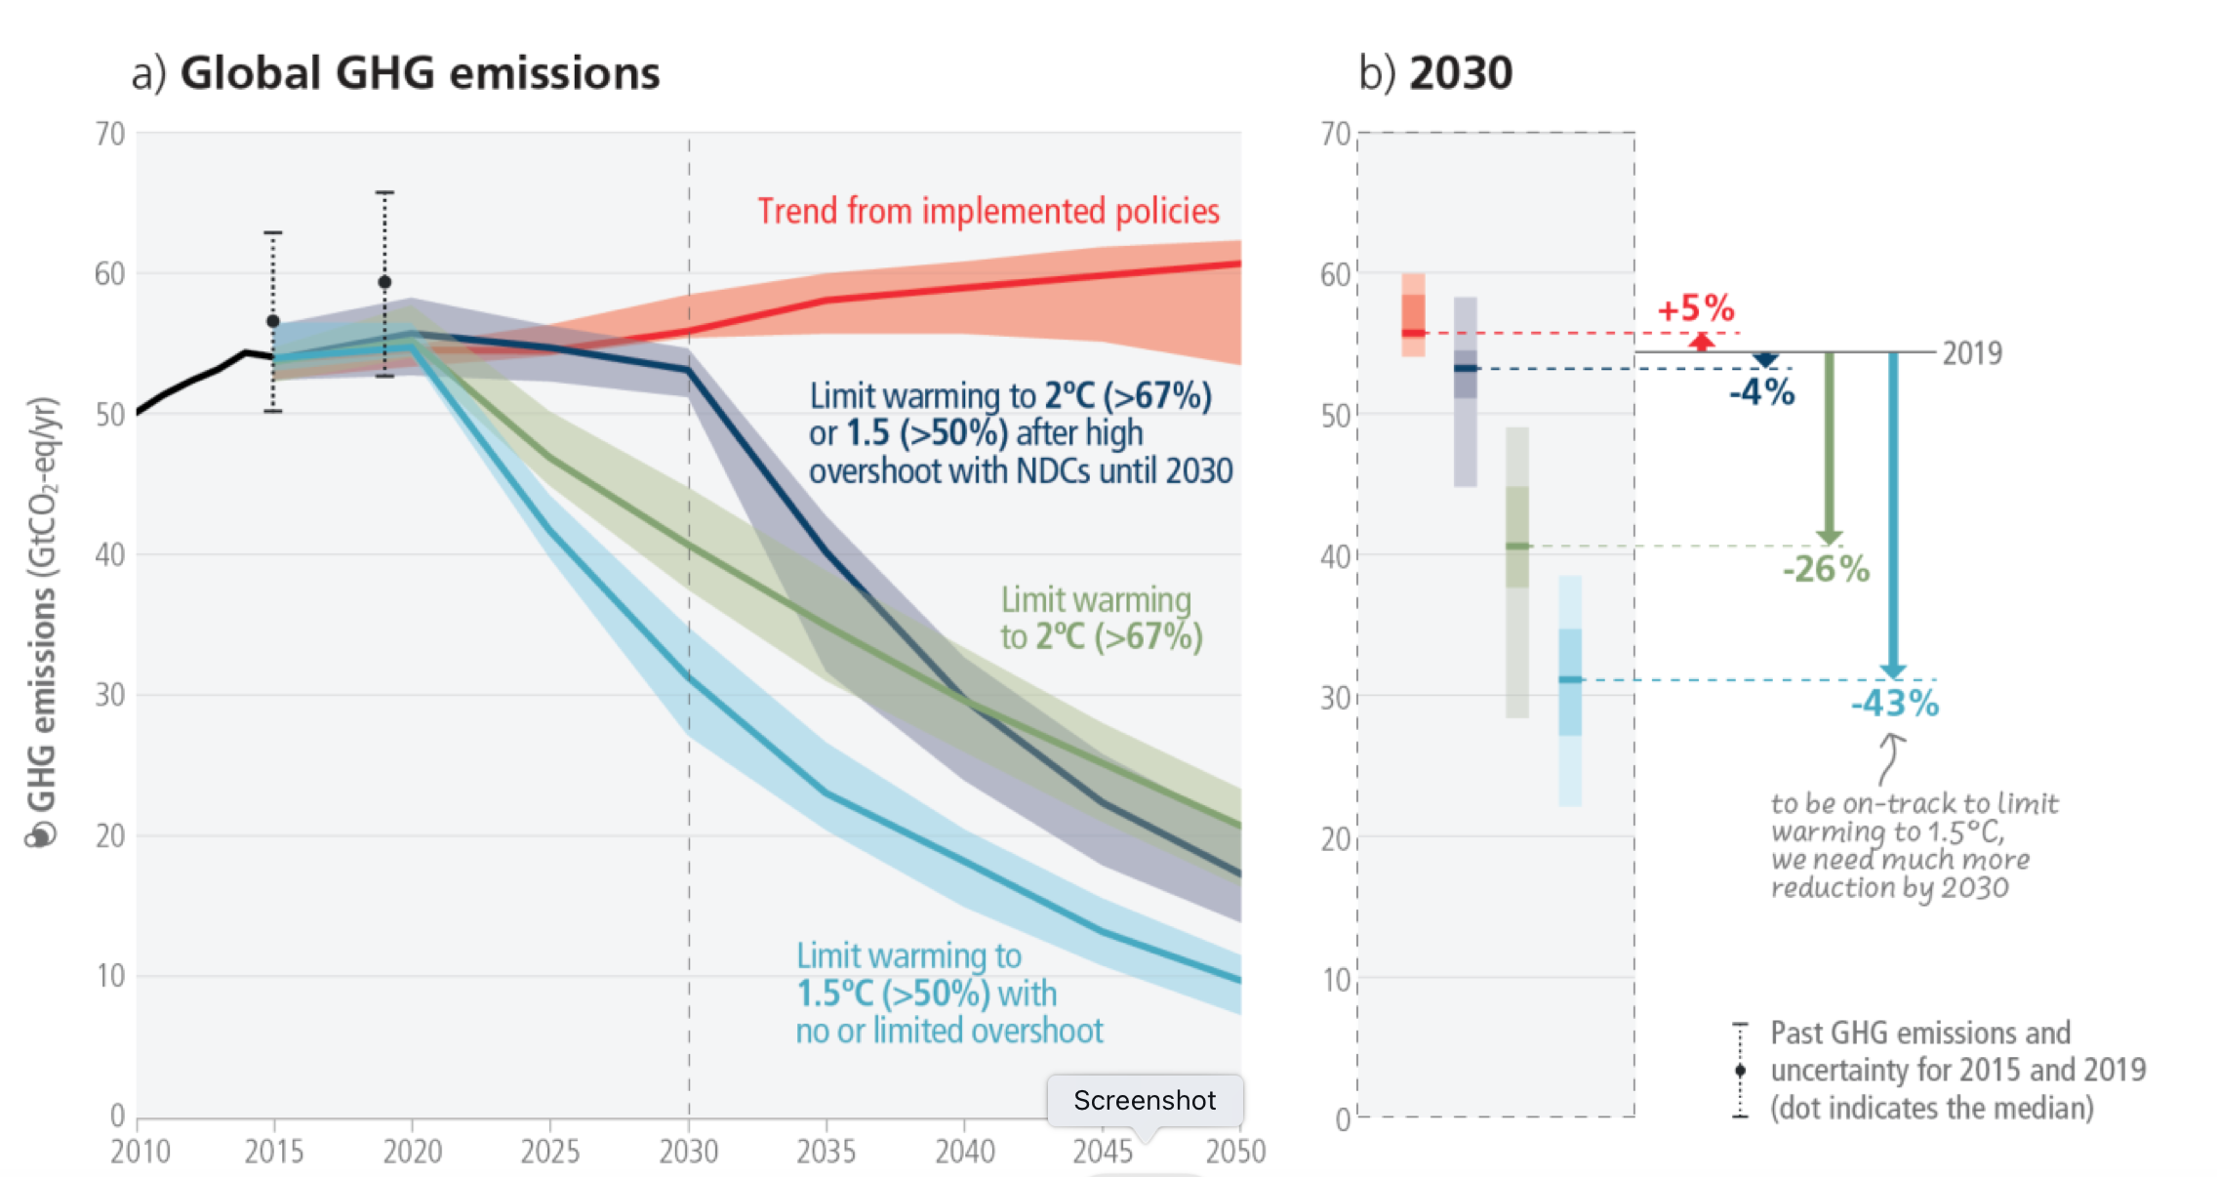
IPCC, 6th Report, 2023

Slide 3
Health effects of climate change
Extreme weather events
  Heat waves
  Floods, hurricanes, landslides
Spread of vector borne disease
Wildfires
Droughts, desertification, salinization of coastal areas
…

Slide 4
Role of ISS - examples
Research
  National and international projects on, eg. Nature Based Solutions such as green/blue space in cities
  Health co-benefits of mitigation policies
Advocacy
  Community-based engagement and interventions to prevent antimicrobial resistance spread in the aquatic environments
  Promoting environmental sustainability of health systems
Capacity building
  Development of on-line courses for young doctors and practitioners
  Coordination of national network of Environment Climate and Health

Slide 5
Support to MoH’s chairing G7-Health
G7 Health Ministers Communique – in preparation
Global Health Architecture and Pandemic Prevention and Response
Healthy ageing – life course
One Health
  AMR
  Climate change

Slide 6

Recommendations on CC
Rapid transition from fossil fuels to non-carbon solutions, including renewables
International coordination of actions concerning deforestation, extensive animal breeding (particularly ruminants), wild animal harvesting, sanitation of food markets
Planetary health oriented dietary changes are urgently needed
Serious action against chemical pollution is also essential
Impact on climate change needs to be considered in healthcare services and delivery
https://www.lincei.it/en/g7-academies-meetings

Slide 7
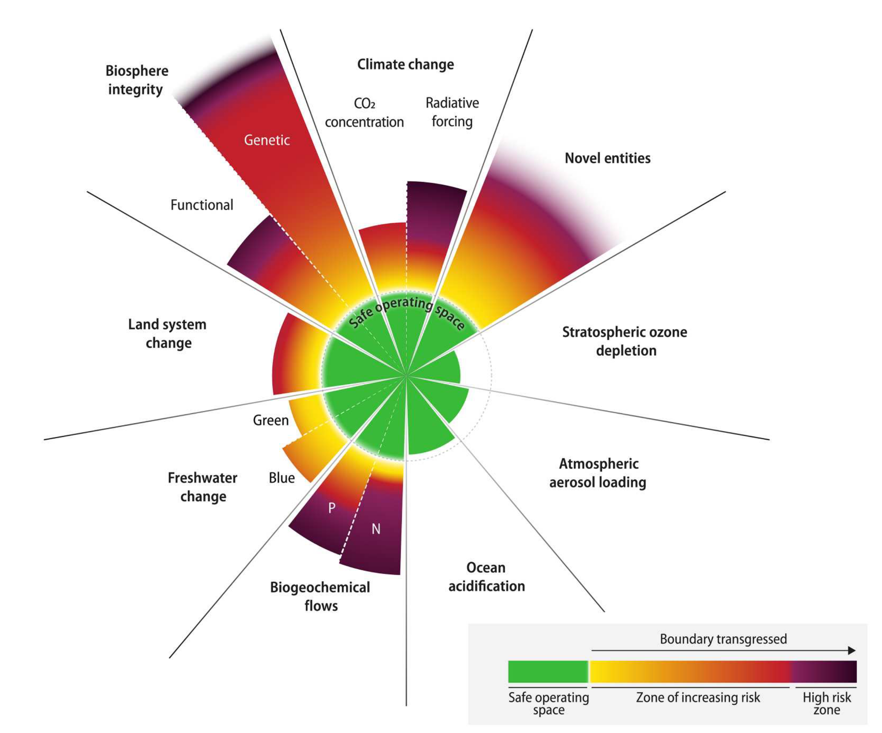
Planetary boundaries (Richardson 2023)

Slide 8
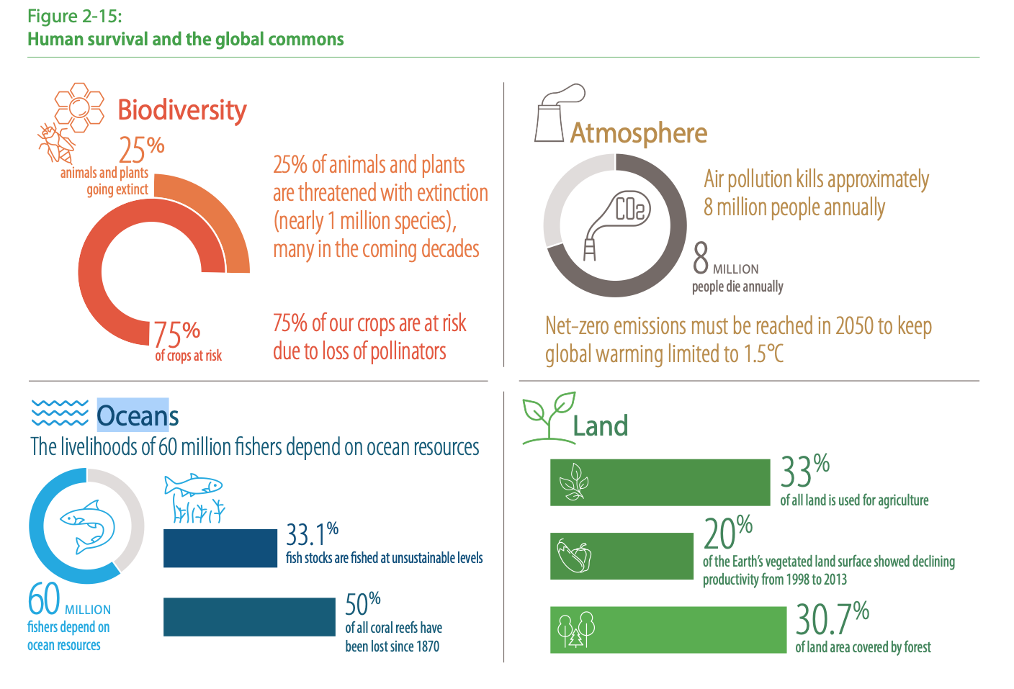
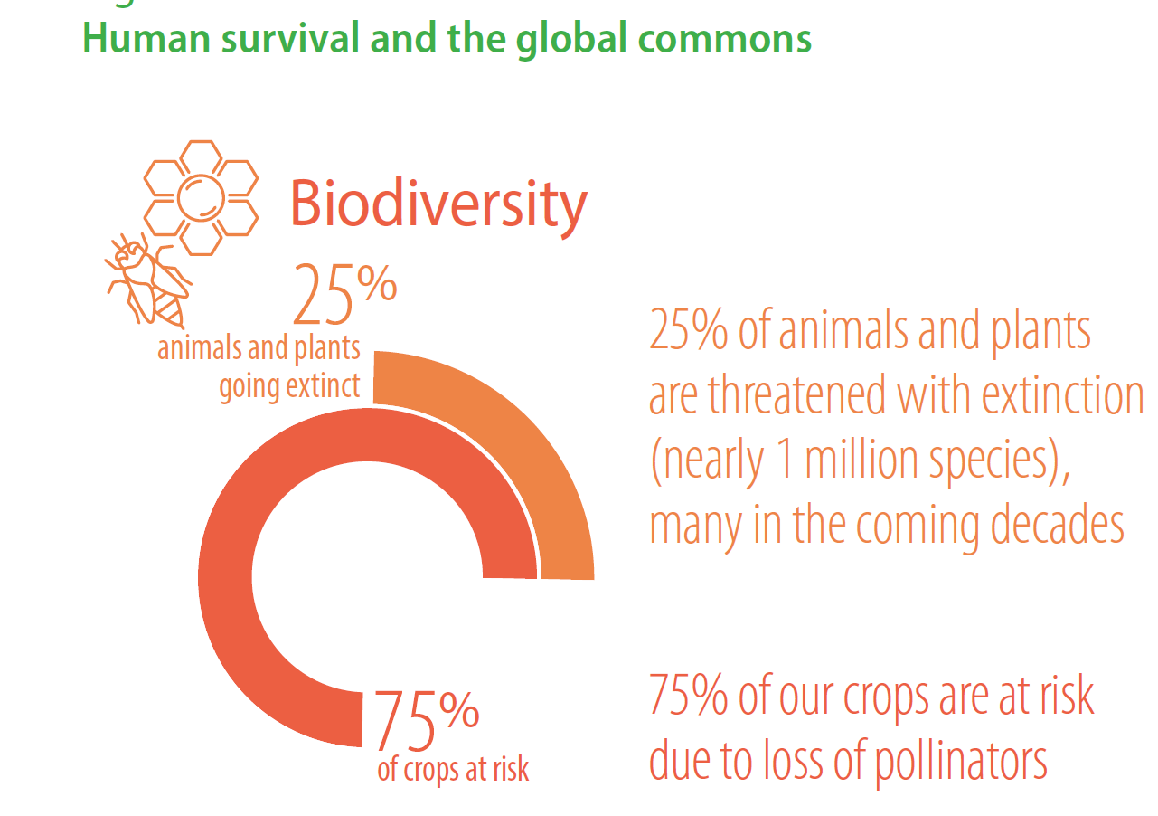
UN, The Future is Now, 2019

Slide 9
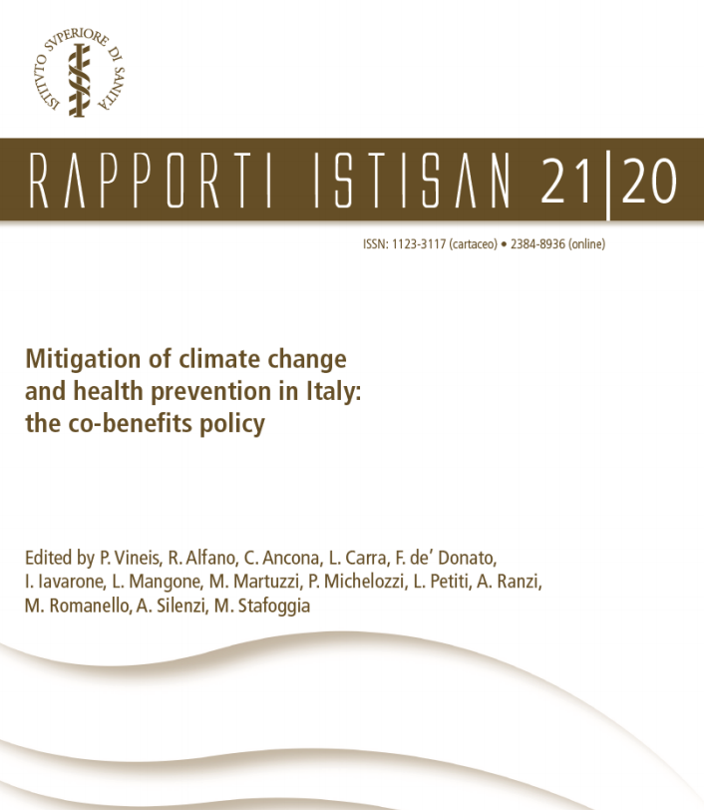
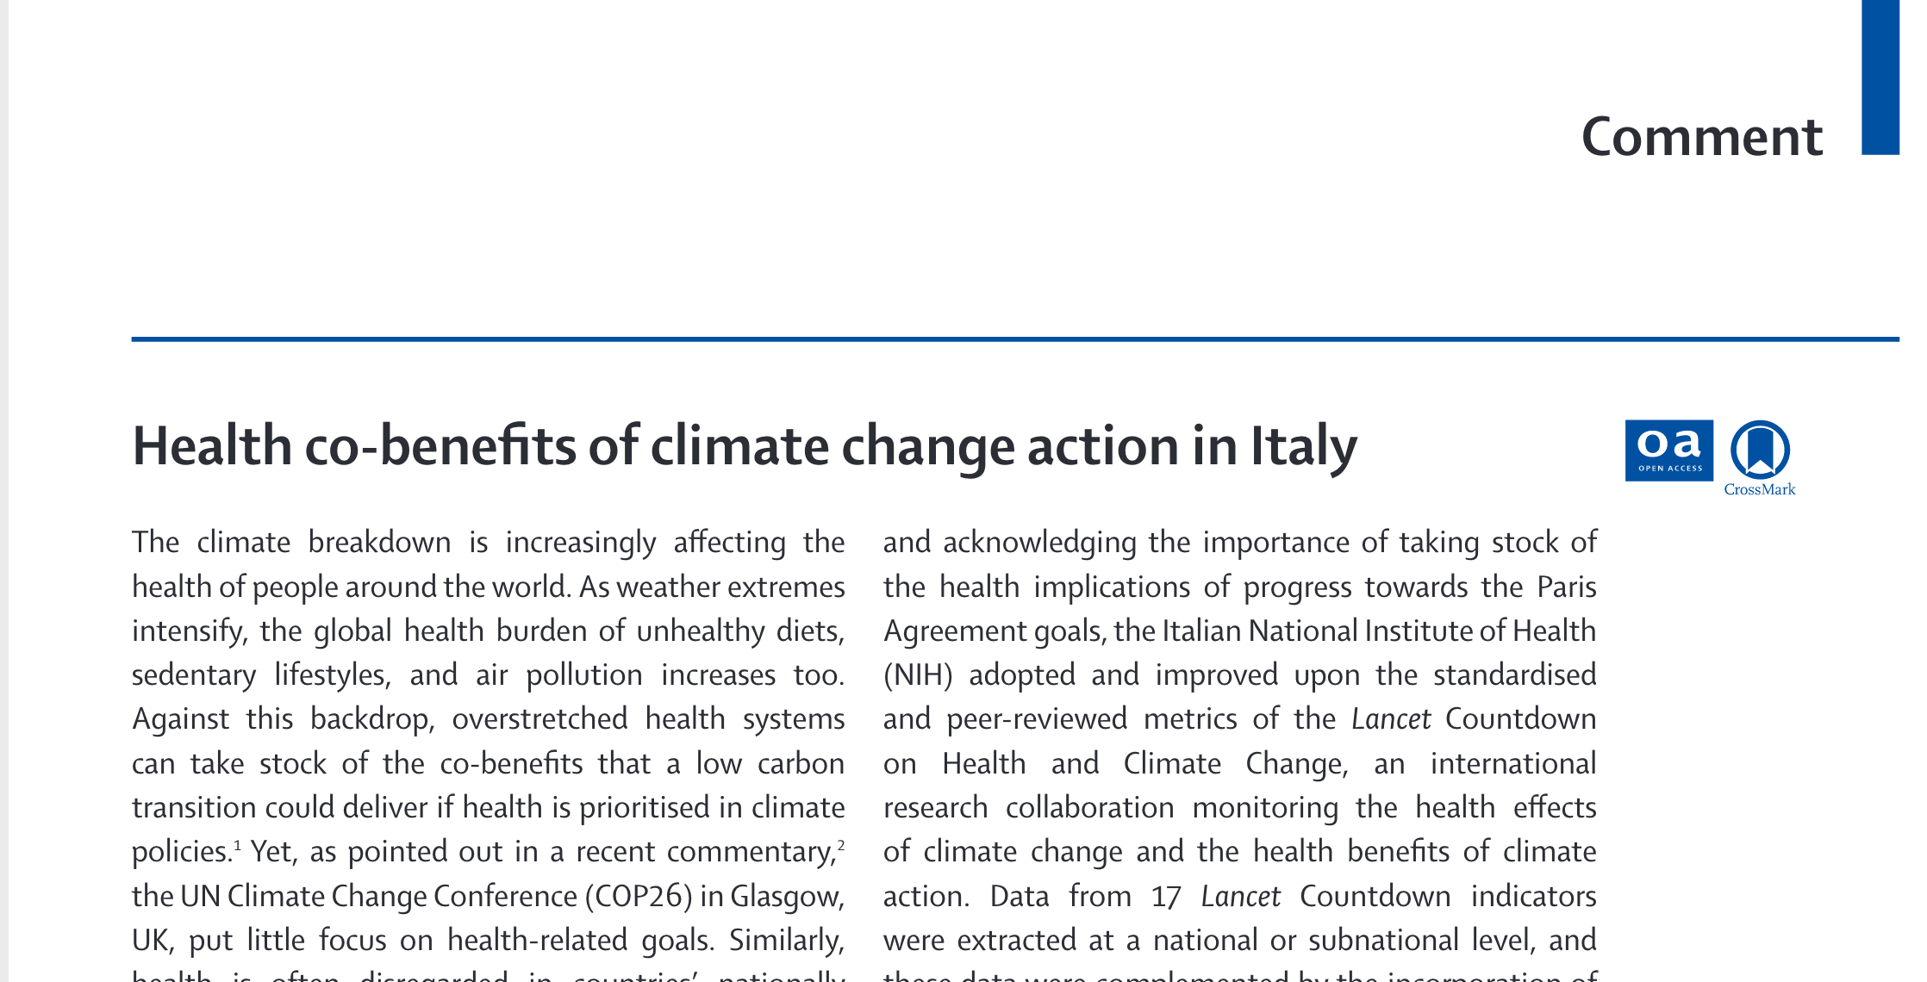
Mitigation of climate change: health co-benefits in Italy
Based on Lancet Countdown methodology:
Transport
  96% of transport runs on fossil fuel
Energy production
  6% still on coal
Agriculture and nutrition
  82% of emissions in agriculture are from meat production

Slide 10
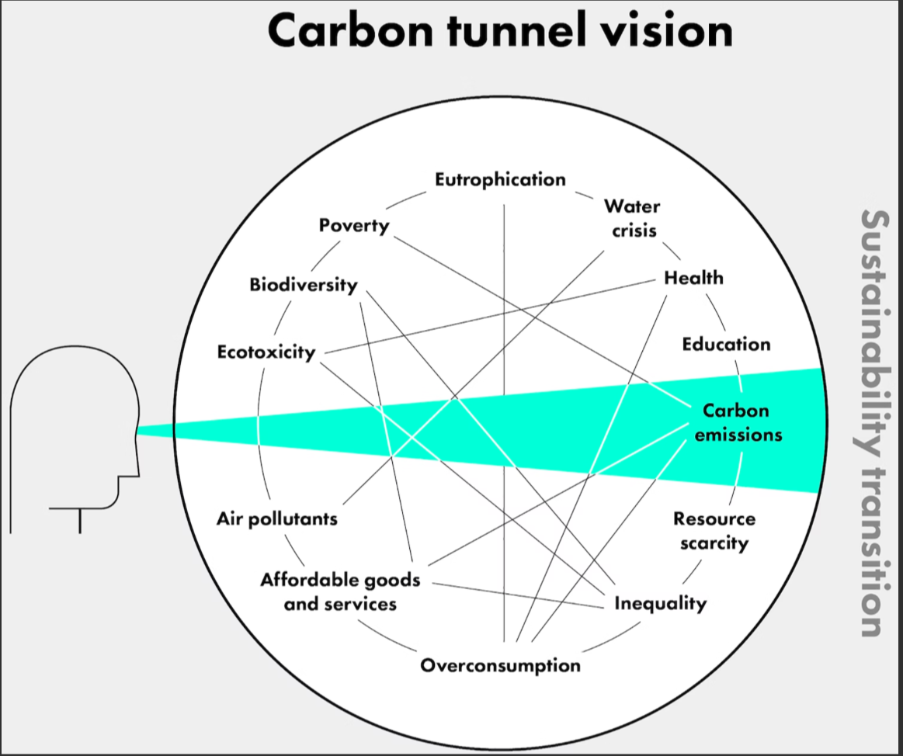
Thilagawathi Abi Deivanayagam 23

Slide 11
Systems thinking in public health
Health and its determinants (or life in general) are part of a complex system (as opposed to “complicated”)
Non-linear behaviours, adaptive responses, feedback loops, tipping points: difficult to extrapolate from past trends
Self-preserving, self-organising
From identification of the optimal intervention to “dancing with complex systems” (D Meadows 93). In IA speak, from product to process
Embrace complexity (as opposed to reduce uncertainty) and deal with it
See eg Petticrew BMJ 2019

Slide 12
Health systems and climate change
Adaptation
  Preparedness
  Climate resilience
Mitigation
  Reduce its environmental impact – go net zero
  Advocate for health benefits of mitigation

Slide 13
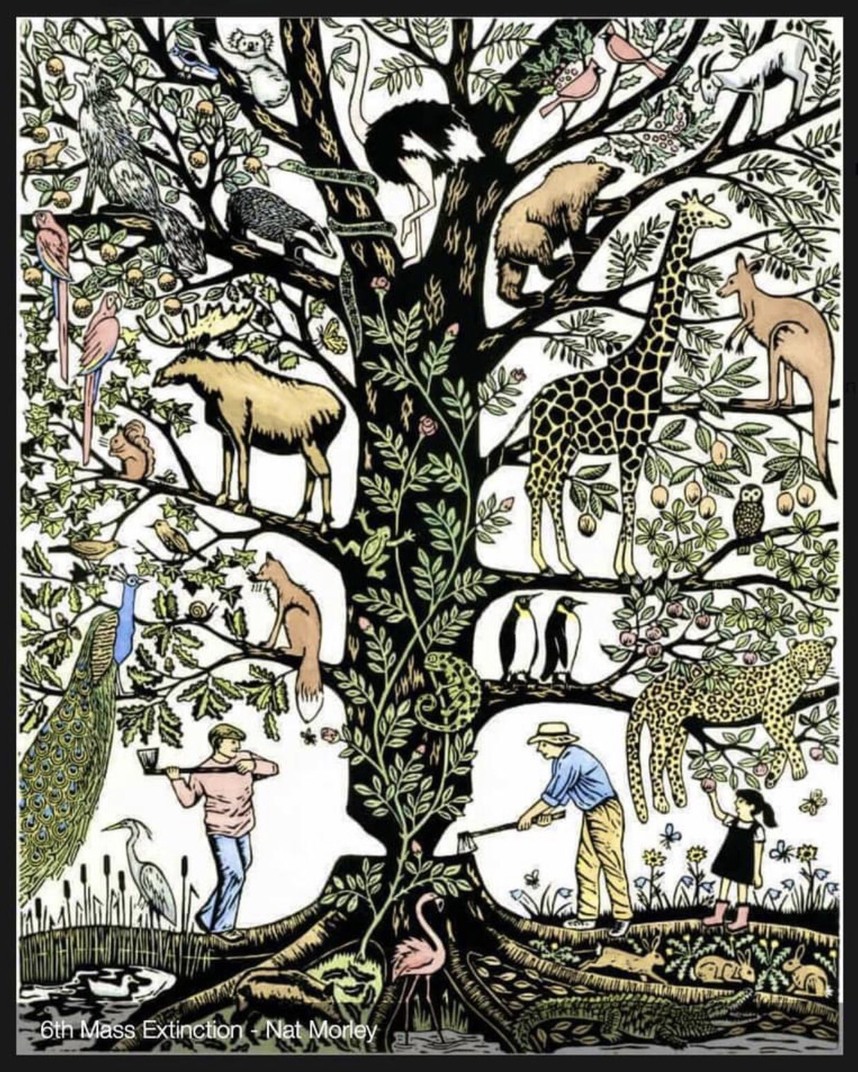
An
A
A clever man solves the problem. A wise man avoids it.
A. Einstein
marco.martuzzi@iss.it

