Slide 1

Eduardo Samo Gudo, MD PhD
Director General, National Institute of Health,
Mozambique
Public Health Surveillance
and
Climate Change

Slide 2
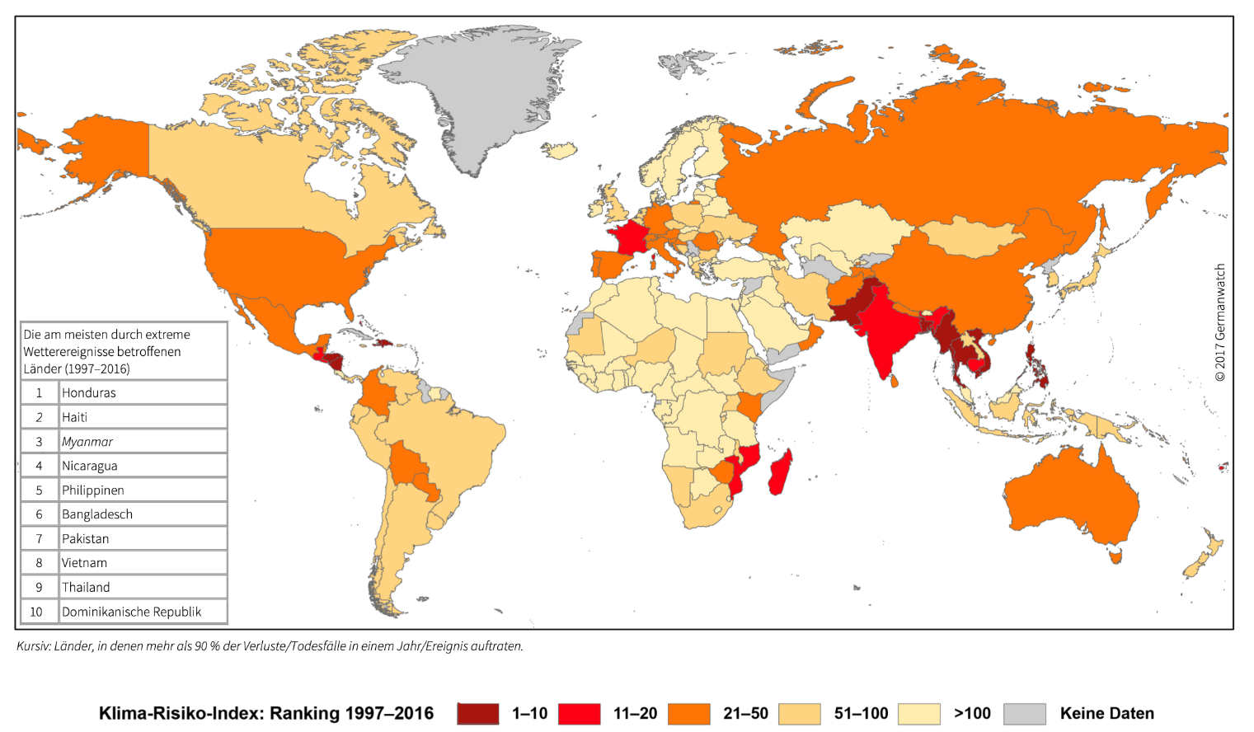
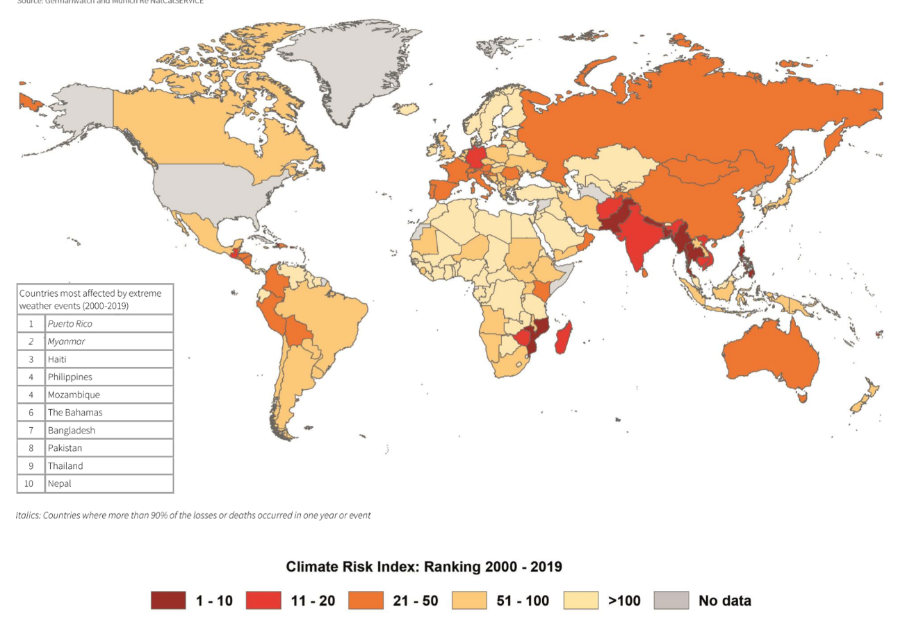
Mozambique is ranked among the most affected by extreme climate events globally
Global Climate Index 2018
Global Climate Index 2021

Slide 3
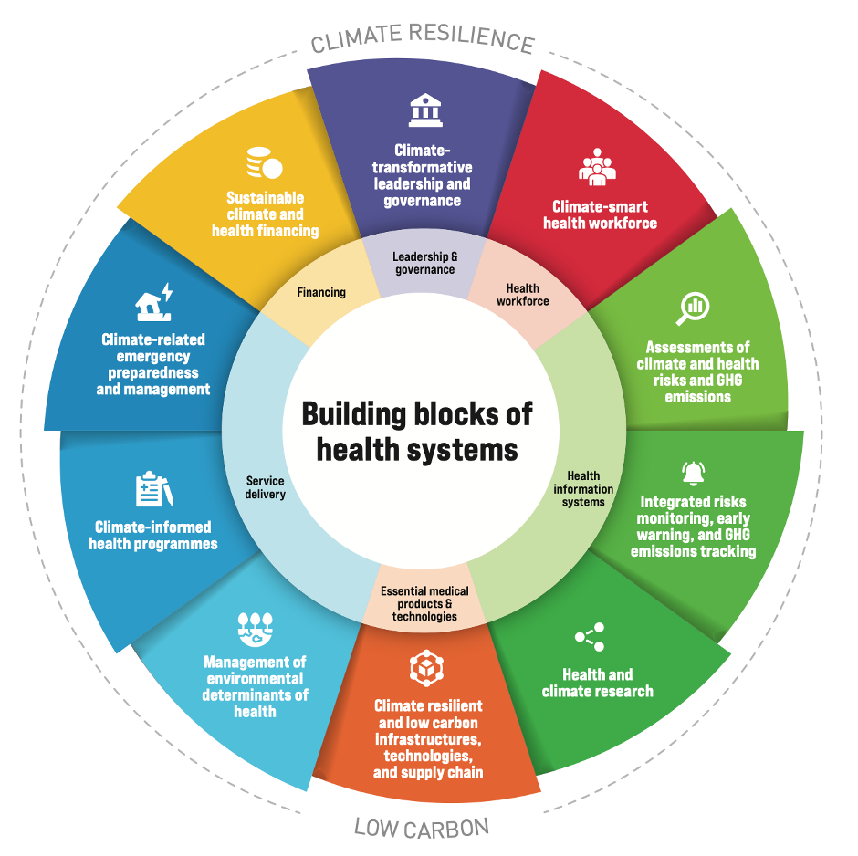
Building Climate Resilient and Low Carbon Health in Africa is undermined by competing crisis and lack of awareness
  Africa:
  Still struggling with heavy burden of endemic and epidemic diseases;
  Health system is still fragile and under funded;
  Health system highly vulnerable to crisis;
  Limited literacy on climate change and health in is limited;
  Scanty evidence and data on climate change and health;
Notes:
The process to building climate resilience occurs in two principal ways:
(i) reducing climate-related health
risks (including hazards, exposures, and vulnerabilities; and
(ii) developing specific health system capacities, integrating climate perspectives to health policy and operations.

Slide 4
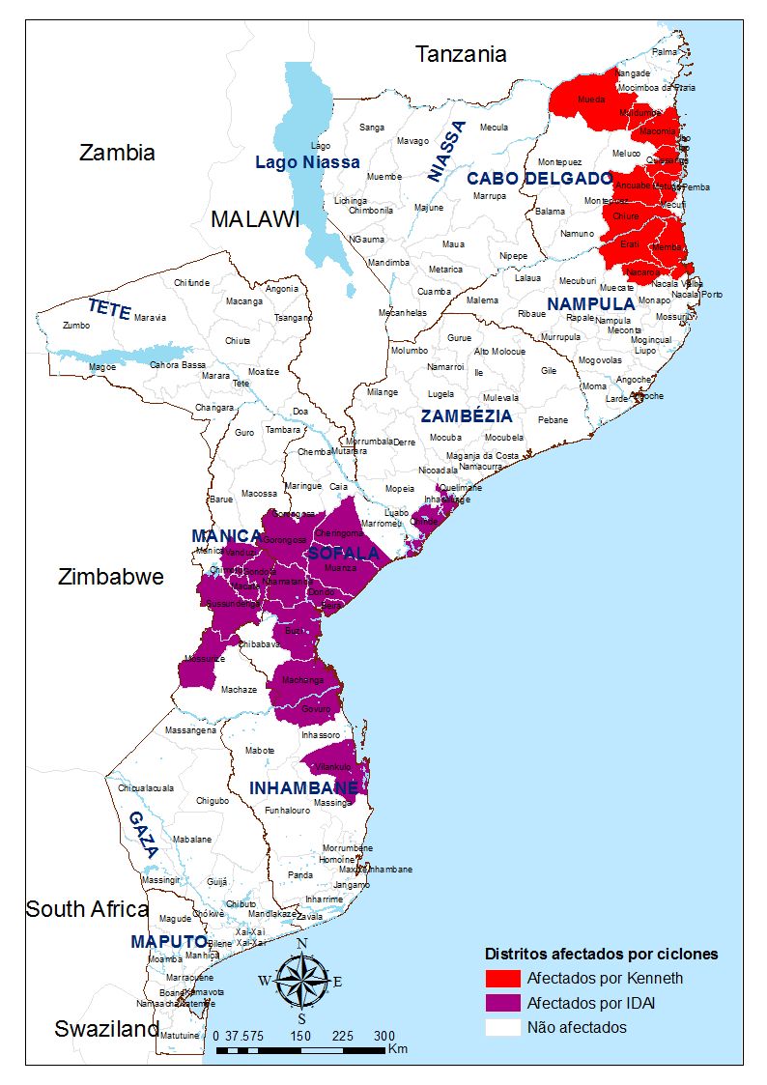
Two consecutive cyclones hit Mozambique in March and April 2019 changed the paradigm on climate change and health in Mozambique
April 25, KENNETH Cyclone hit Northern Mozambique
45 deaths
>18,000 people displaced
March 14, IDAI Cyclone hit Central Mozambique
One of the worst tropical cyclones on record to affect Africa and the Southern Hemisphere
603 deaths
> 400,000 people displaced

Slide 5
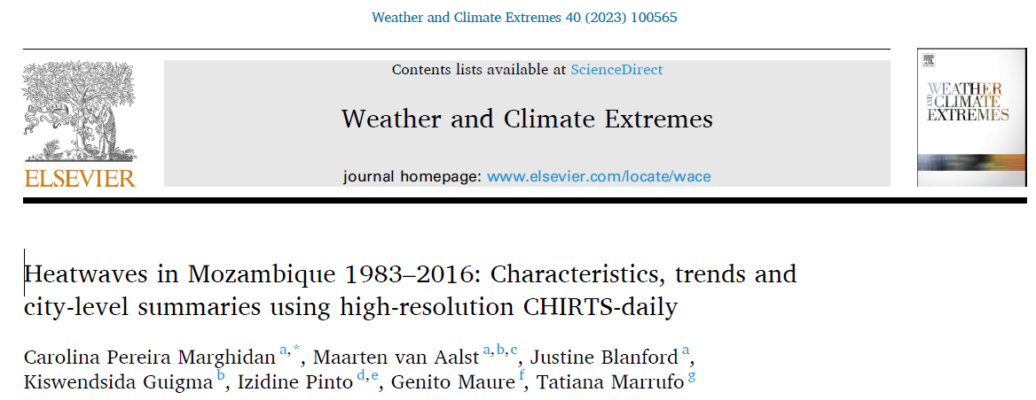
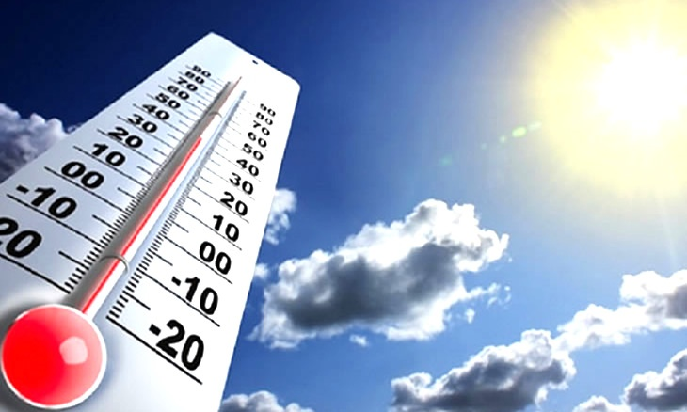
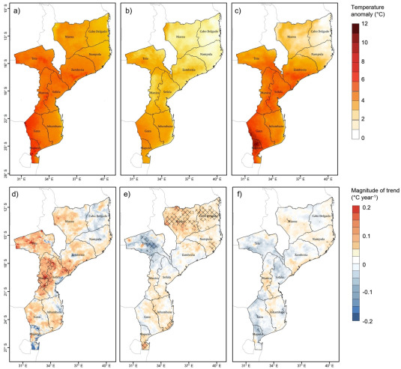
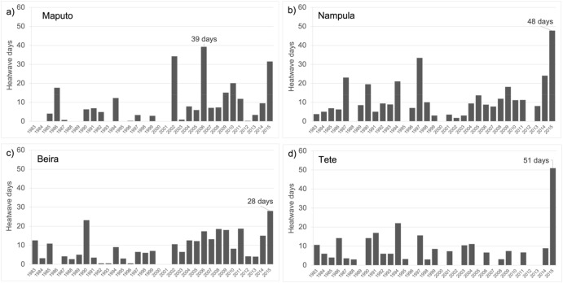
Heat waves are becoming a threat to Mozambique, but evidence on its impact on health is still limited

Slide 6





Mozambique has established the Climate and Health Observatory to pull together multidisciplinary data (including surveillance data)
Climate and Health Observatory
Decision Making
Routine Health Data
Situation Analysis
1
Trend Analysis
Surveillance data of health issues
National
Health
Observatory
2
Indicators Monitoring
Analytical Products
Survey’s reports and database
Fact sheets
Modelling
Analytical sheets
1
Risk Analysis and Mapping
Infographics
Other sectors data:
Vital statistics;
Social determinants;
Environmental data;
Climate data;
2
Current and Future Impact (predictions and scenarios)
Bulletins
Reports
Summary
Policy Brief

Slide 7
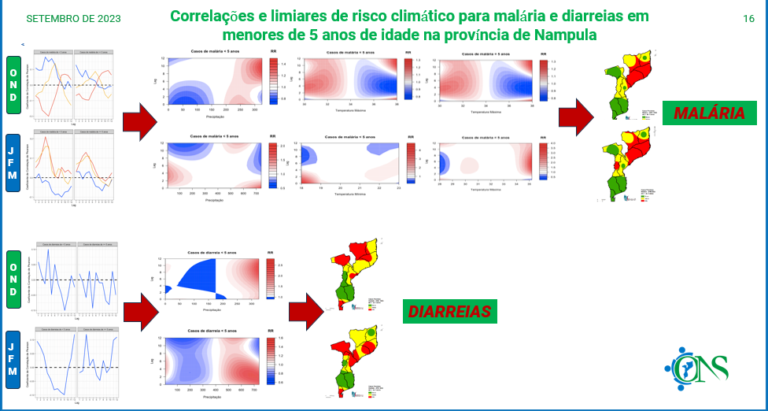
Climate and Health Observatory
Risk maps for malaria and water borne diseases

Slide 8
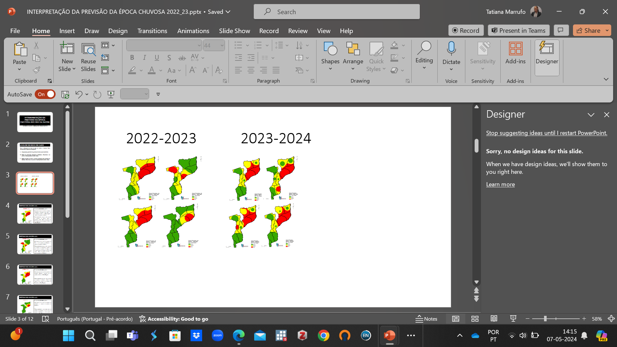
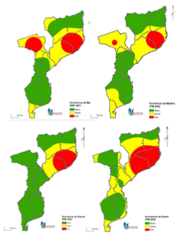
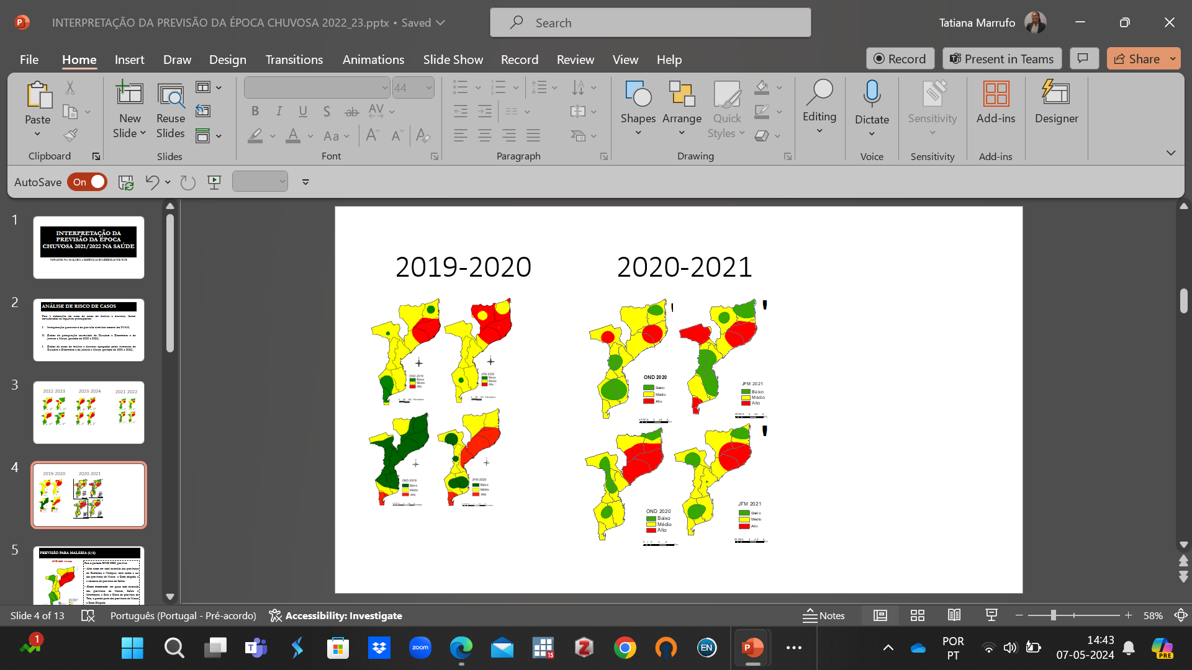
Climate and Health Observatory
Regular Forecast and trend analysis of malaria and diarrhea
2019-2020
2020-2021
2021-2022
2023-2024
2022-2023
8

Slide 9
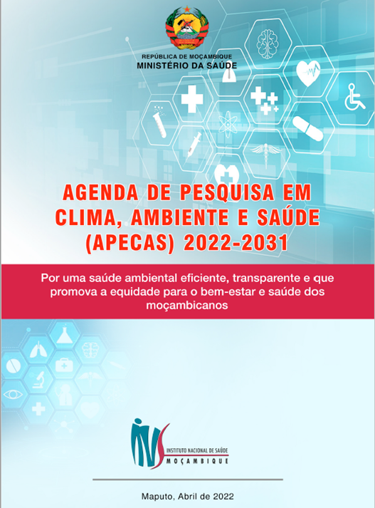
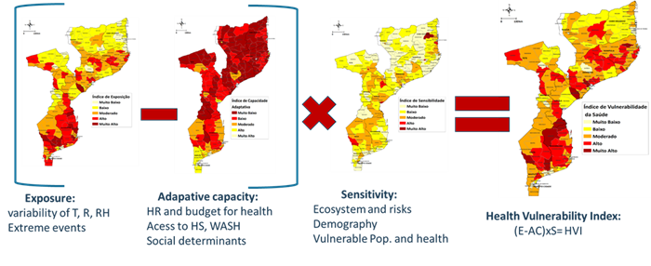
Mozambique also developed a Climate and Health Research agenda and conducted V&A
Climate and Health Research Agenda
District Level Vulnerability and Adaptation Assessment

Slide 10
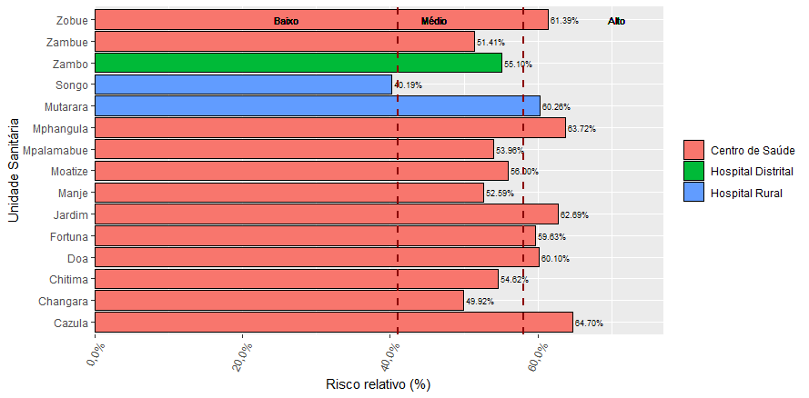
Health Facility Vulnerability and Adaptation Assessment
47% of the Health Facilities had a high vulnerability to extreme climate events;
6% of the Health Facilieites demonstrated na acceptable level of resilience.

Slide 11
Surveillance data and V&A assessments are driven the finalization of H-NAP
Resilient Supply Chain
Improved forescast driven by evidence
Use of Drones
Solution to minimize impact of heat
Climate resilient infrastructure and technologies
Development of new models for facilities
HIMS & Climate Services
Digital & real-time (m-Alert)
Framework of climate and health related indicators (progress and impact)
Service delivery
Mobile facilities and teams + community HC
Differentiated models + checklist
VULNERABILITY/ VULNERABLE COMMUNITIES/GROUPS
&
LOCAL CONTEXT
Climate resilient Public Health Programs
Infectious diseases
NTDs
Others
Workforce
Pre-servisse and on-job training
Update of HR development plan
Climate related education and risk communication
Literacy of health professions
Community literacy (heat waves and cyclones)
Climate adapted planning and financing
Climate sustainability
Adaptation funding
Notes:
Vulnerable groups: women, children, handicaped, displaced, remote areas, areas with higher exposure, risky areas, poorest

Slide 12
Thank you!

