Slide 1
Prof. Claude Mambo Muvunyi, Director General, Rwanda Biomedical Center (RBC), Rwanda
Rwanda Biomedical Center (RBC) strategy for Pandemic Preparedness, Response, and Global Health Security

Slide 2
Pressing challenges
Plateau in Disease Indicators
Healthcare Service delivery gaps
Evolving Health Landscape
Stagnant (or worsening) indicators which indicates that current strategies may not be yielding the expected results.
Gaps in diagnostic and treatment for Mental Health and NCD due competing priorities, High cost for intervention, Limited/Insufficient budget
Shift in Disease Burden
Resistance in pathogen (i.e. Malaria, HIV, TB…)
Integration of services/interventions
Apply best practices from other mature programs
Resource mobilization
Pressing need to embrace advanced research and data analytics to inform evidence-based interventions
Pandemics and Climate Change Resilience
Decline in Funding
Gaps in staffing and issue in retention
New expectation/needs- R&D
Decline in donor funding over the last several year presents a pressing concern
Significant challenges due to heavy workloads and staffing gaps
Growing need to do research and develop local pharmaceutical and medical technologies
Identify new funding opportunities
Design cost-effective interventions
Incentives framework that can help fill staffing gaps, and motivate the workforce
Reduce dependency on imports and create sustainable, locally-relevant solutions

Slide 3
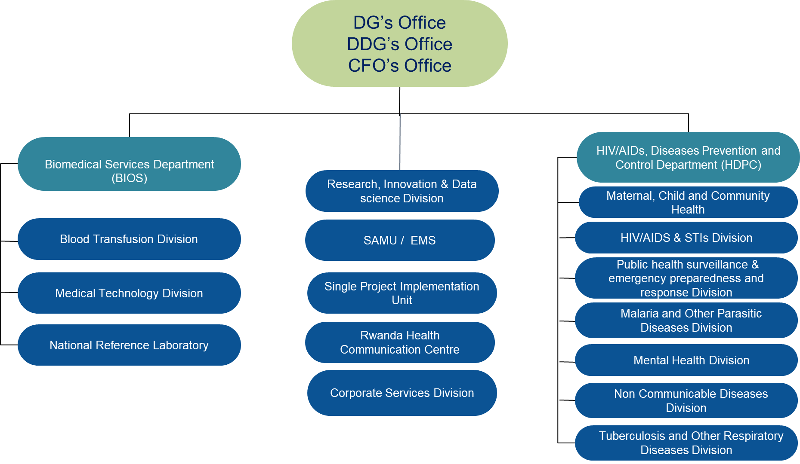
Universal healthcare coverage:
Five high leadership offices.
14 divisions, coordination office.
1700 health posts, 500 health centers, 42 district hospitals, and 5 national referral hospitals
About 60,000 highly trained CHWs.

Slide 4
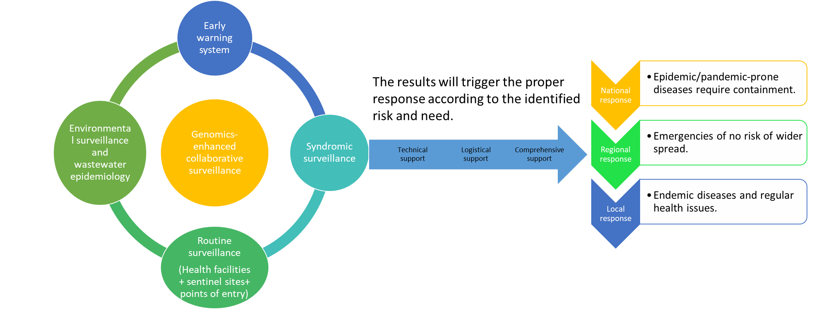
Integrated surveillance & response system

Slide 5
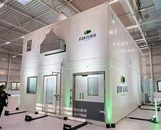
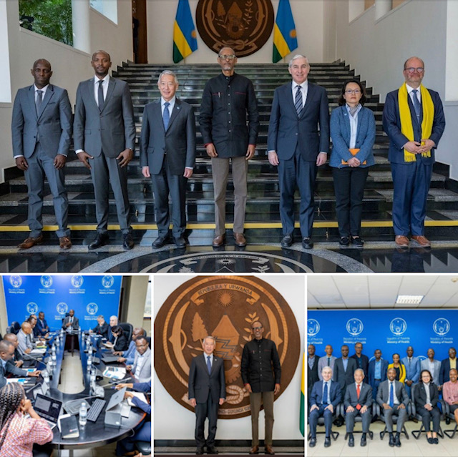
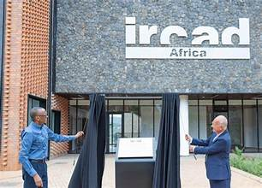
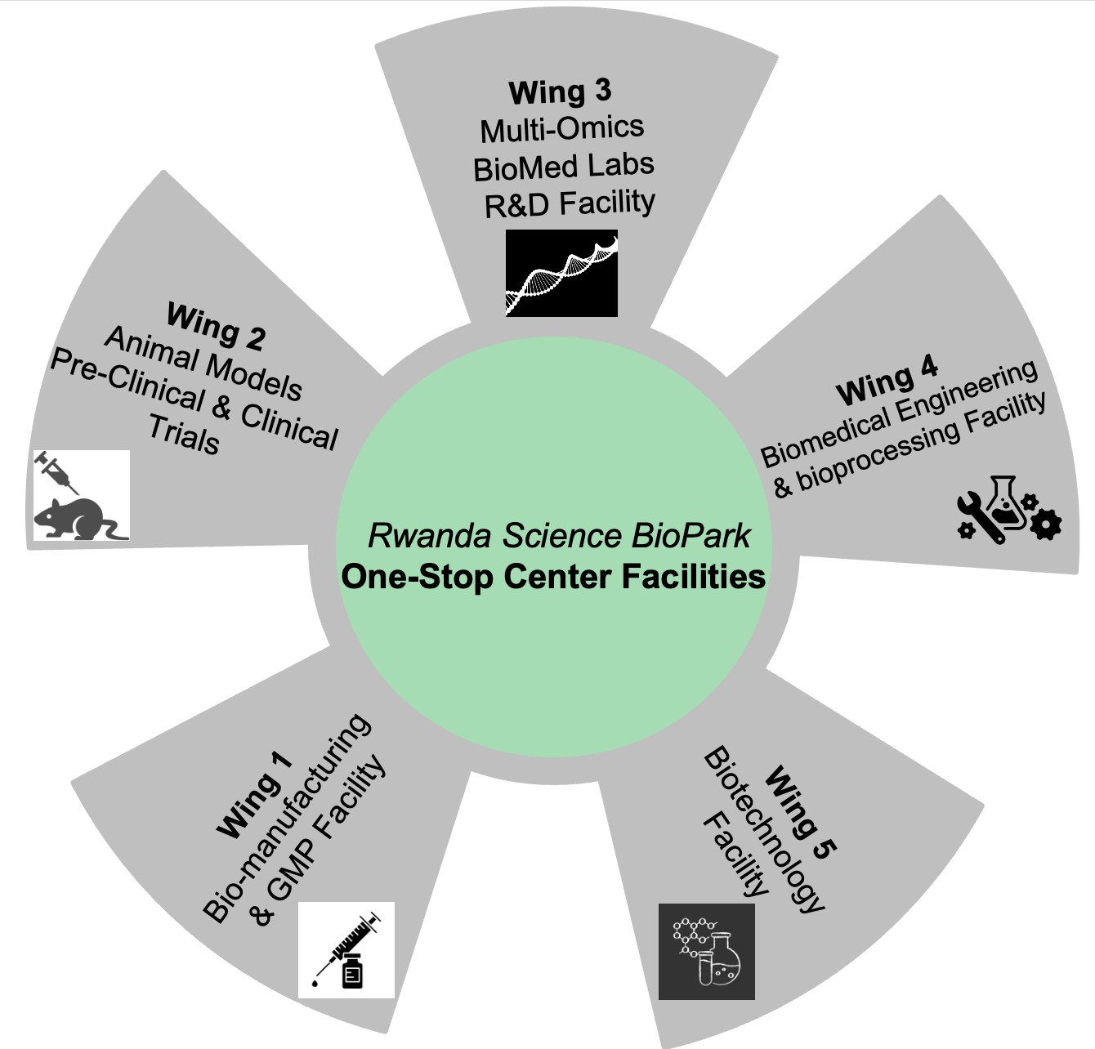
Enhancing vaccines ecosystem in Africa through partnership
BioNTech
International Vaccine Institute
Africa Medicine Agency
Vaccine Ecosystem
Vaccine discovery & development
Vaccine safety, Clinica trails,…
Vaccine regulatory
Training & Capacity
Building

Slide 6
Leading evidence-based Health System
Collect high quality data
Transform data into evidence
Evidence-informed resources mobilization
Evidence-based policymaking + strategic planning

Slide 7
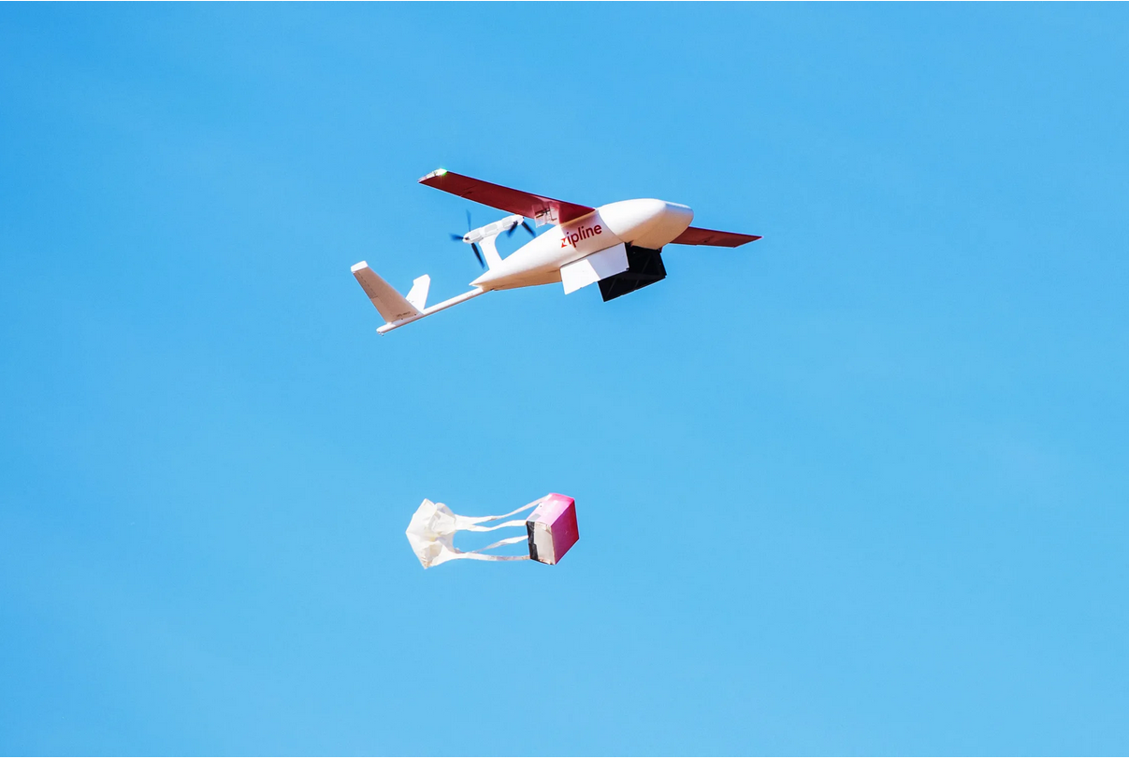
Pioneering innovative approaches for pandemic prevention and response
Using drones to deliver:
Blood products to emergency rooms.
NCDs medications elders and challenged individuals at home.
Human and animal vaccines to communities at risk of outbreaks.
Integrating the use of AI to support surveillance, early warning, decision-making, and diagnostic algorithm.

Slide 8
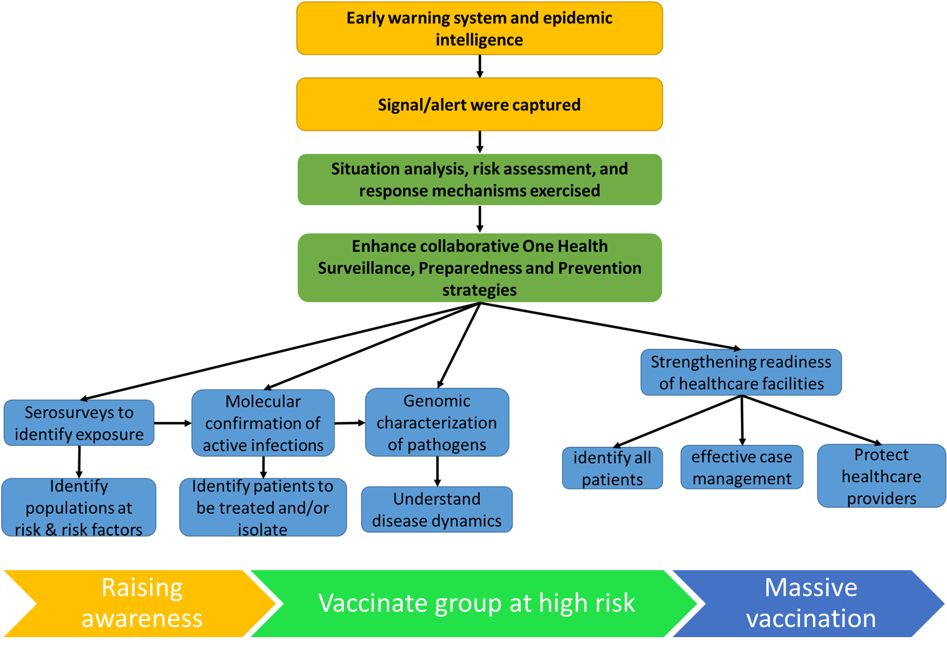
Response to health emergencies such as COVID-19 and Mpox in Rwanda

Slide 9
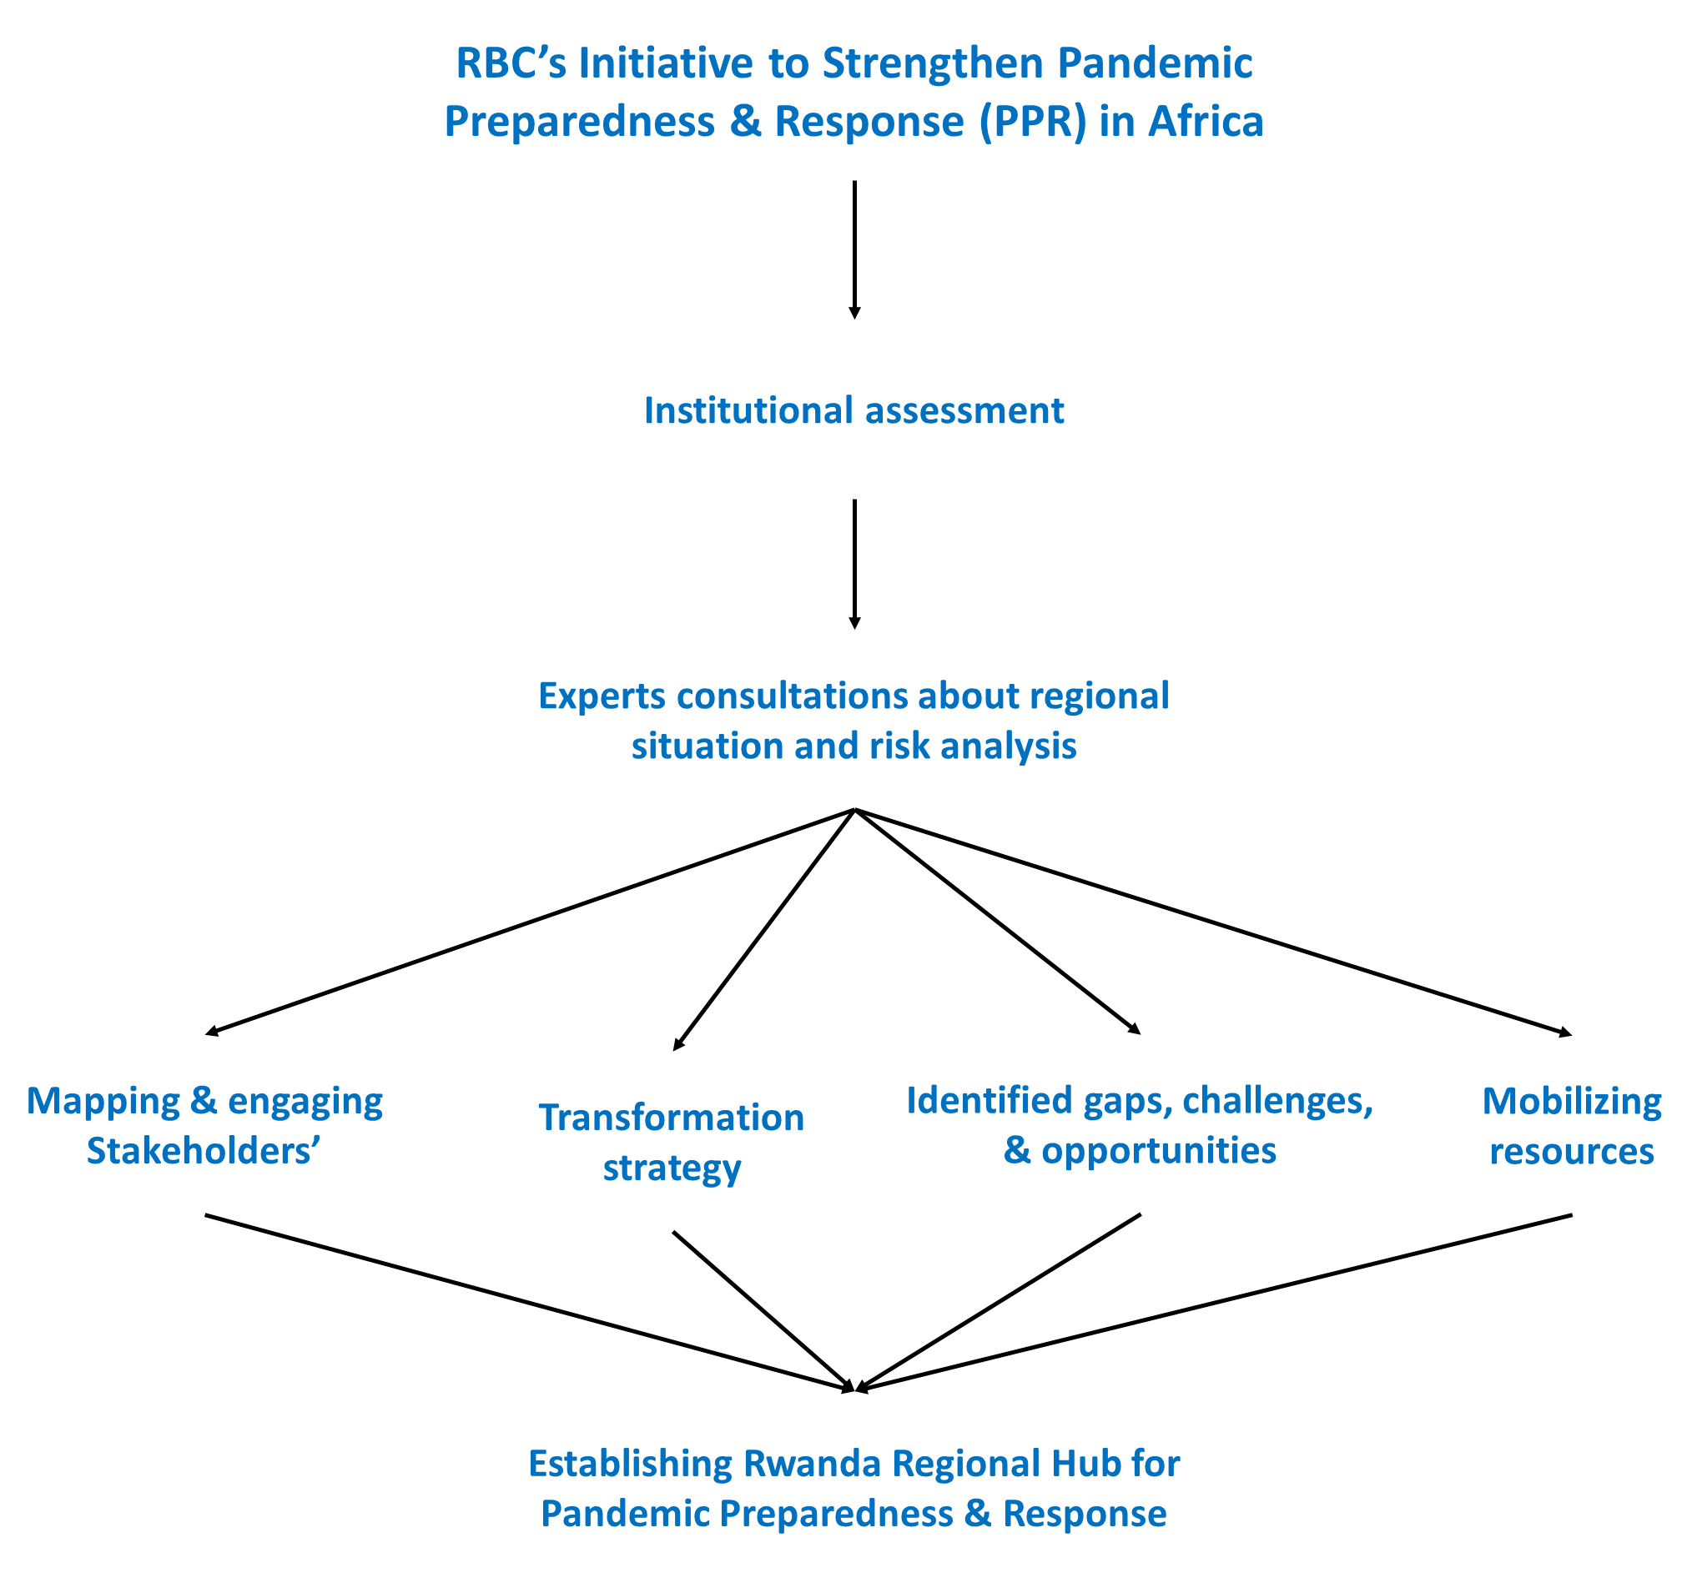
Investing in strengthening the pandemic preparedness, prevention, and response in Africa

Slide 10
Thank you!

