Slide 1


Dr. Lisa Indar,
Ad Interim Executive Director,
Caribbean Public Health Agency (CARPHA)
PREPAREDNESS AND RESPONSE TO
HEALTH EMERGENCIES

Slide 2
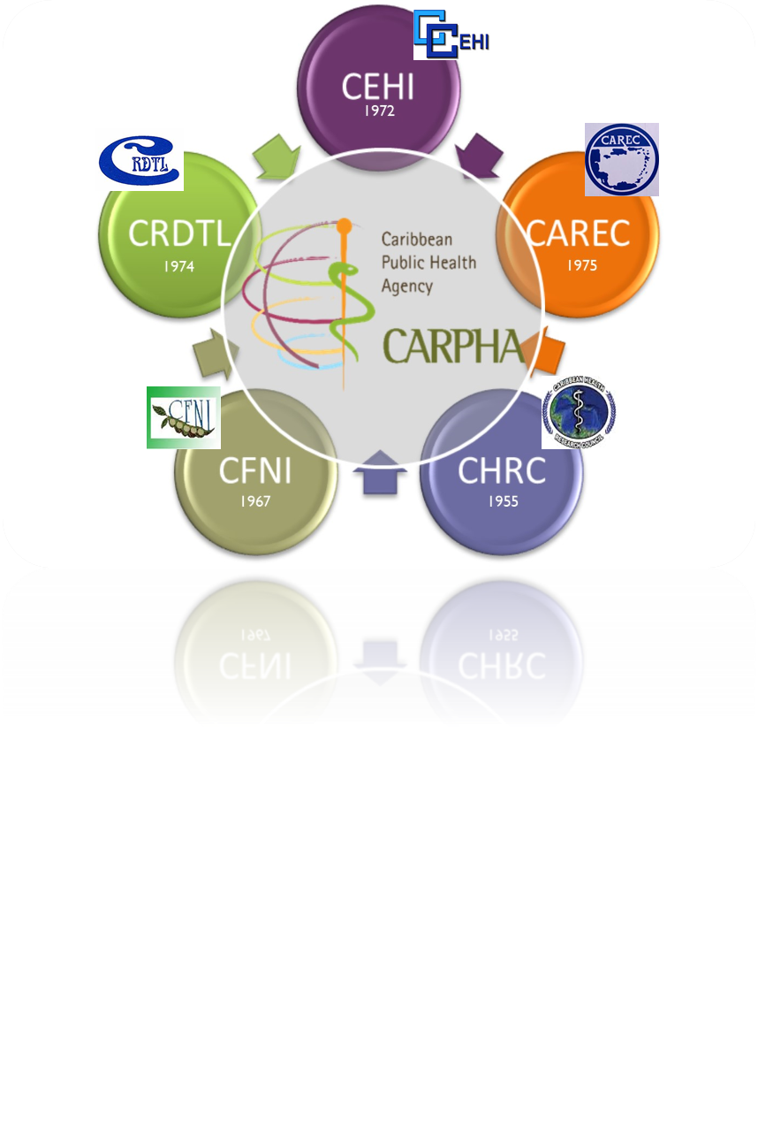
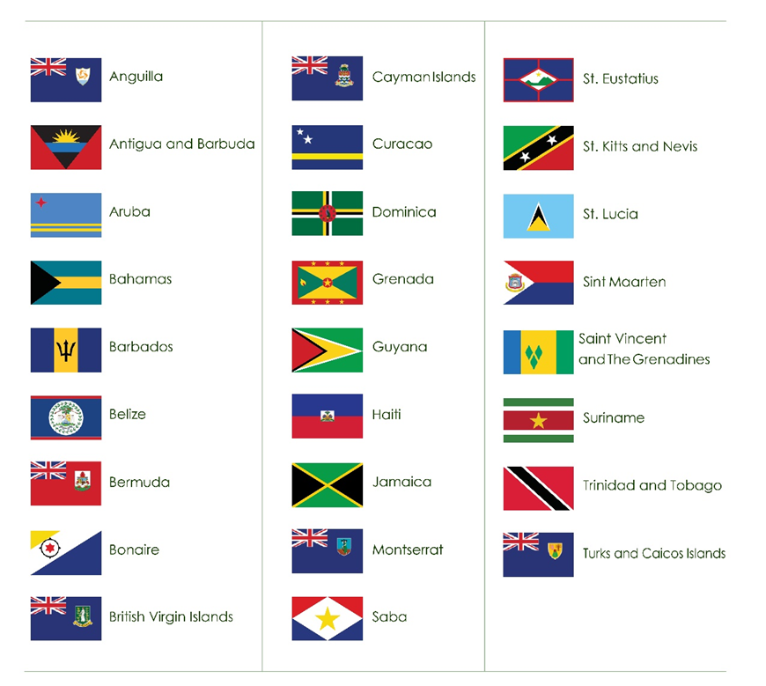
CARPHA
VISION
Health People
Healthy Spaces
Healthy Caribbean
MISSION
As a professional organisation to build Member States capacity to prevent disease and promote health and wellness through leadership, partnership and innovations in Public Health
Sole Public Health Agency for the Caribbean
CARICOM Institution with responsibility for Public Health
Merger of former 5 Regional Health Institutions
Established by CARICOM Inter-Governmental Agreement 2nd July 2011. Operational 1st January 2013
Headquartered in Trinidad and Tobago with campuses in Saint Lucia and Jamaica
Serves 26 CARPHA Member States /countries
Notes:
The International Association of National Public Health Institutes was first envisioned in 2001 by Jeffrey Koplan former director of CDC and Pekka Puska (director general of Finland’s National Institute of Public Health and Welfare – THL ) and chartered in 2006. IANPHI was initially supported through grants from the Rockefeller Foundation and the Bill & Melinda Gates Foundation.
Professional and independent network of NPHIs, or “CDC’s of the world”, which provides a unique forum for peer-to-peer support and strategic exchanges amongst directors and senior staff
IANPHI’s mission is to collectively build public health capacity by connecting and strengthening NPHIs worldwide
The IANPHI Annual Meeting is the only worldwide forum where NPHI directors and partners come together to establish and strengthen relationships and share ideas and best practices on areas of mutual concern

Slide 3
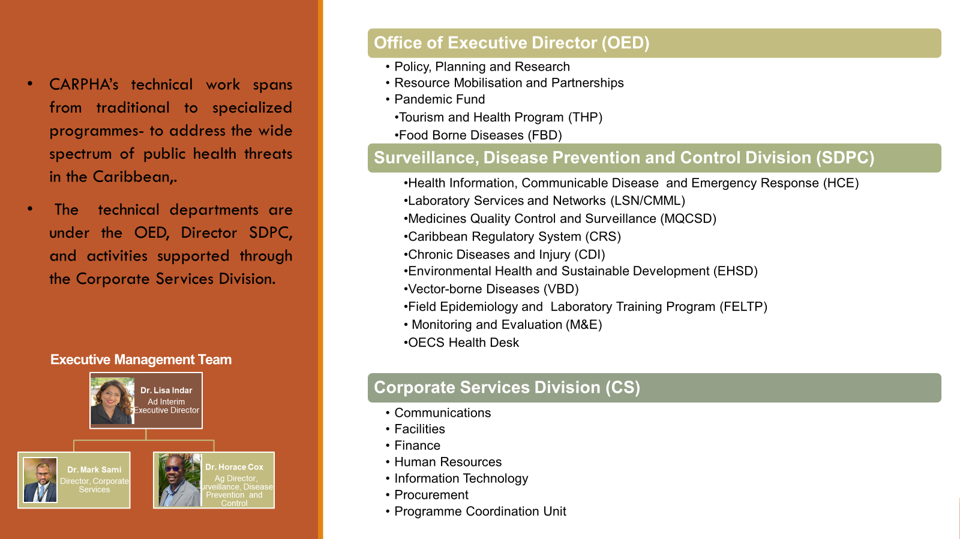
Notes:
The International Association of National Public Health Institutes was first envisioned in 2001 by Jeffrey Koplan former director of CDC and Pekka Puska (director general of Finland’s National Institute of Public Health and Welfare – THL ) and chartered in 2006. IANPHI was initially supported through grants from the Rockefeller Foundation and the Bill & Melinda Gates Foundation.
Professional and independent network of NPHIs, or “CDC’s of the world”, which provides a unique forum for peer-to-peer support and strategic exchanges amongst directors and senior staff
IANPHI’s mission is to collectively build public health capacity by connecting and strengthening NPHIs worldwide
The IANPHI Annual Meeting is the only worldwide forum where NPHI directors and partners come together to establish and strengthen relationships and share ideas and best practices on areas of mutual concern

Slide 4

Caribbean is challenged by many public health incidents and emergencies
Infectious Diseases Outbreaks
Natural Disasters
Man-made events
Amplified by Caribbean’s specific situation:
under-resourced populations, varying levels of surveillance, laboratory & response capacities,
interconnected, porous borders, high dependence on tourism vulnerability to disasters and climatic change,
COVID-19 (2019)
Zika (2016) Chikungunya (2013)
Cholera (2022)
Mpox (2022, 2024)
Influenza
H1N1(2009)
Norovirus
Measles (2024)
Dengue (2024)
Hurricanes:
Beryl (2024)
Dorian (2019),
Maria & Irma (2017)
Mathew (2016),
La Soufriere (2020)
Earthquake in Haiti (2010)
IMPACT on the Region’s capacity to prepare for and respond to public health threats that transcend national boundaries and result in epidemics or pandemics

Slide 5
CARPHA approaches Preparedness and Response (P&R) to Health Emergencies as part of Regional Health Security
RHS: Strengthening capacities and systems in CMS to prepare for and respond to public health threats and issues that transcend national boundaries & potentially impact on economic stability, trade, tourism, & access to goods & services
P& R and RHS is impacted by
Caribbean’s unique situation:
Under-resourced population
Interconnected, porous borders
Varying capacities levels
High dependence on tourism
Vulnerability to disasters, climatic change
Global & Regional diseases trends
To Improve P&R and RHS
Robust, regional, integrated
1. Surveillance & Early warning and response systems
2. Enhanced laboratory systems
3. Workforce capacities
4. Coordination & Partnerships
Crucial for effective response to PHEs and RHS in the region
Increases Region's exposure & risk to public health threats
&
rapid spread of infectious diseases across boundaries
Can possibly result in epidemics/ pandemics
Notes:
The International Association of National Public Health Institutes was first envisioned in 2001 by Jeffrey Koplan former director of CDC and Pekka Puska (director general of Finland’s National Institute of Public Health and Welfare – THL ) and chartered in 2006. IANPHI was initially supported through grants from the Rockefeller Foundation and the Bill & Melinda Gates Foundation.
Professional and independent network of NPHIs, or “CDC’s of the world”, which provides a unique forum for peer-to-peer support and strategic exchanges amongst directors and senior staff
IANPHI’s mission is to collectively build public health capacity by connecting and strengthening NPHIs worldwide
The IANPHI Annual Meeting is the only worldwide forum where NPHI directors and partners come together to establish and strengthen relationships and share ideas and best practices on areas of mutual concern

Slide 6




CARPHA’s Coordination for Regional Response to Public Health Threats
 | Regional Govermental Mandate for responding to PHEs Provides Regional Leadership, Coordination and advocacy for regional solidarity preparedness and response
 | Programs for detection, preparedness and response Communicable diseases and Emergency Response Medical Microbiology referral Laboratory Tourism and Health Vector-borne diseases Field Epidemiology training program.
 | Partnerships and Networks CDC, PAHO, UKHSA, PHAC,WHO,CDEMA, IMPACS, CTO, CHTA, OECS, IANPHI
 | Regional Coordinating Mechanism for Health Security (RCM-HS)
Health Systems and Mechanisms for strengthening RHS
Robust, integrated early warning & response surveillance systems
Strong laboratory systems
Capable workforce
Mechanisms to facilitate data sharing and response
Integration, coordination, communication
Partnerships
Integrated Surveillance strategy & systems
Regional Health Security Pathway (RHS)

Slide 7

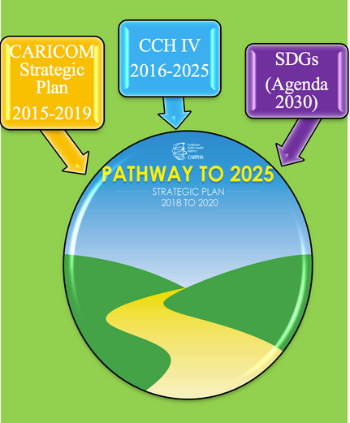

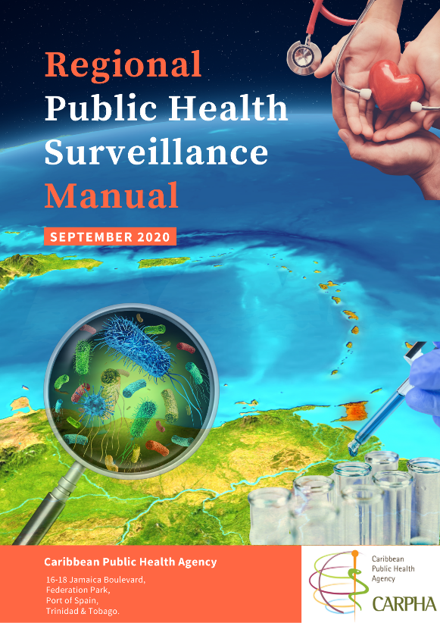
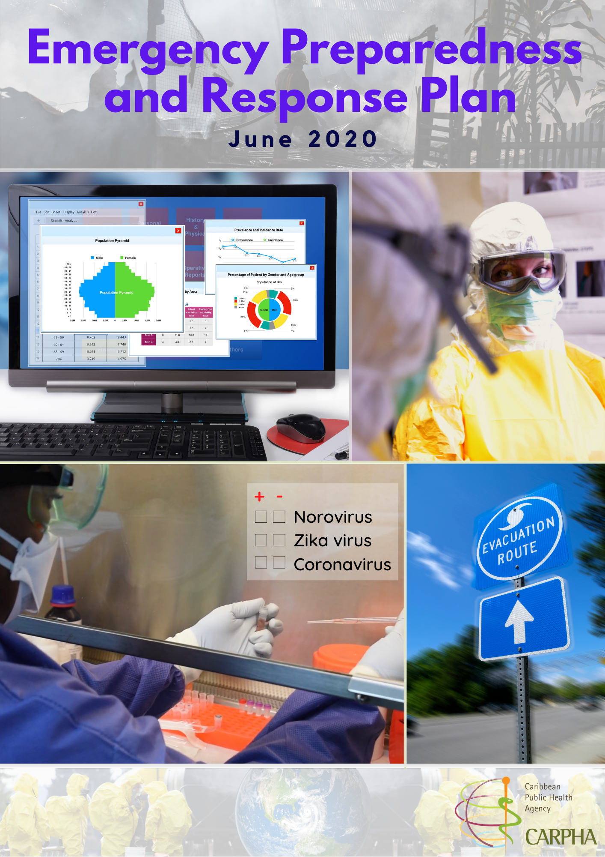

Strategies for CARPHA’s Emergency & Response Mandate
  Regional Integrated Surveillance Strategy
  Regional Public Health Surveillance Manual
  Emergency and Response Plan
  Regional Heath Security Pathway
  Approved: by CMOs, TAC, Ex Board, COHSOD
Leading Role
  Public health surveillance
  Public health emergencies

Slide 8
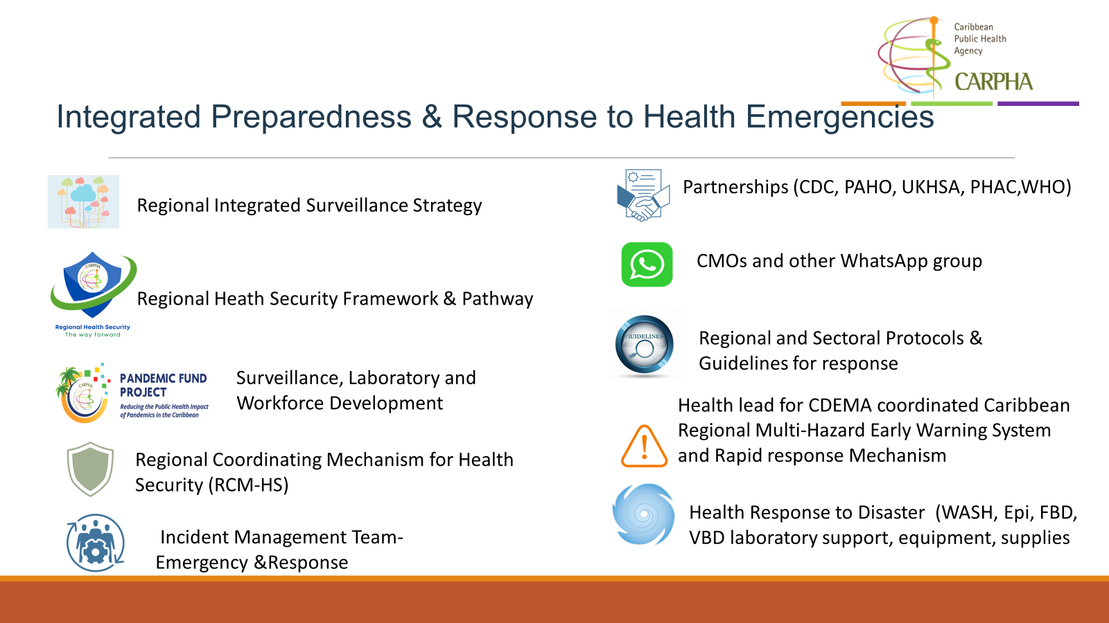
Integrated Preparedness & Response to Health Emergencies Tools
Notes:
The International Association of National Public Health Institutes was first envisioned in 2001 by Jeffrey Koplan former director of CDC and Pekka Puska (director general of Finland’s National Institute of Public Health and Welfare – THL ) and chartered in 2006. IANPHI was initially supported through grants from the Rockefeller Foundation and the Bill & Melinda Gates Foundation.
Professional and independent network of NPHIs, or “CDC’s of the world”, which provides a unique forum for peer-to-peer support and strategic exchanges amongst directors and senior staff
IANPHI’s mission is to collectively build public health capacity by connecting and strengthening NPHIs worldwide
The IANPHI Annual Meeting is the only worldwide forum where NPHI directors and partners come together to establish and strengthen relationships and share ideas and best practices on areas of mutual concern

Slide 9
Regional Response to Outbreaks and Emergencies Mechanism
Regional Emergency
Public Health Emergency
Disaster
(volcano, flooding, hurricane, etc.)
CARPHA leads response
CDEMA leads response under the Regional Response Mechanism
CARPHA responds according to requests
Governed by CARPHA Emergency Preparedness and Response Plan
Sectoral Coordination
Environmental
Shelter
Notify RCM-HS
Capacity Building
Laboratory
Surveillance
Health System
WASH Assessment
Country Response initiated – if requested
Notes:
The International Association of National Public Health Institutes was first envisioned in 2001 by Jeffrey Koplan former director of CDC and Pekka Puska (director general of Finland’s National Institute of Public Health and Welfare – THL ) and chartered in 2006. IANPHI was initially supported through grants from the Rockefeller Foundation and the Bill & Melinda Gates Foundation.
Professional and independent network of NPHIs, or “CDC’s of the world”, which provides a unique forum for peer-to-peer support and strategic exchanges amongst directors and senior staff
IANPHI’s mission is to collectively build public health capacity by connecting and strengthening NPHIs worldwide
The IANPHI Annual Meeting is the only worldwide forum where NPHI directors and partners come together to establish and strengthen relationships and share ideas and best practices on areas of mutual concern

Slide 10
CARPHA’s Key Multidisciplinary Responses
to
Regional Health Emergencies and Disasters
coordination, surveillance, laboratory , supplies, prevention & control, capacity building, risk communication, guidelines
Notes:
The International Association of National Public Health Institutes was first envisioned in 2001 by Jeffrey Koplan former director of CDC and Pekka Puska (director general of Finland’s National Institute of Public Health and Welfare – THL ) and chartered in 2006. IANPHI was initially supported through grants from the Rockefeller Foundation and the Bill & Melinda Gates Foundation.
Professional and independent network of NPHIs, or “CDC’s of the world”, which provides a unique forum for peer-to-peer support and strategic exchanges amongst directors and senior staff
IANPHI’s mission is to collectively build public health capacity by connecting and strengthening NPHIs worldwide
The IANPHI Annual Meeting is the only worldwide forum where NPHI directors and partners come together to establish and strengthen relationships and share ideas and best practices on areas of mutual concern

Slide 11
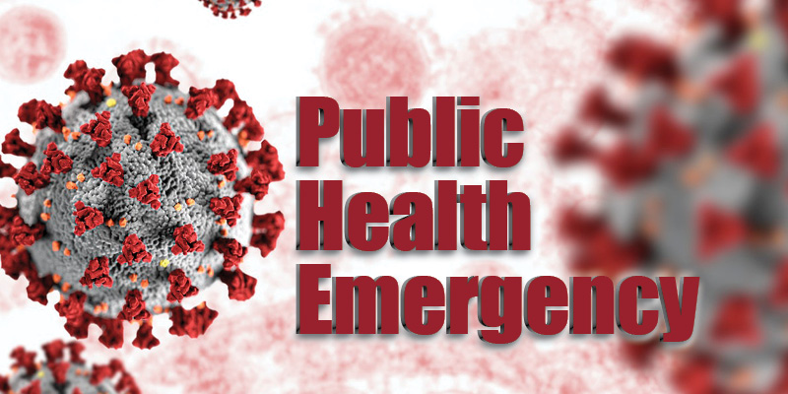
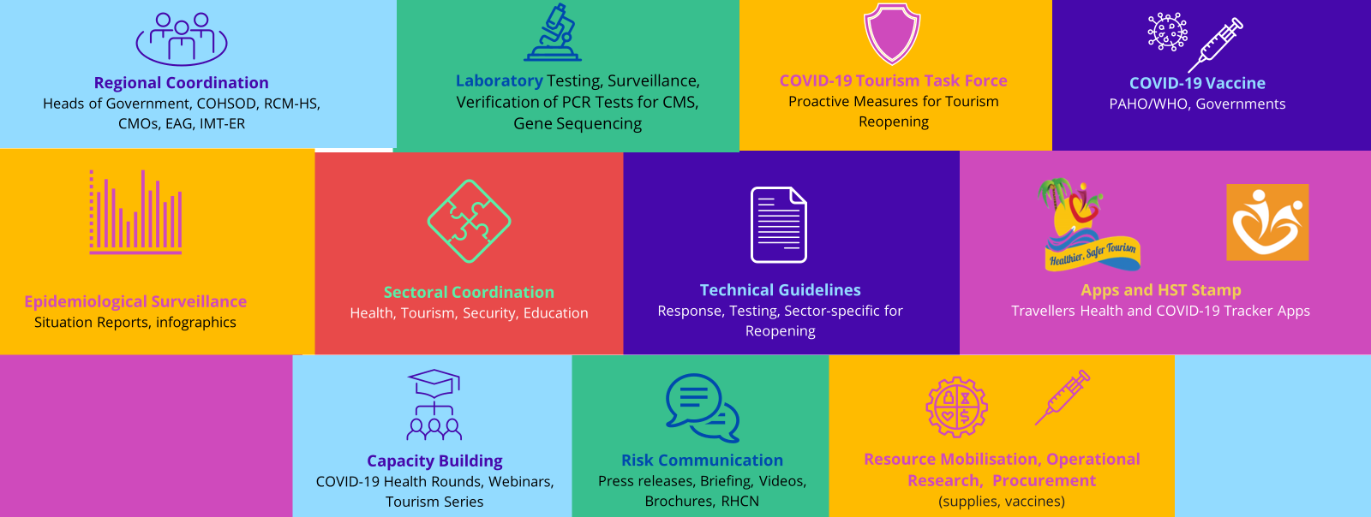
CARPHA’S Response to COVID-19
262 Situation Reports, 66 Technical Guidelines, 113 Vaccine Updates, 114 Countries Reopening Plans/Initiatives Updates, 11 CARICOM guidelines 175 infographics, Trained over 14K persons, 55 countries
Notes:
The International Association of National Public Health Institutes was first envisioned in 2001 by Jeffrey Koplan former director of CDC and Pekka Puska (director general of Finland’s National Institute of Public Health and Welfare – THL ) and chartered in 2006. IANPHI was initially supported through grants from the Rockefeller Foundation and the Bill & Melinda Gates Foundation.
Professional and independent network of NPHIs, or “CDC’s of the world”, which provides a unique forum for peer-to-peer support and strategic exchanges amongst directors and senior staff
IANPHI’s mission is to collectively build public health capacity by connecting and strengthening NPHIs worldwide
The IANPHI Annual Meeting is the only worldwide forum where NPHI directors and partners come together to establish and strengthen relationships and share ideas and best practices on areas of mutual concern

Slide 12






Complex situation: Layers of coordination with multiple Sectors
CARICOM Secretariat
Tourism
Business
06
01
Health
Ministers of Health
CMOs
05
Academia
Education
02
04
Security Sector
03
Maintaining Governance

Slide 13
Regional COVID-19 Health Response Tools
Knowledge and Expert Advice
Capacity Building
Promotion and Advocacy
Surveillance
Research
  PCR Testing
  Genome Sequencing
  Collection of Data
  COVID-19 dashboards
  Surveillance tools
  THiS
  CVSS
  Situation Reports
  Vaccine Updates
  Medicines Updates
  Lab Updates
  Technical Guidelines
  Infographics
  CariPHLN Bulletins
  VigiCARIB Newsletters
  Weekly summary of COVID-19 treatments
  Webinars
  Presentations
  Conferences
  Training sessions
  CARPHA COVID-19 Health Rounds
  CARPHA Operational Research
  Papers on CARICOM response
  Gap Analysis for CMS Readiness
  Vaccine Hesitancy Survey
  Annual Health Research Conference
  Videos
  Flyers
  Social Media Posts
  Boosts
  Testimonials
  CARPHA website
  Collaborations with PH Agencies, public and private sectors
  Media Releases

Slide 14
Response to Mpox PHEIC in 2024
Watching Brief ( Aug 16) & support CARICOM statement: Aug 22
Enhanced awareness & surveillance: : syndromic , visitor based & contact tracing , ports of entry, front line workers
Laboratory Testing and Guidelines
Tracking passengers from Africa (confidential: CMOs)
Enhanced daily global scanning agencies (IMPACS, CDC, UKHSA)
Immediate alerting and sending samples to CARPHA
Liaising with CMOs, Ministers of Health , Agencies
Optimize reporting and response mechanisms
Public awareness and vaccination
Risk communication and tailor specific messages

Slide 15
Emergency Chief Medical Officers Meeting, May 16, 2024
Measles Update/brief May 15, 2024
Laboratory testing, & provision of 2hour test during global cricket mass gatherings event
Laboratory, Training and provision of testing, supplies to CMS
Surveillance refresher in 7 CMS (ANT, DOM,GRN,GUY, SVG, STL, TTO)
SimEx using Measles
Coordination with PAHO EPI and other agencies
Rash and fever included in the Visitor-Based surveillance tool and in MGSS tools being used for the ICC T20 Men’s CWC, with once cases as an alert
Flag and urgently send samples fitting the profile to CARPHA for testing
Enhanced tourism-based surveillance for travellers arriving by air and sea
CARPHA’s Response to Measles
2 cases in May 2024,
First occurrence since 1991.
Risk of an infection from Measles in an unvaccinated person is higher now, post COVID-19
Urgent need to review Detection, Notification and Response actions and to communicate the guidelines widely again.

Slide 16
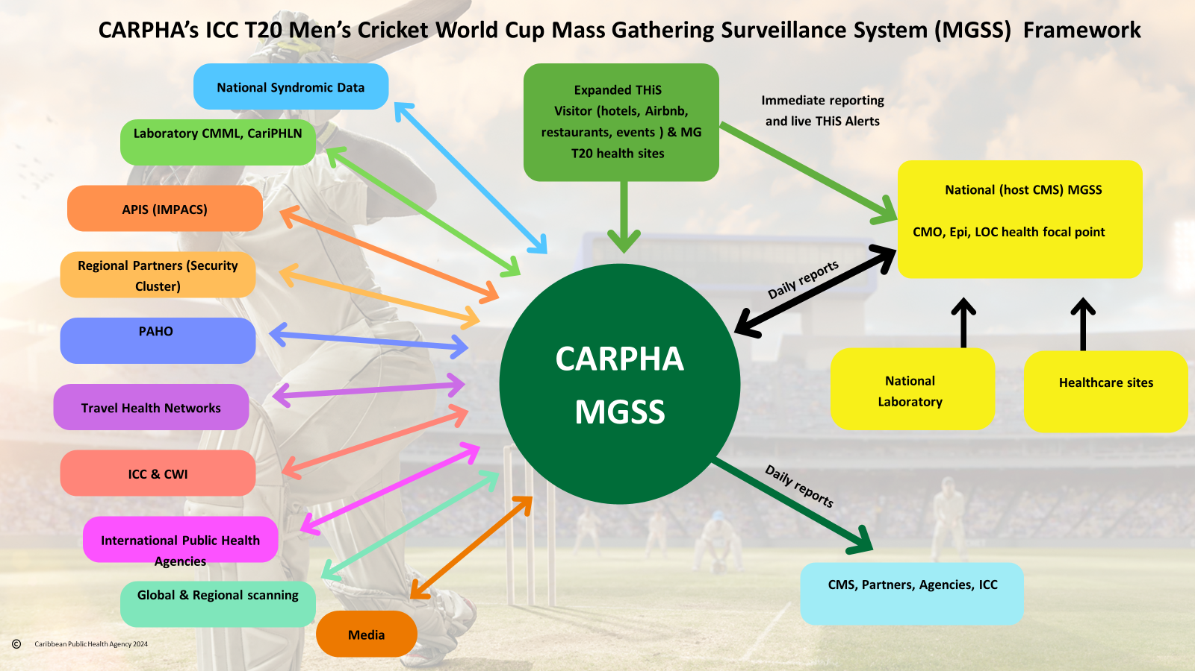
Response to Global T20 World Cup Mass Gatherings Event
Regional Collaboration: HSSC, CMOs, PAHO, IMPACS, RSS, CDEMA, CDC, UKHSA CWI , ICC
Simulation Exercises and File Hospital Training
Real-time web-based MG surveillance system : at stadium/event sites, selected health sites and at tourism facilities, allow for confidential, instant reports and alerts.
Mass Gathering surveillance and response training
Food safety, Prevention control training for infectious diseases, vector borne diseases
Daily reporting of syndromes from its local health facilities (including fever and rash) and daily laboratory reports
Daily global & regional scanning
Daily Health safety and security reports
Laboratory supplies to host CMS for priority pathogen (including measles and rubella testing)
Rik communications
Enhanced sectoral coordination: Health, Tourism, Security, Cricket
On site surveillance and laboratory support
‘Rapid response teams

Slide 17
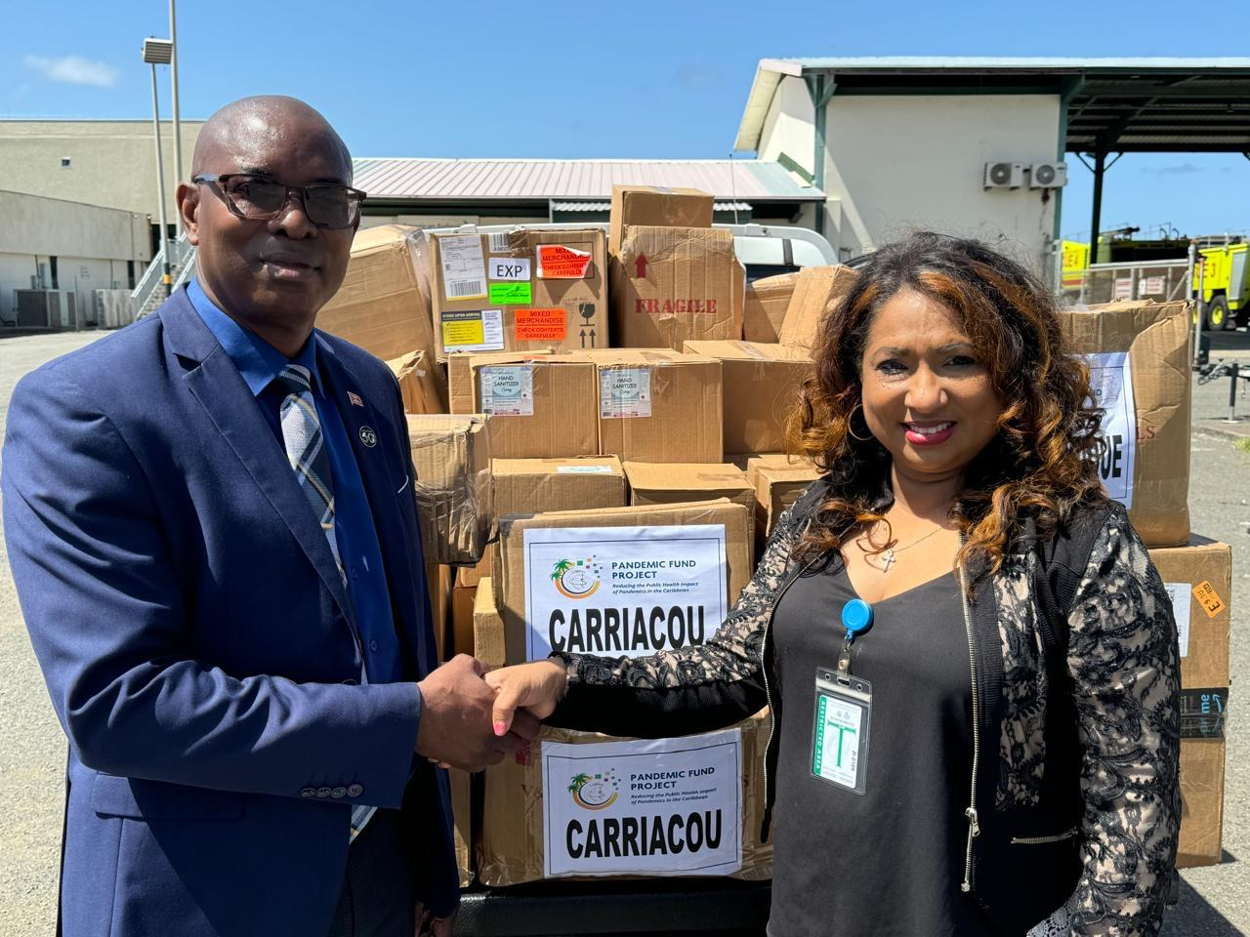
Health Response Post Hurricane Beryl
Letter of Support
Rapid health needs assessment
Laboratory, surveillance and response, technical guidelines, prevention and control of infectious diseases
Health and safety promotional materials
Shelter surveillance tools (digitalized)
Health Emergency Response Package to impacted islands
Technical Guidelines
Deployment
Public Health Emergency Supplies
Notes:
The International Association of National Public Health Institutes was first envisioned in 2001 by Jeffrey Koplan former director of CDC and Pekka Puska (director general of Finland’s National Institute of Public Health and Welfare – THL ) and chartered in 2006. IANPHI was initially supported through grants from the Rockefeller Foundation and the Bill & Melinda Gates Foundation.
Professional and independent network of NPHIs, or “CDC’s of the world”, which provides a unique forum for peer-to-peer support and strategic exchanges amongst directors and senior staff
IANPHI’s mission is to collectively build public health capacity by connecting and strengthening NPHIs worldwide
The IANPHI Annual Meeting is the only worldwide forum where NPHI directors and partners come together to establish and strengthen relationships and share ideas and best practices on areas of mutual concern

Slide 18
Executing Regional Pandemic Fund Grant to Improve Pandemic Preparedness, Prevention and Response
CARPHA's PF Regional Proposal Goal
Four Key Outcomes
Demonstrated capacity to prevent detect and respond to outbreaks through
Functional, integrated early warning & disease surveillance system in CARPHA and CMS
CARPHA and CMS are prepared to respond to public health emergencies
Increased cooperation in the Caribbean region for preparedness and response efforts
Sustained and/ or increased investments in domestic and external PPR funding
Effective stewardship or pandemic preparedness funds
Reduced Public Health Impact of Pandemics in the Caribbean Region

Slide 19
Activities for Outcome 1
Outcome 1: Demonstrated capacity to prevent detect and respond to outbreaks through Functional, integrated EWS surveillance system in CARPHA and in CMS, and CARPHA and CMS are prepared to respond to public health emergencies
Surveillance and Early Warning and Response
Laboratory systems
Workforce Capacity
Testing: expansion, capacity building and reagents
AMR: re-establishment of general AMR surveillance improvement, whole genomic sequencing (SS and training)
Sample Transportation: RSS & alternative means, courier services MOUs with regional carriers alternatively
Biosafety & Biosecurity: Assessments, policies and regulations, training in "infectious substances shipping"
Training for PPR via FELTP (frontline and intermediate level)
Regional Multisectoral Workforce Strategy: strategy and protocols, SOPs, tech guidelines, Min. Standards for animals, env. & human health staffing & implement strategy
Multi-sectoral workforce and establishing Regional Rapid Response Teams for surge capacity
Rapid Response teams
Conducting Health communications training
Electronic regional integrated surveillance system
Syndromic surveillance
Integrated FBD & zoonoses
Integrated VBD
Visitor-based surveillance
Event-based surveillance
Climate early-warning system
Preparedness and outbreak response via regional tools, simulation exercises, training, action plans
Regional Coordination
Date sharing mechanisms
Emergency Op Center

Slide 20
Activities for Outcome 2
Outcome 2: Increased cooperation in the Caribbean for preparedness and response efforts.
Convening of RHS and RCM-HS and other meetings with partners and countries for improved mechanisms for multi-agency collaborations for rapid and seamless coordination and information flow
Advancing and developing new partnerships and networks for EWS diseases notifications
Operationalization of the CariPHLN for laboratory networking with national laboratories
Developing a Regional Deployment Network with agencies and countries
Developing collaboration and data sharing agreement(s) with countries and key public health agencies
Convening of Chief Medical Officers (CMOs) Meeting for strengthening country collaborations

Slide 21




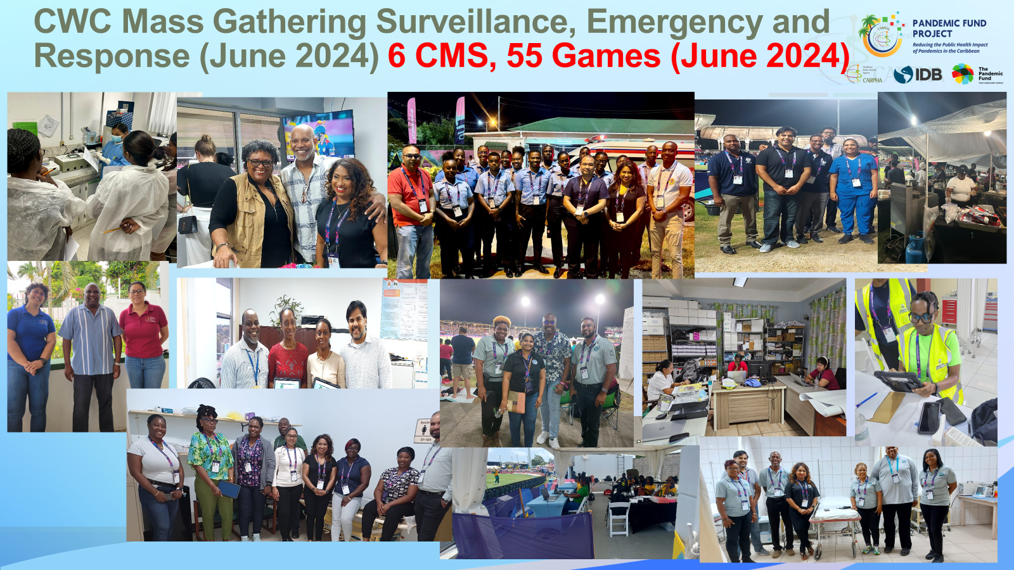
Results thus far
CWC E&R Mass gathering Event based surveillance
    Designed and implemented novel MGSS (COHSOD)
    In country Technical response: 51 games
    Partnerships for Surveillance & Response
    34 Daily Regional Heath Security Reports
    204 Daily surveillance country reports
    7 aggregated reports; Papers
    Report to the COHSOD
Enhanced testing via Molbio Kits
Tablets : 5/CMS for 5 6CMS
Public health response and supplies (beryl disaster)
PF stakeholder workshop (109 participants, 19CMS)
Advanced coordination & Partnerships
Visibility
Notes:
The International Association of National Public Health Institutes was first envisioned in 2001 by Jeffrey Koplan former director of CDC and Pekka Puska (director general of Finland’s National Institute of Public Health and Welfare – THL ) and chartered in 2006. IANPHI was initially supported through grants from the Rockefeller Foundation and the Bill & Melinda Gates Foundation.
Professional and independent network of NPHIs, or “CDC’s of the world”, which provides a unique forum for peer-to-peer support and strategic exchanges amongst directors and senior staff
IANPHI’s mission is to collectively build public health capacity by connecting and strengthening NPHIs worldwide
The IANPHI Annual Meeting is the only worldwide forum where NPHI directors and partners come together to establish and strengthen relationships and share ideas and best practices on areas of mutual concern

Slide 22
Why regional coordination
Keys to Regional coordination
The rapid transmission of COVID-19 to all Caribbean islands within a short period further emphasizes the vulnerability of the entire region to the spread of infectious diseases.
Consequently, pandemic prevention, preparedness and response (PPR) need to be improved not only at the national levels but t the regional level
Functional regional capacities are greater than the sum of the capacities of individual countries for improving PPR in the Caribbean
RCM-HS mechanism for regional coordination
Between agencies, countries, other stakeholders
Coordination
Communication
Trust
Information sharing
Mechanisms to facilitate the above

Slide 23
Thank you!

