Slide 1

Henry Walke, MD, MPH,
ORR Director, Centers for Disease Control and Prevention,
United States
G20 NPHI

Slide 2
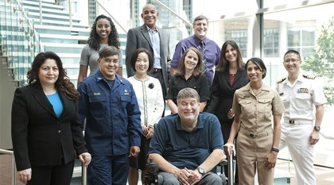
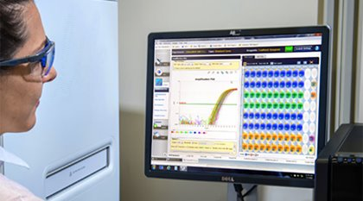
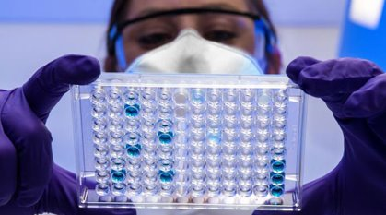
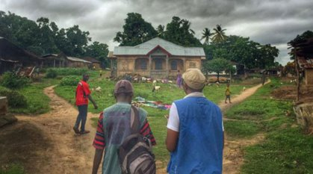
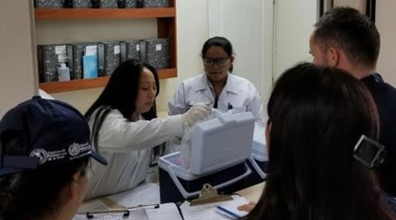
CDC Core Capabilities
Diverse public health workforce
Word Class & Analytics
State-of-the-art laboratories
Rapid response to outbreaks at their source
Strong global capacity & domestic preparedness
Notes:
The International Association of National Public Health Institutes was first envisioned in 2001 by Jeffrey Koplan former director of CDC and Pekka Puska (director general of Finland’s National Institute of Public Health and Welfare – THL ) and chartered in 2006. IANPHI was initially supported through grants from the Rockefeller Foundation and the Bill & Melinda Gates Foundation.
Professional and independent network of NPHIs, or “CDC’s of the world”, which provides a unique forum for peer-to-peer support and strategic exchanges amongst directors and senior staff
IANPHI’s mission is to collectively build public health capacity by connecting and strengthening NPHIs worldwide
The IANPHI Annual Meeting is the only worldwide forum where NPHI directors and partners come together to establish and strengthen relationships and share ideas and best practices on areas of mutual concern

Slide 3
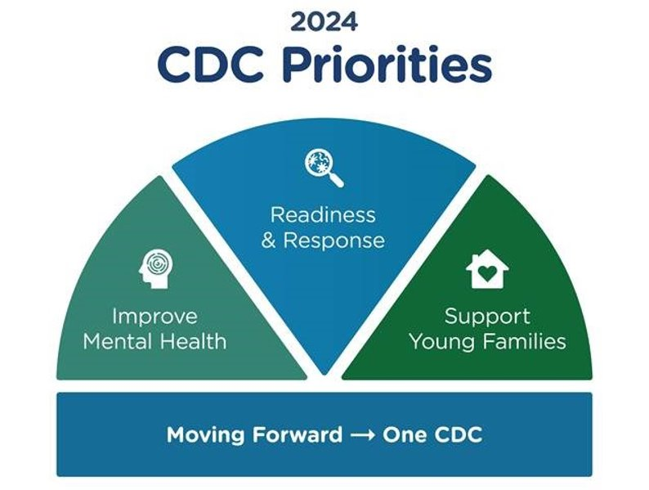

Slide 4






Reflections
Notes:
The International Association of National Public Health Institutes was first envisioned in 2001 by Jeffrey Koplan former director of CDC and Pekka Puska (director general of Finland’s National Institute of Public Health and Welfare – THL ) and chartered in 2006. IANPHI was initially supported through grants from the Rockefeller Foundation and the Bill & Melinda Gates Foundation.
Professional and independent network of NPHIs, or “CDC’s of the world”, which provides a unique forum for peer-to-peer support and strategic exchanges amongst directors and senior staff
IANPHI’s mission is to collectively build public health capacity by connecting and strengthening NPHIs worldwide
The IANPHI Annual Meeting is the only worldwide forum where NPHI directors and partners come together to establish and strengthen relationships and share ideas and best practices on areas of mutual concern

Slide 5
CDC's Office of Readiness and Response (ORR):
Mission & Aspiration​
“ORR will lead, promote, and integrate readiness and response programs, science, and policies that enable CDC to respond to public health threats at home and abroad.​​
We aspire to prepare CDC, the nation, and our partners to be ready to respond to all public health threats—whether such threats arise at home or abroad; to detect public health threats and immediately put readiness and response capabilities into action; and to respond with vigor and protect the nation’s health, safety, and security.”

Slide 6
Building Public Health System Capacity: ​
State, Local, and Federal Level

Slide 7
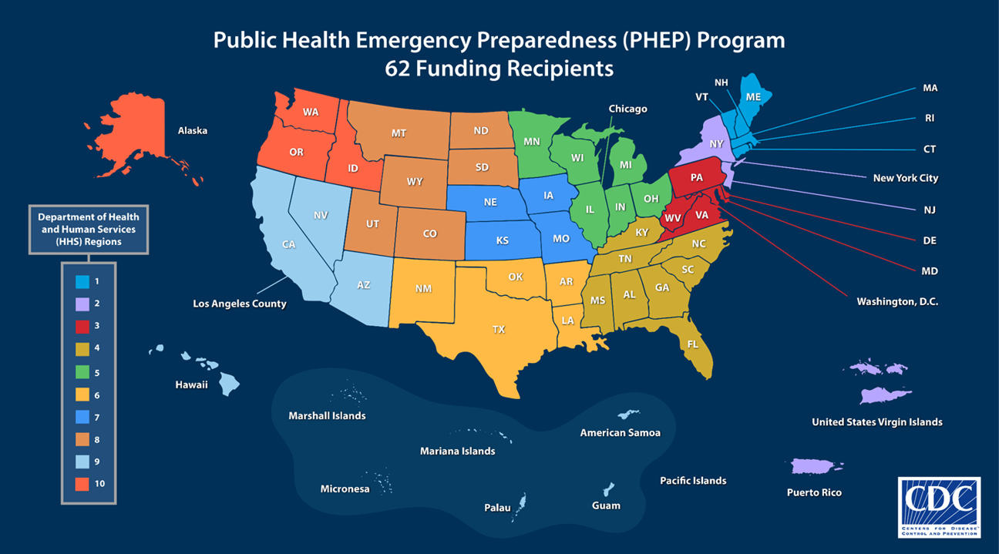

Slide 8
Public Health Response Readiness Framework​
2024-2028 PHEP Program Priorities - Defines Excellence in Response Operations
Develop threat-specific approach
to augment all-hazards planning, address evolving
threats, and support medical countermeasure logistics
Expand local support
to improve jurisdictional readiness to effectively manage public health emergencies
Build workforce capacity
to meet jurisdictional surge management needs and support staff recruitment, retention, resilience, and mental health
1
3
5
Enhance partnerships (federal and nongovernmental organizations) to effectively support community preparedness efforts
Improve administrative and budget preparedness systems to ensure timely access to resources for supporting jurisdictional responses
2
4
Modernize data collection and systems to improve situational awareness and information sharing with healthcare systems and other partners
Incorporate health equity practices
to enhance preparedness and response support for communities experiencing differences in health status due to structural barriers
Prioritize community recovery efforts
to support health department reconstitution and incorporate lessons learned from public health emergency responses
6
8
10
Advance capacity and capability of public health laboratories
to characterize emerging public health threats through testing and surveillance
Strengthen risk communications activities
to improve proficiency in disseminating critical public health information and warnings and address mis/disinformation
9
7
Notes:
The International Association of National Public Health Institutes was first envisioned in 2001 by Jeffrey Koplan former director of CDC and Pekka Puska (director general of Finland’s National Institute of Public Health and Welfare – THL ) and chartered in 2006. IANPHI was initially supported through grants from the Rockefeller Foundation and the Bill & Melinda Gates Foundation.
Professional and independent network of NPHIs, or “CDC’s of the world”, which provides a unique forum for peer-to-peer support and strategic exchanges amongst directors and senior staff
IANPHI’s mission is to collectively build public health capacity by connecting and strengthening NPHIs worldwide
The IANPHI Annual Meeting is the only worldwide forum where NPHI directors and partners come together to establish and strengthen relationships and share ideas and best practices on areas of mutual concern

Slide 9

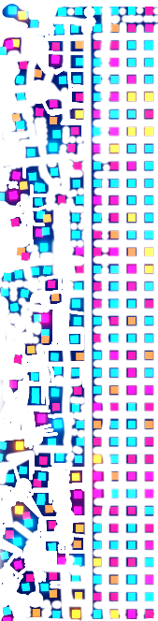
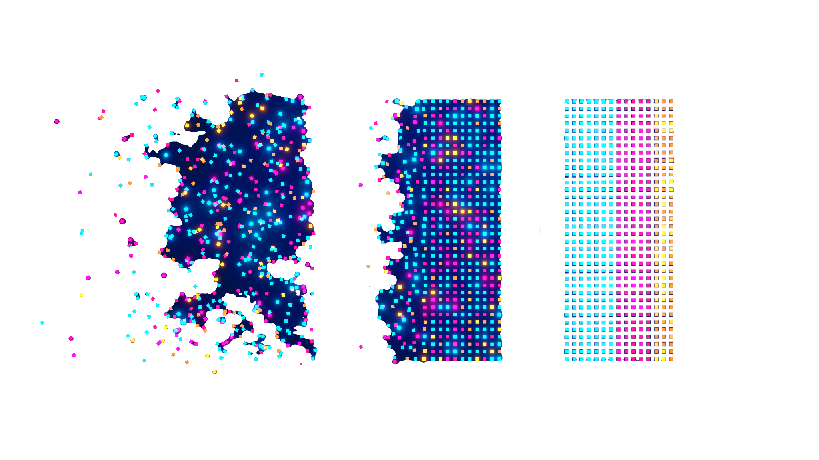

Improving Outbreak Response Data & Decision Making​
Data Modernization Initiative
Response Ready Enterprise Integration
Center for forecasting & Outbreak Analytics
DATA MODERNIZATION INITIATIVE
RESPONSE READY ENTERPRISE INTEGRATION
CENTER FOR FORECASTING & OUTBREAK ANALYTICS
Common operating platform with consolidated data sets
Advanced analytics to support response decision- making
Better, more complete, and more timely data
Collect & Modernize Core Public Health Data
Consolidate Outbreak Response Data
Analyze & Forecast for Decision making
Notes:
The International Association of National Public Health Institutes was first envisioned in 2001 by Jeffrey Koplan former director of CDC and Pekka Puska (director general of Finland’s National Institute of Public Health and Welfare – THL ) and chartered in 2006. IANPHI was initially supported through grants from the Rockefeller Foundation and the Bill & Melinda Gates Foundation.
Professional and independent network of NPHIs, or “CDC’s of the world”, which provides a unique forum for peer-to-peer support and strategic exchanges amongst directors and senior staff
IANPHI’s mission is to collectively build public health capacity by connecting and strengthening NPHIs worldwide
The IANPHI Annual Meeting is the only worldwide forum where NPHI directors and partners come together to establish and strengthen relationships and share ideas and best practices on areas of mutual concern

Slide 10
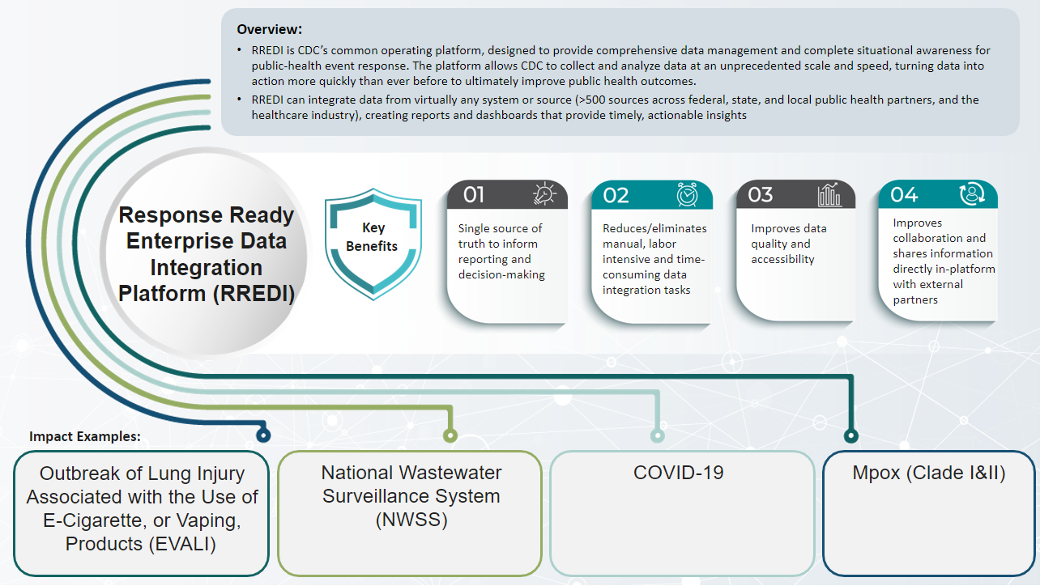

Slide 11
Thank you!
For more information, contact CDC
1-800-CDC-INFO (232-4636)
TTY: 1-888-232-6348 www.cdc.gov
The findings and conclusions in this report are those of the authors and do not necessarily represent the
official position of the Centers for Disease Control and Prevention.

