Slide 1
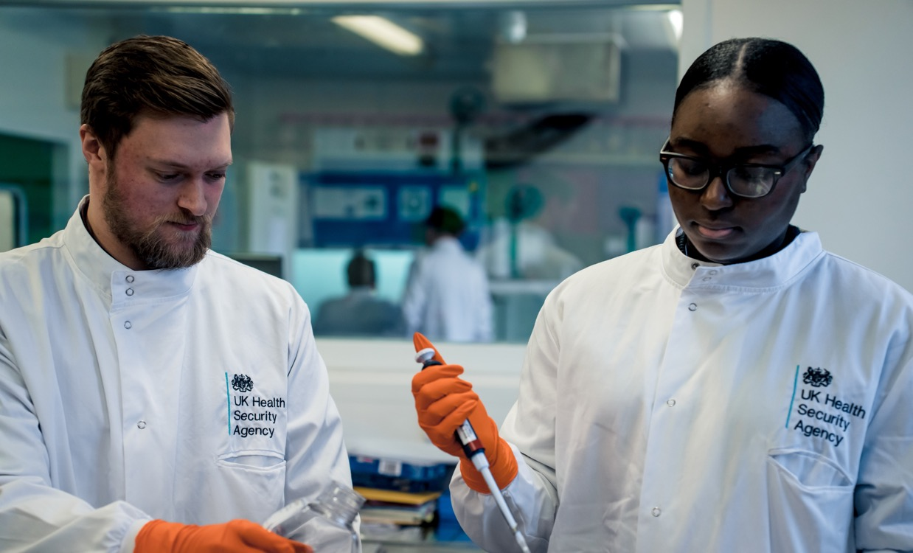
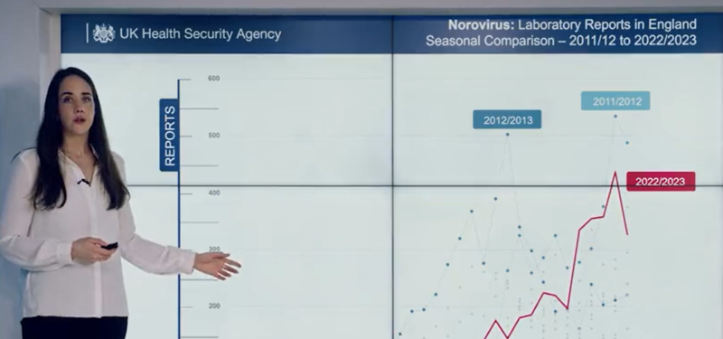


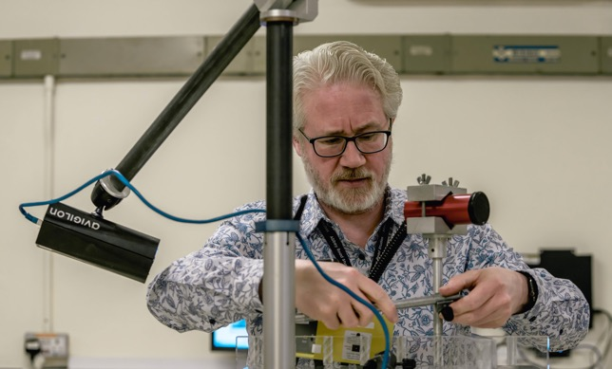
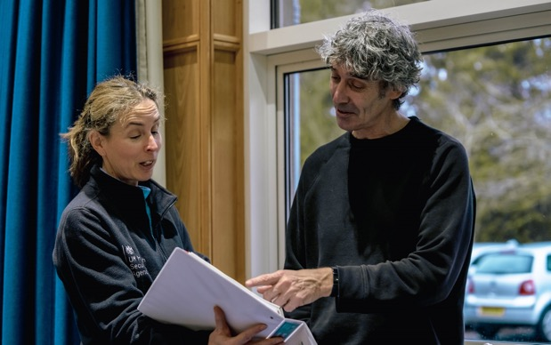
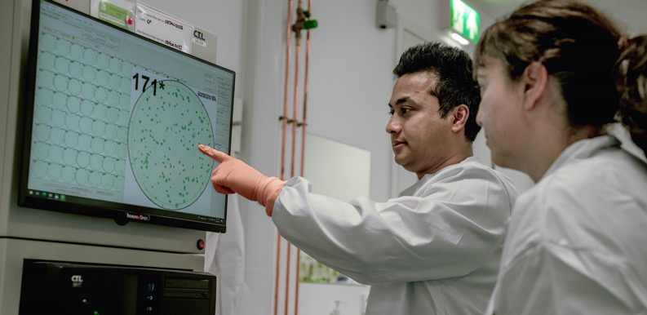

A UKHSA perspective on health emergencies
Professor Dame Jenny Harries
Chief Executive, UK Health Security Agency

Slide 2

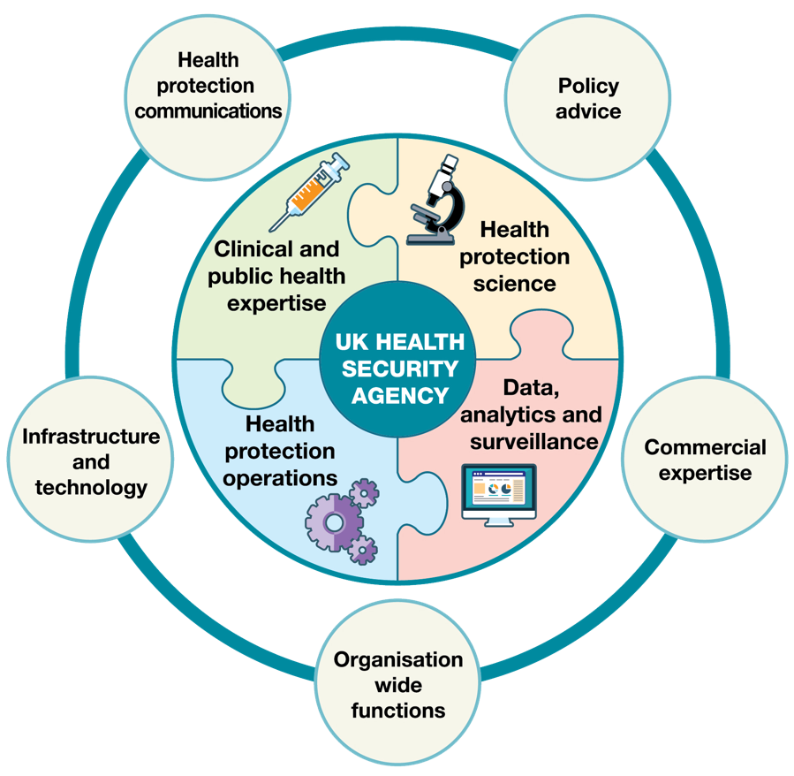
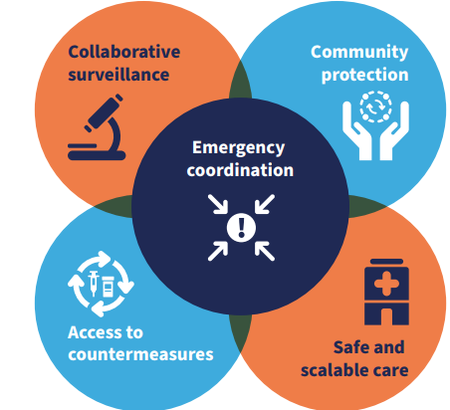
Strengthening health emergency prevention, preparedness, response and resilience. Geneva: World Health Organization; 2023. Licence: CC BY-NC-SA 3.0 IGO

Slide 3
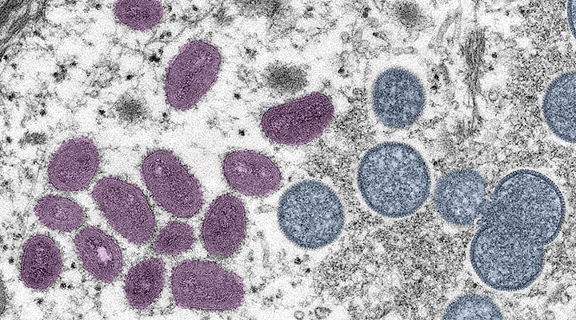
Case study 1:
Infectious disease
Mpox Clade II - 2022

Slide 4
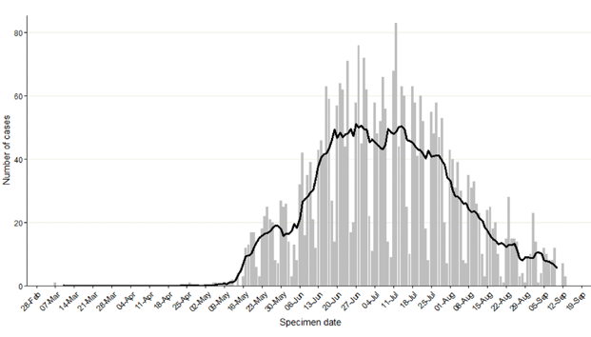
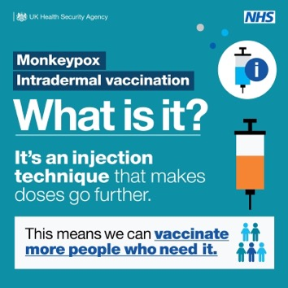


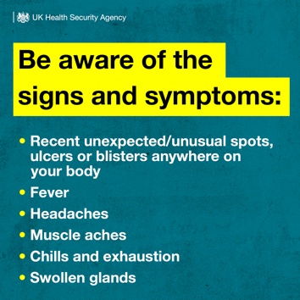
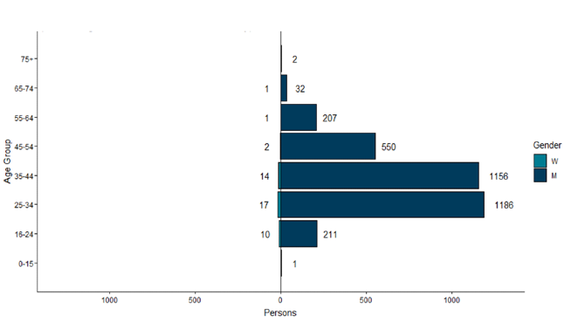



  Horizon scanning, systematic surveillance, notifying partners, scientific and specialist capabilities
  Incident management team, multi-level response, sharing information
Figure: Confirmed and highly probable monkeypox cases by specimen date* in England as of 16 September 2022
  Working in partnership, safe and equitable clinical guidelines and pathways
  Increasing access, research & development, evaluation
  Behavioural insights, risk communication, avoiding stigmatisation
Figure: Age and gender distribution of confirmed and highly probable monkeypox cases by lab result date in England as of 16 September 2022

Slide 5
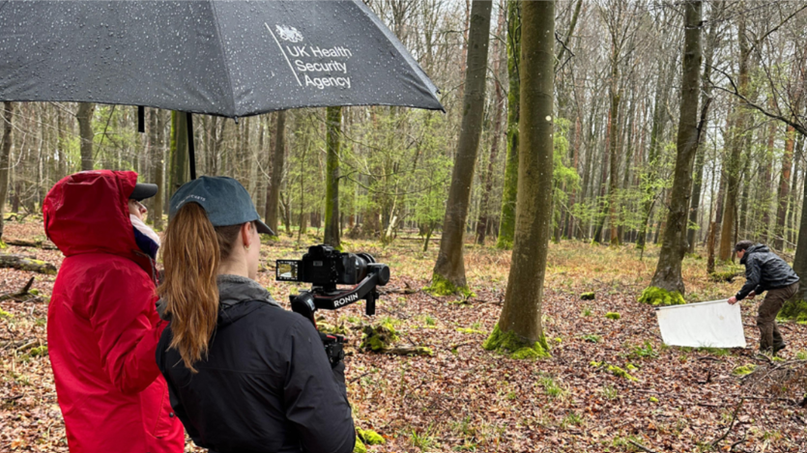
Case study 2:
Protecting health from threats in the environment
Health and climate

Slide 6
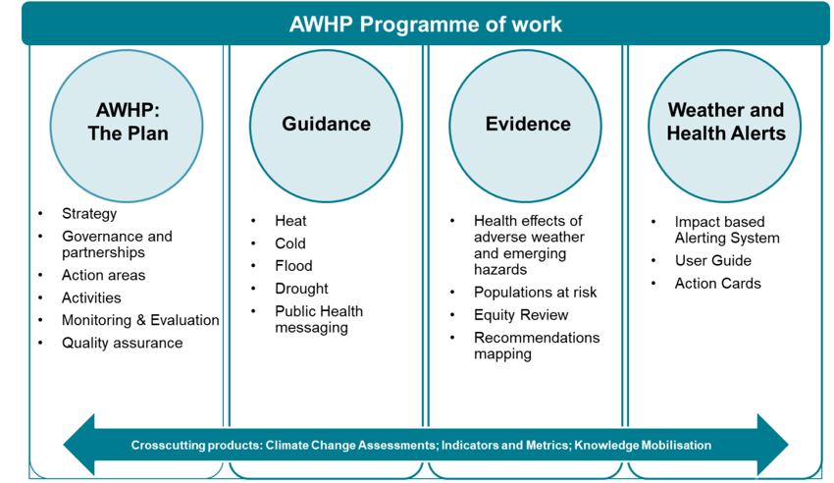
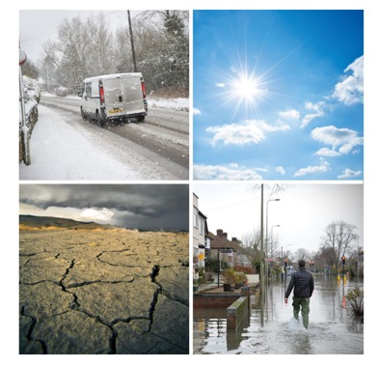
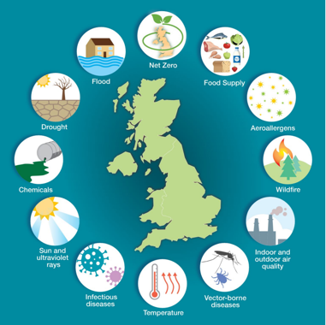
  All-hazards, One Health approach, publishing evidence and findings
  Whole-of-government, multidisciplinary approach at local, regional and global levels
  Developing system-wide plans to support local and national response which plan for the future
  Alerts and actions
  Early warning risk communication via multiple accessible platforms

Slide 7
Prepare.
Respond.
Build.

Slide 8
Thank you

