Slide 1


Preparedness and Response
to Health Emergencies in Singapore
Professor Vernon Lee
Executive Director, interim Communicable Diseases Agency, Singapore
9 September 2024

Slide 2
Threat of frequent and concurrent outbreaks
1995 | 2000 | 2005 | 2010 | 2015
2020
Legend
: Contained outbreak
: Ongoing spread in SG
: Ongoing spread overseas (possible import into SG)
COVID-1G 2020
≥ 2 incidents of EIDs per year
2% annual risk of COVID-like pandemic
Mpox 2019
2020: New mode of spread
↑ animal to
human
transmission
Measles 2018: Global resurgence
2019: Spillover to Singapore
Local
Zika 2016
2022
Influenza Pandemic (H1N1) 2009
SARS 2003
Nipah Virus 1998: Malaysia/Singapore outbreak
2001 to present: Sporadic outbreaks in India, Bangladesh. No import to Singapore.
Polio 2019
2019 – 2021:
Philippines
2022: Israel, US, UK,
Indonesia
|
2015: S. Korea
|
Overseas
MERS 2012
|
2012/3: S. Korea, Japan
|
Severe fever with thrombocytopenia syndrome (SFTS) 2009: Discovered in China, now with increasing geographical spread
|
H5N1 in the region (Vietnam, Thailand, China, Cambodia)
2017: 2019: Taiwan Vietnam
|
Avian Influenza 1996: H5N1 emerges in China, HK
H7N9 in China
Ebola 1994
Sporadic, limited outbreaks in endemic African countries
2013 – 2016: W. Africa,
cases exported to USA, UK, Spain, Italy
2018 – 2020: DRC and Uganda

Slide 3

Singapore has weathered various
2022: Mpox global outbreak
Cases detected in SG
2016 MDR-TB
cluster
Mass screening conducted for residents of Blk 203 AMK Ave 3
challenges over the years
2015 Group B
Strep outbreak
>300 affected, 2 deaths
2020-2023: COVID-19
pandemic
2014: West
Africa Ebola
Multiple dengue and
chikungunya outbreaks
Large dengue outbreaks in 2004, 2007, 2013, 2019-2020
Chikungunya outbreaks : 2008, 2013
2016 Zika global
outbreak
455 cases in SG between 27
Aug and 30 Nov 2016.
2015 MERS
Outbreak
Large outbreak in ROK, major
transport hub to Singapore
2009 Influenza A(H1N1) pandemic
2003: SARS global outbreak
Mar – May 2003: 238 cases, 33 deaths in SG

Slide 4

Next pandemic: A matter of “When” not “If”
Threat of pandemics and outbreaks persist – need to be ready for Disease X
Endemic infectious diseases need to be well managed
Critical to maintain our ability to rapidly and effectively respond to peacetime and crisis threats.
CDA to be established to focus on:
Building up strong public health expertise and organisational capacity
Better integration and coordination of public health functions to improve command, control and coordination
Activating rapid surge capacity in pandemics

Slide 5



Consolidating public health functions in CDA
Consolidate Public Health Functions Bolster Readiness for Disease X
Policy development for Prevention, Preparedness and Response
Surveillance and Outbreak Response
Data Analytics
Global Intelligence
Operations of CD Policies
National Public Health Laboratory
Research
Public Health Training s Education
Public Education on CD
National Immunisation Registry
Autonomous government agency established by an Act
End-to-end public health functions from policy to operations, closely working with clinical services at NCID
Accountable to MOH and its Board, depending on subject matter

Slide 6
CDA’s
strategic priorities
Reinforce Evidence- based Policy and Decision- Making Processes
Build Shared Identity and Foster Sense of Belonging
Take on More Prominent Role in Local Health and Whole-of-Govt Ecosystem
Build Robust and Effective Organisational Structures and Processes
Bolster Preparedness, Readiness and Response for ID threats
Forge Robust Regional and International Partnerships
Attract, Train, and Sustain a Capable Workforce

Slide 7

CDA’s key functions
Policy s Ops
National ID policy
Prevention, preparedness,
readiness and response
WOG PH Coordination
Public health lab capabilities
Data science analytics
AMR C One Health
Field training C public education
Research
National research on ID and PH for policy making
Programme of Research for Epidemic Preparedness and Response (PREPARE)
Catalysing Public Health (PH)
Responses
Global Engagements
Exchange of expertise and intel
Network of like-minded
Capacity building
Bilateral and multilateral
Outbreak Management s Control
National capacities for EIDs
Clinical guidance
Surveillance
Disease control programmes

Slide 8























Singapore’s public health ecosystem
Public Health
Entities
Clinical s Hospital Services
One Health
cal H s

Slide 9
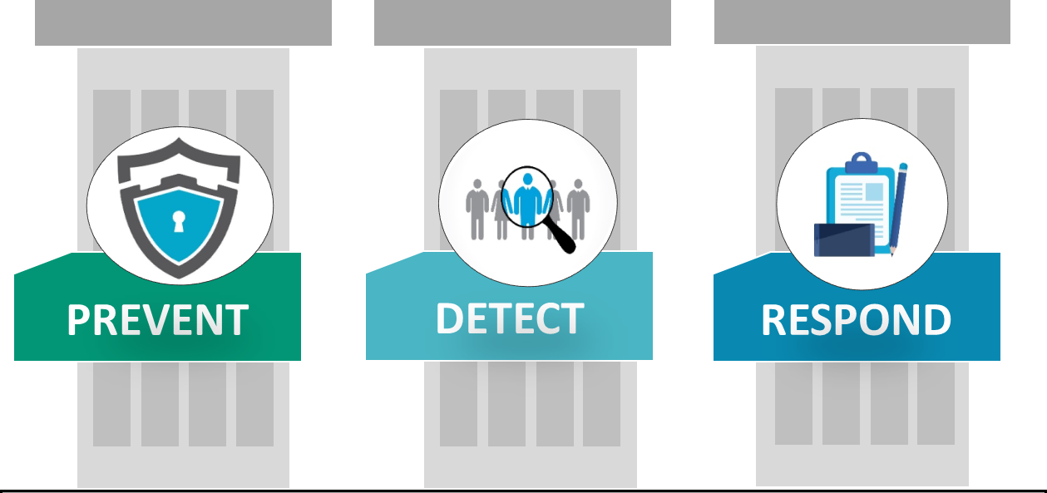
Working together in peacetime and crisis
NATIONAL CRISIS PREPAREDNESS
AND MANAGEMENT FRAMEWORK
 |  | Whole-of-government planning and coordination
 | Assessment, evaluation and capacity building
National legislation, policy and financing

Slide 10
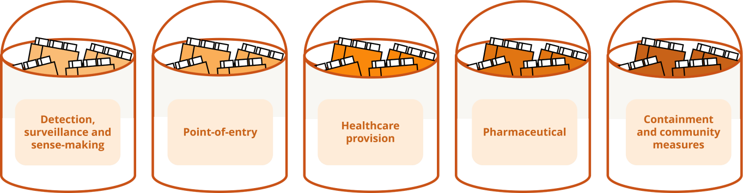
Plug-and-play modular pandemic preparedness approach
Disease X and other future pandemic threats may not adhere to characteristics of current known diseases
Current disease-centric plans are tailored to respond to known diseases; application
to novel outbreaks may be limited
A modular approach would allow us to respond nimbly to evolving knowledge of new
threats and known threats with customised measures and plans

Slide 11
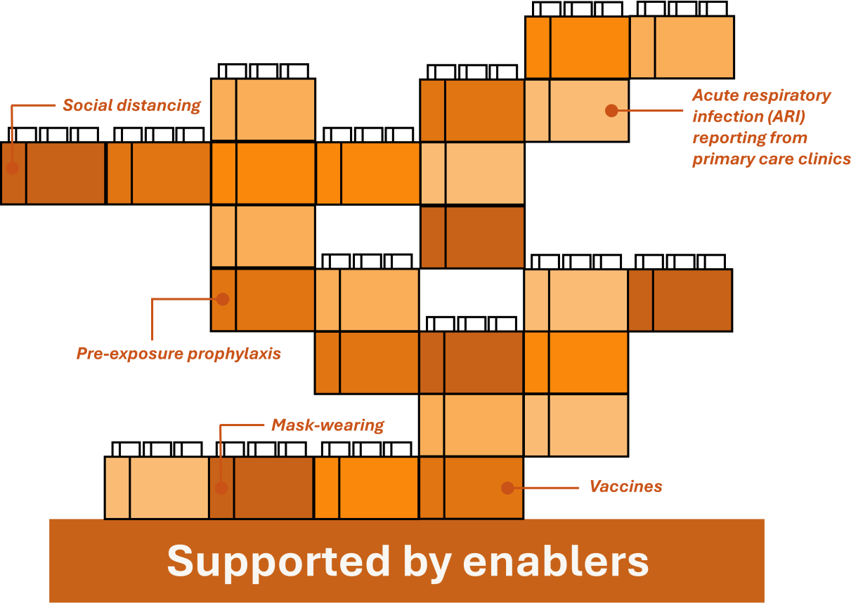
Building transmission-based plans using modules
Disease-agnostic modules can be selected and used for various diseases of the 5 major transmission modes, to form transmission-based plans
For instance, modules are selected for their effectiveness against droplet-borne diseases
Together, this set of selected modules
forms a droplet-borne disease plan

Slide 12
Whole-of government, whole-of society
approach towards pandemic preparedness
planning
Overarching strategy
PROTECTING LIVES AND LIVELIHOODS Intent Risk Assessment Risk Reduction Impact Mitigation
Detection, Surveillance s Sense- making | PoE Activities | Healthcare Provision | Pharmaceutical Intervention | Containment s Community Measures
Overseas Horizon Scanning Local Testing and Surveillance Predictive Modelling | Entry Requirements Overseas Travel Measures Immediate Post Entry Requirements | Case Management Care Model Infection Prevention and Control Healthcare Resource Management | Vaccination Therapeutics | Public Health Measures Environmental Measures Contact tracing and management
WOG Coordination ^{Rallying the Partnering the} Legislation Communications ^{International} Community Private Sector Engagements Research Finance/Fiscal Policies Technology Resources Environmental/Social Planning
Risk Communication s Community Engagement Communication strategies in a pandemic response towards objectives such as: (1) clear and transparent public communications, (2) address misinformation, (3) promote preventive behaviours, (4) deepen engagements with stakeholders and (5) maintain public confidence and trust in MOH and healthcare system/services
Systems
Tools
Enablers

Slide 13
Thank you!

