Slide 1
Prof. Hongbing Shen Director-General, Chinese Center for Disease Control and Prevention Deputy Director-General, National Disease Control and Prevention Administration, P. R. China
Optimize National Public Health Institutes in Safeguarding Global Health Security

Slide 2
Recognizing NPHIs’ central role in addressing public health security
NPHIs in over 100 countries
NPHIs provide workforce, expertise, and knowledge to health security matters :
1. NPHIs across the world have been at the frontline of the response to public health emergencies domestically and globally
2. NPHIs provide evidence-based advices in shaping public health security legislations and policies
3. NPHIs are leading the efforts of core capacity building for public health emergencies

Slide 3
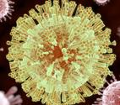
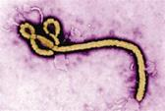
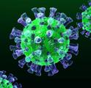
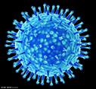
China CDC’s Field Response to public health emergencies
International
Plague in Malagasy
ZIKA ,Guyana
Diseases of unknown origin in Guyana
Ebola in Uganda
Hand, foot and mouth disease in Cambodia
Eobla in West Africa
Typhoon in Philippine
COVID-19, Iran, Italy, Iraq, Russia, Kuwait, Saudi Arabia
Earthquake, Nepal
Yellow fever in Agra
Ebola， Congo
2012
2013
2014
2015
2016
2017
2018
2019
2020
2021
2022
2023
2024
West Nile Virus Disease
Earthquake,Yiliang
PUA,Yunnan
H7N9
Earthquake,Lushan
Radioactive contamination of food in Xinjiang
Pneumonic plague epidemic in Jiuquan
Earthquake,Ludian
Poisoning by pseudomonas coir in Wenshan
MERS,Guangdong
Explosion at Tianjin Port
Earthquake,Shigatse
ZIKA
Rhabdomyolysis
Yellow fever
Rift Valley Fever
H7N9
Earthquake,Jiuzhaigou
Vaccine incident of Changsheng
VDPV Ⅱ in Xinjiang
Flooded in Sichuan and Gansu
VDPV in Sichuan
Explosion at the Xiangshui chemical plant
COVID-19
Flood disaster in related provinces along the Yangtze River
Earthquake, Yunnan and Qinghai
Earthquake, Sichuan
Mpox
Flood in Beijing, Tianjin and Hebei
Measles in Xinjiang
Domestic

Slide 4
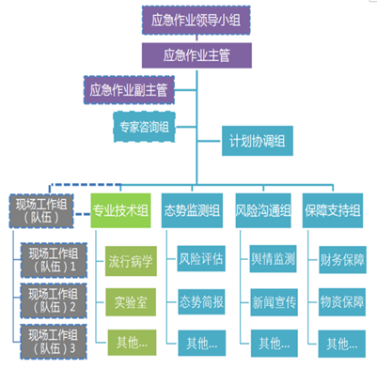
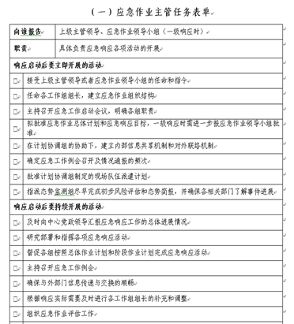
Emergency Response Framework
Public Health Emergency Operations Center in China CDC
IMS and key functions
Activation procedures
and levels
Requirements for operations
Job list for key roles
WATCH
ALERT
GRADE 3
GRADE 2
GRADE 1
Planning
Human resource and RRT management
Deployment
Security
Logistic
Confidentiality
Others

Slide 5
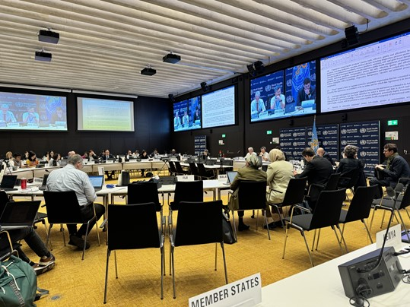
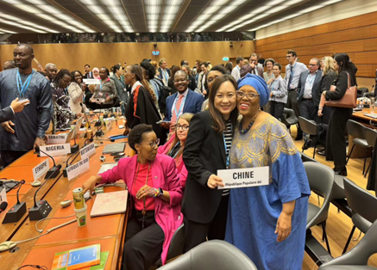
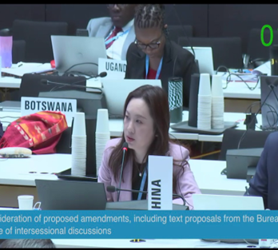
Contributing in shaping national and international legal instruments
The negotiation of legally-binding Pandemic Agreement is central to strengthen future pandemic PPR
Keep the momentum and commitment
Ensure meaningful public health provisions
More voices from NPHIs are needed in the negotiation room
China CDC deeply involved in the negotiation of WGIHR and PA
Develop and update national health security laws and strategies:
China CDC has drafted and submitted the National Infectious Disease Law, National Public Health Emergency Management Law and National Emergency Preparedness Plan for final approval

Slide 6
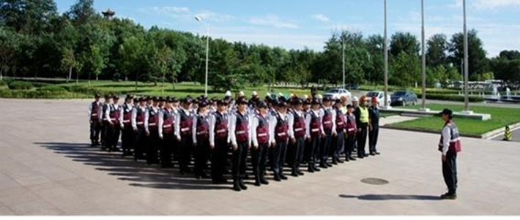
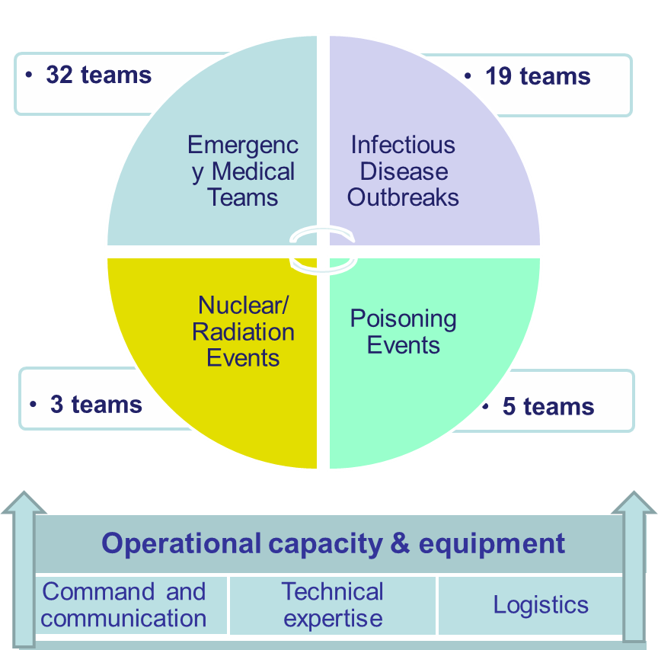
Building capacities of Rapid Response Teams (RRTs)
National RRT program launched in 2010
59 national teams have been developed in 31 provinces, including 20 infectious disease RRTs
4 RRTs in China CDC:
Infectious disease
Poisoning incident
Nuclear and radiation event
Natural Disasters
RRT standards, contingency plan and rapid deployment mechanism are in place
Conduct trainings and exercises every year

Slide 7
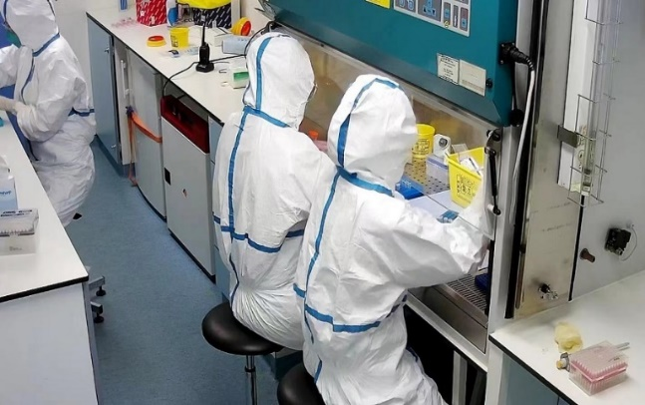
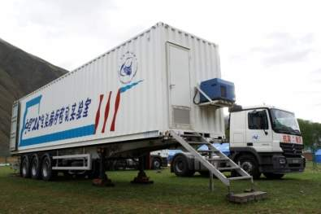
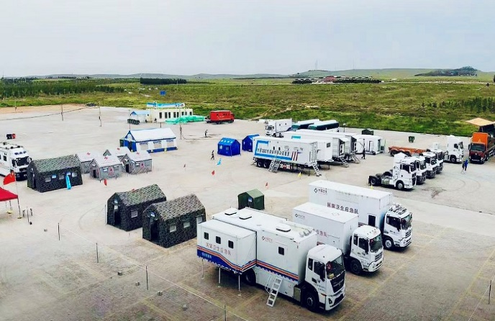
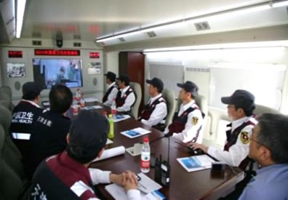
Develop rapidly deployable and self-sufficient mobile teams
Necessary equipment and logistic support for individuals, teams and camps
Mobile BSL-3
Mobile commanding center with satellite communication
Mobile logistics cabin: kitchen, shower room, sleeping room
Be prepared for future international missions and contribute to global workforce network
Joined the technical advisory group of and discussions with GHEC

Slide 8
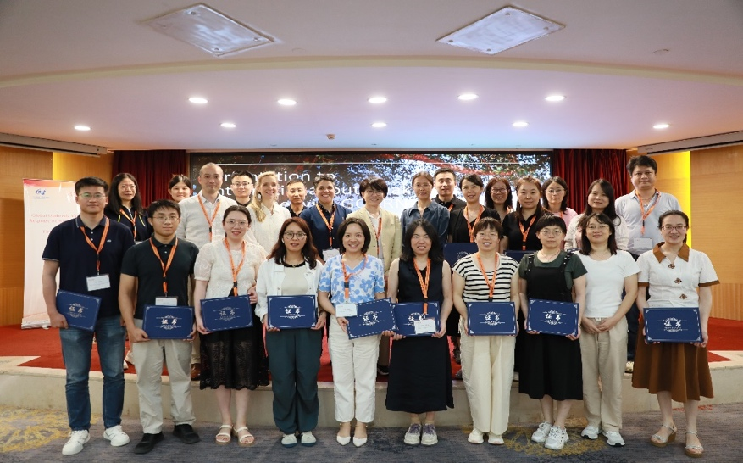
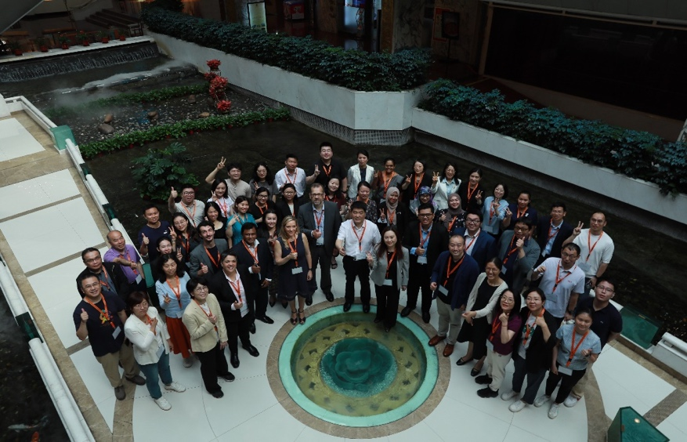
Bi-regional GOARN Tier 1.5 Training 18-20 June, 2024
Co-organized by China CDC, GOARN, and WHO WPRO, supported by RKI, Japan NIID, GD CDC
67 emergency responders participated in the training: Brunei Darussalam, Cambodia, China, Indonesia, Lao PDR, Malaysia, Singapore, Sri Lanka, Thailand and Viet Nam

Slide 9
National contest of health emergency technical skills
2024: epi investigation skills contest
Public health technical staff from 31 provincial CDCs
2017 contest: medical rescue, chemical poisoning, infectious diseases
2015 contest: chemical poisoning, infectious disease

Slide 10
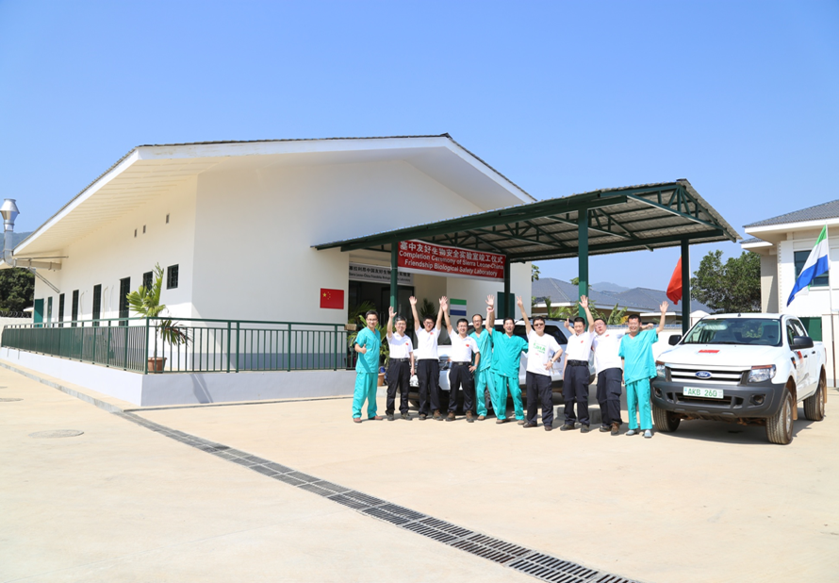
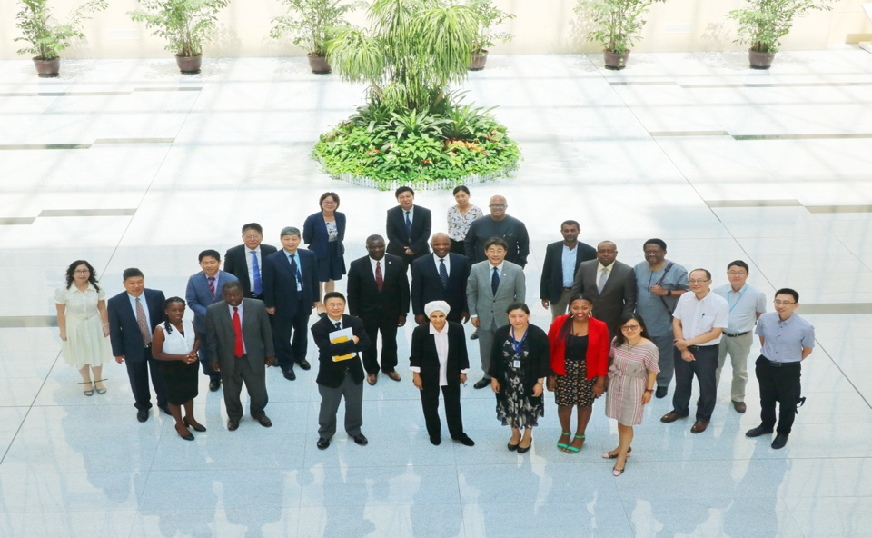
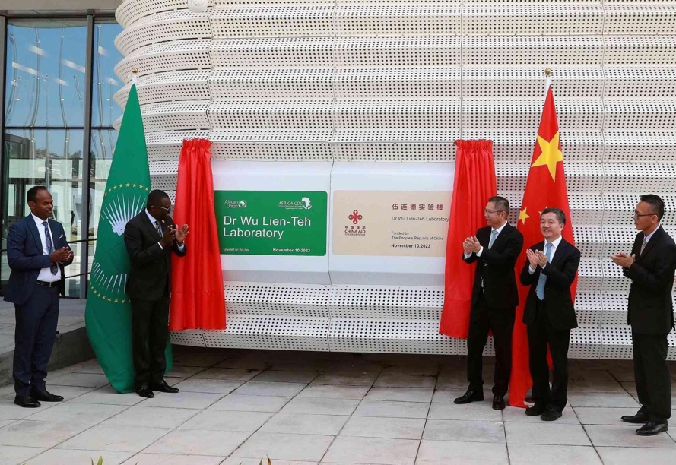
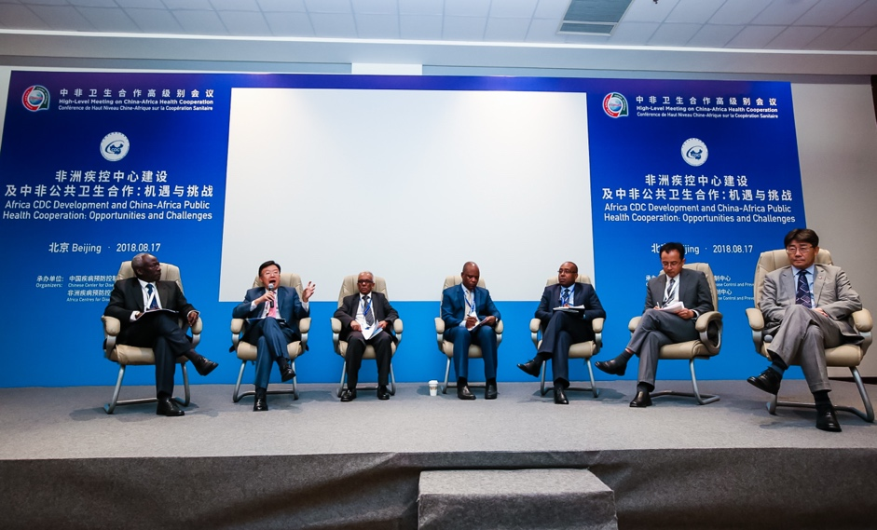
China-Africa Collaboration
Founding partner of Africa CDC
Joined the ACDC task force meeting and multinational working group meeting
Provided support in implementation plan drafting, RCC selection and external evaluation
Trained ACDC fellows
BSL-3 Laboratory in Sierra Leone
Since 2014, over 200 China CDC staff were deployed to the lab for short and long-term support
Assigned senior experts working in Africa CDC
2 experts per year
Convened high level meetings
Bilateral visit exchange between China and African countries

Slide 11
Thank you
Origado

