Slide 1

Dr. JOHN PAUL CLARK
Lead Health Specialist, Pandemic Fund
United States of America
THE PANDEMIC FUND
PRESENTATION AT THE CONFERENCE OF G20
NATIONAL PUBLIC HEALTH INSTITUTES

Slide 2

THE PANDEMIC FUND
  BACKGROUND
  FIRST 18 MONTHS
  STRATEGIC PLAN
  STRATEGIC PLAN
  LOO
  Use bullet points
  Keep it short and clean
Notes:
The International Association of National Public Health Institutes was first envisioned in 2001 by Jeffrey Koplan former director of CDC and Pekka Puska (director general of Finland’s National Institute of Public Health and Welfare – THL ) and chartered in 2006. IANPHI was initially supported through grants from the Rockefeller Foundation and the Bill & Melinda Gates Foundation.
Professional and independent network of NPHIs, or “CDC’s of the world”, which provides a unique forum for peer-to-peer support and strategic exchanges amongst directors and senior staff
IANPHI’s mission is to collectively build public health capacity by connecting and strengthening NPHIs worldwide
The IANPHI Annual Meeting is the only worldwide forum where NPHI directors and partners come together to establish and strengthen relationships and share ideas and best practices on areas of mutual concern

Slide 3
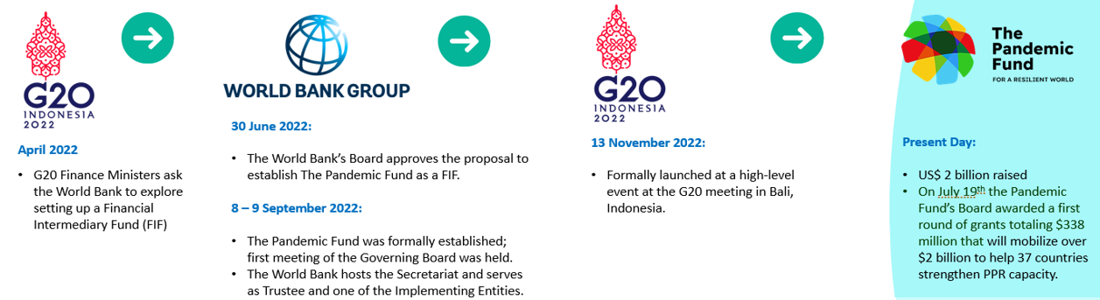
Background
COVID-19 showed how ill-prepared the world was to detect and contain a new virus threat
PPR continues to suffer from chronic under-investment.
Set up as a Financial Intermediary Fund, hosted at the World Bank, the Pandemic Fund is a first-of-its-kind, multilateral platform dedicated to making investments in pandemic preparedness during “peacetime”.
Specifically, the Fund was established to:
  Provide a dedicated stream of additional, long-term grant funding for critical pandemic PPR functions in LICs, LMICs and MICs, through investments and technical support at the national level, as well as at the regional and global levels.
  Support and reinforce capacity building and implementation of pandemic PPR under the IHR (2005) and other internationally endorsed legal frameworks, consistent with a One Health approach.
Second Call for Proposals launched December 22, 2023 with a $500 million envelope
Notes:
The Covid-19 pandemic spotlighted how ill-prepared the world was – and it highlighted the costs of being unprepared – millions of lives, jobs and livelihoods lost and reversals in hard-won economic and social gains. All this because we couldn’t detect and contain a virus from spreading.

Slide 4
The Fund’s mission is to ensure that in the face of the next health threat, countries have the surveillance capacity for early detection, laboratories that can quickly ramp up testing, a health workforce that can be rapidly deployed, and surge capacity that can be called upon to respond.
Incentivizes increased domestic investment by countries and catalyzes financing from multiple sources at the project-level
Leverages international financing for pandemic PPR from multilateral development banks, global health initiatives, United Nations agencies, bilateral agencies, the private sector, and others
Promotes coordination and collaboration among agencies engaged in PPR, and serves as an integrator to defragment the PPR landscape
Mobilizes funding from non-ODA sources (e.g., private philanthropies)
Serves as a platform for advocacy
13 implementing entities
Global Health Initiatives
  Bring in co-financing, integrate disease prevention into broader country-level programs
Multilateral Development Banks
  Provide sizable co-financing, incentivize domestic investment, foster cross-sector coordination, and promote integrated, systemic approaches through on-budget support.
UN Organizations
  Offer deep technical knowledge, normative guidance, and capacity building expertise in challenging environments and for vulnerable populations

Slide 5

The First 18 months
Pandemic Fund demonstrates its commitment to rapid roll-out with a commitment to continuous learning and improvement.
1
2
3
4
5
● Constituting documents ● Governance ● Operational and administrative structure and processes ●Secretariat
● Technical Advisory Panel (TAP)
● Raised over $2 billion in seed capital from 27 contributors
● Awarded US$ 338M in grants under first Call for Proposals
● Launched the second Call for Proposals: US$ 500M
● Independent Stocktaking Review and Evaluation of TAP and First Call for Proposals
● Recommendations incorporated into the design of the Second Call for Proposals.
● Developed the Pandemic Fund’s Medium-term Strategic Plan and Investment Case

Slide 6

Very strong demand for funding
Demand for financing far exceeds current available resources
First Round
Second Round
8x
An envelope of
$338 million
grant requests of ~$2.6 billion covering 133 eligible countries
9x
An envelope of
$500 million
grant requests of ~$4.5 billion covering 136 eligible countries
  1st round was oversubscribed by eight times
  2nd round was oversubscribed by nine times
Strong commitment among countries and regional bodies to invest sustainably in pandemic PPR.
Proposals submitted reflect hard work and strong efforts on the part of applicants, with evidence of:
all of government, all of society engagement in proposal preparation
co-investments from domestic resources and policy commitments to sustain impact
6

Slide 7
19 grants
(16 single-country, 3 multi-country/regional)
US$338M in PF funding
75% of grants to low income and lower-middle income countries
37 countries
$6 leveraged for every $1 of PF grant provided
Strong focus on One Health for prevention at source, on AMR surveillance, and on community engagement and CSO participation in project design and implementation
First Call for Proposals Overview
Icons taken from Flaticon

Slide 8
The Pandemic Fund Strategic Plan (2024-2029)
The Pandemic Fund brings additionality to pandemic PPR financing by catalyzing resources from diverse funders and promotes a more coordinated, cohesive, and comprehensive approach, creating a world that is resilient against the next pandemic.
Impact ambition
Recipient countries and regional/global networks are better prepared to prevent, detect, contain, and rapidly respond to pandemics over the next five years.
The Pandemic Fund’s impact will be measured by the following indicators: Number of recipient countries and regional/global networks with improved pandemic prevention, preparedness, and response capacity.

Slide 9
The Pandemic Fund’s Unique Value Addition
to the Global Health Architecture
  Filling capacity gaps by targeting discrete areas within pandemic PPR that would benefit from additional funding and coordination (e.g., One Health components of surveillance, laboratory systems, and workforce), strengthening institutional enablers for those areas, and embedding a focus on equity and inclusion, community and civil society engagement
  Fostering coordination across the range of pandemic PPR actors, across sectors in countries, and across countries and regions to share learnings, driving coherence in funding streams, and promote multi- sectoral collaboration for a whole-of- government, One Health approach.
  Mobilizing additive investment, by catalyzing co-financing from international partners, incentivizing co-investments from countries themselves, and attracting private sector investments, aligned with country/regional needs and plans, and thereby maximizing sustained investments in PPR.
  Demonstrating flexibility and responsiveness to evolving contexts and priorities within the pandemic PPR landscape to ensure strategic initiatives remain relevant and effective
Notes:
The initial set of projects financed by the Pandemic Fund are illustrative of its value proposition.
As the first multilateral financing mechanism dedicated to strengthening pandemic PPR in LICs and MICs, the Pandemic Fund represents a unique value proposition to the pandemic PPR landscape and broader global health efforts. The Fund adds value by filling capacity gaps, complementing the work of existing institutions, fostering coordination, mobilizing additive investments, and demonstrating flexibility and responsiveness.
Filling capacity gaps, by targeting discrete areas within pandemic PPR that benefit from additional funding and coordination, strengthening institutional enablers for those areas, and embedding a focus on equity and inclusion, community, and civil society engagement.
Complementing the work of existing institutions, as the Pandemic Fund channels grants to recipients through a variety of existing institutions, which are its Implementing Entities (IEs), leveraging their strengths and comparative advantages, and complementing efforts.
Fostering coordination and collaboration across the range of pandemic PPR actors, across sectors in countries, and across countries and regions, with the goals of sharing learnings, driving coherence of funding streams, and ensuring multi-sectoral collaboration for a whole-of-government, One Health approach.
Mobilizing additive investment, by purposefully deploying grant financing to draw in international and domestic financing, encouraging country planning and providing on-budget, catalytic resources aligned with country needs and planning processes and thus facilitating country ownership, absorption of investment, and long-term sustainability of resources.
Demonstrating flexibility and responsiveness to evolving contexts and priorities within the pandemic PPR landscape to ensure strategic initiatives remain relevant and effective.
In addition, the Pandemic Fund’s governance and operating structure include a strong focus on equity, inclusion, transparency, and accountability. The Pandemic Fund’s governance features 21 voting members, reflecting an equal balance of sovereign “contributors” (donors) and sovereign “co-investors” (countries that could receive funding), including a voting seat for non-sovereign contributors (philanthropies/foundations) and two voting seats for civil society organizations (CSOs)

Slide 10
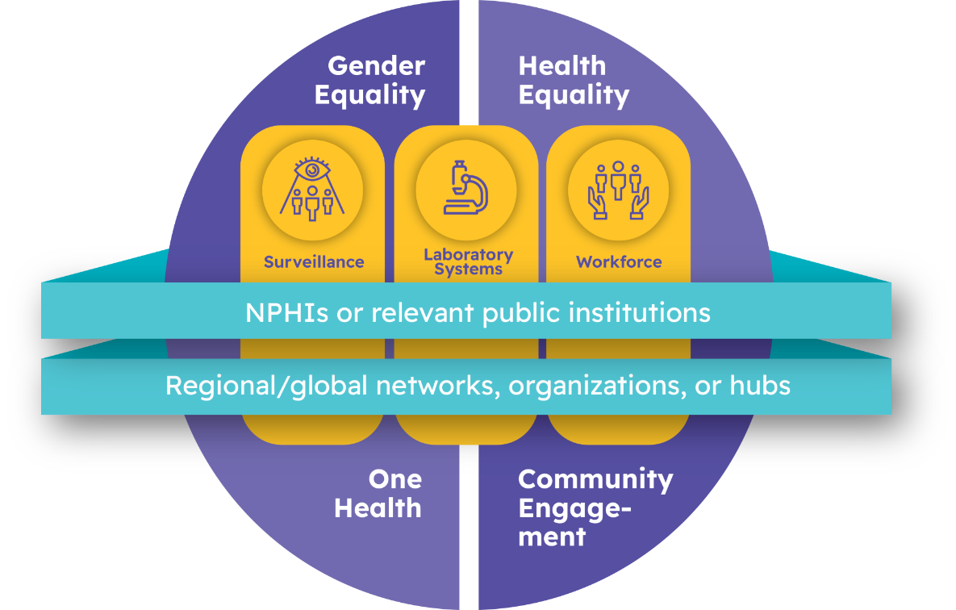
The Pandemic Fund Strategic Plan (2024-2029)
Focus areas
Three programmatic priorities
Surveillance, laboratory systems, and health workforce
Two cross-cutting enablers
National Public Health Institutes and
Regional/global networks, organizations, or hubs
Support the resilience and sustainability of the programmatic priorities.
Four underlying themes
One Health, community engagement, gender equality, and health equity

Slide 11
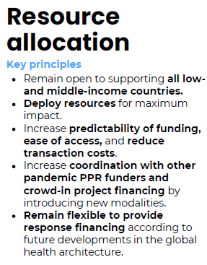
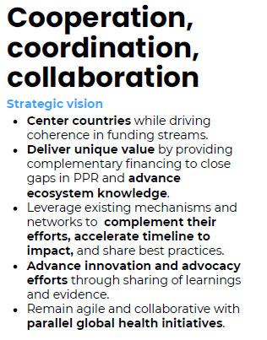
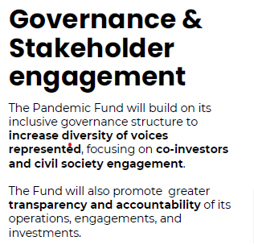
The Pandemic Fund Strategic Plan (2024-2029)

Slide 12
Looking Ahead
The Strategic Plan reaffirms the Fund’s commitment to playing a unique role in the pandemic PPR landscape
  supporting coordination in support of countries’ priorities, and
  empowering countries, regions, and the world to be better prepared to prevent, detect, contain, and rapidly respond to emerging threats.
The Fund is poised to further bridge capacity gaps, strengthen partnerships, and attract investments to amplify its impact.
Maintaining this momentum will require:
  Increased and sustained investment to help fill financing gaps across the Strategic Plan’s programmatic priority areas.
  A two-track approach to resource mobilization, including exploring innovative options to set it on a sustainable financing path.
  New partnerships to catalyze financing.

Slide 13
Thank you!

