Slide 1
Global Health Emergency Corps
Update for NPHI G20 side event, September 2024

Slide 2
IANPHI has been a major partner with WHO in developing the Global Health Emergency Corps
WHA launch – May 2023
IANPHI webinar – Nov 2023
IANPHI Kigali side meeting – Feb 2024
Consistent leadership from IANPHI

Slide 3
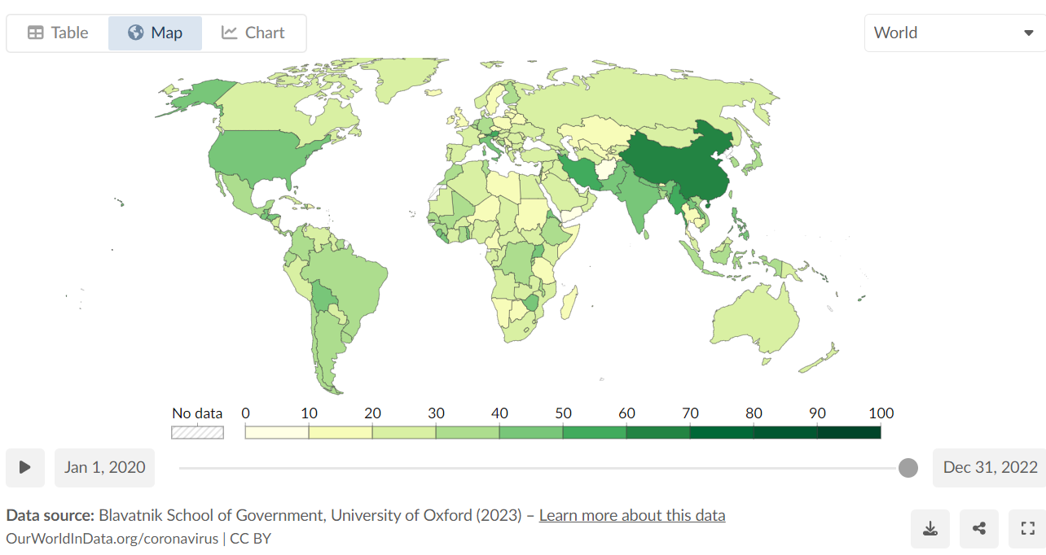
Wide variations in Covid-19 response measures

Slide 4
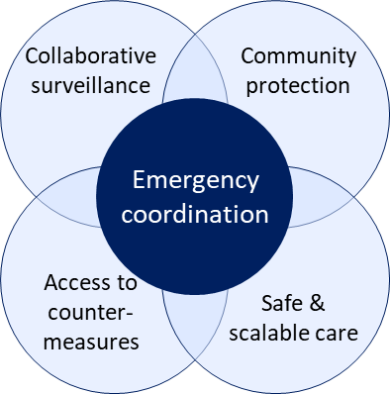
Review of major recommendations from GPMB, IHR RC, IPPPR, IOAC, national coalition reviews, others, with a focus on workforce, leadership, and alert and response coordination
Early alert for timely action
Ability to rapidly scale emergency response
Multisectoral approach
National coordinators and leadership
Regional coordination
Networking, partnership, and trust-building
Global coordination and the role of WHO
Connected leaders
Post Covid-19 recommendations
From the Independent Panel (IPPPR)
“Current institutions, public and private, failed to protect people from a
devastating pandemic…
That is why the Panel is recommending a fundamental transformation
designed to ensure commitment at the highest level to a new system
that is coordinated, connected, fast-moving, accountable, just, and
equitable—in other words, a complete pandemic preparedness and
response system on which citizens can rely to keep them safe and healthy”
Health emergency workforce
National action plans for prevention, preparedness & readiness
Rapid alert & response coordination

Slide 5
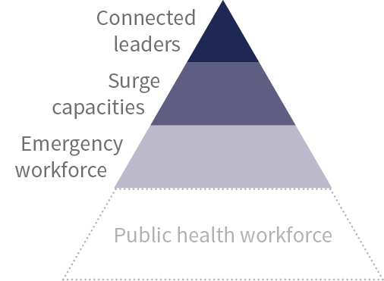
Global Health Emergency Corps | Why “Corps”?
Corps - A body of persons having a common activity or occupation. e.g., the press corps
- Merriam-Webster dictionary
Health Emergency Corps
A body of health emergency professionals in all countries with common training and standards who are globally connected and work together in times of international health crises to:
Strengthen responses to all health emergencies, and
Stop the next pandemic
Composed of:

Slide 6
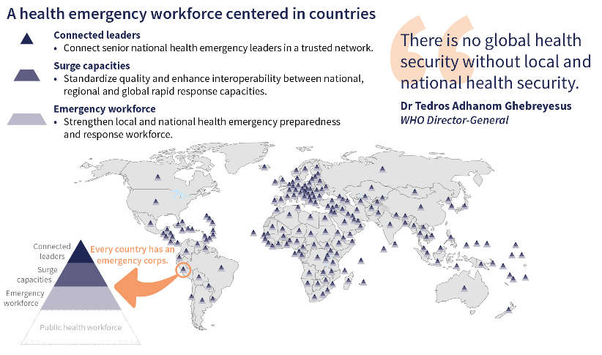
GHEC | Provides a framework for strengthening workforce capacities for health emergencies
A health emergency workforce centered in countries…
Decisions on national response will always remain with each country.
The greatest single asset in health emergency response is the workforce.
Building capacity and coordination across the three levels will strengthen all health emergency responses.

Slide 7
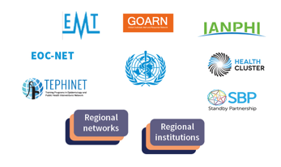
GHEC | Provides a collaboration and coordination platform for countries and health emergency networks
… and coordinated regionally and globally
No country can stop a pandemic by acting alone.
Coordination in emergencies is most efficient with pre-established relationships and trust.
Strong models for collaboration exist but need to be better connected, interoperable and brought together in a coherent and complementary manner

Slide 8
GHEC | Progress in 2024
Strategic alignment and collaboration at global level
Establishment of the GHEC secretariat at WHO Headquarters and the maintenance of a global GHEC working group that includes 7 global health emergency networks and 6 WHO regional emergency leaders
Initiation of a GHEC Design Group with country and network leaders to develop process for operationalizing the GHEC over time
Supporting language included with broad endorsement in the draft article 7 of the Pandemic Accord; supporting language in IHR amendments
Launch of a globally inclusive process to establish common guidance and benchmarks for national rapid response capacities
Acceptance and adaptation at regional level
Establishment of dedicated teams/ secretariats in each of the 6 WHO regional offices
Adaptation of the GHEC framework to regional priorities and strategies: Joint Emergency Action Plan (A CDC-WHO); Asia Pacific Health Security Action Framework (APHSAF), South East Asia Health Emergency Workforce Strategy development, EURO Preparedness 2.0 strategy
Leadership and ownership at national level
Financial ask of approx. USD 318m of GHEC-related activities* were included in Pandemic Fund proposals
* activities corresponding to strengthening connected leadership, surge capacities and/or emergency workforce capacities
National level support to strengthening integration and interoperability of rapid response capacities at country level, with focus on Emergency Medical Teams and Public Health Rapid Response Teams (Ethiopia, April; planned: Uganda, Jordan, Egypt, Tajikistan)
Tabletop exercise on National Health Emergency Corps included in full-scale regional disaster response exercise in Central America (Costa Rica)

Slide 9
GHEC | Outlook
Demonstrating impact:
Multi-country pandemic response simulation exercise to practice and test key components of the GHEC with focus on emergency response at the national level, more effective surge responses, and a functioning network of leaders
Broadening country support
gain ownership by growing number of countries
Ensuring financing
Fundraising to follow on initial seed funding

Slide 10
Key Interventions for the G20 Ministers to Consider
Agree to act in solidarity against health emergencies and pandemics by applying the common GHEC framework and engaging NPHAs, in alignment with Brazil’s prioritization of collective health
Prioritize equity in the production and distribution of pandemic countermeasures and in sharing of information and best practices through the IANPHI and GHEC leaders’ networks

