Slide 1
West Africa PHEM Workshop
Africa CDC
Dr. Raji Tajudeen

Slide 2
Background
One of the mandates of Africa CDC is to facilitate and support Member States in capacity building for enhanced preparedness and prompt response to public health emergencies.
PHEM is in alignment with Emergency Preparedness and Response pillar of the Africa CDC 5 year strategic plan.

Slide 3
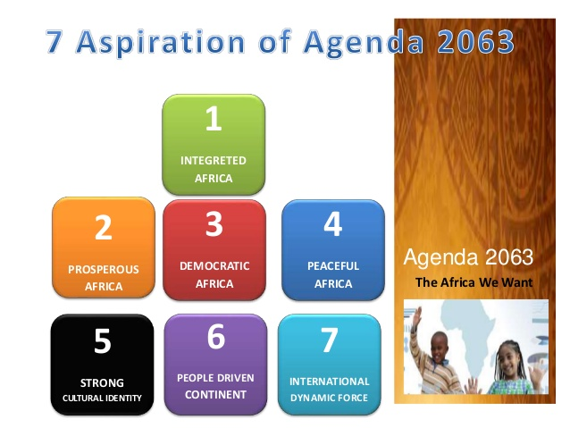
The AU Agenda 2063
“By 2063, Africa will be rid of all the neglected tropical diseases and all infectious diseases, such as Ebola, will be fully brought under control. Robust, integrated systems will be in place to significantly reduce communicable and non-communicable and lifestyle changes related diseases, including obesity, diabetes, cardiovascular diseases, and deaths from HIV/AIDS, Malaria and Tuberculosis will be reduced to zero – Aspiration 1, Goal 3.”

Slide 4
African Health Strategy 2016 – 2030
The strategy calls for a new paradigm for the establishment of effective disaster preparedness and response management.
It urged Member States to strategically focus on disease surveillance, preparedness and response in line with the IHR (2005).

Slide 5
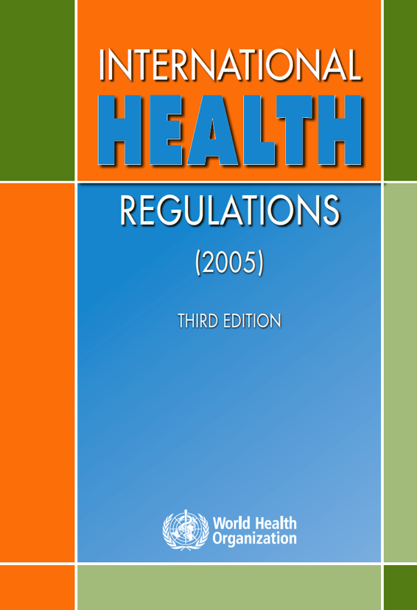
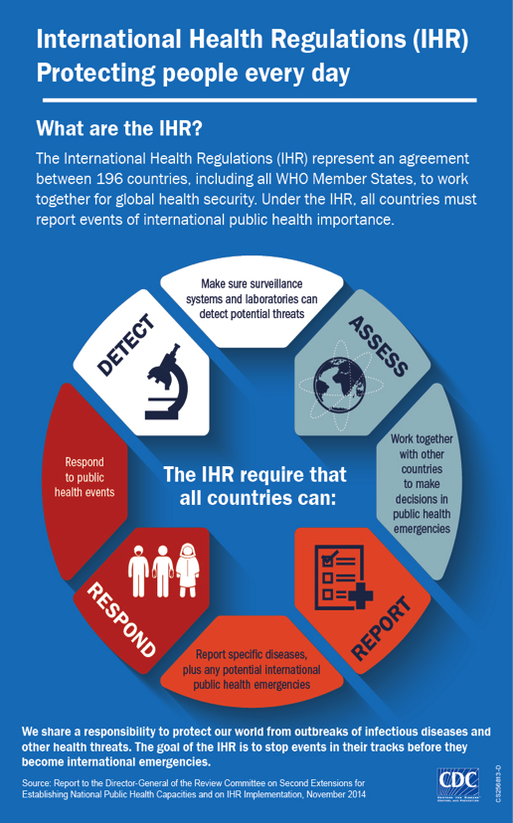
Health Security and IHRs

Slide 6
AU HoSG Declaration on Accelerated Implementation of IHR in Africa
At the AU Assembly of July 2017, the Heads of States and Government raised concern about the recurrent epidemics on the continent and the socioeconomic implications.
Recognized that a fundamental part of Government basic duty is to protect its citizens against health insecurity, risks and emergencies.

Slide 7
AU HoSG Declaration on Accelerated Implementation of IHR in Africa
Committed themselves to the accelerated implementation of the IHR, mobilize the necessary resources and put in place multisectoral mechanism for the implementation of IHR core capacities.
Requested AUC, Africa CDC and WHO Afro to provide the necessary support to MS in this regard.

Slide 8





Three Major African Initiatives
Free Trade
Open Sky
Free People Movement

Slide 9
Goal of the PHEM Workshop
To ensure effective public health emergency preparedness and response in the West African Sub-region.
The success story of the SADC PHEM workshop and the buy-in by MS is one of the main impetus for the replication of similar workshop in West Africa sub-region.

Slide 10
Expected Outputs
Identify the gaps and resources needed for cross-border collaboration in PHEM
Support the development of multi-hazard and multi-sectoral preparedness and response plans for public health emergencies.
Facilitate and promote sustained partnerships for multi-sectoral coordination and collaboration.
Develop surge capacity for public health emergencies in West Africa.

Slide 11
Target Trainees
NPHI Directors
Human health experts
IHR focal point
Animal health experts
Other key stakeholders

Slide 12
Target Resource Persons
Africa CDC
US CDC
US CDC Threat and Hazard Identification and Risk Assessment (THIRA) experts.
PHEM fellowship graduates.

Slide 13
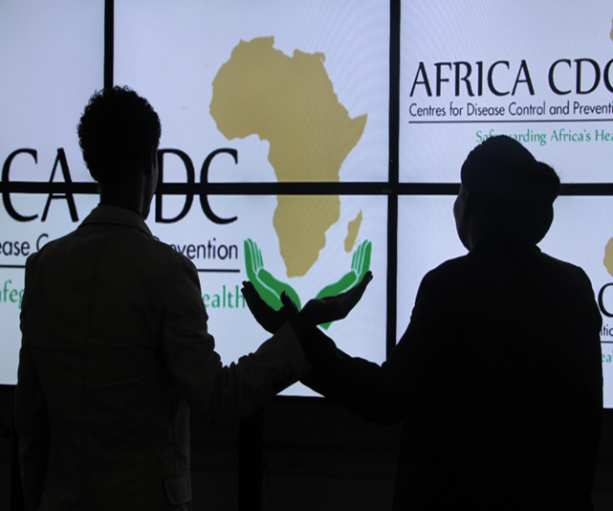
Safeguarding Africa’s Health
THANK YOU!

