Slide 1
The Sustainable Development Goals: how do WHO and IANPHI’s members adapt their activities in response to the SDGs?
Tracey Cooper, Wales, UK

Slide 2
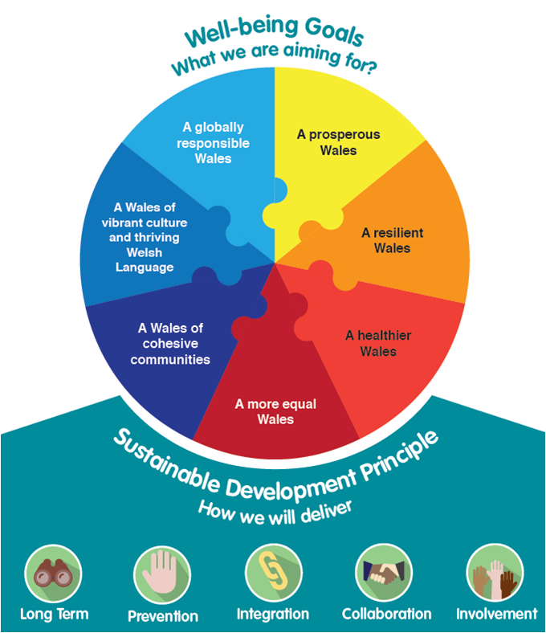

Slide 3
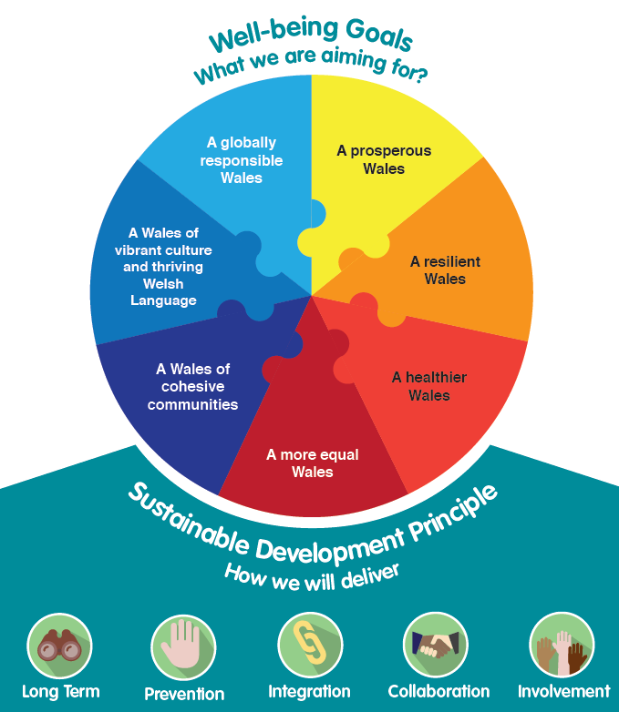
Well-being of Future Generations (Wales) Act

