Slide 1


National Centre for Disease Control-
Looking Back at our
Creation Story: Lessons Learnt
Dr Sujeet K Singh
Director, NCDC
Directorate General of Health Services,
Ministry of Health & Family Welfare
Government of India

Slide 2
Background
Population of India more than 1 Billion
Huge unmet public health needs
  New infectious diseases
  Burden of non- communicable diseases
  Diseases related to climate change, urbanization
National Centre for Disease Control (NCDC) provides technical leadership to advance policy change to maximize health

Slide 3
Evolution of NCDC
Originated as Central Malaria Bureau, 1909
National Institute of Communicable Diseases 1963
Expanded mandate, multidisciplinary team, NCDC, 2009
Nodal agency for Epidemiology training, IHR, Integrated Disease Surveillance Program (IDSP), STH, AMR, Viral Hepatitis, Rabies Control, NCDs and Environment Health
Under oversight of Director General of Health Services, Ministry of Health and Family Welfare (MOHFW)
Director serves as administrative and technical head

Slide 4
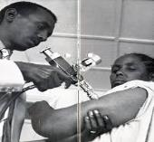
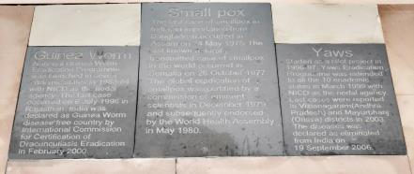

Public Health Impact
Eradication of Communicable Diseases
  Use epidemiology tools to provide strategic inputs for programme implementation
  Country-wide surveillance and surveys
  Diseases eradicated
    Smallpox
    Guineaworm
    Yaws
    Polio

Slide 5
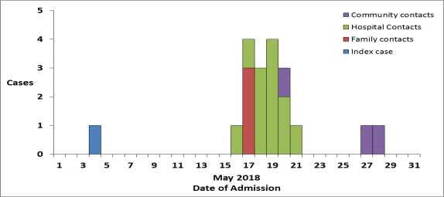
Public Health Impact
Respond to Health Challenges – recent example
Nipah outbreak May 2018: NCDC established facility based surveillance, contact tracing, epi investigation
Outbreak contained in fortnight, n=19, CFR= 89.5%

Slide 6
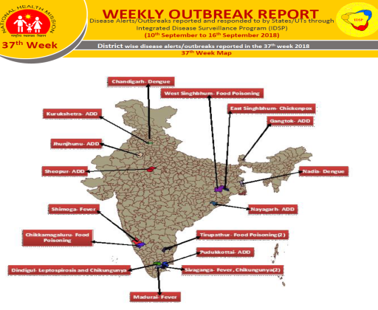
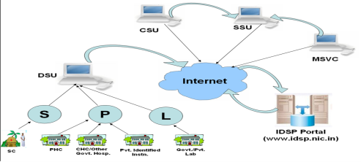
Data – The New Age Gold

Slide 7
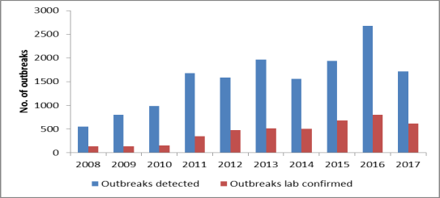
NCDC – Nodal Agency
Integrated Disease Surveillance Programme
Origin 2004
Decentralized surveillance system for epidemic prone diseases
Reaches to more than 600 districts and below
Mix of paper and electronic reporting
More than 20 diseases/ syndromes under surveillance

Slide 8
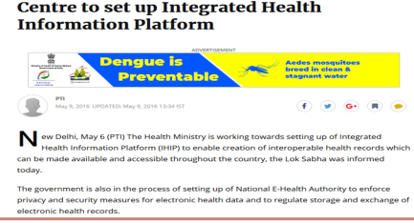
Integrated Health Information Portal
NCDC spearheading creation of interoperable health records which can be made available and accessible throughout the country

Slide 9
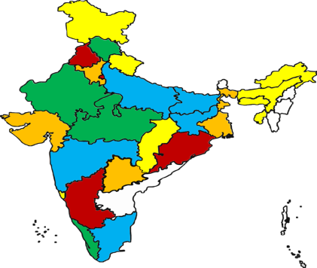
Public Health Workforce
India Epidemic Intelligence Service
Flagship Field Epidemiology Training in collaboration with CDC Atlanta
Epidemiology skill building
Consequential epidemiology
6 cohorts trained
Average class size 15
Trained officers serve in State health departments
No. of investigations
1 to 2 | Yellow
3 to 4 | Orange
5 to 6 | Green
7 to 8 | Blue
9 to 10 | Brown

Slide 10
“A robust public health system is the… best investment for a Nation”
JP Nadda
Minister of Health and Family Welfare
Govt. of India

Slide 11
NCDC Upgradation
30 branches in state headquarters
  Cutting edge lab facilities including BSL 3/4 labs
New centres at NCDC
  Climate change and Health
  Non Communicable Diseases

Slide 12
International Cooperation
NCDC IHR focal
GDD Centre
WHO Collaboration Centre
  Rabies
  Epidemiology and Training
  Polio

Slide 13
Lessons Learnt- NCDC
  National Health System strengthening requires investment in Public Health Institutions
  Multidisciplinary workforce
  Strong surveillance system
  Mandate should evolve with changing epidemiology of disease
  International cooperation

Slide 14
Thanks

