Slide 1
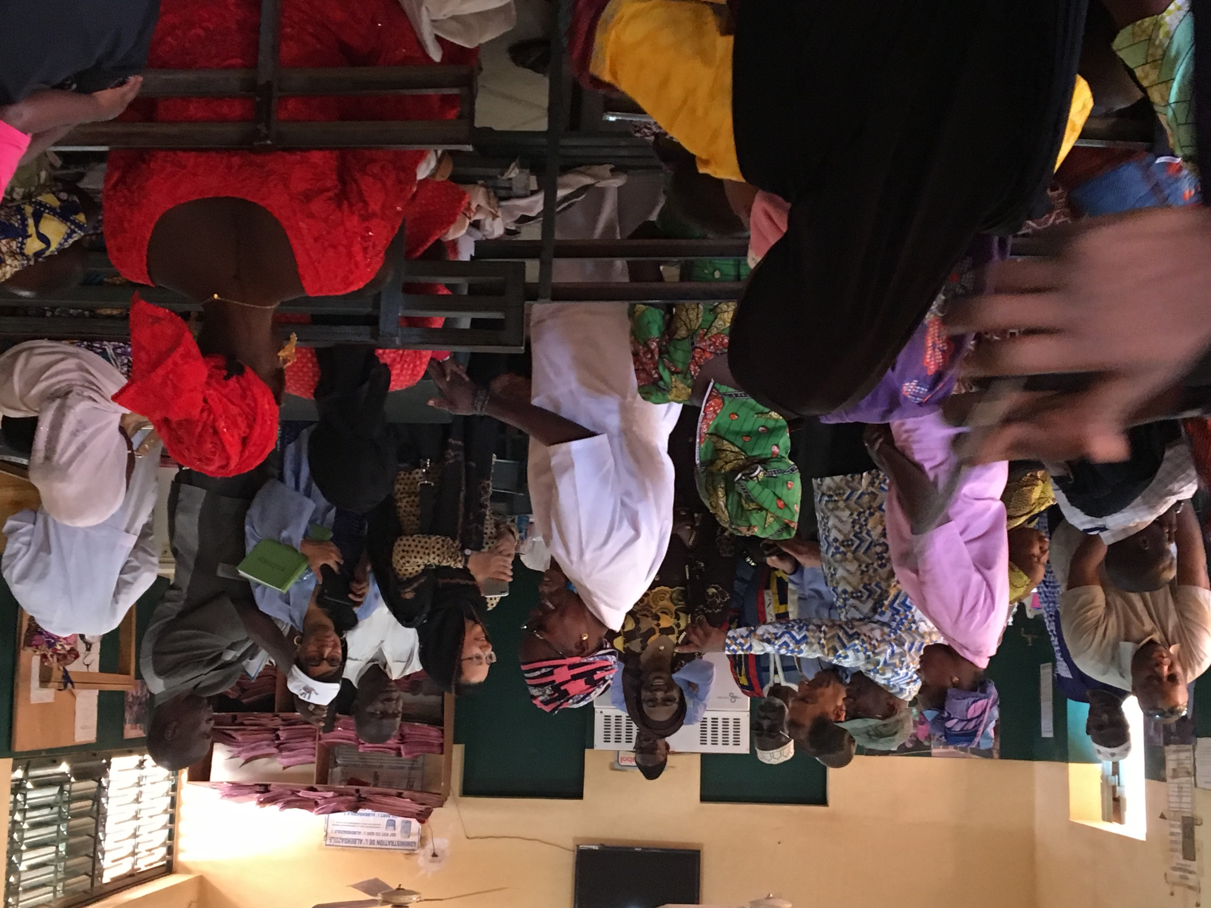
CHAMPS and comsa
Ianphi Annual meeting 2018
Scott F Dowell, MD MPH
Bill and Melinda Gates Foundation

Slide 2

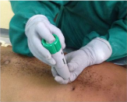
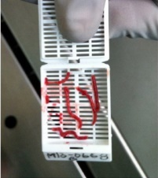
Reminder of CHAMPS network objectives
Primary Objective:
To track causes of childhood death globally: Emphasizing high-mortality areas, focusing on preventable deaths, including neonatal deaths and stillbirths, prioritizing autopsies as the gold standard
Secondary Objectives
  Track incidence of cause-specific severe disease among children < 5 years of age, including neonates
  Establish surveillance platform from which time limiting modules can be added to address epidemics

Slide 3

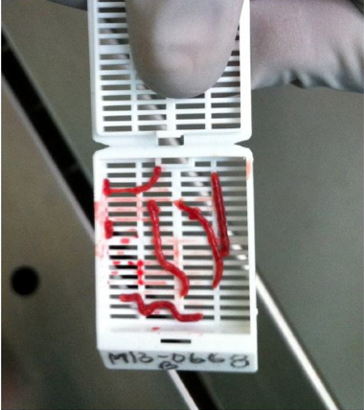
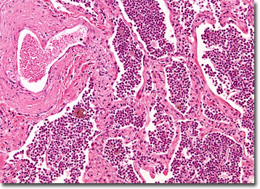
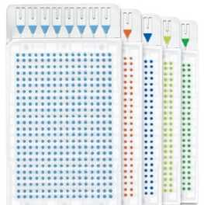
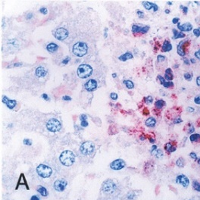
CHAMPS Lab testing: minimally invasive tissue sample (MITS) histopathology and TaqMan PCR Array Cards
DeCoDe Panel
  In-Country Lab
  Basic histopathology
  TaqMan PCR Array Cards
  Biobanking for future analysis
  Focused microbiology
  Expert panel to Determine Cause of Death
  Reference Lab
  Advanced histopathology
  TaqMan PCR Array Cards for quality assurance
  Biobanking for future analysis
  Expert panel to Determine Cause of Death for QA
Notes:
Histopathology example: bacterial pneumonia
IHC example: Fatal Spotted Fever Rickettsiosis and rickettsial antigens (red) in Kupffer cells in liver, Kenya

Slide 4
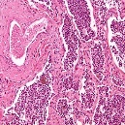
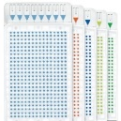
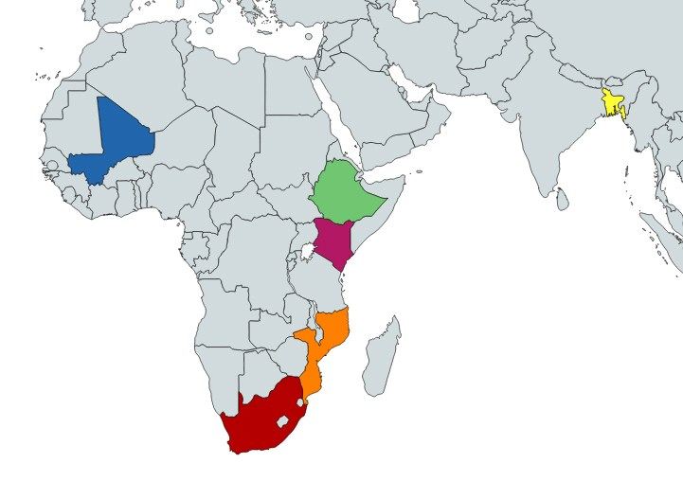
The child health and mortality prevention surveillance (champs) network: Building KNOWLEDGE TO SAVE CHILDREN’s LIVES
  CHAMPS
  Seven active sites
  Based in health and demographic surveillance sites (HDSS)
  Prospective, population-based
  Cause of death determined by minimally invasive tissue sampling (MITS) plus verbal autopsy (VA)
4
Confidential
Notes:
Laser focus on child mortality
Central component: CHAMPS – first of its kind histopathology based determination of child mortality

Slide 5

CHAMPS DETERMINATION OF CAUSE OF DEATH (DECODE) PANEL
Data from site
Linked maternal data
Demographic and clinical data
Verbal autopsy cause of death and raw data
Microbiology, molecular biology (TAC), HIV, TB, malaria findings
Site histopathology findings
Data packet produced centrally
Central certifier review
Panel Members
Clinician
Pathologist
Microbiologist
Epidemiologist
Panel Causes of Death
Recorded in CHAMPS database, shared with clinicians and family (aggregate results shared with community)
Central Pathology Lab (CPL)
CPL histopathology
Special stains
Immunohistochemistry
PCR findings

Slide 6
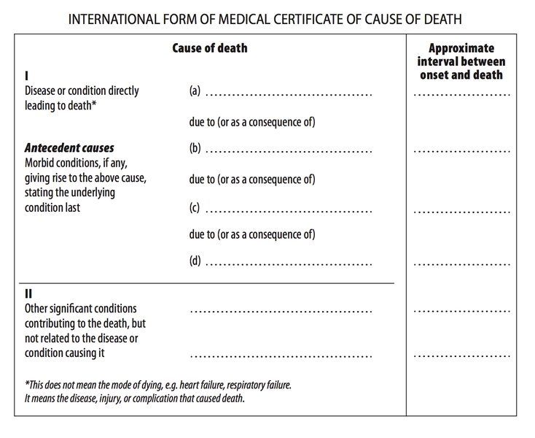
Champs uses the standard WHO Cause of Death certificate
Cause of Death (i.e. Underlying CoD): Causal chain of events (disease or injury) that led to death
Immediate Cause of Death: Final event in the causal sequence that occurred closest to time of death.
Immediate CoD
Antecedent CoD
Antecedent CoD
Underlying CoD
Contributing CoD
Contributing CoD

Slide 7
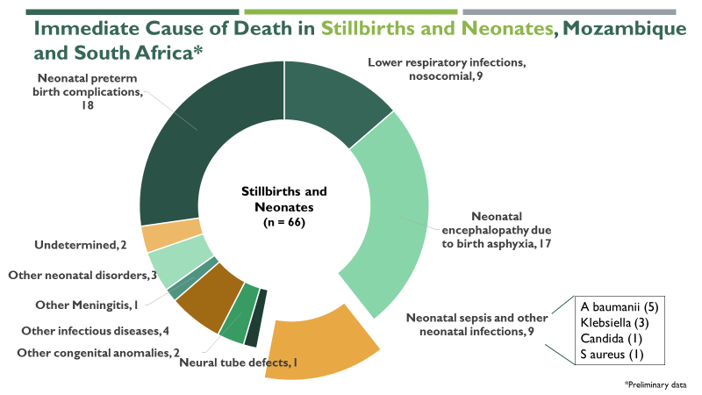
CHAMPS Progress and 2018 priorities
Stories from MITS Cases
Early Findings
  A. Brain showing cerebral malaria
B. Stillbirth with novel pathogen
Finalizing renewal grant to more definitively track causes of childhood mortality, add pregnancy surveillance, and transition leadership of certain components from Atlanta to Africa/South Asia.
Seven sites conducting mortality surveillance by end of 2018
~1200 MITS Decoded by the end of 2018
MITS Surveillance Alliance launching in 2018 to reduce barriers and expand the use of MITS worldwide
2018 Execution Priorities
3-year old boy was treated orally for malaria but had vomiting and did not get parenteral treatment.
Stillbirth with bacteria in lung tissue. 16sRNA analysis identified Leptotrichia amnionii, recently identified among septic abortions in Europe.

Slide 8
Non-typhoidal Salmonella Detection in CHAMPS MITS
Of 267 MITS from cases >7 days old, NTS was detected in 6 (2.2%) by culture and/or TAC in blood or CSF
    Kenya- 1/53 (1.9%)
    Mali – 1/14 (7%)
    Mozambique – 3/30 (10%)
    South Africa- 1/169 (0.6%)
  Of these NTS was detected in 4/109 (3.7%) that were community deaths or hospitalized less than 48 hours and 3/98 (3%) that were community deaths or hospitalized less than 24 hours
    Kenya- 1/34 (2.9%)
    Mali – 0/8
    Mozambique – 2/20 (10%)
    South Africa- 0/26

Slide 9
High estimates for NTS mortality burden
6/267 (2.2%) of all cases >7d old across 4 CHAMPS sites in Africa
4/109 (3.7%) among community deaths (or hospitalized <48h)
Back of envelope possible contribution to global child deaths ~ 20-40k
Fewer if require iNTS as part of the causal chain (underlying, immediate or morbid causes)

Slide 10
Champs Data access – launched November 2018
 | Level 1 Access Rights | Level 2 Access Rights | Level 3 Access Rights | Level 4 Access Rights
 | Fully Public | Online Registration | Data Use Agreement | IRB
 | Instant Access | Instant Access | 48-72 hrs | 3+ mo
Summary data visualizations | ✓ | ✓ | ✓ | ✓
Demographic data | ✓ | ✓ | ✓ | ✓
DeCoDe causal chain data |  | ✓ | ✓ | ✓
Laboratory data |  | ✓+ | ✓ | ✓
Child and maternal clinical records |  | ✓+ | ✓ | ✓
Verbal autopsy data |  | ✓+ | ✓ | ✓
Digitized laboratory slides |  | ✓+ | ✓ | ✓
Additional lab technician annotations |  |  | ✓ | ✓
Exact and actual dates in case data |  |  | ✓ | ✓
Exact geo-location in case data |  |  |  | ✓
Photos of subjects |  |  |  | ✓
Free-text fields (clinical notes, VA) |  |  |  | ✓
How current are the data?
CHAMPS is an operational surveillance system and targets 120 days from the time of death for cases to be complete and publicly available. Data will be refreshed monthly.
How do I request access to data?
De-identified, case-level data will be available through an online, self-service portal. Users will need to register and agree to an end-user license agreement and HIPAA Limited datasets will require an additional Data Use Agreement. Some data like high resolution slide images will be available on request.
What if I need help interpreting the data?
Data specification documentation is available for all datasets. Although CHAMPS is not organized to support all requests, it is open to collaborating on a number of topics. Additionally, manuscripts based on CHAMPS data should be shared prior to submission to any peer-reviewed journals for an opportunity to provide comments.
✓+ Available upon request, randomized date-shifting applied to data

Slide 11
What is CHAMPS/COMSA?
CHAMPS and COMSA
CHAMPS
Child Health and Mortality Prevention Surveillance
High-precision cause of death identification
Fine-grained data on causes of death among children under five, supported by analyzing samples collected using the Minimally Invasive Tissue Sampling (MITS) procedure.
Precise &
Scalable
Mortality
Surveillance
COMSA
Countrywide Mortality Surveillance for Action
Representative sample to provide high quality information on births and deaths
A robust sample registration system that captures the data that allows for calculation of mortality rates, birth rates, and cause-specific mortality fractions at the national and sub-national levels.

Slide 12
comsa demonstration projects - Mozambique and Sierra leone
Mozambique - 700 clusters of ~300 households each
  900,000 people under surveillance
  38,000 annual births
  2,600 annual under-five deaths
Reporting births & deaths in 5 Phase I provinces (2,803 births; 856 deaths)
  381 verbal autopsies completed
Household listing and enumeration in remaining 6 provinces with reporting of events underway
Social and behavioral science work initiated in Zambezia province to pave way for COMSA MITS (expected in Q1 2019)
Preliminary MITS-adjusted cause of death results expected by end of 2018 using statistical calibration models on COMSA VAs using CHAMPS MITS-VA pairs
COMSA cluster
Phase I
Phase II
Parks and reserves

