Slide 1
The role of Public Health Institutes in the Implementation of the SDGs
IANPHI Annual Meeting,
London, 5 November, 2018
Dr Rüdiger Krech, Director, Universal Health Coverage and Health Systems
World Health Organization

Slide 2
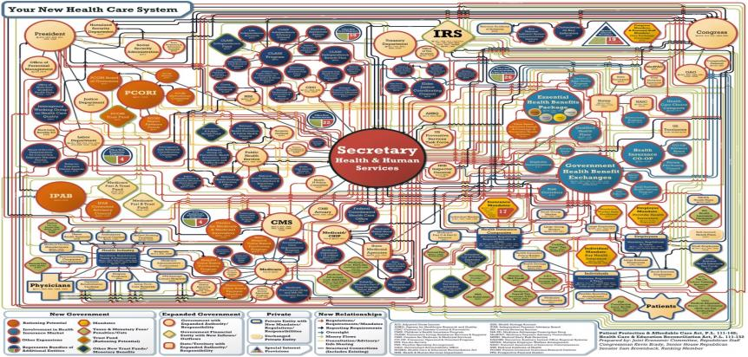
US Health System

Slide 3
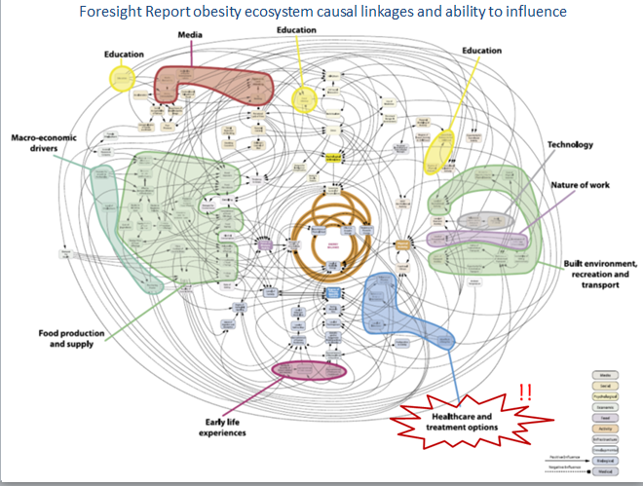
Example: Addressing Obesity

