Slide 2
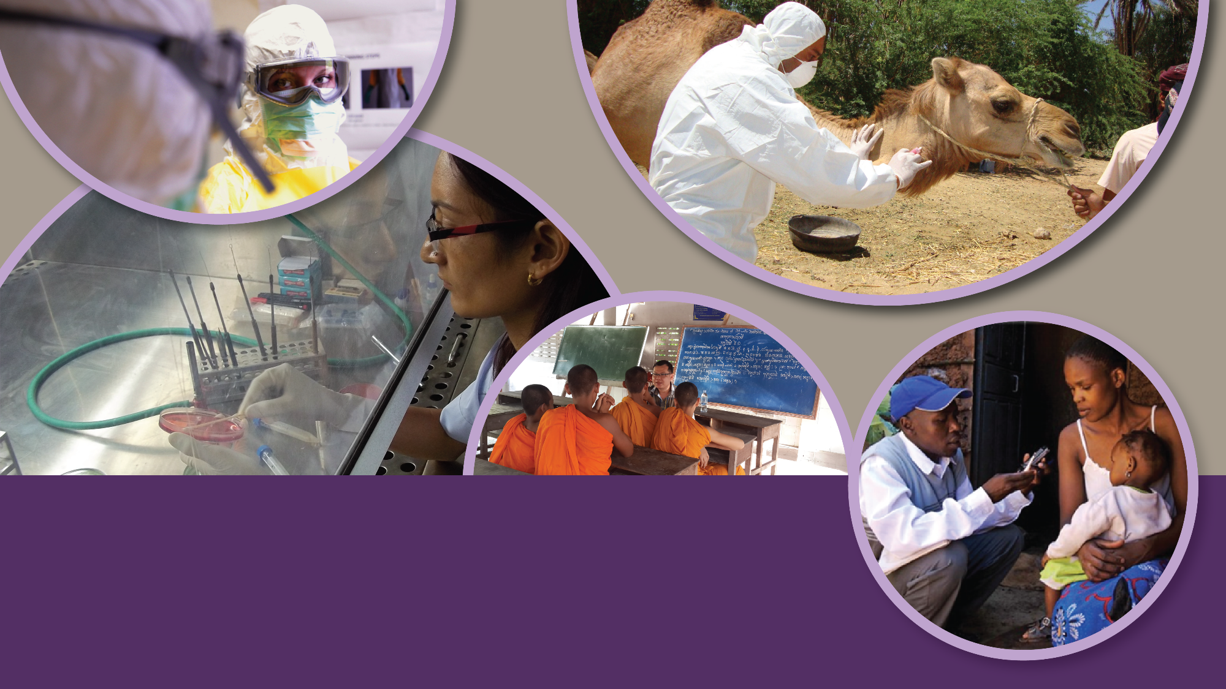

DIVISION OF
GLOBAL HEALTH PROTECTION
CENTER FOR GLOBAL HEALTH

Slide 3
Global Health Security
Investing in the public’s health – the case for prevention
Kip Baggett, MD, MPH
Workforce and Institute Development Branch
IANPHI Annual Meeting, London
November 5, 2018

Slide 4
Global Health Security
Global Health Security – “...the activities required, both proactive and reactive, to minimize vulnerability to acute public health events that endanger the collective health of populations living across geographical regions and international boundaries” (World Health Assembly Report, 2007)
Notes:
When the world recognized the need to come together to take immediate action due to events such as SARS, anthrax attacks, and the AIDS epidemic, IHR provided us with an important set of public health goals. Today, the Global Health Security Agenda will provide us with a road map to help reach those goals. GHSA will build on the work we did with IHR and help us to do more, to do it faster, and to do it better.

Slide 5
Why Global Health Security?

Slide 6
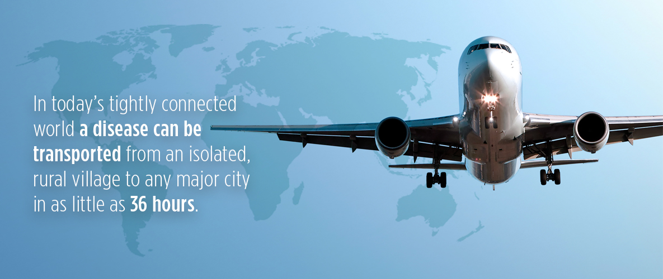
Notes:
This increased connectivity and mobility brings increased risk of infectious disease spread. The next epidemic may very well be just a plane ride away.
36 hours:
The time required for a pathogen from a remote village to reach major cities on all six continents

Slide 7
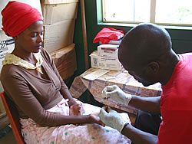
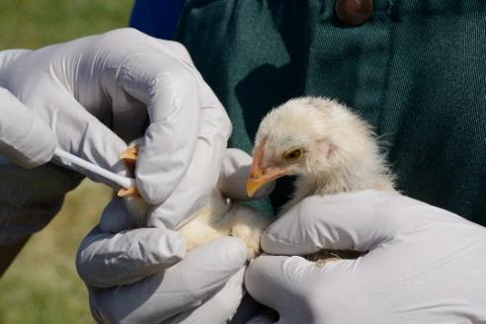
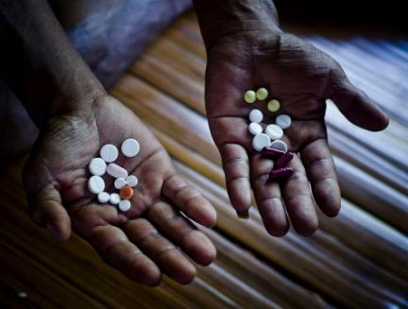
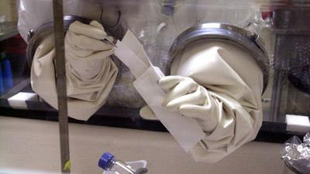
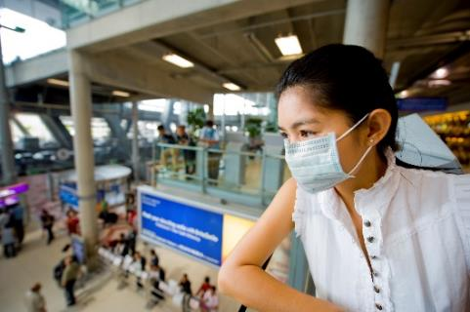
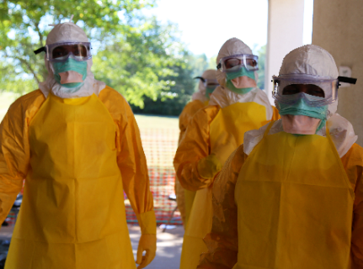
HIV
Avian Flu
Food Supply
XDR TB
PUBLIC HEALTH THREATS
Anthrax
SARS
Ebola
Zika
Notes:
We have seen over time that global health risks have increased through the emergence of new organisms, drug resistance, and intentional events.
HIV raged undetected for over a decade. Drug resistant organisms, including TB are a growing public health threat.
In 2001, targeted mailing of Anthrax spores drew the world’s attention to the reality of intentional release of dangerous pathogens.
In 2003, SARS spread to 37 countries across three continents in four months.
he more recent emergence of Middle East Respiratory Syndrome Coronavirus (or MERs), the Ebola Epidemic in West Africa, and Zika virus in the America’s have kept the world on high alert.
WHO has the authority and responsibility to declare the highest level of health threats, called a Public Health Emergency of International Concern (PHEIC).
Since 2005, WHO has formally declared a total of 4 of these emergencies:
The H1N1 influenza pandemic in 2009,
The re-emergence of wild poliovirus in 2014,
The West Africa Ebola epidemic starting in 2014
The outbreak of Zika virus in 2016

Slide 8
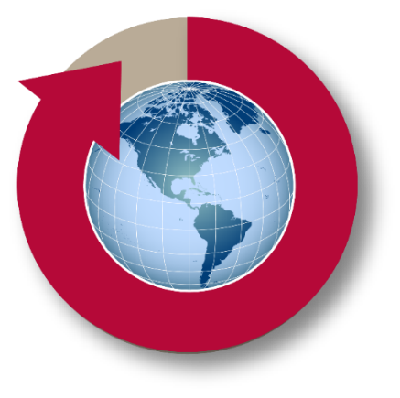

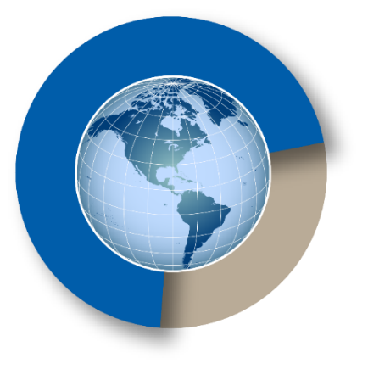
Why Care About Global Health Security?
DISEASES SPREAD
ECONOMIC IMPACT
NOT PREPARED
Faster and farther
SARS: $40B Globally
Ebola: >$30B Globally
At least 70% of
countries not prepared

Slide 9
Framework for Global Health Security

Slide 10
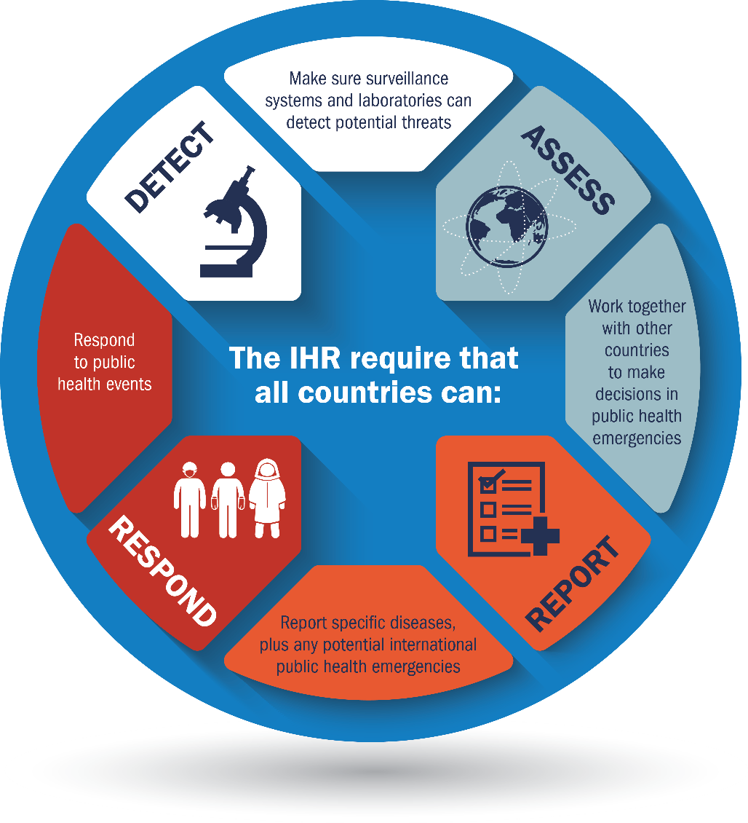
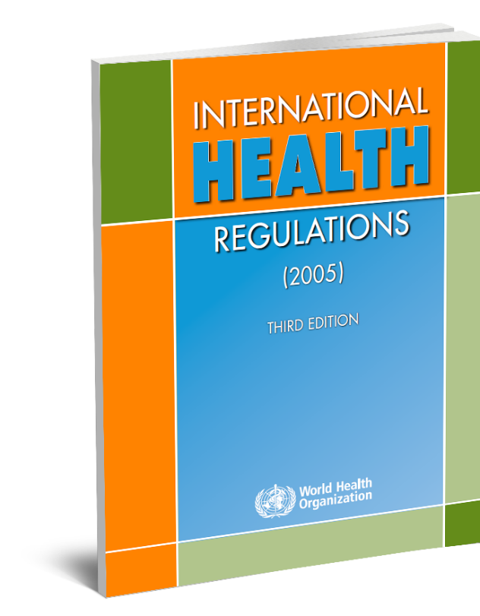
INTERNATIONAL HEALTH REGULATIONS (IHR) (2005)
Notes:
Because of the many ways in which we are connected, no country can protect itself, by itself. This lesson became especially clear during the SARS outbreak in 2003.
To address the shortcomings of the global response to SARS, WHO revised the IHR in 2005 to better control public health threats while avoiding unnecessary interference with international travel and trade.
At the World Health Assembly in 2005, all UN member states (196 countries) committed to achieving the goals of the revised International Health Regulations over a five year period. The IHR governs countries’ timely and effective response to outbreaks of infectious diseases and other public health emergencies that can cross borders.
The IHR require that all countries have the ability to:
Make sure surveillance systems and laboratories can detect potential threats
Work together with other countries to make decisions in public health emergencies
Report transparently through participation in a network of National Focal Points
Respond to public health events. WHO also has the authority and responsibility to declare the highest level of health threats, called a Public Health Emergency of International Concern (PHEIC)
The IHR can be summed up in 4 words: Detect, Assess, Report, Respond

Slide 11
Global Health Security Agenda (GHSA): A Global Initiative to Support IHR
Vision: A world safe and secure from global health threats posed by infectious diseases…
  GHSA launched in February 2014 with leaders from 28 countries, WHO, OIE and FAO
  June 2015, G7 committed to assist at least 60+ countries
  2015-2019: USG Emergency Funding for Ebola and GHSA
  October 2017, The Kampala Declaration is signed, extending GHSA to 2024 at the 4th Annual GHSA Ministerial Meeting, held in Uganda
  January 2018, 64 countries have signed on to be a member of GHSA
Notes:
On February 13, 2014, leaders from 28 Ministries of Health, the World Health Organization (WHO), the Food and Agricultural Organization (FAO), and the World Organization for Animal Health (OIE) came together to launch the Global Health Security Agenda. The vision of the agenda is to realize a world safe and secure from global health threats posed by infectious diseases.
At the time of the launch, Ebola was spreading undetected from Guinea to Liberia and Sierra Leone. By the fall of 2014, Ebola had galvanized the international community around the Agenda.
At the first GHSA Ministerial meeting in September, which was convened in Washington and attended by President Obama, 44 countries joined the agenda. Nine months later, the seven nations of the world’s largest economies, the G7, pledged to help up to 60 countries achieve the GHSA targets.
64 as of 2/9/2018:
Afghanistan
Argentina
Australia
Azerbaijan
Bangladesh
Burkina Faso
Cameroon
Canada
Chile
China
Colombia
Côte d'Ivoire
Democratic Republic of Congo
Denmark
Ethiopia
Finland
France
Georgia
Germany
Ghana
Guinea
Guinea-Bissau
India
Indonesia
Israel
Italy
Japan
Jordan
Kenya
Laos
Liberia
Malaysia
Mali
Mexico
Mongolia
Netherlands
Nigeria
Norway
Pakistan
Peru
Philippines
Portugal
Republic of the Congo
Republic of Korea
Saudi Arabia
Senegal
Sierra Leone
Singapore
South Africa
Spain
Sweden
Switzerland
Tanzania
Thailand
Togo
Turkey
Uganda
Ukraine
United Arab Emirates
United Kingdom
United States
Vietnam
Yemen
Zimbabwe

Slide 12
Economic Case for Global Health Security

Slide 13
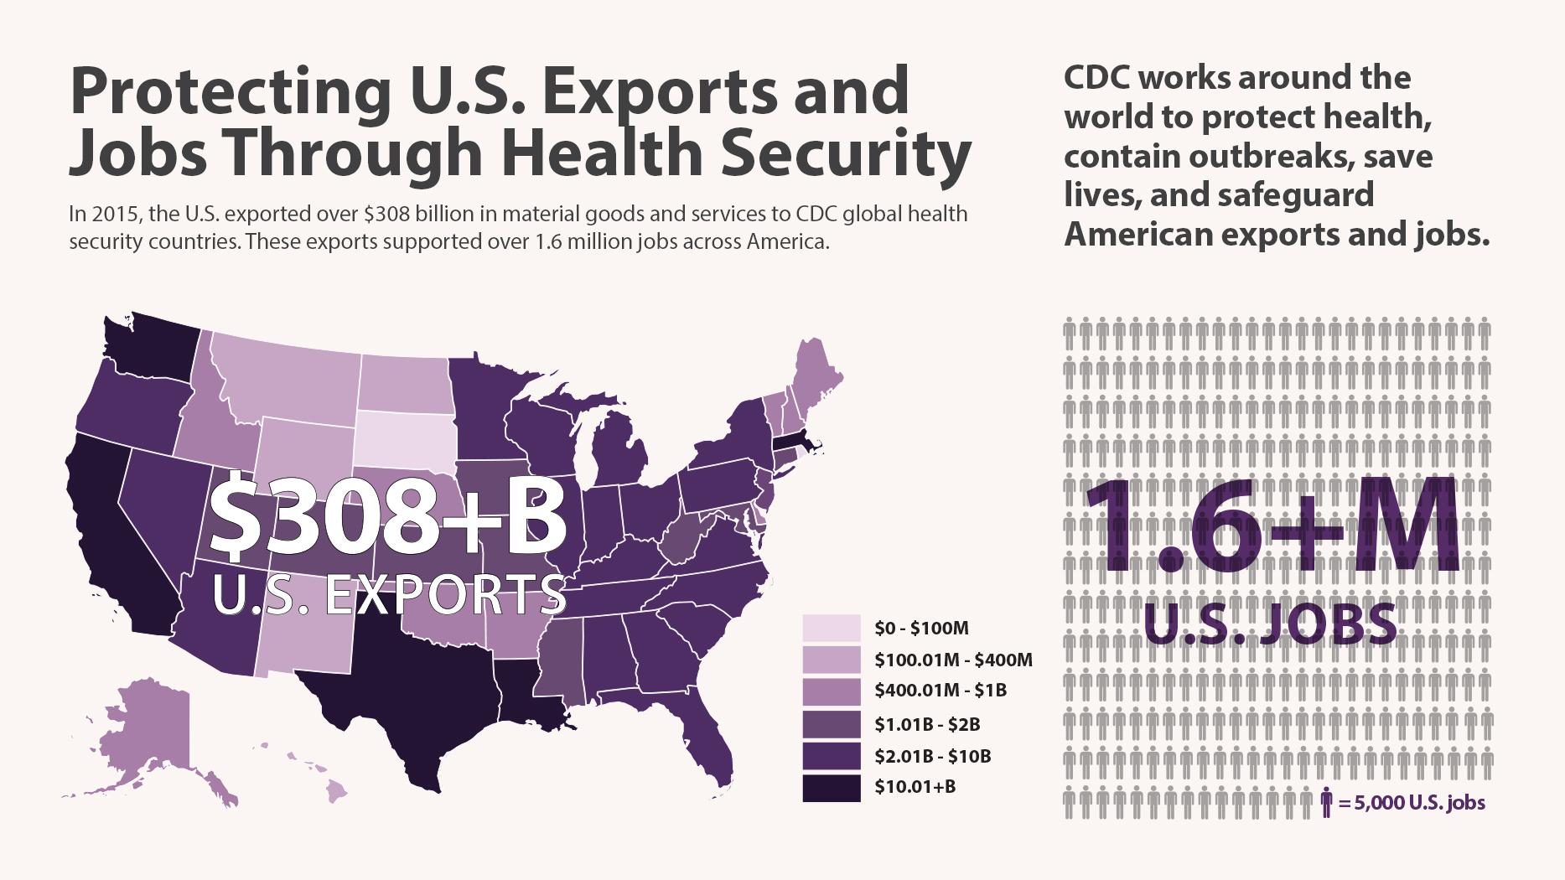
Cassell CH, Bambery Z, Roy K, Meltzer I, Ahmed Z, Payne L, Bunnell RE. Health Secur 2017;15:563-68. http://doi.org/10.1089/hs.2017.0051

Slide 14
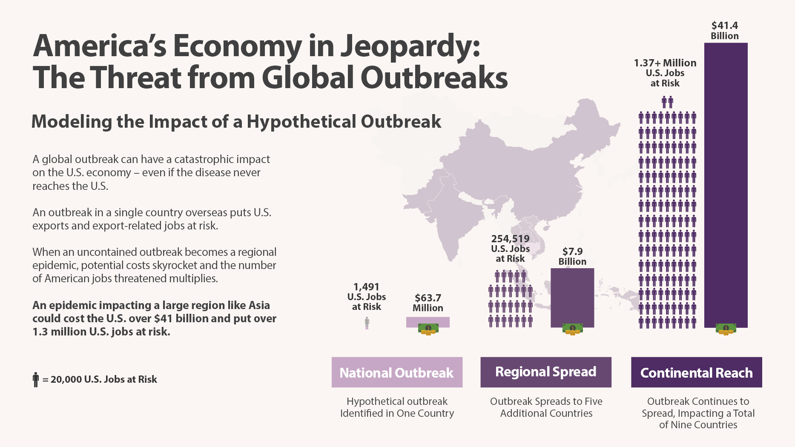
Bambery Z, Cassell CH, Bunnell RE, Roy K, Ahmed Z, Payne RL., Meltzer MI. Health Secur 2018;16:1-7.http://doi.org/10.1089/hs.2017.0052

Slide 15
Global Health Security: Taking Action

Slide 16
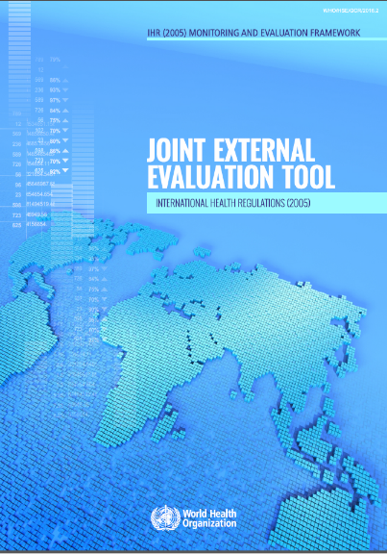
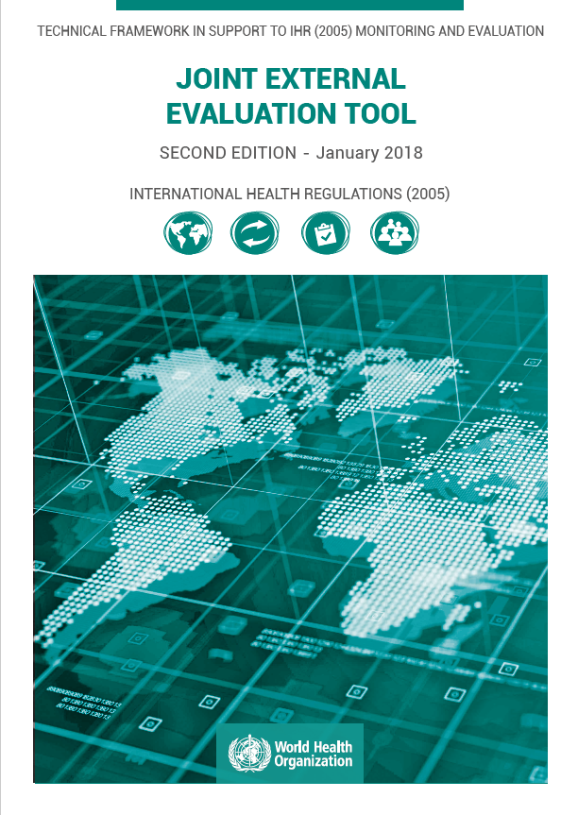
Joint External Evaluation Tool (JEE):
Enhanced IHR Assessments
http://www.who.int/ihr/publications/WHO_HSE_GCR_2018_2/en/
Notes:
I want to talk a bit more now about the JEE Tool itself. As I mentioned at the outset, the JEE Tool is a data gathering instrument designed to evaluate a country’s capacities for health security across all relevant sectors, at a national level. Specifically, it helps to:
-Determine the baseline capacity, including gaps and needs
- Inform the development of implementations plans or roadmaps
- Measure progress on work implemented across the IHR Core Capacities
- Highlight gaps and needs for current and prospective donors and partners, as well as to inform country-level planning and priority setting
It was developed through international collaboration with Member States, subject matter experts, and international organizations.
Indicators in the tool combine qualitative and quantitative measures, and the tool consists of 19 technical areas, which combines GHSA Action Package targets with IHR capabilities not specifically covered by the GHSA Action Packages.
More specifically, the JEE is a critical tool for:
Identifying countries’ abilities and limitations within their health system;
Prioritizing opportunities for capacity development within countries;
Developing a plan to guide allocation of resources and engage partners within countries; and
Measuring country-specific progress.
As of December 15th, CDC subject matter experts – from across numerous CIOs – have participated in about 2/3rd of all JEE missions, lending their expertise to the external evaluation process. The success of the JEE, as well as the agency’s considerable involvement, serves as a powerful example of CDC’s contributions to protecting Americans by strengthening health security around the globe.

Slide 17
Country Progress with Independent Global Health Security Agenda and Joint External Evaluation Assessments
AFRO
EMRO
EURO
PAHO
SEARO
Joint External Evaluations Completed: n=85 (72 published)
Joint External Evaluations Planned: n=21
Global Health Security Agenda Assessments Completed: n=5
*Uganda has completed both a JEE and a GHSA Assessment
WPRO
As of October 19, 2018
Notes:
Thank you to all our CDC staff that have supported the JEE process – those staff in country helping our partners develop their self-assessments and plan for the JEE and those staff that have participated as external evaluators for the JEEs
85 JEEs have been completed and 72 mission reports with recommendations have been published online. Another 20 JEEs are currently in the pipeline. Several countries in the Americas have also expressed interest.
CDC SMEs have filled 73 slots in JEE missions and more than 60% of JEEs have included at least one CDC expert.

Slide 18
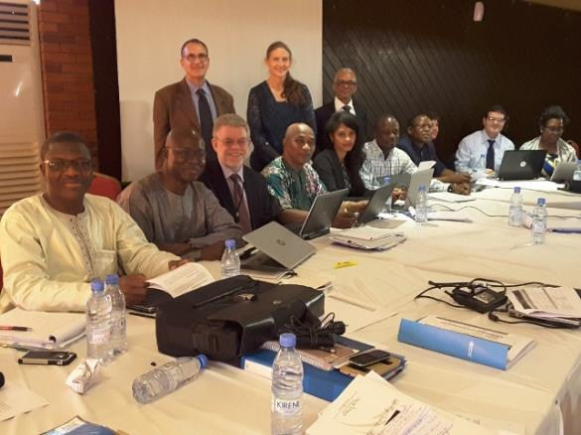
Post-JEE Planning
Once the Final Report is published, the Host Country will begin strategic planning to address health system limitations by developing a costed National Action Plan for Health Security
JEE results serve as a baseline to measure progress and can help countries to target priority gaps, develop or refine roadmaps, and support donor advocacy and alignment
JEE findings will inform:
  Strategic planning and roadmap development
  Engagement with donors and in-country stakeholders
  Annual self-evaluation and JEE repeats

Slide 19
Potential roles for NPHIs in global health security and IHR implementation
  Coordinate the assessment, action planning, and activity implementation
  House operational and public health functions critical to addressing JEE recommendations and implementing national action plans
  Improve core public health capacities including:
    Detecting and responding to acute events
    Providing data for decision-making
Notes:
Main TP: Sustain investments in GHS: there has to be a functional home for this activities that has the capacity to plan, coordinate, and implement, and must be accountable to commitments and targets.
NPHIs can serve a coordinating role, even when an action package, technical area, GHSA activity, is outside of their direct responsibility (e.g., zoonoses and data exchange, surveillance for an immunization program)

Slide 20
Thank You

