Slide 1




Public Health Workforce Development
ASPHER AGENDA
Prof. Kasia Czabanowska
ASPHER President
IANPHI 2018 Annual Meeting – London

Slide 2
Public Health Workforce Development
ASPHER
ROAD MAP TO
PUBLIC HEALTH
PROFESSIONALISATION
TRAINING ACADEMY
OF PUBLIC HEALTH
CORE COMPETENCES
FOR PUBLIC HEALTH
WORKFORCE
STAKEHOLDER INVOLVEMENT AND PARTICIPATION
WHO COP IANPHI ASPPH ECDC EUPHA WFPHA
LEADERSHIP

Slide 3
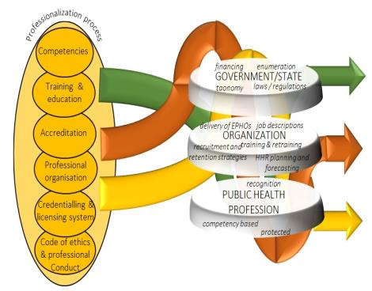
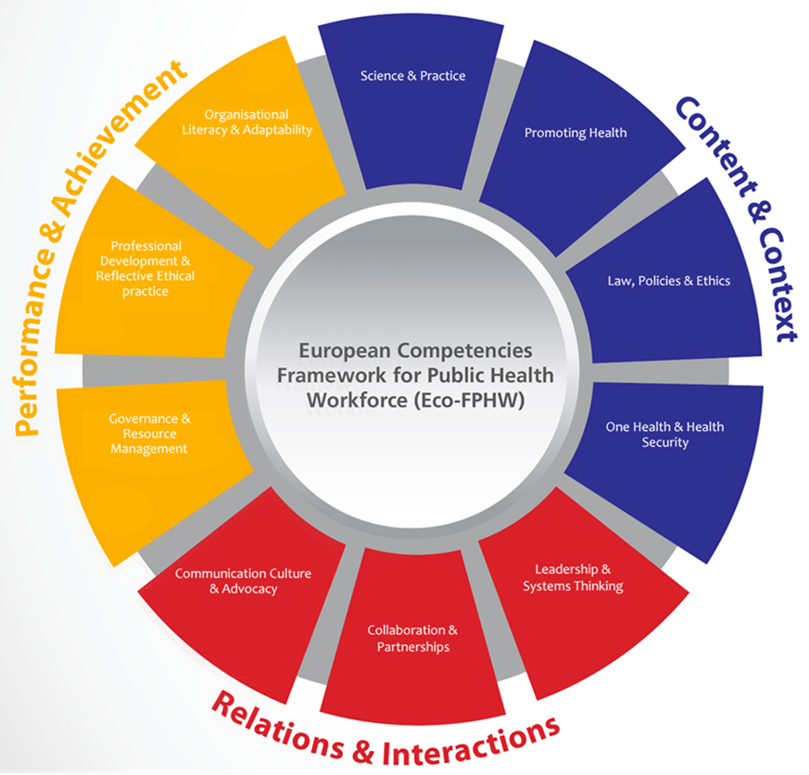
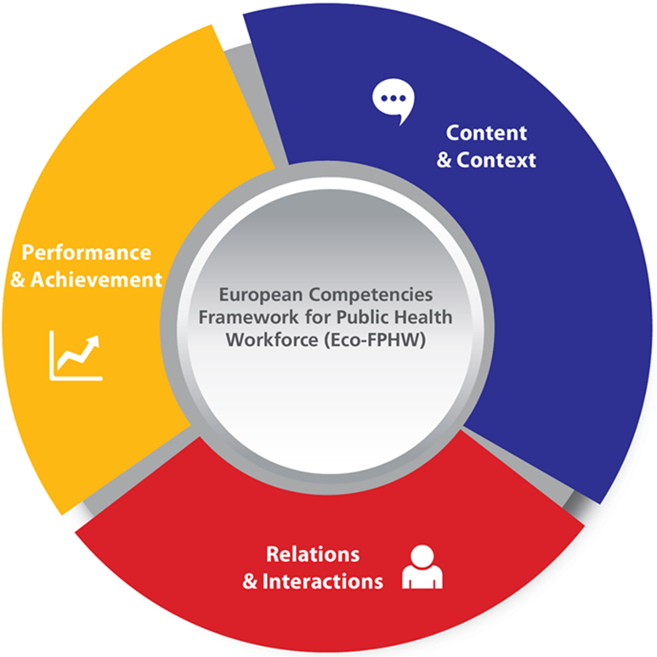
Professionalisation
Competency Framework
Road Map
for PH Workforce

Slide 4
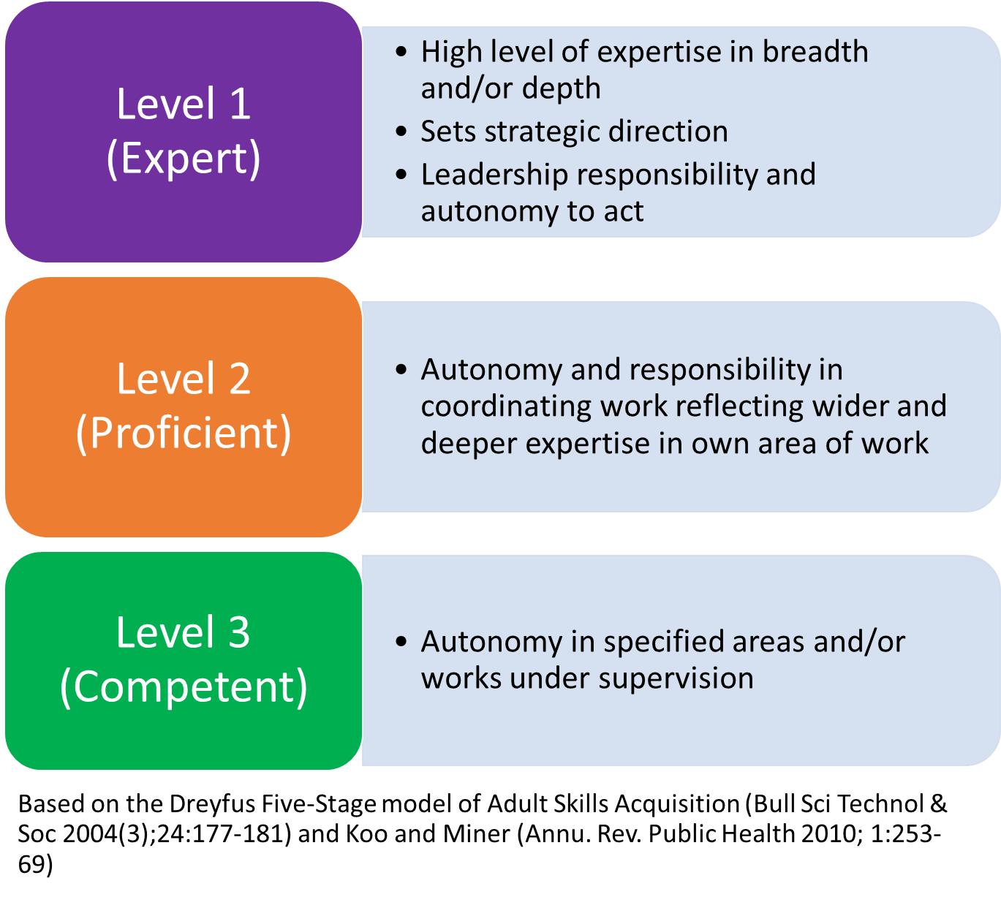
Relations & Interactions
6. Collaboration & Partnerships
6.1 Works across sectors at the local/national/ international level organisational structures
6.2 Understands the interdependency, integration, and competition among healthcare sectors and different actors who have interests in public health issues
6.3 Identifies, connects and manages relationships with stakeholders in interdisciplinary and inter-sectorial projects to improve public health services and achieve public health goals
(...)

Slide 5




Public Health Training Academy
Catalogue of courses on prevention and control
of communicable diseases
in the European Region

