Slide 1


International association of national public health institutes
2018 Annual Meeting| London, England
Investing in the public’s health – the case for prevention
Professor John Newton, Director of Health Improvement - Public Health England

Slide 2

International association of national public health institutes
2018 Annual Meeting| London, England
Return on investment of oral health improvement programmes for 0 – 5 year olds*

Slide 3
International association of national public health institutes
2018 Annual Meeting| London, England
The NHS Health Check

Slide 4
International association of national public health institutes
2018 Annual Meeting| London, England
Impact of the NHS Health Check

Slide 5
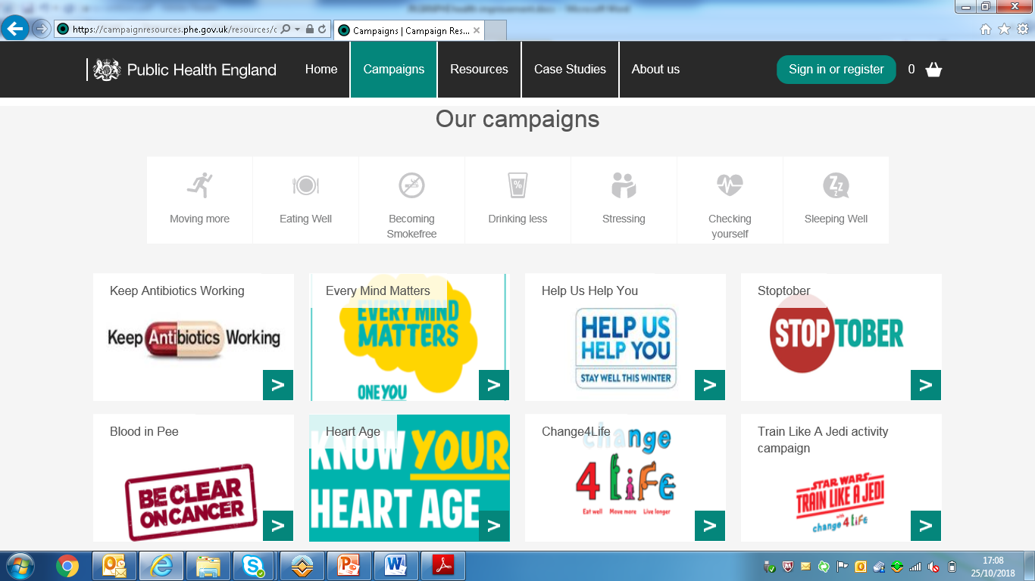
International association of national public health institutes
2018 Annual Meeting| London, England
Social Marketing Campaigns

Slide 6
International association of national public health institutes
2018 Annual Meeting| London, England
Social Marketing Campaigns

Slide 7

International association of national public health institutes
2018 Annual Meeting| London, England
Community health assets

