Slide 1
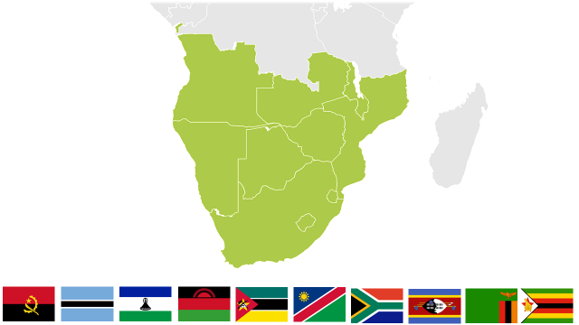
AFRICA CDC SOUTHERN AFRICA RCC PROGRESS UPDATE April 2018
Dr. Victor Mukonka MD, MPH, PhD (Public Health)
Director, Zambia National Public Health Institute
Interim Coordinator – Southern Africa RCC

Slide 2
Africa CDC RCC for Southern Africa Region
Zambia designated to host Southern Africa RCC
RCC inaugural meeting held 20-21 July 2017, Lusaka, Zambia
RCC Role:
Coordinate NPHIs and Public Health activities for 10 Regional Member States:
Angola; Botswana; Lesotho; Malawi; Mozambique; Namibia;
South Africa; Swaziland; Zambia; Zimbabwe
Member States are at different stages in establishing NPHIs

Slide 3
Southern Africa RCC Launch: 20-21 July 2017, Lusaka, Zambia

Slide 4
Outcomes of the RCC inaugural meeting
Stipulated roles and responsibilities of Member States, RCC and Africa CDC
Developed draft framework document on Governance and Structure of the RCC
Agreed to map existing Public Health assets in the Southern African Region
Created various technical committees and task forces
Identified key public health priorities and activities and draft work plan

Slide 5
RCC tasked to:
Ensure the establishment of clear procedures for cooperation and collaboration among Member States and the RCC
Implement activities with Member States in alignment with Africa CDC’s strategy and technical guidance
Establish and maintain agreements between Member States for exchange of data and specimens during routine activities
Coordinate emergency response activities
Participate in Africa CDC governance and programmatic activities
Mobilize staff and resources to support RCC activities

Slide 6
Zambia’s commitment as RCC for Southern Africa Region
MOU and RCC host agreement finalised
The Zambian Government has secured and is providing
Office accommodation
Operation costs ($200,000 secured in 2018 National budget)
Support staff seconded

Slide 7
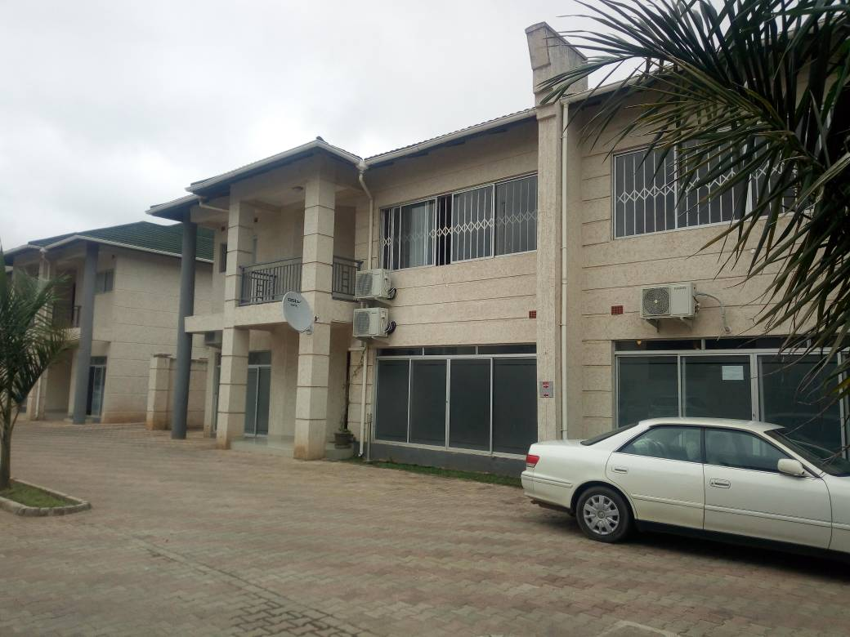
RCC Office Space 13 Reedbuck Road, Kabulonga, Lusaka 10101 Zambia

Slide 8
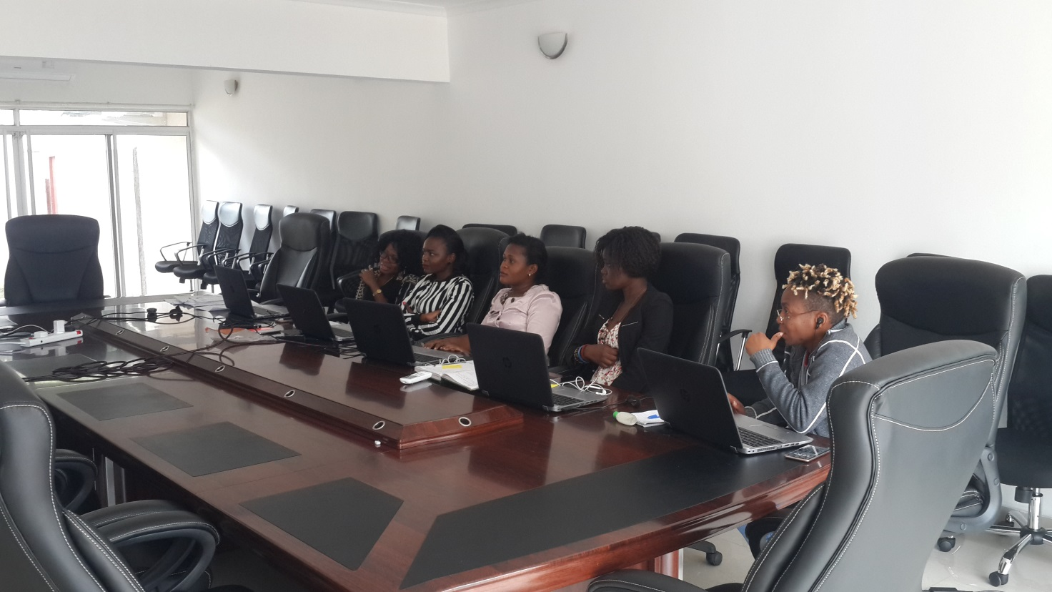
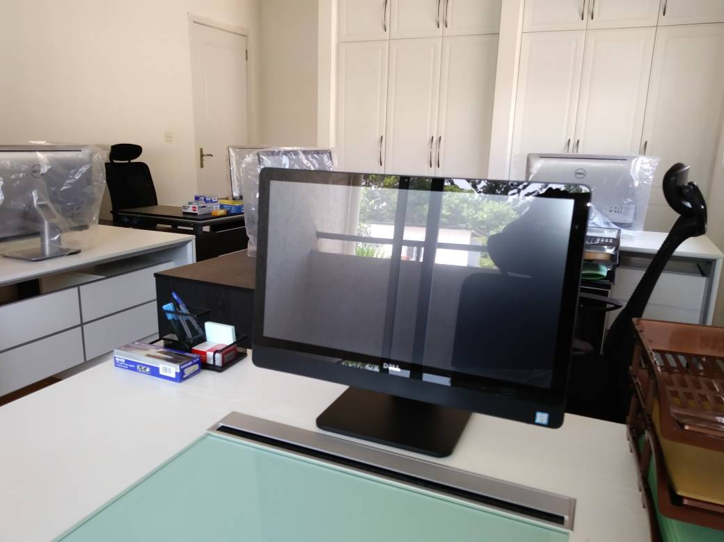
RCC Office Space
Boardroom
specialists’ office
Coordinator’s office

Slide 9
RCC for Southern Region: Progress to date
Framework for RCC strategic plan developed
RCC office set up and operational
Positions being advertised as per AU approved structure, including:
RCC Coordinator
Epidemiologist
Public Health Specialist
Laboratory
Information/Data
Logistics
6 AU Youth Volunteer Corp (Communication, Public Health, Surveillance, Laboratory, legal, logistics)

Slide 10
Progress to date:
ECHO project
Platform for information sharing
Training for Southern Region ECHO project (Nov. 2017)
Weekly ECHO meetings launched in Dec 2017
Has facilitated exchange of information and experiences on outbreaks and public health issues in the region (Listeriosis, Cholera, AMR)
SA-RCC participated in high level SADC meeting with Permanent Secretaries
Delegated to give update on priorities, operationalisation, areas of collaboration & SA PHEM training
Public Health Emergency Management
Included other SADC member states not in the Africa CDC Southern Africa RCC region

Slide 11
Progress
Technical support to outbreaks
Cholera in Malawi, Zambia & Zimbabwe
Ebola DRC – (technical support through discussions on the ECHO platform)
Listeriosis in SA – (technical support through discussions on the ECHO platform)
Situation room to integrate surveillance, emergency preparedness
Laboratory networking and asset mapping meeting
Public health asset mapping done (7/10 countries submitted)
Cholera elimination strategy TWG launched

Slide 12
Southern RCC Priorities
Establish governance structures for regional activities (TAC, TWGs)
Support establishment of NPHIs in each Member State
Mapping of Public Health Assets
Establishment of Public Health Emergency Operation Centers (PHEOC)
Strengthen epidemic preparedness and response capabilities in each Member State
Enhance cross-border disease surveillance
Information, data and specimen sharing
Capacity Building
Public Health research
Fight and stem the spread of Antimicrobial Resistance (AMR)

Slide 13
RCC for Southern Region: Partnership Created
Capacity building for the region – Working with JICA to develop both short and long training program for the region, seek input in priority setting from Member States
Engaged World Bank for infrastructure development and equipping the RCC offices plus Regional Public Health Lab
Technical support in short training programs from IANPHI & CDC Atlanta

Slide 14
Thank You

