Slide 1


Role of EPHI in the CHAMPS project
የኢትዮጵያ የሕብረተሰብ ጤና ኢንስቲትዩት
Ethiopian Public Health Institute
Ebba Abate, PhD, Director General, EPHI

Slide 2
Outline
Background about EPHI
Data to action initiative at EPHI-NDMC
EPHI’s data to action strategy in the context of the CHAMPs project
CHAPMS Ethiopia and EPHI collaboration with Data Access Working Group
Opportunities and Challenges
Way forward

Slide 3
CHAMP: Data to action

Slide 4
EPHI data to action initiative
EPHI- National Data Management Center (NDMC)
  to create a central system to collect, store and manage all health and health-related data
  Indepth analysis using standard scientific methods and techniques
  to harmonize data collected from different sources
  to produce policy-relevant findings at national and subnational levels
  to develop a framework to facilitate effective use of data at local and ministerial level as well as at regional and global levels
EPHI has a special position
  to influence policy at the ministry (MOH) and
  to influence action at sub-national public health institute and
  to align efforts with other initiatives

Slide 5
EPHI’s data to action strategy in the context of CHAMPs
Engage FMoH and partners in using CHAMPS and related data for action
EPHI engage a range of groups in understanding the CHAMPS data and their importance to Ethiopia when data are available.
  FMoH, RHBs, partner organizations (such as WHO, UNICEF, and Save the Children), and representatives from the CHAMPS site)
Raise awareness of CHAMPS – results to date and expected to a wider group of organizations including professional associations (Eg. Pediatric association, UNICEF…)
To discuss how to use the results to influence policies and programs

Slide 6
EPHI’s data to action strategy in the context of the CHAMPs project (cont.)
Make CHAMPS data accessible
  Using EPHI network to ensure use of CHAMPS data for cause of death estimation
  Tailor CHAMPS messaging to various types of external audiences (Eg. media, for national policy)
  Integrate CHAMPS data with other existing systems

Slide 7
EPHI’s data to action strategy in the context of the CHAMPs project (cont.)
Ensure full participation of EPHI in the CHAMPS network and project
  Active involvement of EPHI in local, national, international CHAMPS network meeting (Scientific advisory committee---)
  Share issues, concerns, and solutions; discuss best practices; and establish relationships that support ongoing sharing and support
  engage in non-CHAMPS NPHIs in discussion about how CHAMPS data are relevant for their decision-making

Slide 8
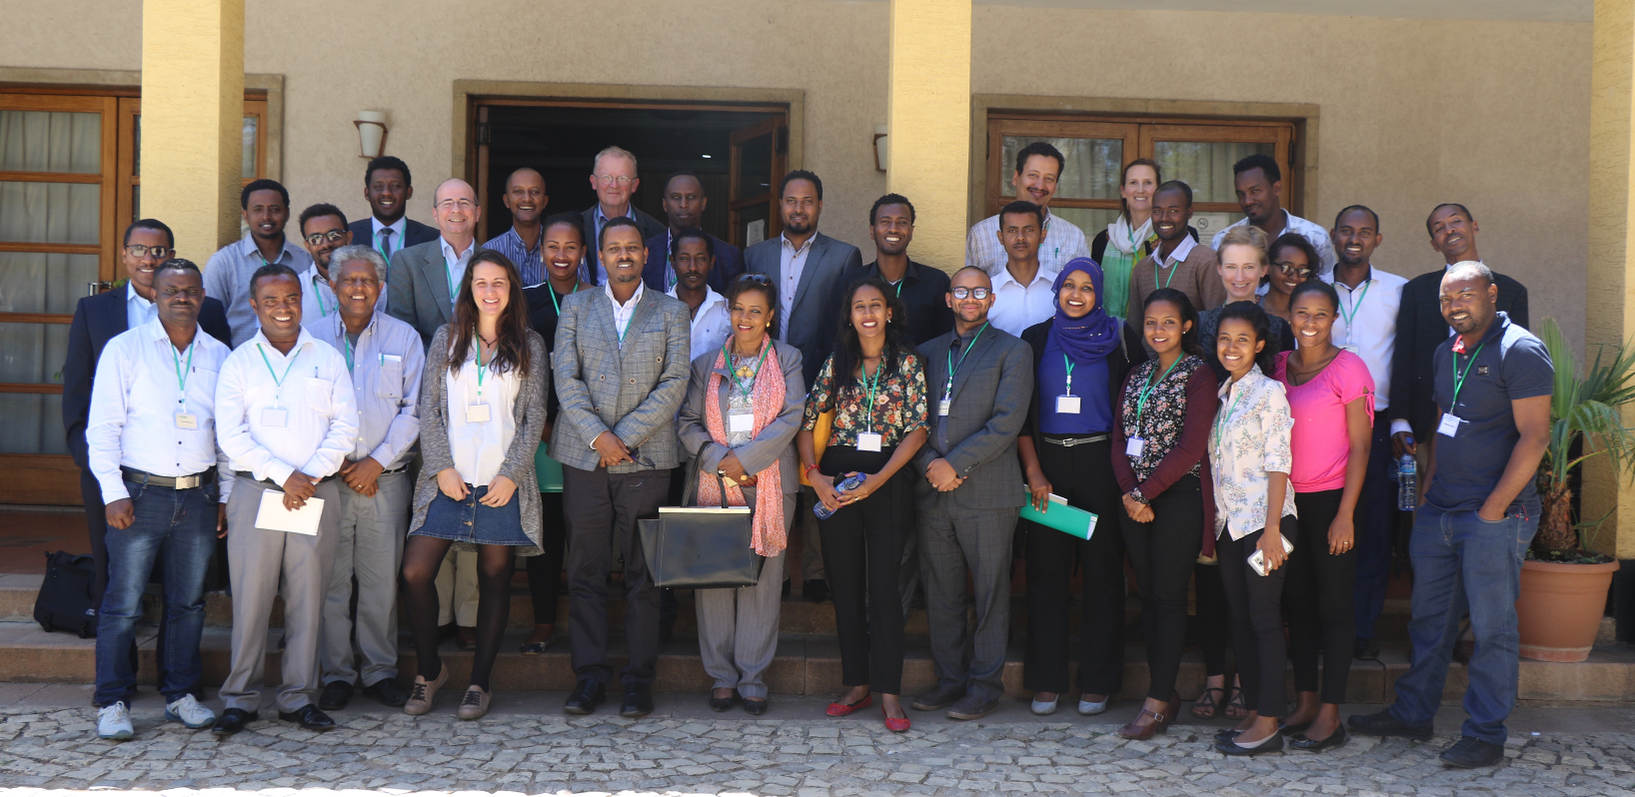
Advisory Board meeting, 31st Oct 2018

Slide 9
EPHI’s data to action strategy in the context of the CHAMPs project
Develop systems and infrastructure to manage and use of CHAMPS data
  Address issues related to data sharing,
  participate in DeCode panels
  Establish/adapt standard digitals system to structure data
  Oversee the systems and data in the systems
  Analyze CHAMPS and complementary data
  Harmonize CHAMPS data with other data sources to maximize impact
  Contribute to overall data management and epidemiology at IANPHI
  Ensuring the information developed is used widely

Slide 10
CHAPMS Ethiopia and EPHI collaboration with Data Access Working Group (cont.)
Collaborative involvement on the establishment of a Data Access Working Group with other CHAMPS site
On the development of informal group, to get key stakeholders together who will have input on data review process and share any specific site-constraints with DAWG
Discussion on data levels specific definitions for the data levels
On the decision of Data Access Plan agreement with other CHAMPS site

Slide 11
CHAPMS Ethiopia and EPHI collaboration with Data Access Working Group (cont.)
    Level 1- includes summarized data sets (charts, dashboards, tables) on the CHAMPS website and excludes identifiable data.
    Level 2- includes minimally restricted data and will also have basic end-user license agreement.
    Level 3- will be moderately restricted data and will require a data use agreement between Emory University and requesting individual/organization.
    Level 4- is highly-restricted data and will require IRB approval at Emory and/or potential Ethic Committee approval from each respective CHAMPS site institute from which data is solicited

Slide 12
Opportunities and challenges
Opportunities
CHAMPS present a unique opportunity for EPHI to generate reliable and valid data on child mortality and cause of death
EPHI has systems in place at different levels (from national to community)
  For notifiable disease surveillance
  Case based surveillance (eg. HIV)
  Mortality surveillance (eg, Maternal and perinatal death surveillance)
  Death review (decode)
  Response (rapid response team, data for local and national action)
  EPHI provides quality laboratory, back and referral services

Slide 13
Opportunities and challenges(cont.)
Challenges
  Poor engagement
  Poor awareness
  Other factors

Slide 14
Way forward
Hiring professionals to improve engagement
Improve participation in the monthly data access working group meeting
Develop data sharing platform with Haromay University, Kersa HDSS and CHAMPS project
  Explore EPHI’s data sharing platform for notifiable health events
  Explore EPHI’s data sharing platform for Maternal and Perinatal Death Surveillance and Response system
Establish secured electronic data transfer system and in house data storage with backup

Slide 15
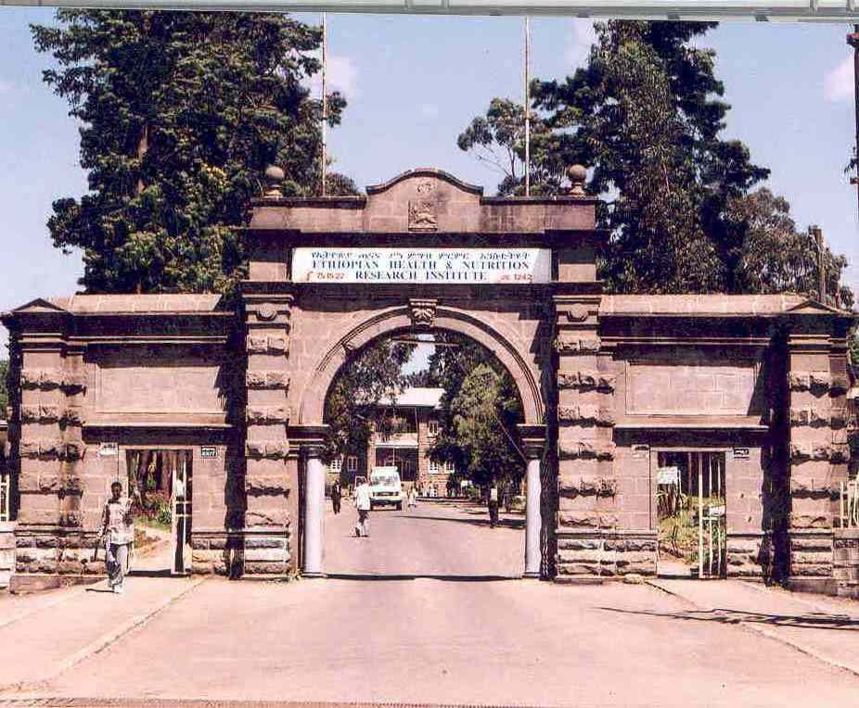
Thank you

