Slide 2


International association of national public health institutes
2018 Annual Meeting| London, England
The role of Law and Regulation in relation to National Public’s Health Institutes (NPHIs)
Ebba Abate (PhD)
Ethiopian Public Health Institute (EPHI)
Ethiopia

Slide 3

International association of national public health institutes
Roles of NPHIs
2018 Annual Meeting| London, England
  Public Health Emergency Management
  Capacity building and Quality improvement (Laboratory and others---)
  Evidence generation-Research
  Work force development

Slide 4
International association of national public health institutes
2018 Annual Meeting| London, England
Why do we need to have Law/Regulations to NPHIs
Provides defined roles and responsibilities- in line with the government set plan and policy
Avoids duplication
Autonomy and power (IHR 2005)
Legal protection
Ownership and sustainability
Resource and Financing
Foundation for successful collaboration
Etc----

Slide 5
International association of national public health institutes
The role of law and regulations to public health
2018 Annual Meeting| London, England
Eg. The Ethiopia Constitution Article 90, stated that
  To the extent the country’s resources permit, policies shall aim to provide all Ethiopians access to public health and education, clean water, housing, food and social security.
As results, Ethiopian Government also endorsed health policy:
    Established EPHI as primer implementer of public health (IHR, PHEM, Research, Data management add lab capacity)
    FMHACA (Regulatory Agency)
So, core Legislation for regulatory intervention on public health has been issued by government of Ethiopia

Slide 6
International association of national public health institutes
The Ethiopian Public Health Institute (EPHI)
2018 Annual Meeting| London, England
EPHI: established in 2013
  to address several needs in Ethiopia’s public health system
It has close to 1000 staffs and getting direct budgetary support from government and partners

Slide 7

International association of national public health institutes
Evolution of EPHI
1922- Hospital by the American
missionary, Dr. Lambie
1935- “Minstro dela Sanita”
1940- Imperial Medical Research Institute
1952- ‘Institute Pasteur d’Ethiopie”
established

Slide 8

International association of national public health institutes
Evolution of EPHI
1965- Imperial Central Laboratory
and Research Institute (ICLRI)
1986- the National Research Institute of Health
1996- The Ethiopian Health and Nutrition
Research Institute (EHNRI)
2013- Ethiopian Public Health Institute (EPHI)

Slide 9
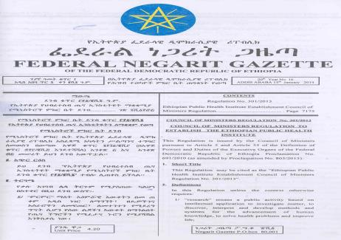
International association of national public health institutes
2018 Annual Meeting| London, England
EPHI-Endorsement
EPHI was created by regulation
  the Council of Ministers
The institute Director General and the Deputies are appointed by the Prime minister of the country

Slide 10
International association of national public health institutes
Accountability
2018 Annual Meeting| London, England
Accountable directly to the Ministry of Health
However, the Law gives EPHI full responsibility for its day-to-day operations.
Under emergency situation to use alternative approaches-more flexible

Slide 11
International association of national public health institutes
EPHI: Regulation and legal mandates
2018 Annual Meeting| London, England
Authority to coordinate emergency management nationally
Mandate to build the National Laboratory Capacity at National level
Legal framework for conducting public health research
Manage National Public Health data-NDMC
Clearly defined public health mandates, leadership, and lines of authority.
Funding directly from the Ministry of Finance and authority to raise funds from other sources.
Accountable to MoH and House of representatives (Parliament)

Slide 12
International association of national public health institutes
Takeaway Message
2018 Annual Meeting| London, England
A stronger public health law and regulation given to NPHIs is the foundation for success and sustainability- ensures addressing societal health needs

Slide 13
International association of national public health institutes
2018 Annual Meeting| London, England
Thank you!

