Slide 1

Sierra Leone NPHA: CHAMPS
Reverend Dr T.T. Samba
October 24, 2017
Notes:
Thank you for joining me today and thank you for your interest in the Sierra Leone National Public Health Agency (NPHA).
Planning for the SL NPHA has been underway since 2014.
We have been making progress with the development of the NPHA and I want to share that with you now.

Slide 2
Presentation Outline
CHAMPS Journey
CHAMPS Site
Activities to Date
Data-to-Action
Prospects for Integration of CHAMPS Data

Slide 3
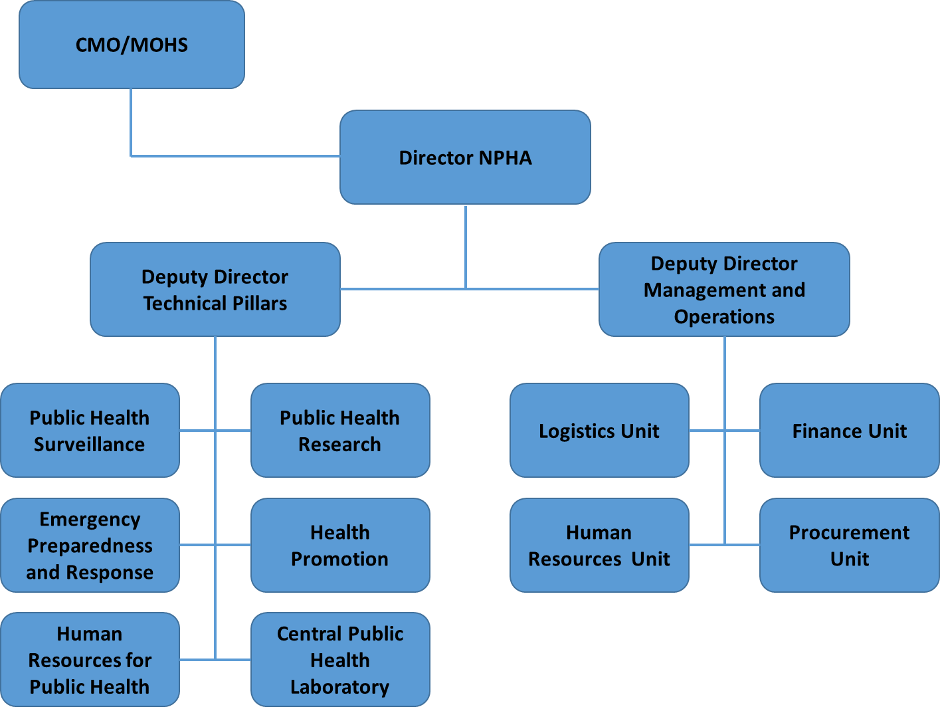
Sierra Leone NPHA: Vision and Mission
Presentation Outline
Vision
A Healthy Sierra Leone through evidence based leadership in Public Health.
Mission
To secure the health of Sierra Leone, as the trusted source of Public Health information, guidance, and leadership.

Slide 4

CHAMPS Journey: From Assessment, to DeCoDe, to Action
Data to
Action
DeCoDe
Panel
Help inform a range of policies and public health actions to reduce child mortality
Local & Central Histopath Analysis
Review all findings and assign cause of death
Microbiology, Real-Time PCR Analysis
Analyze tissues to understand pathogens associated with cellular changes; compare central and site findings
Clinical Data Verbal Autopsy
Identify pathogens in specimens that may have caused death
Specimen Collection
Gather other information around terminal state to improve context for DeCoDe panel
Mortality and Pregnancy Surveillance
Collect tissue and non-tissue specimens for further laboratory analysis
Social Behavioral Science
Identify deaths for MITS and collection of additional data
Understand acceptability of proposed processes
Notes:
Assigning a cause of death involves a series of steps to collect, analyze and interpret relevant data
The primary objective of CHAMPS is to track the causes of childhood mortality. This will be a steep journey to ascertain the cause of death in each of our surveillance sites. Here is a simplified overview of the processes that CHAMPS encompasses.
First As mentioned a unique aspect of this surveillance program is to use postmortem collection of specimens for further diagnostic testing.
As you can imagine because of the sensitivity of this subject and CHAMPS procedures the starting step and foundation for this whole process is the community assessment and engagement which is a function of our SBS team

Slide 5
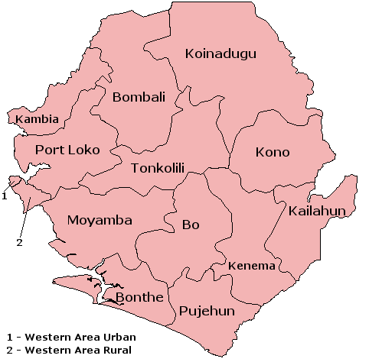
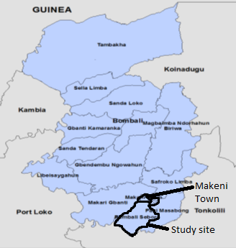
CHAMPS Site : Bombali Shebora Chiefdom
Presentation Outline
Basic demographic and health parameters
Population 161,383: including Makeni city (population 125,970)
20,000 under-five children
5,500 live births annually
Under-five mortality rate 120 per 1,000 live births
670 under-5 deaths per year
150 stillbirths per year
Nationally: about 70% of under-five deaths are due to communicable diseases, neonatal sepsis and other neonatal infections

Slide 6
CHAMPS: Work to October 2017
Presentation Outline
Governance
Advisory group established with MoHS and CDC as co-Site Directors
SBS
Protocol approved by Ethics and Scientific Review Committee
Initial PICK-CHAMP community engagement workshops completed
Mortality Surveillance
Protocol approved by Ethics and Scientific Review Committee
Partners and geographic location identified
Budgets and work plans prepared
Death notification Pilot started Oct. 9, 2017
Formative research ongoing, community engagement strategy developed and launched
SBS and mortality surveillance teams recruited
Verbal autopsy and clinical data abstraction in preparation to be started Feb. 2018
Notes:
SBS= Social Behavioural Science

Slide 7
CHAMPS: Data to Action
Presentation Outline
Local:
Community engagement sessions and empowerment for strategies to reduce causes of stillbirth and U5 child mortality
Guide prevention & response efforts at participating health facilities
Contribute to weekly epidemiological bulletin for Bombali district
Guide mortality prevention committee reviews – can build on Maternal Death Review Committee experience with stillbirth and U5mortality
National:
MoHS website data hosting (health.gov.sl)
NPHA to act as a repository
Contribute to MCH health policy and strategy
Leverage donor support to measure MCH intervention impact
Solidify further evidence on causes of Childhood deaths in Sierra Leone

Slide 8
Prospects for Integration of CHAMPS Data into NPHA
Presentation Outline
NPHA is designed to have a credible data repository
This data is to be used for a variety of useful courses such as decision making, programming, policy formulation, resource mobilisation, disease prevention and control and mortality reduction
CHAMPS will generate data that is relevant to the overall goal of the NPHA
There are very good opportunities for integrating CHAMPS data into the NPHA repository

Slide 9
Thank You
Presentation Outline

