Slide 1


Meaning of Independence of NPHIs
Tolbert Nyenswah, LLB, MPH
Director General
National Public Health Institute of Liberia (NPHIL)
2017 Annual Meeting
ISS, Rome, Italy
October 22-25, 2017

Slide 2

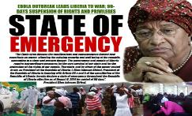
Over view of EVD in Liberia ……2
2nd Wave:
  Confirmed 30 May, 2014
  Confirmed Case: 3,150. Deaths 4, 785
  Health Care Workers: 378 (192 deaths)
  Declared free of Human Transmission on 9 May, 2015

Slide 3
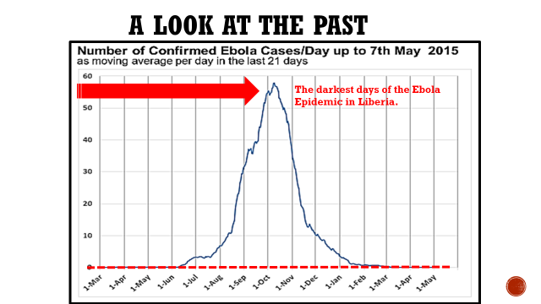

Slide 4
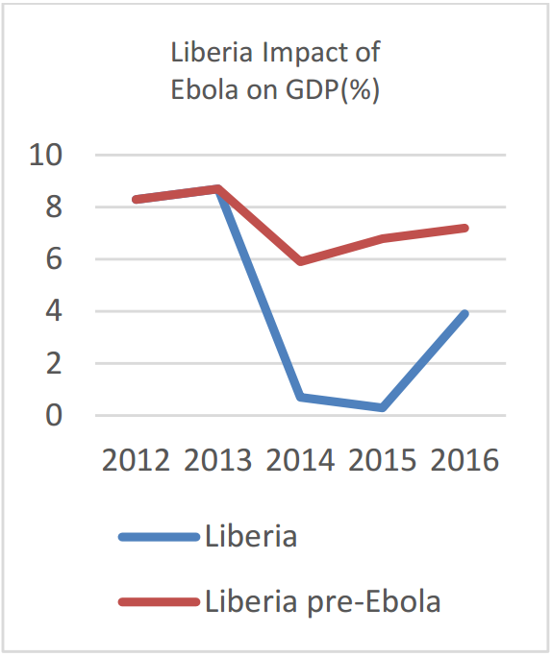
A weak Public Health System created An EVD Crises that destroyed the Economy
The economic and fiscal impact has outlasted the epidemiological impact due to severe shocks to investment, production, and consumption throughout the region, coupled with commodity price shocks.
The World Bank Group, 2016

Slide 5
Critical Timeline and Next Steps
Study Tour: Thailand
Strategic Plan
Operational Plan
Stakeholders meetings
Negotiation for new HQs
ACT passed into Law
Oct
2015
Dec
2015
Jan
2016
Feb.
2016
Mar
2016
May
2016
Jul
2016
Aug
2016
Dec
2016
Jan
2017
Feb
2017
Mar
2017
OCT
GB
New
HQs
Study Tour:
Norway
ACT of the NPHIL
Fund Raising
Transition Processes from MOH
Complete Functional Dept
Cabinet
Presentation

Slide 6
Vision and Mission of the NPHIL
Vision:
A center of excellence for better health outcomes for Liberians through a strong health system
Mission:
To prevent and control public health threats by promoting healthy outcomes and serving as a source of knowledge and expertise

Slide 7

Liberian Legislature Passes National Public Health Institute of Liberia Act.
FPA News: Monrovia – The House of Representatives on December 8, 2016, concurred with the Liberia Senate on the passage of the Act to establish the National Public Health Institute of Liberia (NPHIL) and the Act that officially creates the new Ministry of Health.
The core mission of the Institute will be, to prevent and control public health threats. Its vision is to create a center of excellence for better health outcomes.

Slide 8
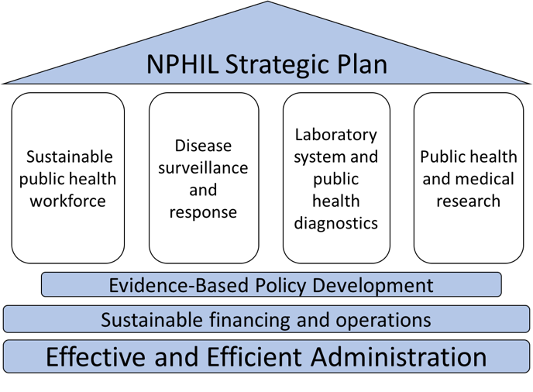
NPHIL Pyramid, Key Pillars
Notes:
NPHIL Department
Overview of Core Functions
Training and Capacity Building
Develop and coordinate national and international opportunities for advanced public health education and training for Liberian researchers
Support the development of higher education in public health and medical research in Liberia
Infections Diseases and Epidemiology
Implement public health surveillance efforts and develop national strategic plans for responding to diseases of epidemic potential.
Make data generated through the system available for evidence-informed policy generation
Laboratory and Public Health Diagnostics
Provide diagnostic capacity, including a comprehensive National Laboratory Network, for timely and reliable detection of priority conditions and diseases
Public Health and Medical Research and Development
Facilitate public health and medical research activities by developing capacity and infrastructure and promoting the adoption of evidence-based policies to mitigate public health risks
Promote regional and international research partnerships and collaboration
Provide expert opinion and technical guidance on key public health issues, medical conditions, and healthcare quality assurance

Slide 9
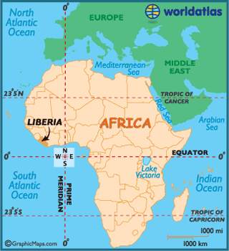
Strategic Values of the Proposed NPHIL
National Benefits
Epidemic preparedness
Improved surveillance
Reduction in morbidity and mortality
Reduction in reactive treatment costs
Shift to prevention
Improve health innovation and technology
Strong PH Laboratory System- IDSR- detection
Independent research capacity
Regional benefits
Academic and research opportunities for African scientists
Laboratory and diagnostic capacity in close proximity
Affiliation with the African CDC
Global benefits
Decrease dependence of Liberia on international aid
Advance global study of tropical disease
Contribute novel devices and methods
Contribute to GHSA Liberia-satellite Country
Not New Institution: Packaging, repurposing and Improving recessive Institutions to meet 21st century realities.
Empirical Experience from Ebola

Slide 10
Organogram Based on the
NPHIL ACT of 2016
Board of Directors
MOH, MOA, MFDP, UL, TU, CSO, Elect Chair-
Director General
Deputy Director General
for Technical Services
Deputy Director General
for Administration
Director for Training and Capacity Building
Director for Infectious Diseases & Epidemiology
Director for Laboratory and Public Health Diagnostics
Director for Public Health and Medical Research and Development
Chief Financial Officer
Head of Human Resources
Logistics
Communication

Slide 11
Sustainability Plan
Alignment with Strategic Partners
  Universities and Donors (WHO, World Bank, CDC, NIH, DOD etc.)
Establishment of the NPHIL Foundation
  Modeled after CDC foundation
Linking with the Universities of Liberia
  Joint appointments
  Support training and creation of Masters programs
Diversifying funding sources
  GoL Budget Line from the very beginning Direct funding from National Treasury.
  Fees, grants, donations, consulting and service fees, cooperative agreements
  Recruitment, Staffing, Training and Deployment issues

Slide 12
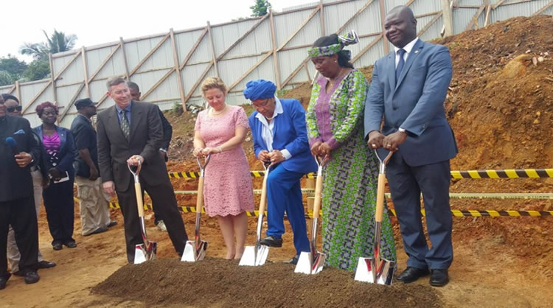
Groundbreaking for New NPHIL complex
FPA: Monrovia – The National Public Health Institute of Liberia (NPHIL) in collaboration with the U.S. Department of Defense Biosafety and Biosecurity Program Thursday broke grounds for the construction of a new facility which will serve as the headquarters of two new Public health facilities that will enhance Liberia’s ability to diagnose and conduct research on infectious diseases, 2017 Oct. 5th

Slide 13
Thank you!

