Slide 1


Role of NPHIs in Policy Support and Behavior Change for Health Improvement
Rome, October 23, 2017
The role of the Istituto Superiore di Sanità in
Policy Support and Guidance
Stefano Vella MD

Slide 2

The National Institute of H ealth of Italy:
the health research and policy reference center in Italy
Mission:. The National Institute of Health (Istituto Superiore di Sanità) is the leading technical and scientific body of the Italian National Health Service. Its activities include research, clinical trials, control, and training. It also serves as a major national clearing house for technical and scientific information on public health-related issues.
Vision: The National Institute of Health produces knowledge through basic and applied research activities and disseminates knowledge and scientific evidence to decision-makers , economists and citizens in order to protect and promote public health
“Improving health in Italy and in the world”

Slide 3
The role of the National Institute of Health of Italy (ISS): a knowledge creator and a disseminator
Regions
Patients Organisations
International
Italian Medicines Agency AIFA
Scientific Societies
UN System
ISS- National Institute of Health of Italy
Global Fund
Citizens
University
Ministry
of
Health
EU Commission
Ministry of Research
AGENAS
International Bilateral Cooperation
The Network of Research Hospitals (IRCCS)

Slide 4
The role of the National Institute of Health of Italy (ISS): knowledge creator and disseminator working together with the Ministry of Health
ISS is working closely with the Italian Ministry of Health and with all national health Institutions.
ISS is also investing at the EU level, and has launched an EU Office in Brussels
For specific projects, the ISS acts as a funding agency to support scientific programs of national relevance and to promote the Italian participation in international activities.

Slide 5
The role of the National Institute of Health of Italy (ISS): knowledge creator and disseminator working together with the Ministry of Health
ISS is the national contact point within relevant EU Research Infrastructures such as ECRIN (European Clinical Research Infrastructures Network), BBMRI (Biobanking and Biomolecular Resources Research Infrastructure), EATRIS (European Advanced Translational Research Infrastructure in Medicine)
ISS participates also in the article 169 EDCTP2.
ISS promotes scientific and policy research in a wide variety of fields of special relevance for public health, and in particular, basic, translational and clinical research in major disease areas, including cancer, and neurological, infectious and rare diseases.
Research priorities are based on those set forth in the National Health Plan.

Slide 6
ISS – Scientific and Technical Areas
6 Departments
16 National Centers Nazionali + 2 Reference Centers
5 Services
Environmental Health
Eugenia Dogliotti
Rare Diseases
Domenica Taruscio
Health Promotion and Diseases Prevention
Angela Spinelli
Health Technology Assessment
Marco Marchetti
Biological
Laura Nicolini
Ageing and Chronic Diseases
Simona Giampaoli
Eccellenza Clinical, quality and safety of care
Primiano Iannone
Additions (alcohol, tobacco etc..) and doping
Roberta Pacifici
Control and evaluation of drugs
Carlo Pini
Coordination and support for research
Luisa Minghetti
Infectious Diseases
Giovanni Rezza
Preclinical and Clinical evaluation of drugs
Patrizia Popoli
Research on HIV/AIDS
Barbara Ensoli
Global Health
Stefano Vella
Grant Office and technology transfer
Pietro Panei
Neurosciences
Maurizio Pocchiari
Telemedicine and new welfare technologies
Francesco Gabbrielli
Chemicals, cosmetics and consumer protection
Rosa Draisci
Radiation protection and computational physics
Francesco Bochicchio
Core facilities & equipment
Marco Crescenzi
Oncology and molecular medicine
Mauro Biffoni
Innovation in Public Health
Mauro Grigioni
Animal experimentations and welfare
Rodolfo Nello Lorenzini
Reference Center for behavioral sciences and mental health Enrico Alleva
Statistics
Susanna Conti
Food security, nutrition and veterinary health
Umberto Agrimi
National Trasplant Center
Alessandro Nanni Costa
National Blood Center
Giancarlo Maria Liumbruno
Reference Center for gender medicine
Walter Malorni
Notified body
Roberta Marcoaldi

Slide 7
Examples of ISS policy support and guidance
Tobacco Control; Early Warning System on New Psychoactive Substances (NPS)
Alcohol Abuse,
Anti-doping policies and control of drug addiction services
Infectious Disease Surveillance
Antimicrobial Resistance ONE Health approach: veterinary and human health
Vaccination
Mental Health and Behavioral Sciences
First in man/phase I scientific committee. Quality of medicines
Improving Health Systems:
HTA and HSPA, Innovation in healthcare,
Food safety and Security; Nutrition and Childhood Obesity
Rare diseases, e.g. Patients Registries , ERNs Rare diseases National Plan projects
Health Information for the citizens
Measuring Health inequalities;
Guidelines for Migrants Health
Italian Therapeutic Guidelines System
Population Surveillance system and Patients registries (maternal mortality, Children health, Lifestyles, Performance of Health System, medical assisted reproduction)
Ensuring health security: blood, tissues and organ transplantation
Italian Database of mortality and hospitalizations
Assessment of the risks to human health arising from environmental exposures
Risk factors for Major Chronic Diseases, cardiovascular Diseases, Neurosciences, Cancer and Oncology
Advice on bioethical issues in research and institutional activities,

Slide 8
The policy guidance role of the ISS at the European level

Slide 10
Fresher objectives
Producing quantitative estimates of the future global burden of NCDs in the EU and its impact on
  Health care expenditures and delivery
  Population well being
  Health and socio-economic inequalities
  Goal: to Identify and present alternative health scenarios to test future policies that tackle the burden of NCDs
TIME FRAME: 2020 → 2050

Slide 11
FRESHER approach
Combining qualitative foresight methods and quantitative forecast modelling
Extensive use of Forward Looking methods and techniques (critical uncertainties and risk factors, horizon scanning, scenario building) to capture interdependencies of structural long term trends (technological, economic, environmental, societal incl. demography and gender relations)
Microsimulation model to quantify health and socio-economic impacts of alternative policy options

Slide 12
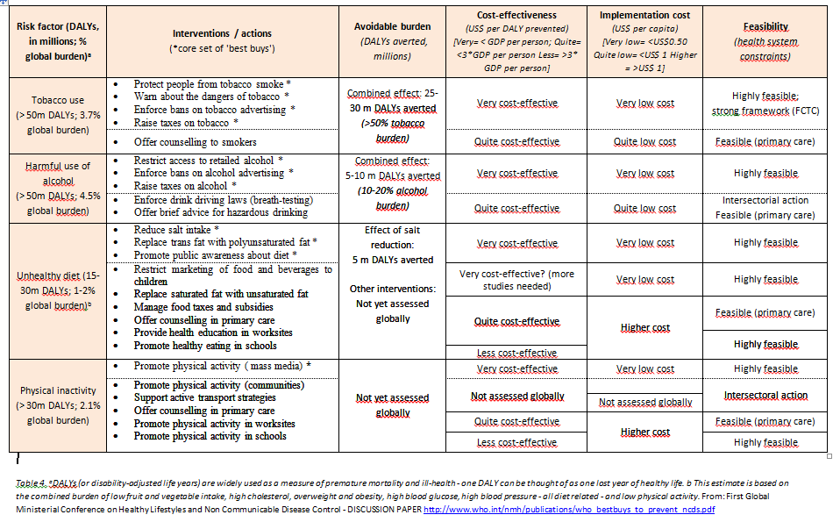
Risk Factors Policies (the classical ones)
Notes:
In D6.2 we then had a look in the cost effectivenss and impact of these policies

Slide 13
Horizon scanning: From Policies addressing risks factors and diseases to Policies targeting DISTAL determinants and drivers
Demographic change
Equality
Education
Nutrition
Industrialization of food production
Chemistry and pestizides
Organic farming
Agriculture
From drivers to trends
Physical activity
Marketing and advertising
Urban development
Social innovation
Changes in gender roles
Innovation in medicine
Environment
Social networks
Mental well-being
Depression, unemployment and stress

Slide 14
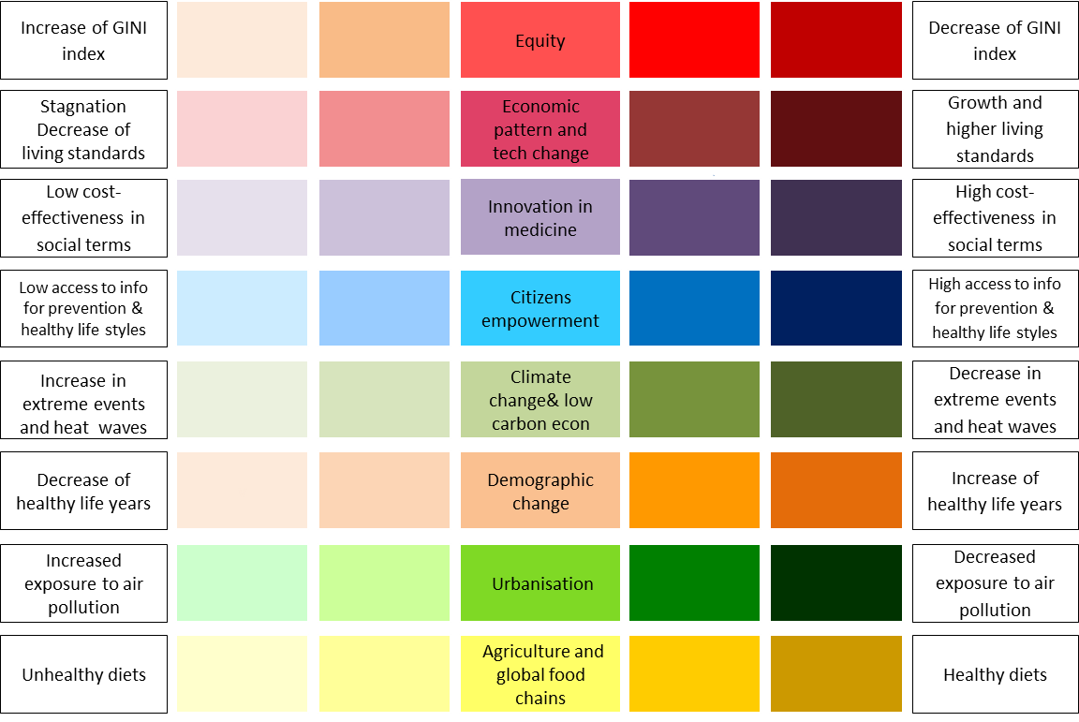
FRESHER SCENARIOS OVERVIEW
DESOLATION HEALTH
RICH GET HEALTHIER
WE WILL TREAT YOU
HEALTHY TOGETHER

Slide 15
Desolation Health Scenario
Equity |  | European society is highly unequal due to the collapse of social policies, ever-lasting economic stakgnation, the inadequate organisation of public authorities and widespread corruption.
Technological change and economic innovation |  | Technological change has continued in terms of digitalisation but most EU countries have failed to take advantage to create new jobs and re-organise economic activities. EU countries have lost their competitive advantage in the world market.
Innovation in medicine |  | No significant discovery in medicine. Investments in R&D are stagnating and undertaken only by big pharma in partnership with insurance companies.
Citizen empowerment |  | Internet is used to escape reality. More than before citizens need to live in a ‘second life’ on the internet and are willing to sacrifice social interactions to maintain their on-line “status”. There is an increase of the use of on-line games in the health sector to help promote and test medicine and treatments.
Climate change and decarbonisation |  | Environmental break down and economic war over resources. Environmental resources are scarce and cause conflicts worldwide. Climate change is worsening, causing continuous environmental emergencies and threatening human survival in many areas.
Demographic Change and migration |  | The European population has aged without taking any precautions with regards to health insurance, relying on the existing but failing European social security of previous decades. The public healthcare sector is collapsing in most countries. Europe is no longer an attractive place for migrants with a wave of migration of European citizens underway.
Urbanisation |  | Cities are constantly engulfed in financial crises due to the impoverishment of the population and persistent corruption. As a consequence, the provision of essential services is reduced. People live in polluted, chaotic cities that are characterised by insecurity and violence.
Agriculture and global food chains |  | Proliferation of global food chains. Few big corporations have monopolies and commercialise highly processed food. The intake of nutrients is highly unbalanced and the variety of food is low.
Notes:
Today’s health priority is to maintain basic health care services available to citizens.
The decline of the European model started three decades ago when nationalist movements took over by promising to bring back wealth and security. It didn’t happen but European governance, shared values and the common market were destroyed in the attempt. Now, European countries, regions and cities face different challenges: while some have managed economic recovery, others have lost their competitiveness in international trade and show very unstable patterns of growth. To gain some legitimacy, national governments cooperate with different stakeholders for policies that are short-sighted as the time frame is generally set for the next election.
Economic stagnation has led many countries to gradually reduce number of people that can avail public services, increase user charges for services and limit the number of public health providers. These measures, especially in times of high unemployment and low income, create “health shocks”, defined as unpredictable illnesses that diminish health status, to which citizens got costumed. Innovative medicines and treatments remain hardly affordable for European states and citizens.
The high unemployment rates coupled with the deterioration of living standards undermine the community values and lead to tensions among citizens and mistrust in policies. Moreover, citizens suffer the consequences of climate change as international agreements are stalled since decades. There is a rise in the frequency and length of heat waves, as well as extreme events, especially in vulnerable regions, from where people increasingly emigrate. Mortality due to these events, as well as communicable diseases and pandemics related to them, drain resources, which are already scarce, from national healthcare systems.

Slide 16
The rich get healthier Scenario
Equity |  | European countries have witnessed a rise in inequality following the privatisation waves of the beginning of the century. Wealth is now concentrated in the hands of a few who live in gated areas. Society is stratified.
Technological change and economic innovation |  | Digitalisation of the economy has led to high structural unemployment. Technology is owned/controlled by a limited number of private companies, pursuing profit-seeking behaviours and collecting all the productivity gains without sharing it with workers.
Innovation in medicine |  | Exclusive medical innovations. Innovation in medicine is financed by private companies, focusing on new health solutions for diseases affecting wealthy people, to ensure high monetary returns to R&D investments.
Citizen empowerment |  | Citizens are overwhelmed by commercials and information tailored by companies to shape their desires and expectations. Only few people have the knowledge and time to navigate this turbulent digital world.
Climate change and decarbonisation |  | Reformed international climate change panels and prices on environmental goods and services. Production is reshaped with technologies and solutions to lower emissions and meet agreed targets. Environmental goods and services are considered high priced commodities for which citizens need to pay.
Demographic Change and migration |  | Beyond differences between countries, today the world seems divided in income categories: wealthy strata of the population get very old and stay healthy in their ageing, while the poorest either die prematurely or experience severe conditions whilst incurring diseases and disabilities Increased global cooperation.
Urbanisation |  | Wealthier people live in similar ways around the globe with easy access to education, health services and healthy food, fast transport opportunities and ecosystem services (food, water, green areas). Conversely, those who belong to less wealthy social groups struggle
Agriculture and global food chains |  | Polarised agriculture and food system.
Notes:
Freedom and meritocracy are the pillars of societal structure.
Market forces are dominant and a ‘light government’ has the main role of guaranteeing the functioning of the economic playground. Following the economic crisis of the beginning of the century, many European states have privatised the health-care and education sectors to guarantee that their public debt falls in line with European thresholds and have deregulated labour to revitalise the stagnating economy. These policies induced a new wave of economic growth but European citizens paid a high price in terms of equity.
Health is now just like many other services: potentially available but expensive. The more you can afford it, the better cure you will receive by picking from an incredibly rich basket of medical innovations including new-generation biomedical devices. While citizens’ health is left to individual decisions and financial capacity, global governments have agreed on protecting the environment by pricing it.
This policy works to the extent that most of the economies are now decarbonised and climate change is under control. However, it confers an elitist character to global governance, with a focus on achieving results with no or limited concern for the level of inclusion of the solutions pursued. As a consequence, this system ends up reinforcing existing patterns and societal structures, failing to give adequate representation and promote the interests of more marginalised, less educated and poorer groups.
Even in times of economic growth/recovery, the demolition of welfare states has created new, unexpected challenges: the growing tensions among citizens make security rise in the political agenda, the number of citizens marginalised seems to increase and populist movements gain ever growing consensus.

Slide 17

We will health you Scenario
Equity |  | In a competitive world, equity is reached in the EU by ensuring that economic growth leads to (some) social progress. In Europe, equity is improved thanks to the new wave of economic growth and targeted redistribution policies.
Technological change and economic innovation |  | Europe is a dynamic and innovative economy competing with emerging economies’ cost advantage by delivering high-quality goods and services. The European knowledge society, led by a top-down approach- makes the most of technological advancements although the boost in productivity does not entail any radical changes in the production system.
Innovation in medicine |  | Breakthrough in personalised medicine. Thanks to government- managed big data, implanted chips and gene scans personalised prevention and treatment, including tissue regeneration, are accessible.
Citizen empowerment |  | Uniform society in which on line information is strictly controlled. A new order is set in the digital world, now governed by an alliance of governments, industries and citizens’ representatives to serve public policy goals.
Climate change and decarbonisation |  | Growth beyond environmental limits. Increases in production and consumption put pressure on ecosystems. Green investments are only undertaken if economically profitable.
Demographic Change and migration |  | Europeans are old but healthy and work longer to sustain themselves and to be part of the work-oriented society. Migration rises but the EU accepts only those who can match the qualification needed in the EU economy.
Urbanisation |  | Cities are the engine of growth and first and foremost place to work. Urban planning aims at offering the optimal condition to work (housing, transport and health services) and disregard everything that is not related to productivity, including environmental issues.
Agriculture and global food chains |  | Industrialised agriculture. There is widespread use of chemicals and biotechnologies to increase agricultural production. Food is produced in laboratories and diets are monitored to ensure the intake of balanced nutrients.
Notes:
Today’s priority is to guarantee access to adequate health care for European citizens.
Governments and the private sector collaborate closely to maintain a healthy workforce and NCDs under control, with the aim of ensuring the continuation of economic productivity as well as the sustainability of the healthcare systems. Thanks to big data, public and private investments effectively influence citizens’ behaviour towards healthy lifestyles.
By offering healthy working environments and care services employers compete to attract talented, motivated and well-educated people. On the other hand, thanks to fair labour legislation, employees increasingly have the means, including money, time and knowledge to take better care of their own health. This top-down approach is accompanied by ambient 24/7 surveillance measures and a high degree of regulation and control of individual behaviours through personal implanted chips. However, renouncing privacy is considered a small price to be paid for the advantages offered by tele-medicine and tailor-made diagnostics and treatment.
EU countries enjoy a new era of economic growth and social progress founded on education, innovation and full employment, thanks to important government action, and the “European model” stands out in an increasingly competitive world. Environmental sustainability is in the background as efforts are focused on producing and delivering more to everyone, without any paradigmatic change in production and consumption. This leads to the continuous outbreak of environmental emergencies, the exacerbation of pandemics and the increase in economic and environmental migrants. Migrants from non-EU countries are only let in following very restrictive migration policies that take into consideration their possible contributions to the EU economy’s growth.

Slide 18
Healthy together Scenario
Trends
Equity |  | Equity is a global goal and goes hand in hand with sustainability goals. Equity is fostered by highly inclusive social policies and universal healthcare, delivered through new welfare schemes and innovative social protection programmes,
Technological change and economic innovation |  | Digitalisation has facilitated the transition towards a circular economy and reshaped society. Machines are used to decrease working hours and the gains from the increase in productivity are shared among workers through social dialogue.
Innovation in medicine |  | Disruptive innovation and access to medical innovations enhances treatment outcomes and prevention on a personal and community level. Progress in medicine is made thanks to new organisational practices.
Citizen empowerment |  | Slow society, diversity of cultures. Citizens are well educated, connected, and aware. Citizens have reached a level of empowerment that allows them to use social networks to enhance their public engagement and look for health support when needed.
Climate change and decarbonisation |  | Circular and decarbonised economy. Any investment is assessed against social and environmental goals. Everybody contributes to reduced carbon emissions.
Demographic Change and migration |  | Elderly citizens are healthy and active in society thanks to the combined effect of individual behaviours and welfare reform. Thanks to a new global coalition there is a recognised right of free movement of people but number of migrants is reducing.
Urbanisation |  | Smart and environmentally and socially just cities. Cities are greener, less congested and less polluted thanks to smart urban solutions and the engagement of citizens’ networks.
Agriculture and global food chains |  | Local production of food and urban gardening. Sustainable agricultural practices are widespread and people prefer to consume fresh local food, due to an awareness of health benefits and the assignment of a social value to it.
Notes:
Today’s priority is to promote health and well-being for all.
Governments, the private sector and citizens’ networks collaborate closely to develop and experiment solutions that promote quality of life, healthy opportunities and efficient care. The overarching aim is to guarantee good lives for all while respecting the limits of the planet. Health concerns have long been included in all policies on a global level and EU strategies systematically set health targets in all relevant EU policy areas. When governments take the lead for delivering policy, citizen participation is ensured throughout the policy making process and policy-makers as well as industries are held accountable for the health impact of products, services and policies by well organised networks of citizens. These mechanisms allow for effective regulation that respects individuals’ aspirations and needs, while promoting equity, sustainability and human health.
Human well-being and happiness are the new metric of development, which does not merely focus exclusively on GDP growth. High value is given to leisure, having a sense of community and nature, rather than economic wealth. While fair incomes level up everyone’s means, recycling and sharing allows for overcoming the need for continuous increases in the production of goods, lowering the focus on productivity and the pressure on the environment. This new socio-economic pattern provides for the means to take better care of one’s own health but also to care about others through informal networks and community engagement

Slide 19
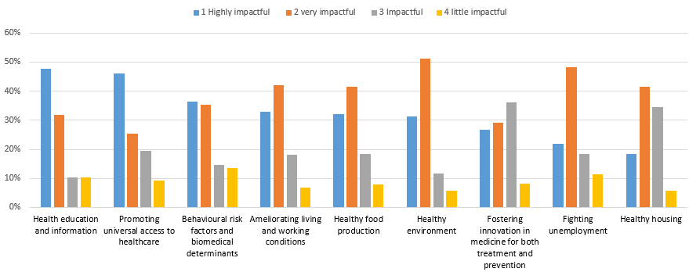
Imagining a change toward a healthier future, whether 'Healthy together' or 'We will health you', what do you think will be the most impactful policy areas in fighting the future burden of NCDs?

Slide 20
Policy Areas
 | Highly impactful & very impactful
Healthy environment** | 83%
Health education and information** | 80%
Ameliorating living and working conditions** | 75%
Healthy food production** | 74%
Behavioural risk factors and biomedical determinants | 72%
Promoting universal access to healthcare | 71%
Fighting unemployment | 70%
Healthy housing | 60%
Fostering innovation in medicine for both treatment and prevention** | 56%

Slide 21
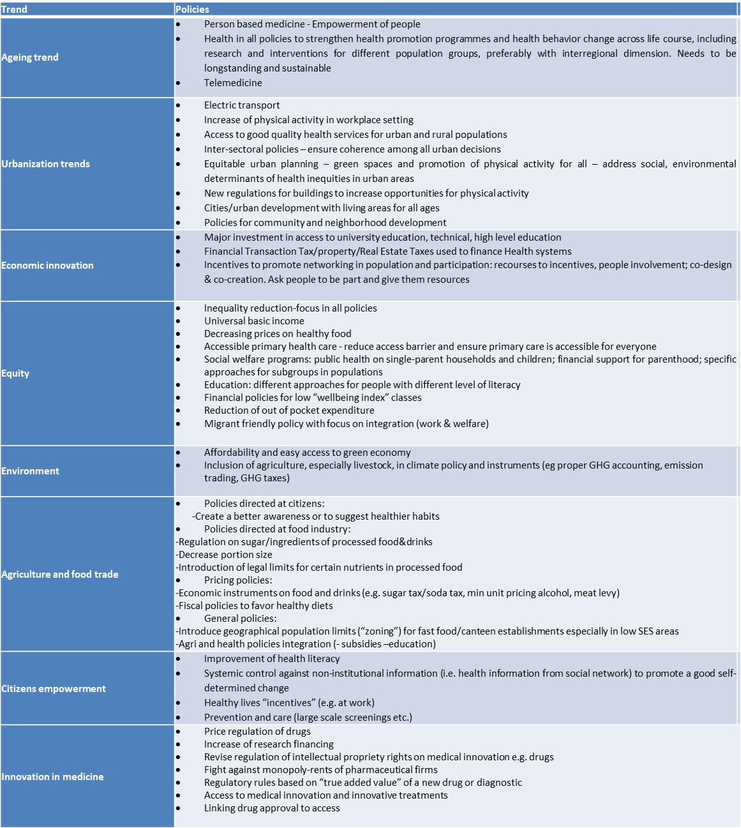
List of future policy options identified (1)
Notes:
And a List of desirable policy options was produced
The most discussed three have been urbanization, environment and equality (this fitted well also with the choices done for the scenarios.

Slide 22
List of future policy options identified (2)
Notes:
These are perceived as those that will and can have the most important effects on NCDs (both acting on risk factors and risk behaviours since they indirectly impact all other trends.

Slide 23
ISS and Health Systems Research
A CSA Born to identify the European Health Care common challenges and organizational needs,
and to propose possible solutions to improve health system performance and
to identify the most effective ways to organize, manage, finance, and deliver high quality care to our citizens

Slide 24
The Challenges

Slide 25

The changing health systems landscape: preparing for the “perfect storm”
Scarcity of resources
Chronic diseases, multimorbidity
Growing expectations of patients/citizens
Demographic change and population ageing, migration
Expensive biomedical innovations:
breakthrough medicines
and biomedical devices
Health Systems
The commonest chronic conditions are costing the EU countries more than 1 trillion Euros per year, which is expected to increase to 6 trillion Euros by the middle of the century.

Slide 26
The Health Systems

Slide 27
Health systems differ widely but face common challenges
European countries and their health systems share common values with regards to social protection, social cohesion and social justice as well as to sustainable development.
To maintain these fundamental values, decision makers at national, regional or service level need to explore solutions to ensure that they can continue to provide health care that is of high quality, responsive, affordable, accessible, equitable and financially sustainable.
There is a growing consensus that the traditional way of organizing care is not longer appropriate to address the various challenges. Instead a shift in focus is required, which includes (but is not limited to):
  from acute care to prevention and early intervention;
  from inpatient and hospital care to outpatient and primary care
  from fragmentation to integrated care;
  from professional dominance to citizen and patient empowerment;
  and from volume to value based financing mechanisms.

Slide 28
Huge number of Biomedical Innovations are at the Horizon

Slide 29
All biomedical innovations to come (and those already here) - for both prevention and treatment – from basic science to clinical science - need to be “translated” to our citizens, who represent the ultimate beneficiaries of our work.
The “translators” are….. our health systems.

Slide 30
Health Systems and Services Research
Health Systems and Services Research is the multidisciplinary field of scientific investigation that studies how social factors, financing systems, organizational structures and processes, health technologies, and personal behaviors affect access to health care, the quality and cost of health care, and ultimately our health and well-being.

Slide 31
The TO-REACH consortium
Chaired by Prof Walter Ricciardi, President of the Istituto Superiore di Sanità), the EU-funded TO-REACH project consists of 27 partners, clustered around three main types:
At the core are Ministerial and funding bodies from 15 EU Member States and 5 non-EU countries, all seeking to fund research that has the potential to change how care is being provided in the near or distant future.
  the Istituto Superiore di Sanità (the Italian National Institute of Health), coordinator,
  Ministero della Salute, Italy
  Agenas, national Agency for regional health services, Italy;
  ZonMw (Netherlands Organisation for Health Research & Development), the Netherlands;
  Austrian Public Health Institute (GÖG), Austria
  Academy of Finland, Finland;
  IReSP/ITMO santé publique, France;
  Health Research Board, Ireland;
  Latvian Council of Science, Latvia;
  Research Council of Norway, Norway;
  Foundation for Science and Technology (FCT) Portugal;
  National Institute of Public Health, Slovenia;
  Forte, Swedish Research Council for Health, Working Life and Welfare, Sweden;
  Federal Office of Public Health (FOPH), Switzerland;
  Health and Care Research Wales, UK;
  Regional Agency for Public Health and Social Well-being (PHA) HSCNI, Northern Ireland UK;
  CIHR Institute of HSPR, Canada;
  Israeli Ministry of Health, Israel;
  Agency for Healthcare Research and Quality (AHRQ), United States.
National research organisations, able to identify methodological guidance for a future research programme and mapping shared priority areas between countries and stakeholders in those countries.
  NIVEL, Netherlands organisation for health services research, the Netherlands;
  National Institute for Health and Welfare (THL), Finland;
  University of Riga (RSU), Latvia;
  University of Malta (UoM), Malta;
  Babeș-Bolyai University (UBBCU), Romania;
  Catholic University of Sacred Heart (UCSC), Italy.
European level bodies, able to contribute to part of the scientific preparations as well as well-positioned to identify fellow bodies and initiatives which require alignment.
  European Observatory on Health Systems and Policies;
  European Health Management Association (EHMA);
  European Public Health Association (EUPHA).

Slide 32
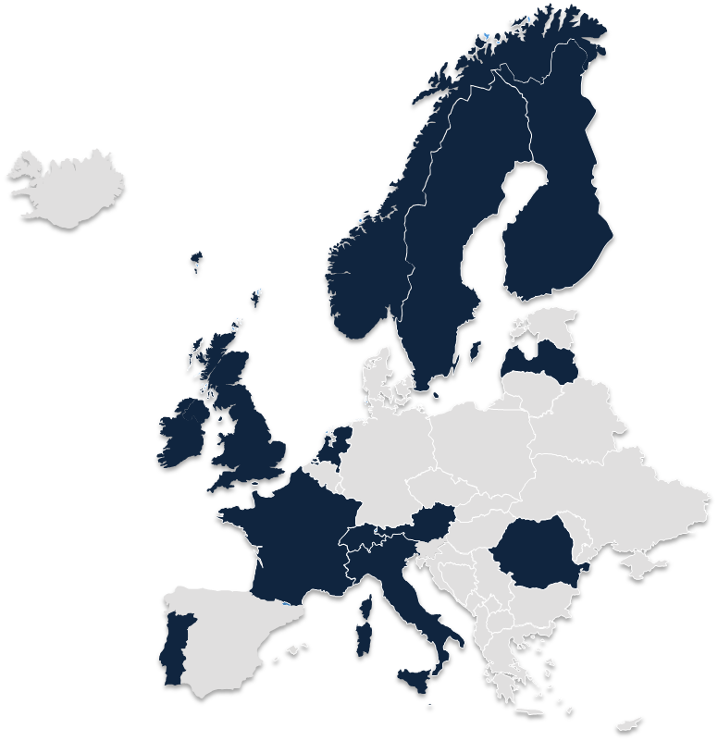
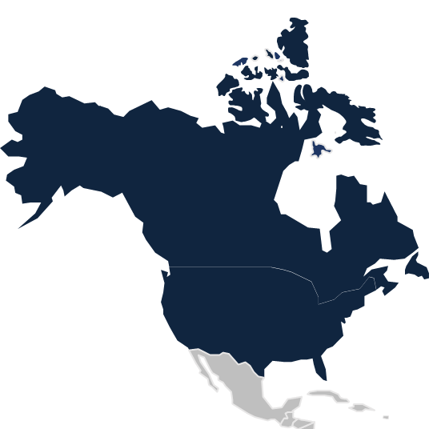

28 partners
20 countries

Slide 33
TO REACH: objectives, tasks, outcomes
Main objectives
Main tasks
Outcomes
1.A. Identify future challenges and priorities (roadmapping)
1. Identify Strategic Priorities
1.B. Provide knowledge synthesis and analytical framework (meta-questions)
Strategic Research Agenda
2.A. Prepare a common and sustainable platform by research funding bodies (strengthening the network)
2. Building Research Infrastructure
2.B. Enhance cooperation and linkage with other funders networks
(embedding the network)
Notes:
Synthesize:
European and national roadmaps
Ongoing research
Stakeholder inputs
SRA: contribute to research agenda setting at European and Member States’

Slide 34
TO REACH Conceptual framework
Starting question
Meta-questions
Identify good models of care
Transferability and absorptive capacity
Scalability & performance enhancement
Substantive themes
(some…)
Role of self-care in prevention
Shift from inpatient to outpatient care
Optimal design of integrated care
Decentralisation of long term care
Exploring the reasons (and suggest the solutions) for the existing disparities and inequalities in health care
Implementing biomedical innovation, such as personalized medicine, in health services and systems
Notes:
34
JH: THIS IS OUR CONCEPTUAL FRAMEWORK: FIRST YOU NEED TO SET CRITERIA TO IDENTIFY GOOD MODELS OF CARE, THEN DETERMINE THE FACTORS THAT DETERMINE THEIR TRANSFERABILITY, AND NEXT, THE CONDITIONS FOR SCALABILITY IN ORDER TO REACH MEANINGFUL PERFORMANCE ENHANCEMENT AT SECTOR LEVEL
SUBSTANTIVE THEMESE TO BE PROVIDED BY MS, AND THESE CAN ADDRESS WAYS TO ORGANISE CARE, BOTH FOR INDIVIDUAL AS WELL AS FOR POPULATIONS.
PLUS KEY POINT TO MAKE HERE: THESE QUESTIONS AND THE METHODOLOGICAL ENHANCEMENT WE SEEK TYPICALLY MAKE IT A RESEARCH ACTIVITY, LINKING TO HORIZON 2002 MORE SO THAN TO THE SANTE HEALTH PROGRAMME (IN SUBTLE TERMS?)
Performance in the broadest terms, so also including how it can improve access, lower inequalities, next to general quality and cost-effectiveness

Slide 35
Enhancing European cooperation: forward-looking perspective
Supporting evidence-informed decision by focusing those domains that will dominate policy agendas in the next years and decades to come.
Contributing to answering the fundamental question about the conditions and contextual factors that are required for a given solution working in one setting to also work in other settings, and therefore inform the transferability, absorptive capacity, and scalability of innovation.
Europe can act as a ‘natural laboratory’ for scientific comparison across Europe, using European experiences, comparing data (quantitative and qualitative) and testing innovative solutions developed in one context in real life contexts.

Slide 36
The proposal:
A Joint European Initiative on Health Systems and Services Research
A research initiative that will help predict if and how a proposed care organisational innovation may work in different settings.
The program should be beneficial to at least three perspectives:
  a policy perspective, by helping decision makers to take the right direction.
    → Instead of traditional “trial and error” policy making, evidence based decision making would benefit from real-life experiments, duly explored owing to scientific comparative data, both qualitative and quantitative
  a funding perspective, in order to align limited resources and avoid duplication,
  a scientific perspective as it can help the EC, the Member States and the researchers to best incorporate this “delivery of care” element into their traslational research designs.

Slide 37
thank you !
stefano.vella@iss.it

