Slide 1

2017 IANPHI
Annual Meeting
ISTITUTO SUPERIORE DI SANITÀ | ROME, ITALY

Slide 2
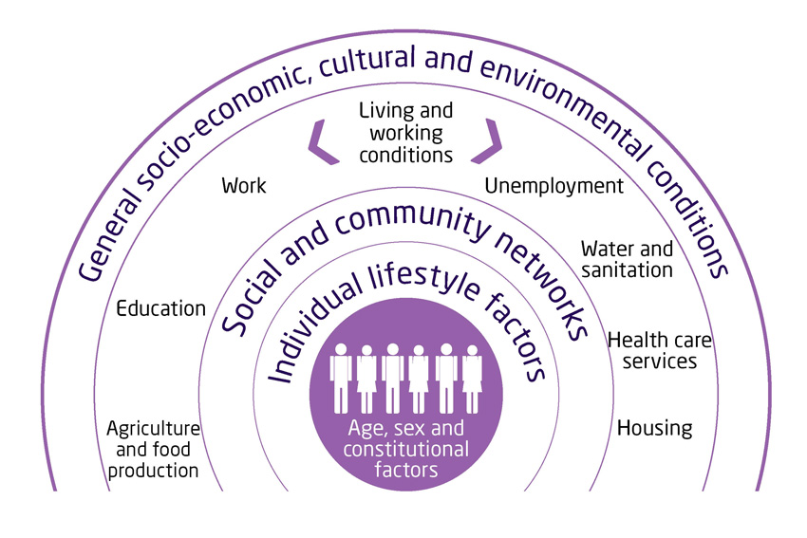
Health inequalities
National-level burden estimates mask local variations
Some people are more at risk than others
Differential exposure vulnerability
e.g. exposed to high air pollution concentrations
Differential susceptibilities
e.g. intrinsic factors (age, genetics)
e.g. acquired (chronic illness, lifestyles and behaviours, multiple deprivation)
Interaction with wider health determinants
‘Triple jeopardy’ concept

Slide 3
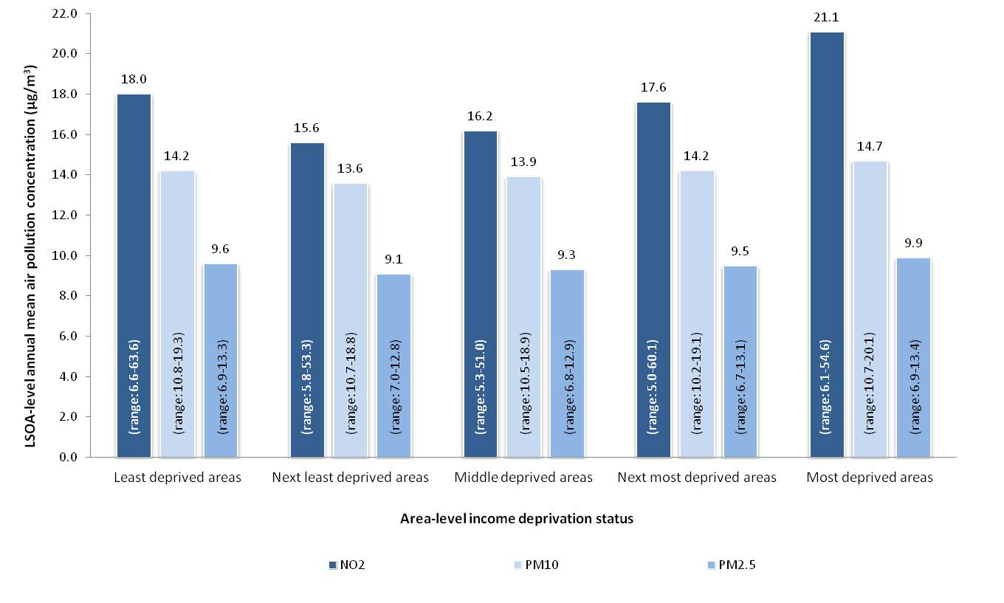
Triple jeopardy in Wales
Research carried out to explore relationships between linked air pollution, deprivation and health data
Air pollution concentrations highest in ‘most deprived’ areas where population most susceptible
Next highest in ‘least deprived’ but population less susceptible
 |  | Air pollution status (PM₁₀)
 |  | Low | Moderate | High
All-cause mortality | Least deprived | - | 1.02 (0.96 to 1.08) | 1.06 (0.91 to 1.24)
 | Most deprived | 1.56* (1.46 to 1.66) | 1.58* (1.50 to 1.66) | 1.65* (1.50 to 1.80)
Respiratory disease mortality | Least deprived | - | 1.19* (1.02 to 1.39) | 1.35 (0.86 to 1.95)
 | Most deprived | 2.05* (1.73 to 2.41) | 2.21* (1.92 to 2.53) | 2.38* (1.89 to 2.95)
*Statistically significant result; Rate ratio increased as area-level air pollution status worsened
Rate ratios show strong associations between all-cause and respiratory mortality and deprivation
Air pollution interactions modify associations
Targeted intervention that complements universal risk reduction measures can reduce inequalities

Slide 4
Public health role
A key stakeholder in air quality management:
  to support others to assess air pollution in the context of public health risks
  to support others to mitigate risks
  to advise and support planners and regulators
  to provide information to the public to reduce risks and drive behaviour change
  to manage public health risks associated with acute and chronic incidents
  to influence and support action to improve corporate environmental sustainability
  to lead evidence-based change through effective advocacy and informed policy development

Slide 5
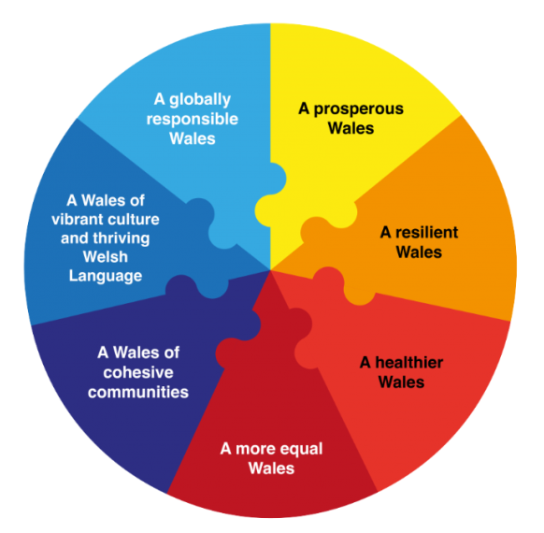
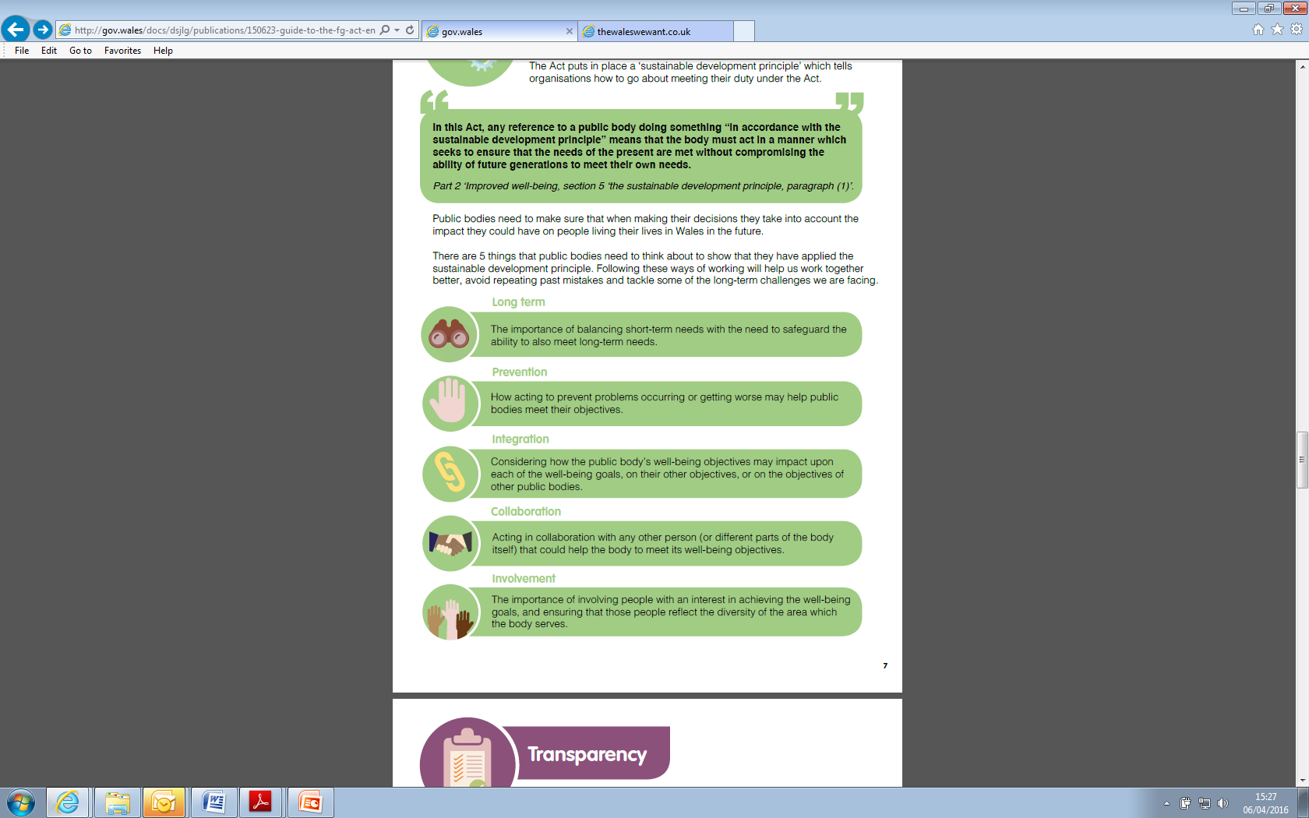
Drivers for change in Wales
Environment Act 1995 (LAQM)
... an integrated policy framework that supports a sustainable approach to tackling linked well-being priorities...
Wellbeing of Future Generations (Wales) Act 2015
Environment (Wales) Act 2016
Active Travel (Wales) Act 2013
Climate Change Act 2008
Planning (Wales) Act 2016
Public Health (Wales) Act 2017

