Slide 1
Influencing on air policy – a PHE perspective through three documents.
Professor Paul Cosford CB

Slide 2
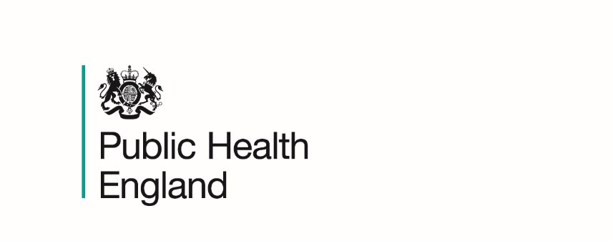
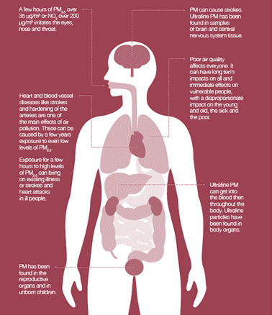
Air pollution: still harming health
Ambient air pollution contributes to a wide variety of adverse health effects, including mortality and effects on lung, cardiovascular and cognitive function.
To date, the strongest evidence is for fine particulate air pollution, measured as PM_{2.5}
The deposition and fate of particles in the respiratory tract depends primarily on inhaled particle size.
Health effects caused by air pollution can be classified as due to either short-term (acute) or long-term (chronic) exposure
© Royal College of Physicians 2016

Slide 3
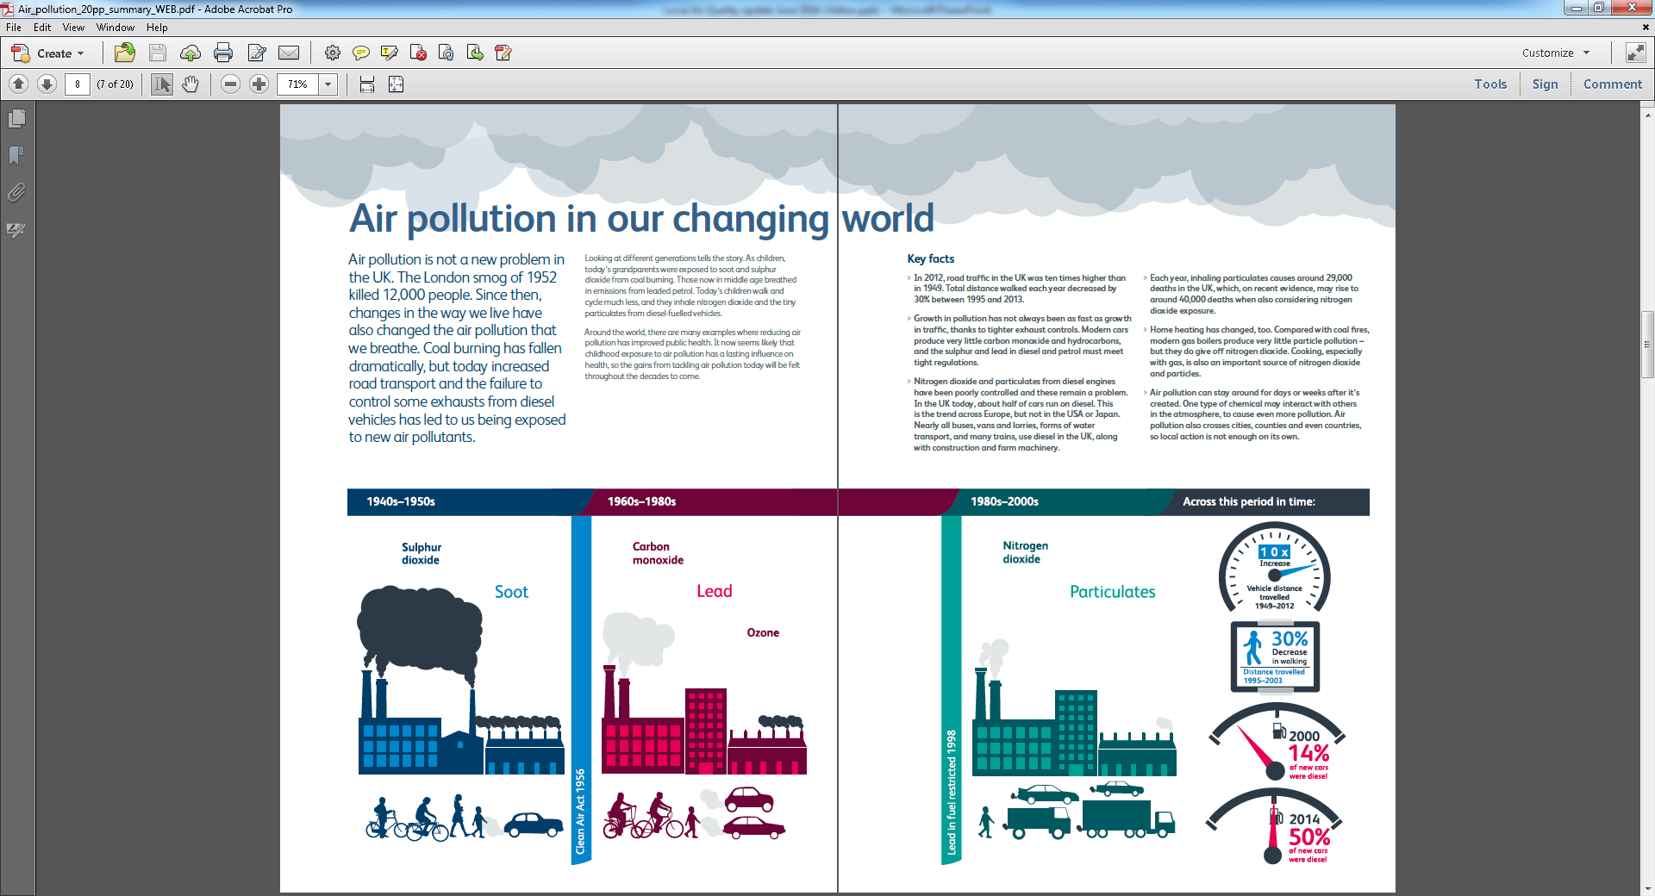
Air pollution: still a problem
© Royal College of Physicians 2016
Latest WHO urban air quality database shows more than 80% of people living in urban areas are exposed to air quality levels that exceed the WHO limits (WHO 2016)

Slide 4
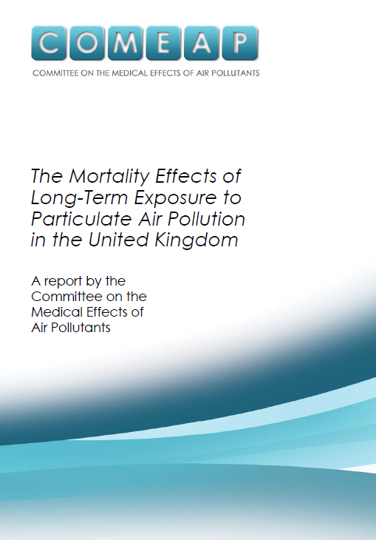
1: COMEAP report
COMEAP (2010) estimated the mortality burden of human-made particulate pollution in UK in 2008 as:
an effect equivalent to approximately 29,000 deaths
a loss of 340,000 years of life
average loss of 6 months of life expectancy from birth

Slide 5
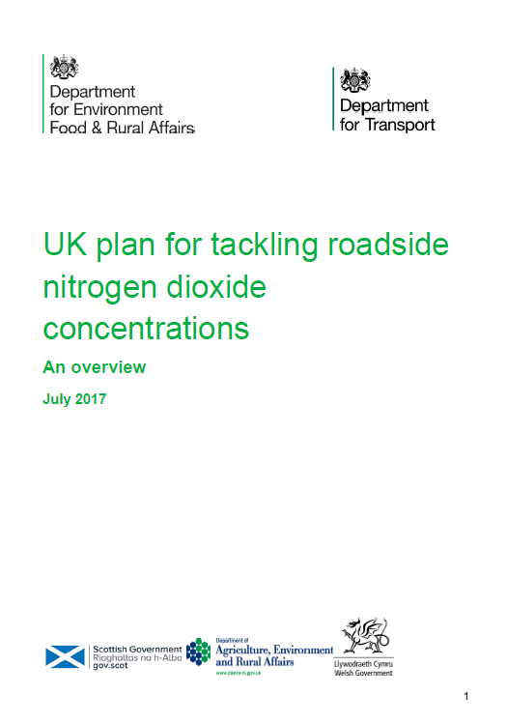
2: Air quality plan for nitrogen dioxide
Air quality plan (2017) setting out how the UK’s approach to meeting the statutory limits for nitrogen dioxide (NO2), and the policy background.
The Direction requires specified local authorities to carry out studies to identify how to meet legal limits for nitrogen dioxide in the shortest possible time, and sets deadlines.

Slide 6
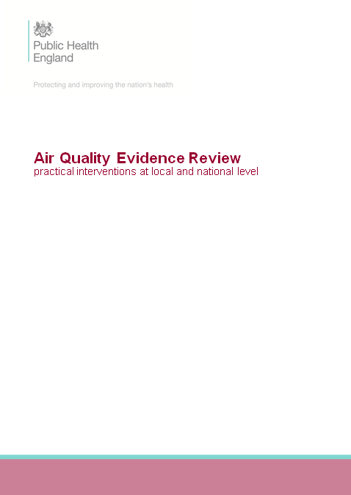
3: PHE’s evidence review and HMG’s Clean Air Plan
PHE evidence review:
Practical recommendations for interventions, stratified where possible by health and economic impacts.
The work will build on the UK’s 2017 plan for reducing roadside NO2 concentrations and the NICE guidelines.
Wider remit to cover the pollutants that will be in the Clean Air Strategy (NO2, SO2, VOCs, ammonia and PM) and other sources of pollutants.

Slide 7

Conclusion

