Slide 1
PHE’s Role and Experience in the Public Health Response to Terrorist Attacks
Professor Paul Cosford CB

Slide 2
March 2017: Westminster attack
Vehicle and Knife attack
5 Killed
50 Injuries

Slide 3
May 2017: Manchester Arena
Suicide bombing
23 killed
At least 250 injured

Slide 4
June 2017: London Bridge attack
Vehicle assault and knife attacks
8 killed
At least 48 injured

Slide 5
June 2017: Finsbury Park attack
Vehicle assault
At least 8 injured

Slide 6
September 2017: Parson’s Green tube attack
Attempted bombing
At least 30 injured

Slide 7
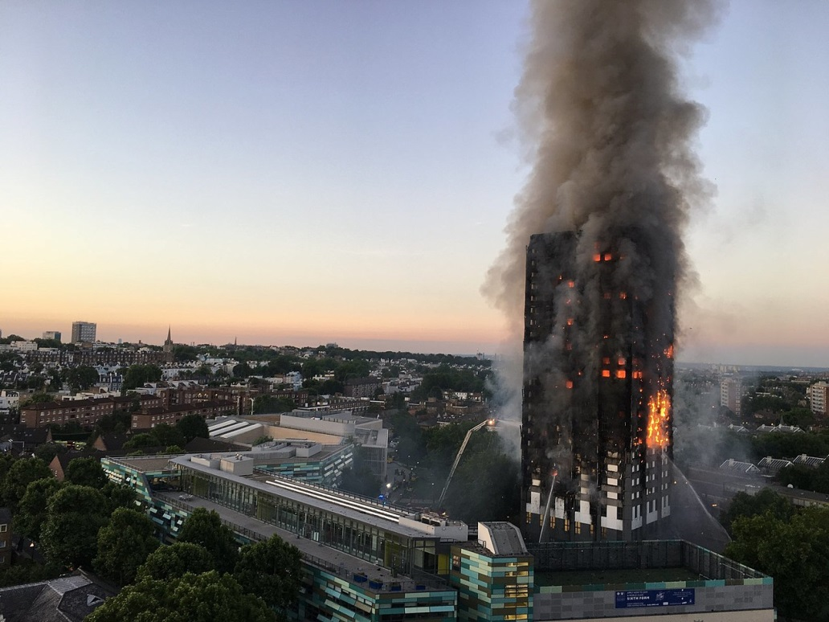
Grenfell Tower
Provision of immediate advice on environmental hazards / threats to emergency services, local population and NHS staff receiving patients (asbestos / cyanide / air pollution).
Research into building materials and review of potential residual hazards.
Continued monitoring of air quality and feedback to investigators and local people.
June 2017
At least 80 people are confirmed or presumed dead

Slide 8
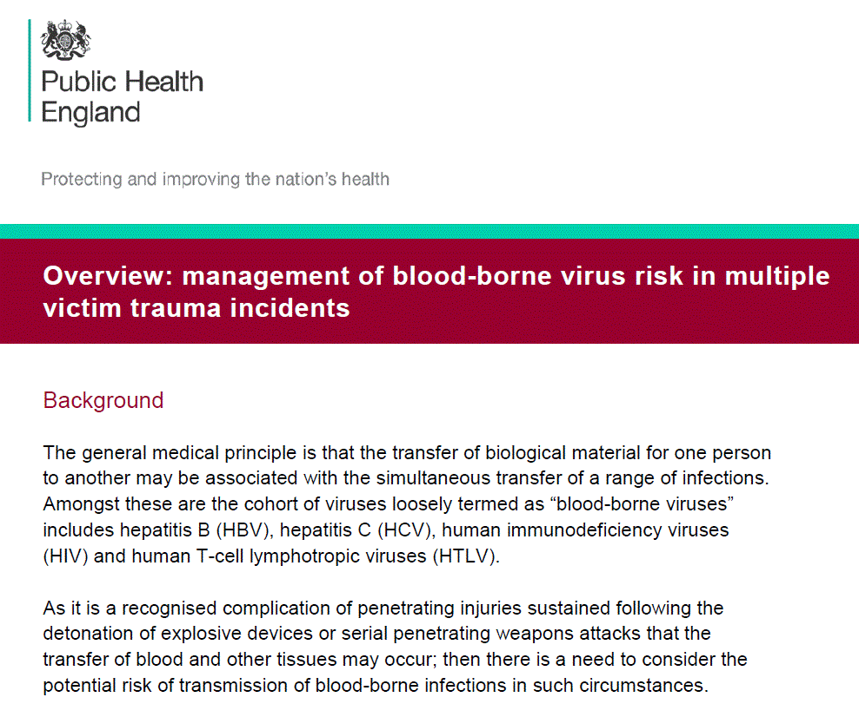
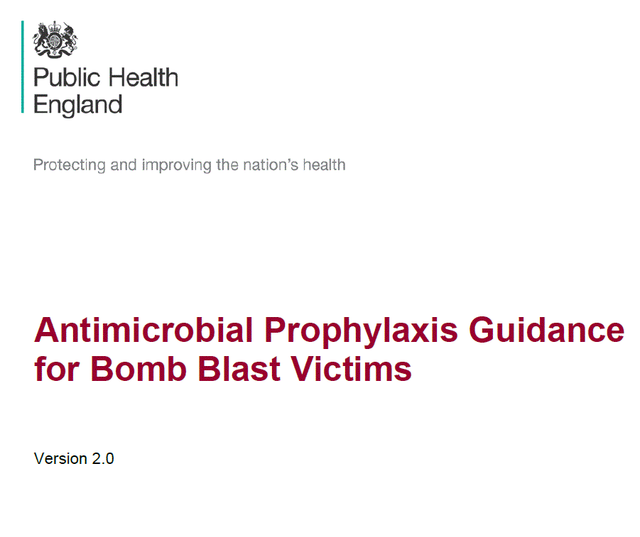
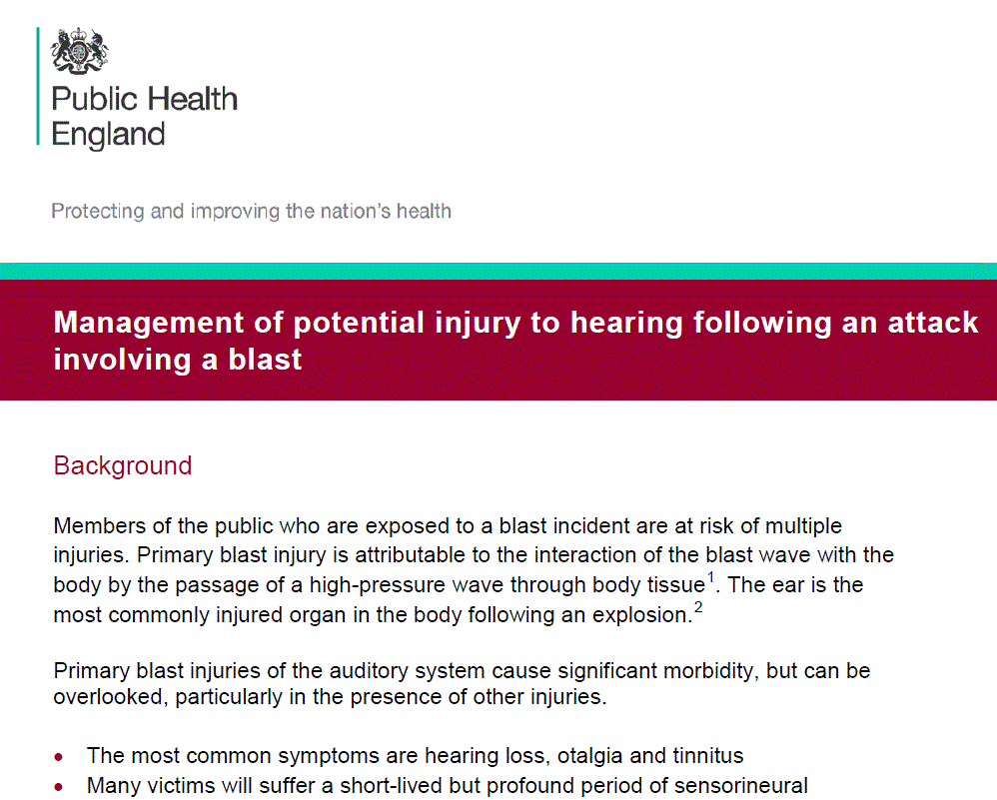
Examples of specific roles taken by PHE in Manchester & London incidents
Trained, tested and developed the trauma response capability of the Manchester Hospitals prior to the bombing incident.
Coordinated the initial care and follow-up for potential blood-borne virus transmission in survivors in London and Manchester.
Supported local authority to provide appropriate mental welfare services in Manchester.

Slide 9
Conclusion
When we think of the major threats to our national security, the first to come to mind are nuclear proliferation, rogue states and global terrorism. But another kind of threat lurks beyond our shores, one from nature, not humans - an avian flu pandemic.
―Barack Obama

