Slide 1

2017 IANPHI
Annual Meeting
ISTITUTO SUPERIORE DI SANITÀ | ROME, ITALY

Slide 2
Child Health and Mortality Prevention Surveillance (CHAMPS)
South Africa
Role of Minimal Invasive Tissue Sampling in using data for action
Dr Natalie Mayet on behalf of
Professor Shabir Madhi & CHAMPS Team

Slide 3
Objectives
Background CHAMPS
Under-5 mortality and stillbirths - cause of death attribution.
Validation of minimal invasive tissue sampling (MITS) against complete diagnostic autopsy in stillbirths, neonates and children.
Using MITS data for action

Slide 4
CHAMPS Background - Program Objectives
Track definitive causes of child mortality in sites throughout Sub-Saharan Africa and South Asia.
Produce and disseminate high-quality data to inform policy and public health action.
Enable sites to able to provide additional services and surveillance infrastructure to prevent mortality.
Notes:
For the main objective, we will be identifying all child deaths within a defined catchment area or demographic surveillance site, and attempting to collect data and specimens from all. Rather than complete diagnostic autopsies which are considered the gold standard for cause of death determination, we will be using an approach called minimally invasive tissue sampling, or MITS, which are post-mortem needle biopsies.
Data and specimens collected, primarily via minimally-invasive tissue sampling (MITS)
2
Dashboards enable customizable reports and visualize data for each site country and major stakeholder
IANPHI leads effort to engage local stakeholders, including NPHIs, and develop the technical capacity to analyze and use data locally
3
The CHAMPS investments in sites’ surveillance infrastructure will enable sites to perform ancillary activities (e.g., outbreak event monitoring) and evaluation of impact of interventions on preventing mortality
Today I will focus on objectives 1 and 2

Slide 5

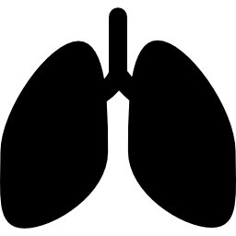




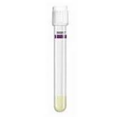
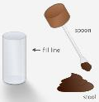
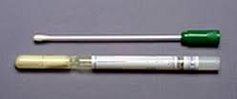
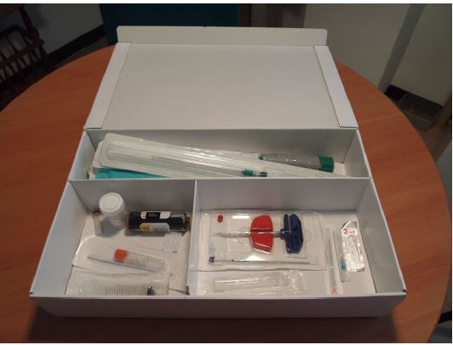
CHAMPS - Minimally Invasive Tissue Sampling SOP and Specimen Collection Kits
Brain
Lung
Heart
Liver
Bone Marrow
Blood
CSF
Stool
NP/OP swab
Tests: Standard bacterial culture (blood, CSF, liver, stool) Multi pathogen molecular diagnostics (blood, stool CSF, lung) Histopathology (Brain, lung, liver, bone marrow) Immunohistochemistry
Notes:
After the measurements and photographs the postmortem specimens will be collected-through a minimally invasive technique- MITS, not obvious in the procedure name but both tissues and non-tissues specimens will be collected. The non-tissues will include…

Slide 6

Determination of Cause of Death (DeCoDe) Panel
Demographic
DOB, DOD, Sex, Date/Time of MITS procedure, Gestational age (if applicable), Birth weight
Clinical Abstraction
Raw data
Clinical Postmortem Diagnostic Results
HIV
TB
Malaria
Verbal Autopsy
Summary of VA
Raw data (answers to all of the questions)
MITS Collection Data
Measurements (interpretation)
Photographs (interpretation)
DeCoDe Panel*
Pathology Results
Site pathology report (standardized)
CPL pathology report (with relevant photomicrographs)
Whole slide images available upon request
Maternal Abstraction
Raw data
Molecular ID Diagnostic Results
TAC results with assay interpretation (supplied centrally)
*Panel assigns underlying and immediate causes of death according to ICD10.

Slide 7
Objectives
CHAMPS Background
Under-5 mortality and stillbirths - cause of death attribution.
Validation of minimal invasive tissue sampling (MITS) against complete diagnostic autopsy in stillbirths, neonates and children.
Using MITS data for action

Slide 8
Trends in under-5 mortality Rates in South Africa, 2000 to 2013
Under-5 Childhood deaths increased from 74,753 in 2000, peaked at
89,418 in 2005 and has now declined to 47,409 in 2013.

Slide 9
Deaths in South African Children Under One Month of Age (2000 to 2013)
Number deaths in Neonates: 18,781 in 2000 compared to 15,607 in 2013
(Birth cohort 1,168,000)

Slide 10
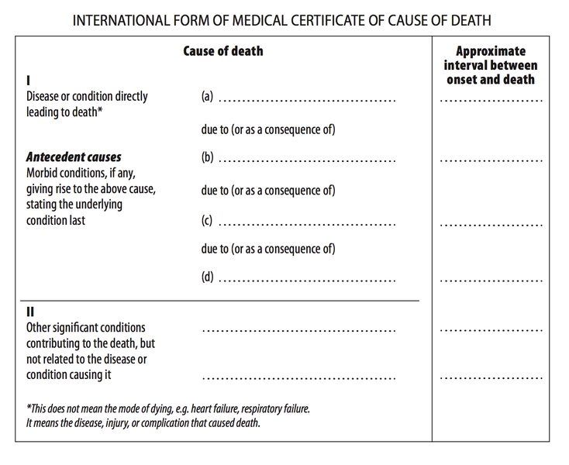
International Cause of Death Certification
Immediate Cause of Death: (i.e. Direct CoD) Final event in the causal sequence that occurred closest to time of death.
Antecedent Cause of Death.
Underlying Cause of Death: Initiating event in the causal sequence that occurred most remote from time of death.
Contributing factors
Nosocomial sepsis
RSV pneumonia
Bronchopulmonary dysplasia
Premature
Malnutrition

Slide 11
Challenges with Global Surveillance and Cause of Death Data
CHALLENGE 1: INCOMPLETE
CHALLENGE 2: POOR QUALITY
CHALLENGE 3: delayed
These challenges prevent us from truly understanding what is killing children under five years of age.
Notes:
Challenge 1: Lack of robust primary data, gaps, heavy reliance on modeling = little insight into etiology in high-mortality countries
Challenge 2: Non-standardized and siloed processes across geographies are unreliable and difficult to integrate and analyze; verbal autopsies and syndrome-based data are not granular
Challenge 3: Academic publishing timetables and in-country review cycles can delay data release by 2-3 years, providing a lagging view of evolving epidemiology

Slide 12
Objectives
CHAMPS Background
Under-5 mortality and stillbirths - cause of death attribution.
Validation of minimal invasive tissue sampling (MITS) against complete diagnostic autopsy in stillbirths, neonates and children.
Using MITS data for action

Slide 13
Concordance of Minimal Invasive Tissue Sampling (MITS) Compared to Complete Diagnostic
Autopsy (CDA) for Cause of Death (CoD) Attribution in Children (1 mnt-15 Years age)
CoD identified in 100% CDA and 96% of MITS cases.
Significant concordance between MITS and CDA (Kappa=0.70, 95%CI: 0.49-0.92).
MITS allowed detection of specific pathogen in two-thirds (66%) of infectious CoD cases.
Addition of basic clinical information (verbal autopsy or clinical record) would reduce
discrepancies between MITS and CDA.
Bassat Q et al., PLoSMed, 14(6): e1002317

Slide 14
Concordance of Minimal Invasive Tissue Sampling (MITS) Compared to Complete Diagnostic
Autopsy (CDA) for Cause of Death (CoD) Attribution in Neonates (N=41).
CoD identified by CDA in 100% and 85% by MITS.
Moderate concordance between MITS and CDA (Kappa=0.40, 95%CI: 0.18-0.63), with agreement in 68% of cases.
Higher concordance for infectious diseases (85%) and preterm complications (60%), than for congenital abnormalities (50%, 2/4).
Addition of basic clinical information (verbal autopsy or clinical record) would reduce discrepancies between MITS and CDA.
Menendez C et al., PLoSMed, 14(6): e1002318

Slide 15
Concordance of Minimal Invasive Tissue Sampling (MITS) Compared to Complete Diagnostic
Autopsy (CDA) for Cause of Death (CoD) Attribution in Stillbirths (N=18).
CoD identified by CDA in 89% and 83% by MITS.
Substantial concordance between MITS and CDA (Kappa=0.78, 95%CI: 0.56-0.99), with agreement in 83% of cases.
Maternal factors contributing to CoD attribution limited, since no placenta examination or histopathology undertaken, viz cause of fetal growth retardation not fully elucidated.
Menendez C et al., PLoSMed, 14(6): e1002318

Slide 16

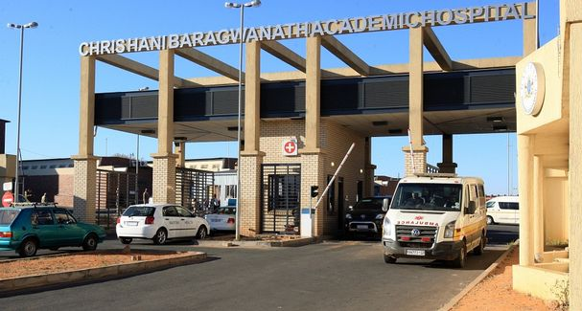
MITS Data for South Africa
Site at Chris Hani Baragwanath Hospital
Process of enrolment continues
Preliminary data: 409 deaths :
- 126 paediatric
- 154 neonates
- 129 stillbirths

Slide 17
MIA #: 0014
TEST/INFO SOURCE | FINDINGS
Details | 2.5 mo. Female; DoBirth – 2015/4/24, DoAdm – 2015/7/12, DoDeath – 2015/7/12
Clinical Records | Born prematurely (34 wk GA). HIV infected. Presented with lethargy, cough, difficulty breathing, crepitations, lower chest indrawing, hepatomegaly. Weight: 1.9kg
Discharge summary | J18.0 (BPN); A09 (Diarrhoea and GE); A41/Y95 (nosocomial sepsis)
Antemortem NHLS | FBC: ↑WCC, ↓Hb, ↑PLT; Blood culture –negative, LFTs: ↓Ttl Prot, ↓Alb, ↑Conj Bil, ↑ALT, ↓ALP; U&Es: ↓Na⁺
Histpathology | L lung – viral pneumonitis, CMV inclusion bodies, R lung – infarct, interstitial pneumonitis; L+R lungs - IHC Bordetella pertussis; Brain – N; Liver – inadequate
Molecular tests | Stool: Sapovirus (Ct: 38.2); CSF: CMV (Ct: 36.1)

Slide 18
International Cause of Death Certification
Immediate Cause of Death: (i.e. Direct CoD) Final event in the causal sequence that occurred closest to time of death.
Antecedent Cause of Death.
Underlying Cause of Death: Initiating event in the causal sequence that occurred most remote from time of death.
Contributing factors
Pertussis
CMV pneumonitis
HIV
Malnutrition
Prematurity

Slide 19
Concordance Between DECoDE and Attending Physician CoD Attribution in Children 1-59 m Age.
 | Agreement | Kappa |  | Std. Err. | Z | Prob>Z
Immediate CoD | 82.89% | 0.4269 |  | 0.0614 | 6.96 | <0.01
Underlying CoD | 87.55% | 0.6360 |  | 0.0591 | 10.77 | <0.01
Underlying infectious CoD | 84.20% | 0.4716 |  | 0.0792 | 5.95 | <0.01
Underlying non-infectious CoD (complete) | 87.46% | 0.5943 |  | 0.0679 | 8.76 | <0.01
¥: Complete concordance is the agreement between the DeCoDe panel CoD and attending Physician CoD using the WHO ICD10 specific conditions (i.e. 3 character code)
Ŧ : Kappa score interpretation: 0.0 - .20: slight; .21 - .40: fair; .41 - .60: moderate; .61 - .90: substantial; .81 - 1: almost perfect Landis & Koch (1977)

Slide 20
Underlying Cause of Death Per WHO Categories in
Children 1-59 Months of Age

Slide 21
Preliminary findings
Specific pathogens identified in select infection related deaths among South Africa children
Identified Co-infections and Co-morbidities
Identified multiple pathogens that contribute to mortality
Determination of Antibiotic Susceptibility Profile in Neonatal Deaths
Identifying underlying maternal conditions that contribute to stillbirths
Understanding of social acceptability for MITS
Further investigations underway with communities and traditional leaders

Slide 22
Objectives
CHAMPS Background
Under-5 mortality and stillbirths - cause of death attribution.
Validation of minimal invasive tissue sampling (MITS) against complete diagnostic autopsy in stillbirths, neonates and children.
Using MITS data for action

Slide 23
DECoDE Panel Cause of Death Category Attribution

Slide 24
All Stillbirths Cause of Death Categories

Slide 25
Objectives
CHAMPS Background
Under-5 mortality and stillbirths - cause of death attribution.
Validation of minimal invasive tissue sampling (MITS) against complete diagnostic autopsy in stillbirths, neonates and children.
Using MITS data for action

Slide 26

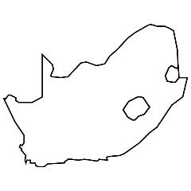

Using CHAMPS Data: Examples of Data to Action
Reporting pertinent results to families
Family HIV testing and referral to care
Reporting aggregate findings to communities
Investigating possible outbreaks
Presenting findings during hospital mortality reviews, Ministerial committee on child morbidity and mortality
Implementing strategies to reduce nosocomial infections
Training on death certificate completion
Local
National
Incorporating CHAMPS surveillance findings in national child mortality reviews
Including pediatric deaths in epidemiologic surveillance bulletins
Analyzing CHAMPS data to inform national vaccination policies
Incorporating CHAMPS surveillance findings in international child mortality analyses
Setting international priorities for achieving U5M targets
Planning efforts for vaccine development
International

