Slide 1

2017 IANPHI
Annual Meeting
ISTITUTO SUPERIORE DI SANITÀ | ROME, ITALY

Slide 2
NPHIs and Linkages with the Global Health Security Agenda
CAPT Nancy Knight, MD
Director
Division of Global Health Protection
Center for Global Health
U.S. Centers for Disease Control and Prevention
23 October 2017

Slide 3
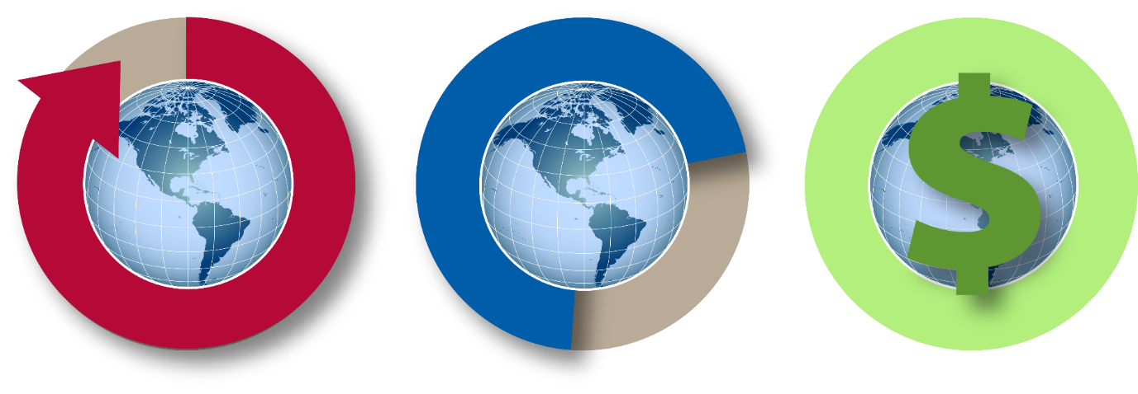
Why Care About Global Health Security?
DISEASES SPREAD
NOT PREPARED
ECONOMIC IMPACT
Faster and farther
At least 70% of
countries not prepared
SARS: $40B Globally
Ebola: >$30B Globally
Notes:
This presentation builds upon the presentation by my colleague Dr. Kashef Ijaz at the 2015 Annual Meeting in Paris. The topic of Dr. Ijaz’s presentation was “Implementing IHR: a Platform for NPHI Action” and looked at the convergence of IHR, GHSA, and NPHIs.
Now that GHSA is two years farther into its implementation, this presentation will look more specifically at how NPHIs link with GHSA.
A quick review (if time permits):
When the world recognized the need to come together to take immediate action due to events such as SARS, anthrax attacks, and the AIDS epidemic, IHR provided us with an important set of public health goals. Today, the Global Health Security Agenda will provide us with a road map to help reach those goals. GHSA will build on the work we did with IHR and help us to do more, to do it faster, and to do it better.
When aligned with IHR, most of the ideas behind GHSA are not new; we are building on agreements and commitments countries have already made.
GHSA was developed to advance IHR, by providing a path with clear targets and milestones to strengthen core capacities and achieve IHR compliance. GHSA will help us move forward and help us achieve the goal of IHR, a goal of a world safe and secure from the threat on infectious diseases.
Today, most of the world is not prepared to address public health events. As of 2014, only a 1/3 of the world’s countries reached their goals associated with committing to IHR in 2005.

Slide 4



Global Health Security Agenda
PREVENT avoidable outbreaks
DETECT threats early
RESPOND rapidly and effectively
Notes:
GHSA is not another single-disease initiative; it drives a set of concrete and achievable actions to help actualize the International Health Regulations. It helps us reach public health goals through the prevent, detect and respond model.

Slide 5
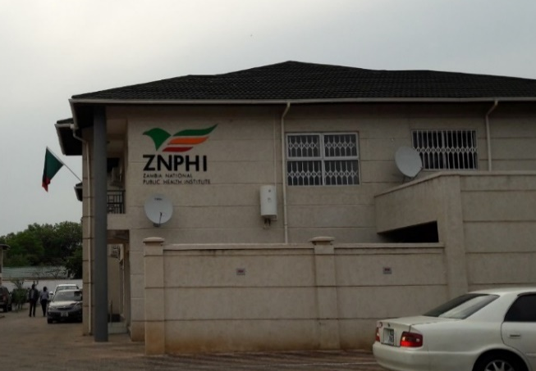
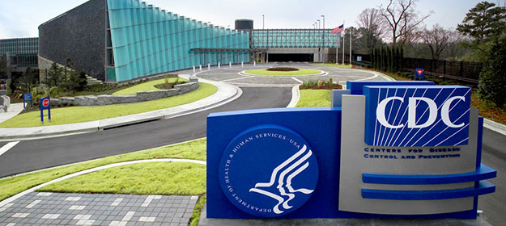
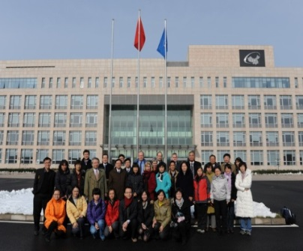
NPHI Core Functions are Critical to Global Health Security
NPHIs provide quick and effective decision making to save lives
NPHIs conduct
  Surveillance, including laboratory
  Outbreak detection and response (including emergency preparedness and response)
  Research (evidence-based for policies and programs)
  Health education/health promotion
  Public health workforce development
Notes:
Functions critical to GHSA success in a country often sit within an NPHI, including those listed on the screen.
Additive value of any NPHI is having data readily available for decision making. That means knowing which diseases are affecting the population, when and where, and being ready to respond if something out of the ordinary occurs.
Photos shown here are of the Zambia National Public Health Institute, U.S. CDC, and China CDC.

Slide 6
Impact of the Global Health Security Agenda
Prevent illness and death from infectious disease threats globally and domestically
Improve countries’ ability to meet the priorities they set for themselves
(IHR compliance)
Reduce impact to
travel and trade
Notes:
Global Health Security not only mitigates the impact of disease outbreaks locally and globally, but also sets a pathway to achieve IHR compliance and mitigates the impact on other sectors, like travel and trade.

Slide 7
NPHIs and the Global Health Security Agenda
NPHIs can facilitate faster detection, enhanced preparedness, and improved public health outcomes.
Coordinated, timely information for decision-making and response
Established focal point with collaborative, multi-sectoral partnerships
More effective response = reduced public health impact
Notes:
Although NPHIs are not a panacea for infectious disease threats, NPHIs are countries’ focal points for public health and provide leadership and coordination for public health programs and activities. Their development may address fragmentation of public health responsibilities across entities and sectors.
NPHIs can serve to:
Facilitate faster disease detection: Through their role coordinating public health information, NPHIs help to produce timely, reliable data that are critical for an effective response.
Enhance preparation: In their role as public health focal points, NPHIs often have partnerships with entities which would be part of an outbreak response. This collaborative relationship between various players makes a country more prepared to prevent, detect, or respond to a disease threat.
Reduce impact: Faster detection and better preparation promote more effective responses, which ultimately serve to reduce impact to the public’s health.

Slide 8
Joint External Evaluation
The JEE tool is a data gathering instrument created to measure a country’s capacities for health security across all sectors, at a national level. The tool specifically helps to:
Determine baseline capacity, including gaps and needs
Inform the development of implementation plans or roadmaps
Measure progress on work implemented across the IHR Core capacities
Highlight gaps and needs for current and prospective donors and partners, as well as to inform country-level planning and priority setting
Notes:
The Joint External Evaluation is a tool which measures countries’ individual status and progress in building the necessary capacities to prevent, detect, and respond to infectious disease threats, in accordance with GHSA targets and in support of IHR implementation.
As of September 2017 nearly 60 countries have completed a JEE.
There is strong overlap between NPHIs and the JEE.

Slide 9




NPHI Linkages with the JEE
Notes:
A functional NPHI can serve as a home for planning, implementation, and accountability. This is particularly relevant to the JEE process.
The JEE Tool is intended to measure country-specific status and progress in achieving GHSA targets.
The NPHI Staged Development Tool (SDT) dives deeper into many of the issues and defines the NPHIs specific role and goals. The SDT is a focused assessment and work planning tool for NPHI functions. For GHSA targets that fall within an NPHI’s mandate, detailed information on NPHI capacity from SDT results can inform the JEE assessment – and vice versa.
I will now give a few examples of how NPHIs have be involved in or influenced by the JEE.
Myanmar: Myanmar used the recent JEE recommendations to frame discussion about potential functions of the Myanmar CDC.
Mozambique: Recommendations from Mozambique’s JEE informed work planning for Instituto Nacional de Saude (INS).
Namibia: The developing Namibia Institute of Public Health has played a critical role in the JEE and action planning, serving as secretariat for the process and home to many of the actions.
USA: The JEE in the United States allowed HHS to coordinate the multi-sectoral conversation around specific challenges that are extremely difficult to address because of the size, diversity, and complexity of the country’s public health structures. Examples include One Health preparedness and response, public health preparedness at privately owned airports, integration and streamlining of data for health surveillance, radiation emergency preparedness, and risk communications. The United States will be holding their One Health Zoonotic Disease Prioritization Workshop in December 2017, which is closely linked to the JEE.
Transition to Next slides:

Slide 10
NPHI Achievements in Global Health Security

Slide 11
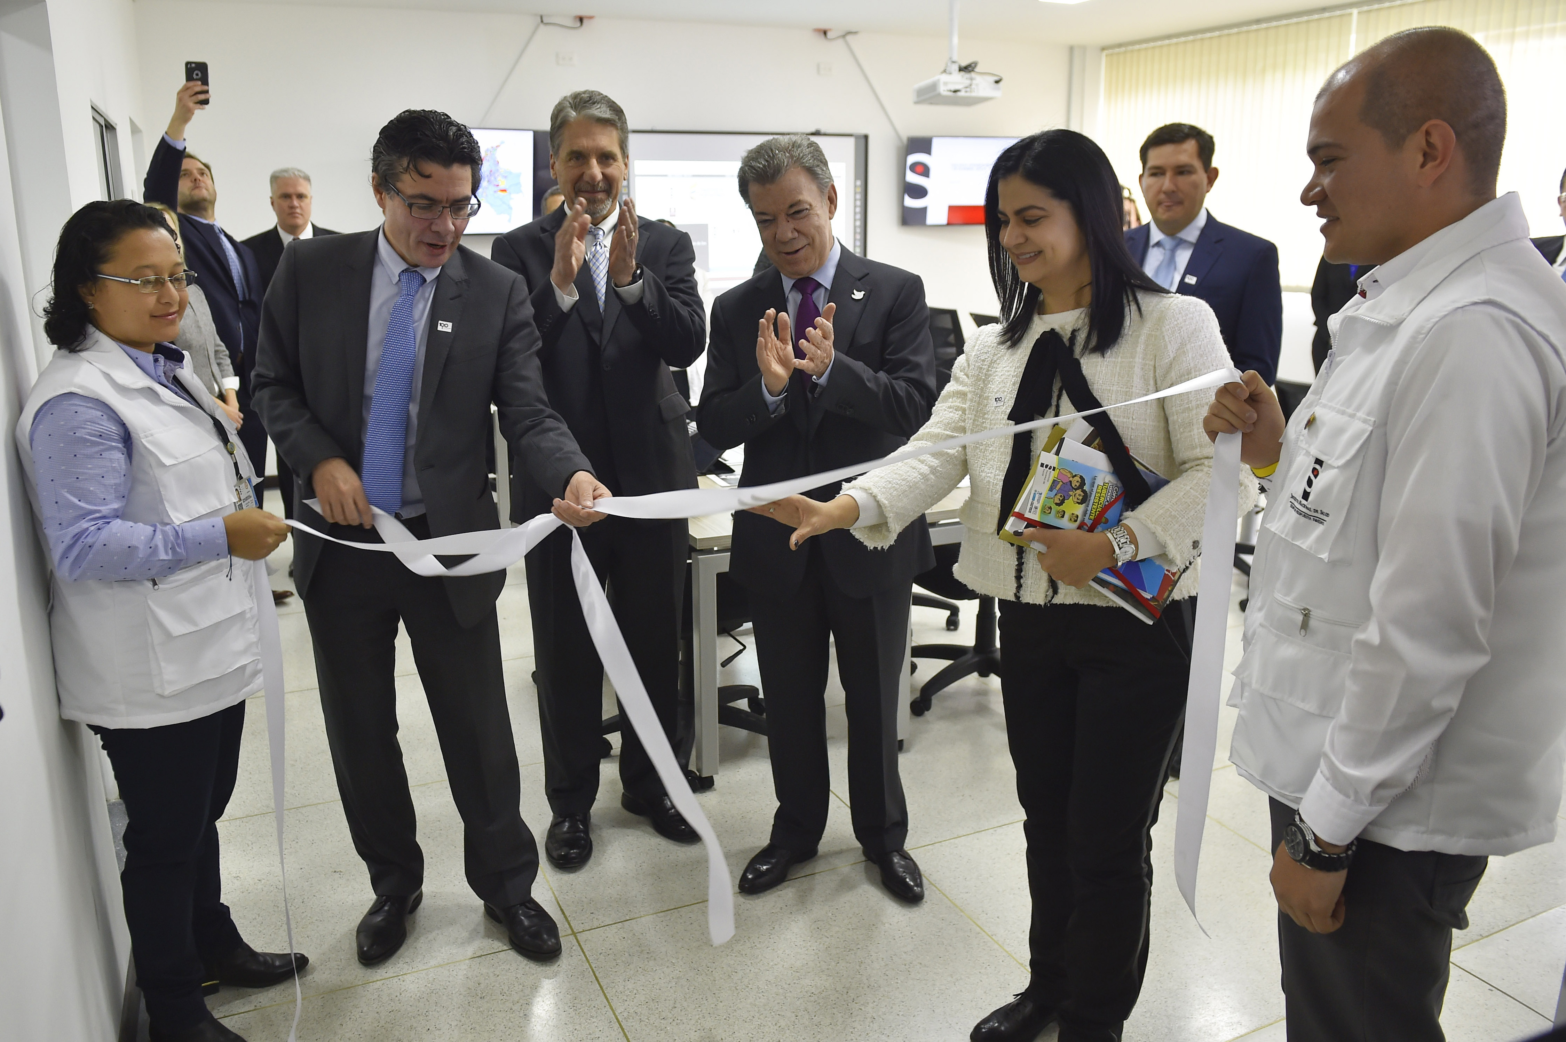
A Stronger Response to Zika in Colombia
Better prepared health systems are better able to detect and respond to disease threats
Prior to the initial outbreak of Zika, Colombia’s Instituto Nacional de Salud invested in strengthening critical functions:
  Laboratory capacity
  Surveillance
  Risk communications
  Public health emergency operations center
As a result, INS was better prepared to respond
Opening the Public Health Emergency Operations Center in January 2017
Notes:
With the Zika outbreak, INS’s investments paid off. Two notable examples of this include:
Labs were better able to handle the many samples – and in a safe manner.
INS was better prepared to communicate with the public to help them understand the kinds of information they need in the best way possible

