Slide 1

2017 IANPHI
Annual Meeting
ISTITUTO SUPERIORE DI SANITÀ | ROME, ITALY

Slide 2
PEER REVIEWS
Initiated at the annual meeting in Mexico (2012)
Inspired by experience from THL and China CDC evaluations
4 meetings in 2012 and 2013 with members interested
11 interviews of Directors (RIVM, THL, Finland, PHAC and INSPQ, Sweden, Germany, Ireland, Mexico (2013)
A collective effort of many IANPHI members

Slide 3
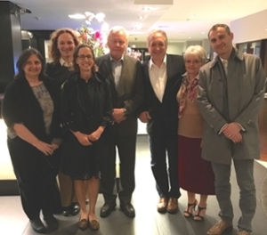
PEER REVIEWS
In 2015/2016
  WIV – ISP, Belgium
  RIVM, The Netherlands
  INS, Peru
"It was a pretty amazing to experience how in a few days’ time this team had come to know the RIVM.“ Andre van der Zande, RIVM Director
“The evaluation started with an internal preparation, which included an extensive SWOT and self-evaluation. … It was a pretty amazing to experience how in a few days’ time this team had come to know the RIVM. It resulted in perspicacious recommendations. We obviously will discuss these internally, but also with the ministry, for follow-up. Besides the valuable reflection, the outcomes help me in my future strategic discussions, a great experience!”
April 2016, RIVM, Bilthoven
Anthony Kessel, Jitka Sosnowsca, Reinhard Burger, Camilla Stoltenberg, Courtenay Dusenbury, Anne-Catherine Viso

Slide 4
PEER REVIEWS - 2017
 | Dates | Panel and report
Public Health England | 26 - 29 June 2017 | President : Andre van der Zande Panel members : Mauricio Hernandez (Mexico), Jean-Claude Desenclos (France), Natalie Mayet (South Africa), Lothar Wieler (Germany), Johan Carlson (Sweden) Report : Courtenay Dusenbury, Anne-Catherine Viso (IANPHI) Funding : PHE
Public Health Wales | 8 -12 October 2017 | President : Juhani Eskola (Finland) Panel members : Lars Schaade (Germany), Nicole Damestoy (Québec, Canada), Ivan Ertzen (Slovenia) Report : Anne-Catherine Viso (IANPHI) Funding : PH Wales
NPHI Mongolia | 11- 14 September 2017 | President : Jeff Koplan (IANPHI) Panel members : Wang Yu (China), Jean-Claude Desenclos (France), Mari Asami (Japan) The peer review was coupled to an SDT exercise Ezra Barzilay and Henri Vendi (US CDC) Funding : US CDC

Slide 5
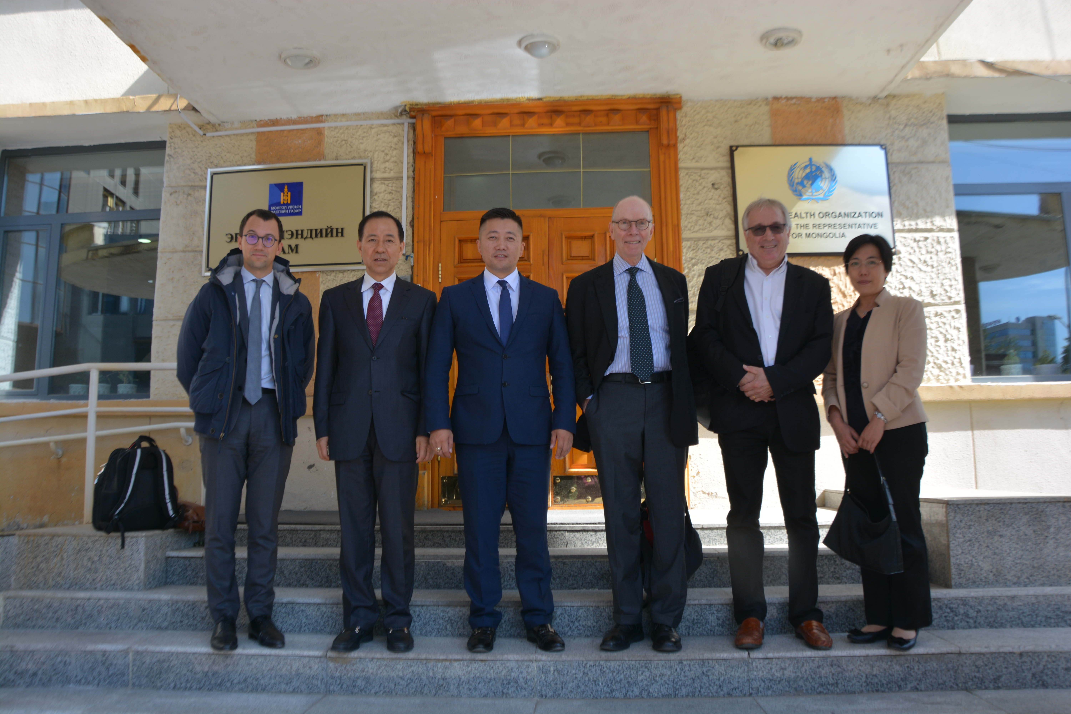
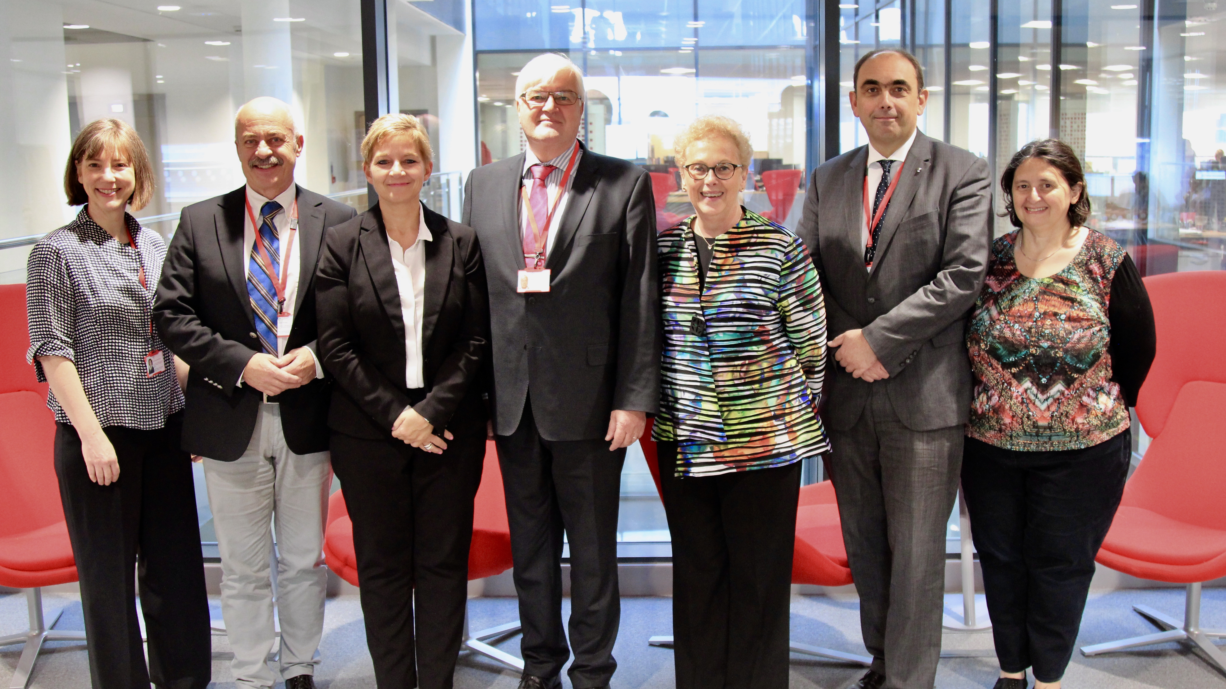
2 PEER REVIEW TEAMS
Public Health Wales – October 2017
National Public Health Institute, Mongolia, September 2017

Slide 6
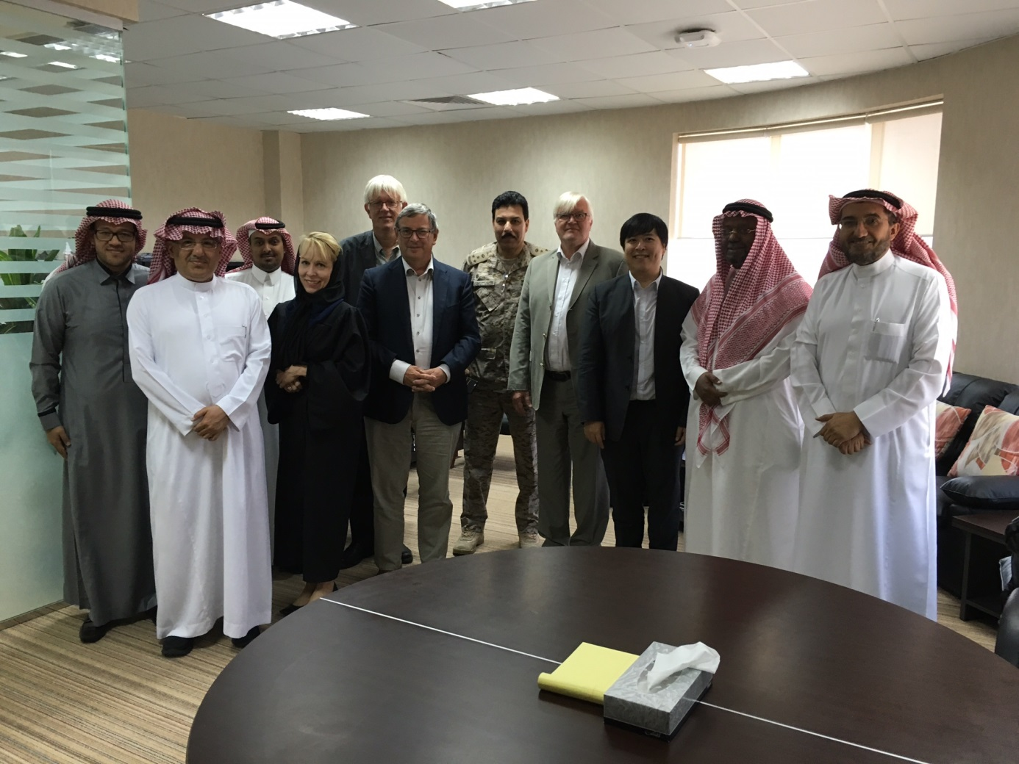
TECHNICAL ASSISTANCE TO SAUDI ARABIA
From June 2016 – February 2017
Support to the MoH to advise on the creation of the new national agency Belgium, Sweden, US CDC, Finland, Tek –Ang Lim (IANPHI)

Slide 7
LESSONS LEARNED BY IANPHI
An experience for the Institutes being reviewed and for the reviewers themselves to share experience and know better each other (4 to 5 directors are involved in each review). The IANPHI secretariat provide support for the organization and the report writing.
Building a practice of evaluation in the IANPHI office that could generate revenue to the Foundation to sustain the IANPHI network activities.
Experience used also to contribute to the Staged Development Tool developed by US CDC and IANPHI. The SDT help the institute to identify for specific public health function their own objectives and a realistic road map to achieve them.
Good material collected to contribute to the Best Practices project funded by US CDC and developed by the US Office.

Slide 8
2018-2019
If interested, please contact IANPHI Secretariat to know more about the peer reviews.
Funding for 3 reviews is available in RIPOST for 3 French speaking NPHIs in French speaking countries of West Africa. There are to be realized in 2018 and 2019 – NPHIs are not identified yet. RIPOST aims at strengthening the national capacities and to strengthen the network between the institutes in West Africa. RIPOST is funded by the West Africa Health Organization with the French Agency for Development.

