Slide 1
G20 Germany 2017
Lothar H. Wieler
Robert Koch Institute

Slide 2
G20, Germany
Science20 Dialogue Forum (March 22nd, Halle)
Ministers of Healths Meeting (May 19th/20th, Berlin)
Meeting of the NPHI and VPHI (Berlin, September 13th/14, Berlin)

Slide 3
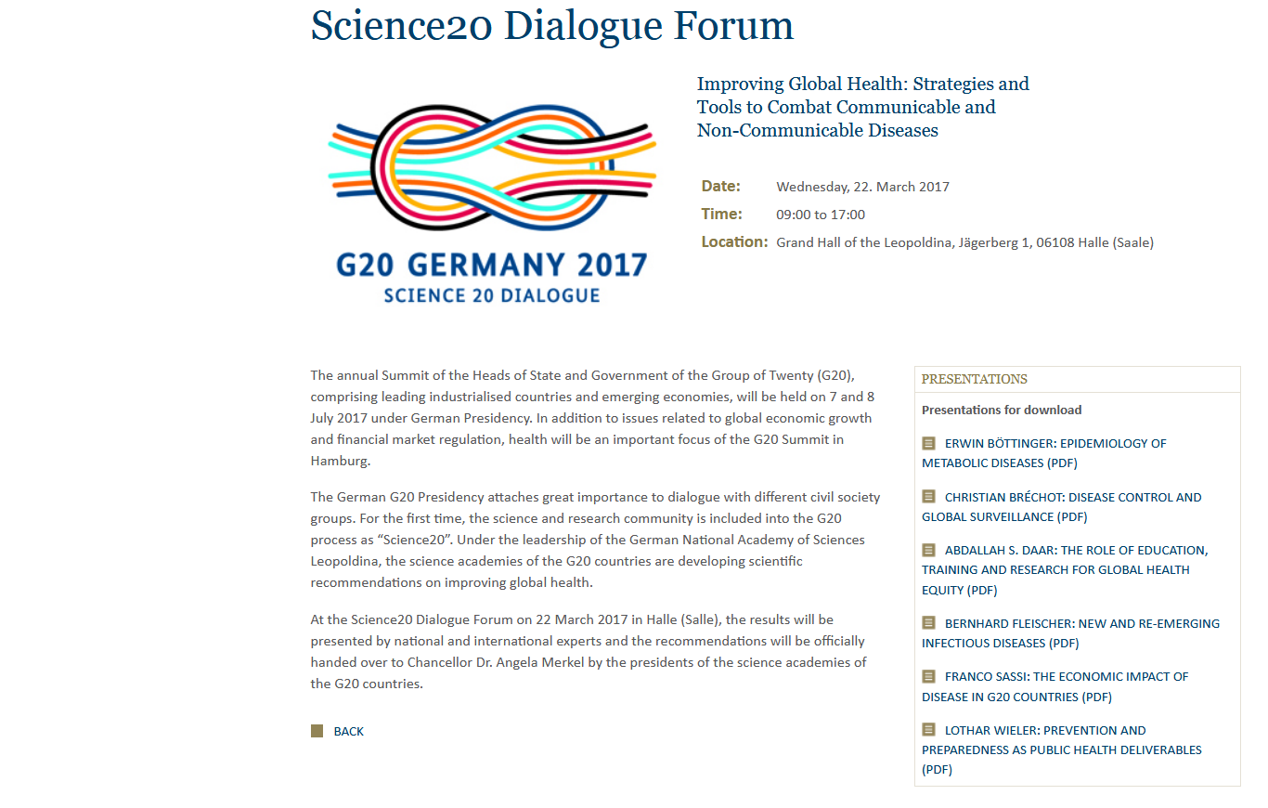

Slide 8
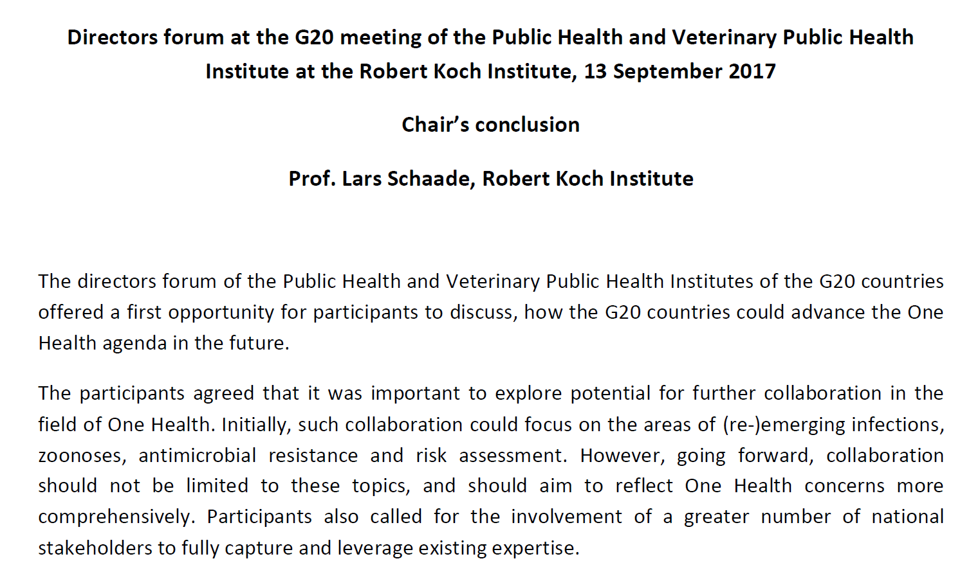

Slide 10
