Slide 1
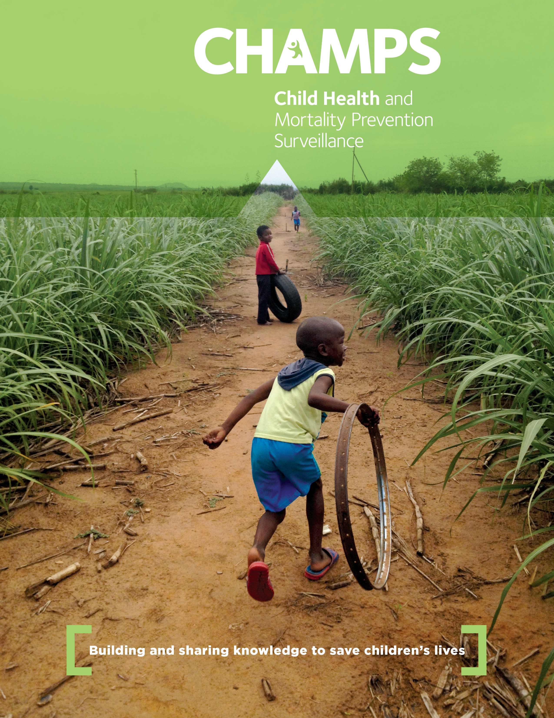
OVERVIEW: CHILD HEALTH AND MORTALITY PREVENTION SURVEILLANCE NETWORK
October 24, 2017

Slide 2
CHAMPS is an innovative surveillance program
The focus of the first phase of the grant (June 2015 – June 2018) is to track the most preventable causes of mortality among children under five (U5) Mortality.
Funding: Bill & Melinda Gates Foundation
Original Scope: 6 sites in 3 years
Geographic Focus: South Asia and Sub-Saharan Africa

Slide 3
To track the causes of childhood mortality, we are focused on three objectives
Primary Outcomes
1
Track definitive causes of child mortality
2
Disseminate and use high-quality data to inform policy
3
Enable sites to provide additional services

Slide 4
Our guiding principles showcase the uniqueness of the data produced by this surveillance network
CHAMPS data are:
Actionable
Shared (data and specimens)
Provided in real time
Locally-owned
Comprehensive
Collaboration
Standardized

Slide 5
CHAMPS surveillance activities are ongoing in seven countries
Baliakandi, Bangladesh
Bamako, Mali
Makeni, Sierra Leone
Harar/Kersa, Ethiopia
Kenya: MITS implementation
Mozambique: MITS implementation - DeCoDe
South Africa: MITS implementation - DeCoDe
Mali: MITS implementation - beginning Pregnancy Surveillance
Bangladesh: MITS implementation
Kisumu, Kenya
Manhica, Mozambique
Soweto, South Africa
Notes:
In the lungs of this stillbirth there were cells with cytoplasmic inclusions (indicated by arrow), these inclusions, sometimes referred to as “owls eye” are characteristic of CMV infection.
With these findings and with the positive PCR findings in multiple specimens the DeCoDe panel very easily determined the cause of death in this stillbirth was congenital CMV.

Slide 6
CHAMPS is assessing tension and alignment with community priorities
Lower alignment caused by tensions:
Religious beliefs
Perception that CHAMPS will not address community maternal and child health priorities
68 Community workshops across 6 sites
1,657 Participants engaged
Key findings: Site alignment with CHAMPS’ health priorities
Ethiopia
Sierra Leone
Bangladesh, Mali, Mozambique
Alignment
Low
Medium
High
Mali, Mozambique
Bangladesh, Sierra Leone
Ethiopia
Tension
Low
Medium
High
Notes:
CHAMPS has been unique in its community engagement approaches, which we deem essential to maintaining the acceptability of our surveillance over the long term. CHAMPS social behavioral science colleagues have conducted structured workshops with community members and leaders to assess the extent to which CHAMPS shares their MCH priorities. Through participant inquiry approaches they are able to gauge the level of alignment and tension with mortality surveillance activities. This helps focus subsequent formative research and has ultimately led to many concrete adaptations in procedures that likely increase acceptability, for examples timing with respect to religious practices and approaching families for consent with imams.

Slide 7
Pediatric and perinatal deaths notified by CHAMPS Surveillance Sites, December 2016 – October 2017*
 | Manhiҫa, Mozambique | Soweto, South Africa | Bamako, Mali | Kisumu, Kenya | Baliakandi, Bangladesh | TOTAL
Mortality surveillance start date | 12/5/2016 | 1/16/2017 | 8/8/2017 | 5/25/2017 | 9/22/2017
Data received through: | 9/28/2017 | 9/27/2017 | 9/29/2017 | 9/26/2017 | 10/4/2017
Unique notifications received | 167 | 1108 | 256 | 63 |  | 1594
Able to conduct eligibility screening | 163 | 396 | 59 | 21 |  | 639
CHAMPS-eligible cases | 161 | 391 | 57 | 13 | 4 | 622
Consent granted for MITS, Clinical, VA | 55 | 203 | 11 | 11 | 1 | 280
MITS procedure conducted | 52 | 202 | 10 | 11 | 1 | 275
Consent granted for Clinical, VA | 77 | 59 | 32 | 2 | 3 | 170
Not enrolled in CHAMPS | 29 | 129 | 14 | 0 | 0 | 172
*provisional data
Notes:
We have 5 sites notifying deaths according to CHAMPS surveillance system, including our latest site Bangladesh which just conducted its first MITS procedure last week, so their figures are unofficial. Across the network,, we’ve been notified of 1600 deaths, screened for eligibility in 639, and identified 622 CHAMPS eligible cases, meaning they met age and residence criteria. Of those, 280 granted consent for MITS, and we have counted 275 with confirmed MITS procedures. Another 170 granted consent for clinical data abstraction and verbal autopsy; 172 were not enrolled in CHAMPS.

Slide 8
CHAMPS Determination of Cause of Death (DeCoDe) Panel
Data from site
Linked maternal data
Demographic and clinical data
Verbal autopsy raw data
Microbiology, molecular biology (TAC), HIV, TB, malaria findings
Site histopathology findings
Data packet produced
Central review
Panel Members
Clinician
Pathologist
Microbiologist
Epidemiologist
Panel Causes of Death
Recorded in CHAMPS database, shared with clinicians and family (aggregate results shared with community)
Central Pathology Lab (CPL)
CPL histopathology
Special stains
Immunohistochemistry
PCR findings

Slide 9
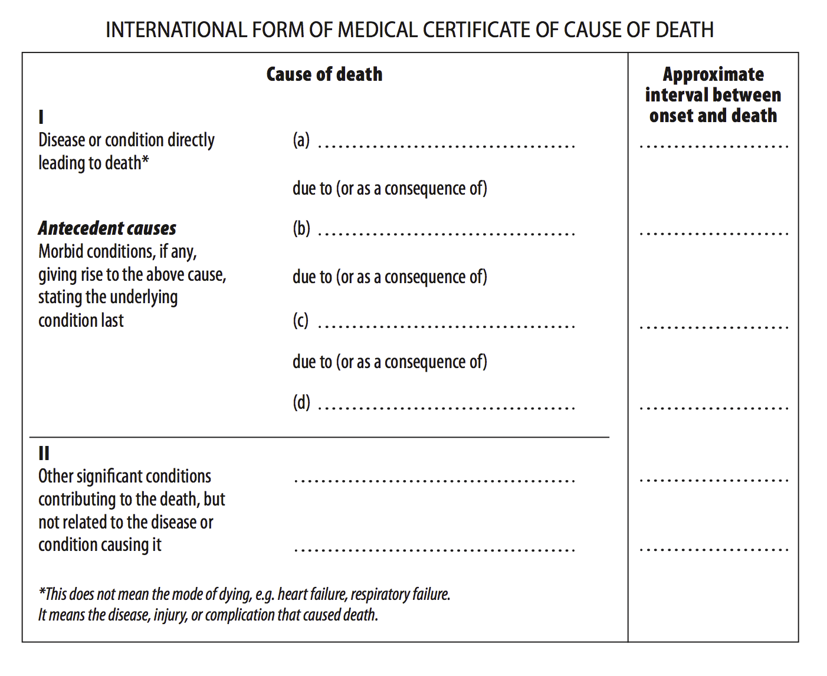
Underlying and Immediate Causes of Death
Immediate cause of death
“the disease or complication which directly preceded or directly led to death”
Underlying cause of death
“disease or injury that initiated the train of events leading directly to death, or circumstances of accident or violence which produced the fatal injury”
Source: WHO, International Classification of Diseases (ICD-10)
Notes:
Before we turn to the South African precursor study, we would like to remind you of how WHO standardizes the description of the causal chain leading to death. For those of you who have had to fill out a medical death certificate, you may recall that the last event in the sequence is the immediate cause of death, or the disease or complication which directly preceded or directly led to death.
But the most important concept from International Classification of Diseases is the underlying cause of death: this is the condition that initiated the train of events leading directly to death. The underlying cause of death on this last line of the death certificate is the subject of the global burden of disease estimates you are all familiar with.

Slide 10
Infectious Pathogens Listed Anywhere in Causal Chain, CHAMPS DeCoDe cases (N=52)
 |  | Cause of death
Pathogen | Total cases with pathogen* | Pneumonia | Meningitis/ Encephalitis | Sepsis | Other
Acinetobacter baumannii | 6 | 5 | 1 | 3
Klebsiella pneumoniae | 6 | 3 | 1 | 3
Pseudomonas aeruginosa | 5 | 2 | 1 | 1 | 1
Streptococcus pneumoniae | 5 | 4 | 1 | 1
Staphylococcus aureus | 5 | 3 |  | 2
Adenovirus | 4 | 3 | 1 |  | 1
E coli | 3 |  |  | 3
Group B Streptococcus | 3 |  |  | 3
Candida albicans | 2 | 1 |  |  | 1
Cytomegalovirus | 2 | 2
Haemophilus influenzae | 2 | 2 | 1
Malaria | 2 |  |  |  | 2
Aggregatibacter aphrophilus | 1 | 1
Influenza A | 1 | 1
Rhinovirus | 1 | 1
Respiratory syncytial virus | 1 | 1
Other Streptococci | 1 | 2
* Pathogens were implicated in multiple syndromes in some cases
Notes:
Here we assess the pathogens that were listed anywhere in the causal chain among the 52 CHAMPS DeCoDe cases. While the numbers are still small, we observe 17 different pathogens, most commonly Acinetobacter baumannii, Klebsiella pneumonia, Pseudomonas aeruginosa, Streptococcus pneumonia, and Staph aureus. The associated syndromes included pneumonia, meninigitis/encephalitis, and sepsis; in 11 of 52 cases, multiple pathogens were detected in the same individual.
In summary, the DeCoDe process is generating pathogen-specific etiology, and more granular information than we would obtain from verbal autopsy.

Slide 11
Projecting 1070 MITS obtained by June 2018
South Africa
Mozambique
Kenya
Mali
Bangladesh
Ethiopia
Sierra Leone
Actual MITS cases
Projected MITS cases
Notes:
If all goes well with all sites, we are anticipating just over 1000 MITS obtained by June 2018, the end of our first three year grant period. SA has the most MITS because of their experience with the pilot, and due to the expansive size of the population that uses the hospital. We project the contributions from other sites will increase as they gain experience. However, these projections assume that operations continue at steady state with no interruptions.

Slide 12
Nearly two-thirds of current CHAMPS cases are neonates and stillbirths (so far)
Data received by CHAMPS PO as of 10/1/2017
Notes:
Out of our 275 MITS cases, nearly two-thirds are neonates and stillbirths.
61.5% of CHAMPS-eligible deaths captured through Sept 2017 are stillbirths and neonates
Amongst MITS, 69.9% are neonates and SB; fewer SB because SA has suspended enrolling SBs

Slide 13
CHAMPS has started to capture deaths and stillbirths that occurred outside the health facility
Location of death, CHAMPS-eligible cases, n=622
Location of death,
MITS cases, n=275
Over time, CHAMPS will collect more MITS from deaths that occur in the community
n = 6 (eligible) and 2 (MITS) with location listed as other or unknown.
Data received by CHAMPS PO as of 10/1/2017
Notes:
About 14% of CHAMPS eligible cases have died in the community; about 6% of MITS cases have died in the community. We anticipate that the proportion of MITS cases that died in the community will increase over time as the sites shift to more intensive community outreach strategies – for example, conducting MITS in more remote health centers of Mozambique, or engaging with undertakers in Soweto.

Slide 14
champshealth.org

