Slide 1
“Responding to terrorist attacks: the role & experience of the French National Agency of Public Health”
Jean-Claude Desenclos
IANPHI Annual Meeting, Rome, October 23-24, 2017

Slide 2
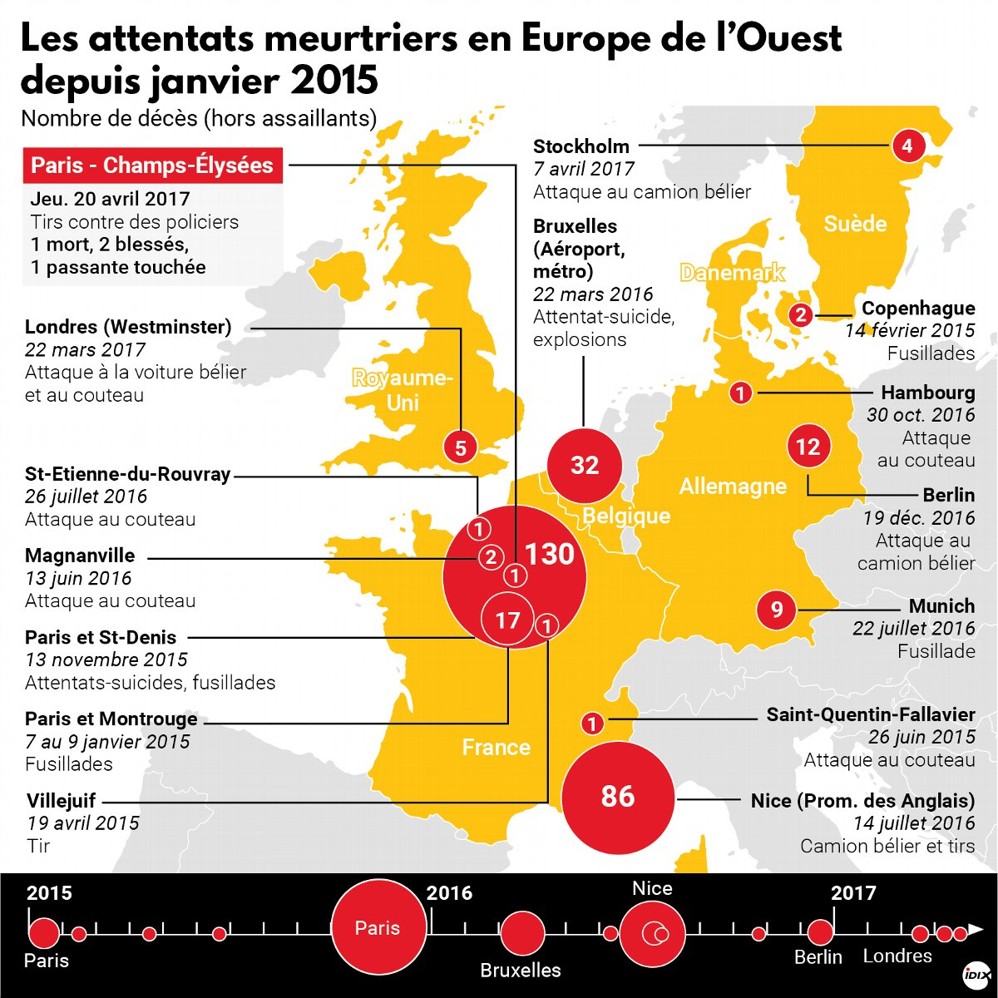
Main terrorist attacks in Europe
since January 2015

Slide 3
Three area of activities undertaken at Santé Publique France
Contribution to the emergency response
Mobilize existing syndromic surveillance
Produce knowledge to prevent PTSD*
among those exposed to the attacks
within the general population
*PTSD: post traumatic stress disorders

Slide 4
Contribution to the emergency response Mobilization of the French health reserve corps
Santé public France manages the emergency health reserve corps
Corps of volunteer health professionals that can be mobilized upon request of French authorities in France and abroad (Ebola…)
Within a few minutes of the event (24/24h, 7/7d organization)
Include deployment of psychology emergency teams from a region to another
Examples :
deployment emergency teams and medical specialists to face increased needs (Nice)
psychology emergency team deployed to the city of attack to face increased needs
emergency car regulators (Nice)
support to the emergency coordinating center of the ministry of interior & foreign affair (in case of a terrorist attacks abroad, Barcelona attacks)

Slide 5
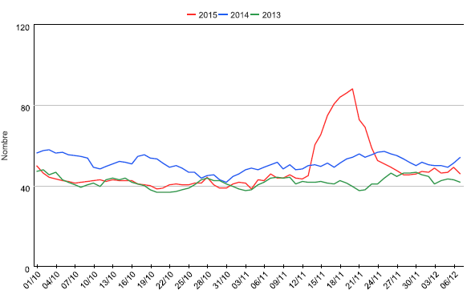
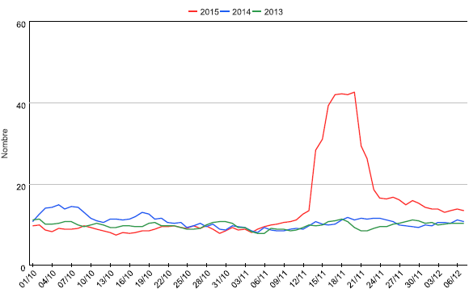
Mobilize syndromic surveillance Assess the immediate population mental health impact
France
Paris area
2015
2015
Emergency visits for mental stress disorders after the terrorist attacks of November 13, 2015, France

Slide 6
Post traumatic stress disorders (PSTD) after terrorist attacks, a preventable consequence
PTSD:
10-40% of those exposed; increase over time after a stressful intentional event
severe burden on life and health of those exposed
effective interventions to reduce the occurrence of PTSD
Not much available knowledge on PTSD after terrorist attacks
prevalence of PTSD by type of exposure
risk factors and preventive effect of early intervention
Survey on PTSD 6 months after the attack
population of those exposed to attacks: victims, families & beavered, those present on the scene, rescuers, security forces and neighbors of the attacks
data collection: standardized questionnaires with mental health specific tools & scales
face to face (Charlie Hebdo) or web based (November 2015) questionnaires
close collaboration with ministries of health, interior, justice, NGOs

Slide 7
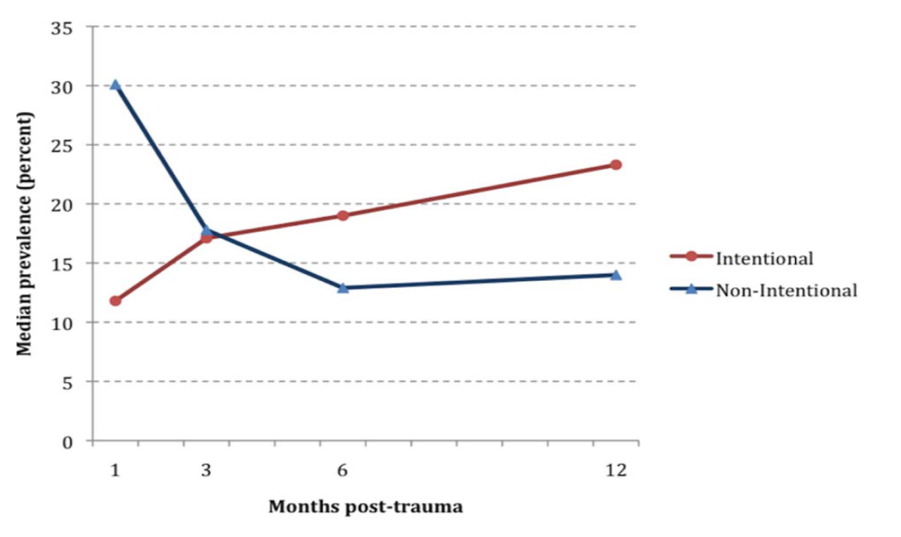
Post traumatic stress disorders (PSTD) after terrorist attacks, a preventable consequence
PTSD:
10-40% of those exposed; increase over time after a stressful intentional event
severe burden on life and health of those exposed
effective interventions to reduce the occurrence of PTSD
Not much available knowledge on PTSD after terrorist attacks
prevalence of PTSD by type of exposure
risk factors and preventive effect of early intervention
Survey on PTSD 6 months after the attack
population of those exposed to attacks: victims, families & beavered, those present on the scene, rescuers, security forces and neighbors of the attacks
data collection: standardized questionnaires with mental health specific tools & scales
face to face (Charlie Hebdo) or web based (November 2015) questionnaires
close collaboration with ministries of health, interior, justice, NGOs

Slide 8
Main results and implications
Exposed civilian population
prevalence of PTSD 18% , depression 20%, anxiety 30%
prevalence increases with the level of exposure
1/3 of exposed unable to work after the event; 6% still on sick leave six month after
Rescue and security forces: much less impact (PTSD 3%; anxiety 14%)
Risk factors for depressive disorders at 6 months
being female
lower socio-professional status,
economic impact of the attack on the business in which the exposed person worked
lack of early care by psycho-medical emergency services.
Stress the importance of
early detection and psycho-medical care, and follow-up (for any exposed, including rescuers)
training of mental health professionals
systematize training and care within rescuers organization

Slide 9
Assess consequences on mental health at the population level
Internet based panel survey 6 months after the November 13, 2015 attacks
N ~ 2 000; >15 years; quota method; over sampling of Paris (n=760)
Specially designed questionnaire to collect data on:
demography, impact on life (work leave, drug, doctor visits, psycho-social support…)
exposure to attacks, media (TV/internet…) & social media
psycho-social impact : DSM5 PTSD checklist (PCL-5), coping strategies, stress, anxiety…
Results: PCL-5 score remained rather high 6 months after the attack
PCL-5 score increases
with time spent on TV & internet the day of attack and the following 2 days
with time spent on social media
only for those not exposed to the attacks
Similar results in studies done in other countries after similar events

Slide 10
Conclusions
Not very much experience around from a National public health Institute perspective (research experience in Norway)
We build our activities through experience and learning
Linked to core missions: surveillance, response & prevention
Challenges
PTSD surveys, access to list of victims, ethical and legal issues…
work with many stakeholders: police, justice, rescuers, victims, NGOs…
demonstrate usefulness
completely new area to which almost nobody had experience with
Lesson learned implemented for prevention of PTSD

Slide 11
Acknowledgements
Direction des alertes et crise
Cire Ile de France
Reserve sanitaire
Philippe Pirard, Yvon Motreff, Stephanie Vandentorren, Thierry Baupet, Maëlle Robert, Enguerrand Du roscoat

