Slide 1
IANPHI and the WHO Global Action Plan on Physical Activity
Dr Justin Varney
National Lead for Adult Health and Wellbeing
Public Health England
Justin.varney@phe.gov.uk

Slide 2
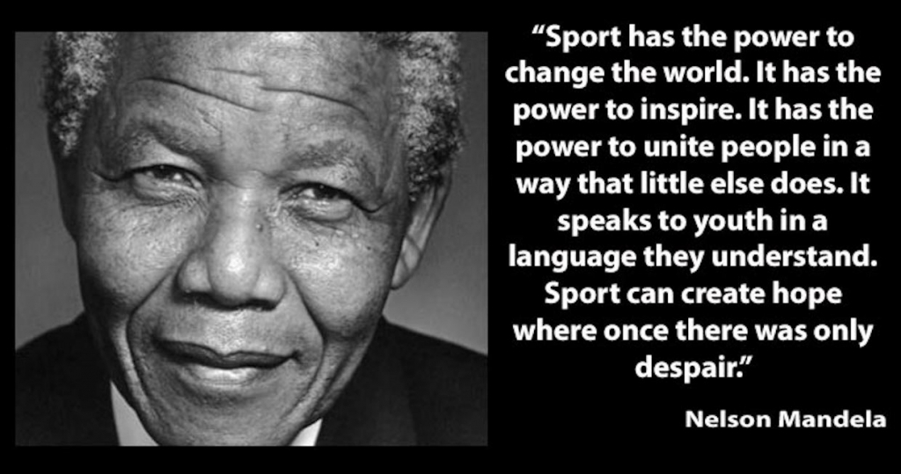

Slide 3
What is physical activity?
Physical activity
Active living
Active travel
Active recreation
Informal sport
Organised sport
Active sport
Active Play
Utility transport
Schools
Homes
Workplaces
Important at every age across the life-course

Slide 4
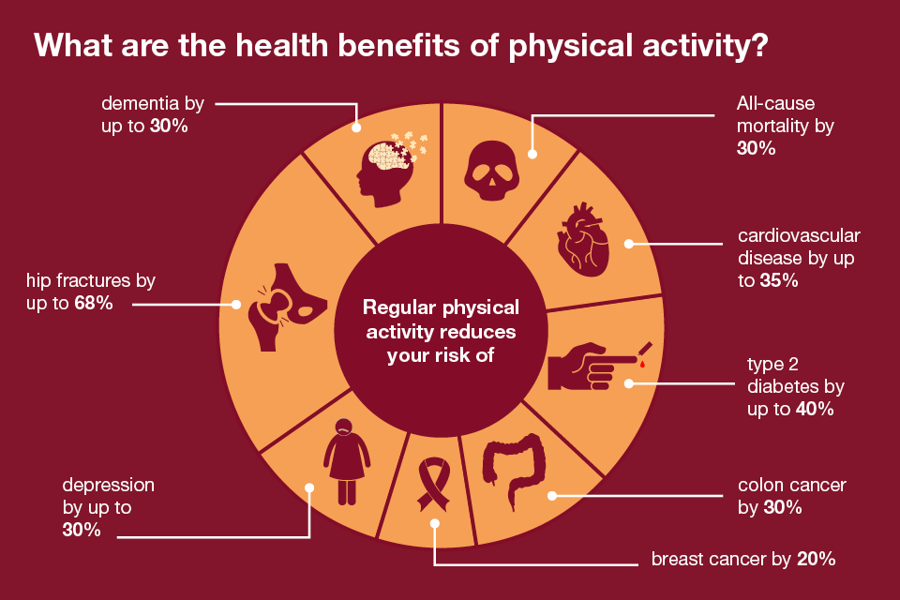

Slide 5
WHO GLOBAL ACTION PLAN ON PHYSICAL ACTIVITY

Slide 6



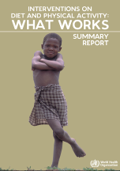
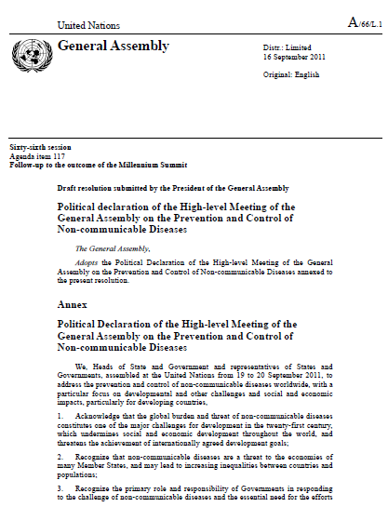
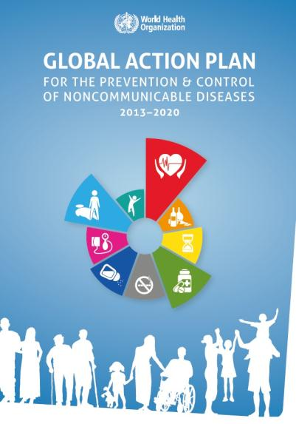

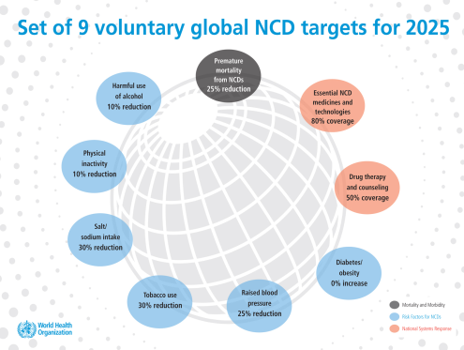
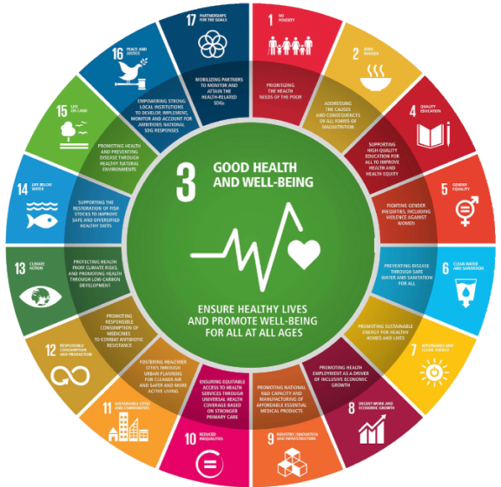
KEY MILESTONES IN PHYSICAL ACTIVITY AND GLOBAL HEALTH
1996
2004
2006-8
2010
2011
2013
2013
2015
2018
Global PA Action Plan
Global PA
Tool Kit
Global PA
Movement

Slide 7
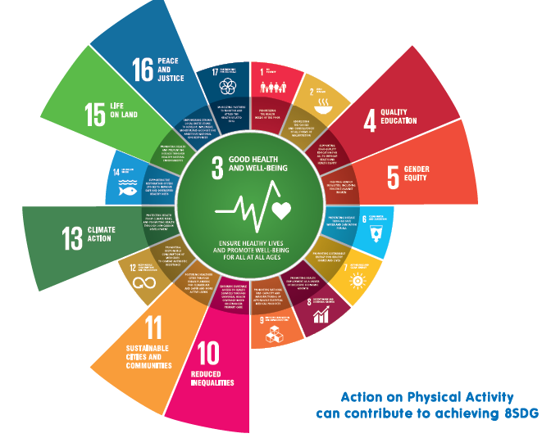
Agenda 2030: New opportunity for physical activity for joint action within shared global agenda
Actions on physical inactivity can contribute to achieving
SDG 3 - Health (3.4, 3.6, and 3.9)
SDG 4 - Quality Education (4.1 and 4.2)
SDG 5 - Gender Equity (5.1)
SDG 10 - Inequalities (10.2 and 10.3)
SDG 11 - sustainable cities and communities (11.2, 11.3, 11.6 and 11.7)
SDG 13 - Climate Change (13.1 and 13.2)
SDG 15 - Life on land (15.1 and 15.5)
SDG 16 - Peaceful and inclusive societies (16.1 and 16.5)

Slide 8
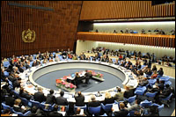
A New Global Physical Activity Action Plan
PART 2: MANDATE TO DEVELOP A NEW GLOBAL ACTION PLAN ON PHYSICAL ACTIVITY
Decision at the 140th session of the Executive Board in Jan 2017
Requested to submit draft global action plan to be considered by the World Health Assembly in May 2018 through the 142nd Executive Board session in January 2018
Build on previous NCD strategies
Strategic links to Sustainable Development Goals 2030
New opportunity to provide countries with guidance on how to tackle inactivity especially around areas where the evidence has advanced most in recent years

Slide 9
PART 2: TIME LINES AND PROCESS FOR DEVELOPMENT PROCESS
2017
2018
April
May
June
July
August
September
February
October
January
March
May
Establish and Commence Internal Steering Group (ISG) - Meetings held monthly
Convene Expert Technical Advisory Meeting
Regional consultations led by WHO
Stakeholder led consultations
Open on-line consultations
Briefing for Permanent Missions and UN Agencies
Webinars
Submit Draft to GBS
Revised Draft submit to GBS
EB142
Jan 2018
WHA 71
May 2018

Slide 10
Part 2: Vision and Goal (Para 45-46)
Vision (para 45)
A world where all countries provide the enabling environments and opportunities for all citizens to be physically active and through this enhance the social, cultural, economic development and wellbeing of nations
Goal (para 46)
One hundred million people more active by 2030
(a calculation based on the number of adult population in 2030 that needs to be more active to achieve 10% target)

Slide 11
Part 2: guiding Principles (Para 47)
Eight Principles
Life course approach
Equity
Empowerment of peoples, families and communities
Human Rights-based approach
Evidence based practice
Cross-sectoral Engagement and Partnership for Joint Action
Policy coherence
Universal health coverage

Slide 12
PART 3: FOUR STRATEGIC OBJECTIVES
I
ACTIVE SOCIETY
III
ACTIVE PEOPLE
IV
ACTIVE SYSTEMS
II
ACTIVE ENVIRON-MENTS

Slide 13
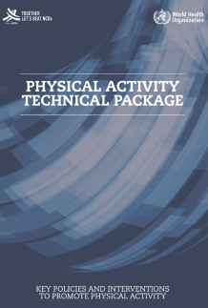
GLOBAL PHYSICAL ACTIVITY TOOLKIT, RESOURCES AND TRAINING
The guide to how to…
Align as Supporting tool for Global Action Plan
Dissemination & Promotional
Resources in 2018
DRAFT
Training Resources & Tools
2018/2019
Leadership, Learning
Networks, Sharing
2018-2025
Structure sections by Settings/Sectors for ease of use by sectors but with emphasis on joint action

Slide 14
IANPHI Consultation Response
To develop the IANPHI response to the consultation an online survey was developed with the support of the secretariat and approved by the executive then disseminated to members.
A further member specific template was disseminated to gather more specific views on the draft global action plan.
The response was further developed with support from a small groups of IANPHI member.
The IANPHI response highlighted:
Support for the aims and ambitions of the draft global action plan and core themes and approach
Offered opportunities to strengthen the action plan through greater focus on those who are least active, better use of data, a strong emphasis on the human right aspect of physical activity for health and being clearer about the involvement of cultural interventions.
We highlighted the issue of violence as a barrier to physical activity which is something that was also fed back directly to the WHO policy team as a significant gap in thinking for Low & Middle Income Countries
The IANPHI response was approved by the IANPHI executive and submitted before the close of the WHO consultation period.

Slide 15
IANPHI PHYSICAL ACTIVITY SURVEY RESULTS

Slide 16
IANPHI Member Survey on Physical Activity
196 visits to survey page
61 submissions
22 NPHI responded
45 responses from identified organisations
Country income demographic
11 HIC
5 UMIC
5 LMIC
1 LIC
WHO Regions represented
13 Europe
3 Western Pacific
3 Americas
1 South-East Asia
2 Africa
Survey launched on-line on 1st August and closed on 8th September.
A word and pdf version of the survey questions was also circulated by email to IANPHI members.
Reminder prompts for participation were sent alongside prompts to participate in the WHO GAPPA webinars.
The survey was only available in English and this may have limited the response from some member organisations.

Slide 17
Initial findings from survey analysis
NPHI Focus on PA
Only 2 countries reported that there was no national commitment to addressing population physical activity, however all were committed to implementing the global sustainable development goals
86% of NPHI responding were doing specific work on physical activity.
Of those specifically working on physical activity:
53% identified a specific organisational framework/strategy on physical activity
37% had no dedicated resource or programme working on physical activity
In those with dedicated resource or programmes the number of programmes specifically on physical activity ranged from 1 to 5 different programmes. Hong Kong and Finland described the most programmes.

Slide 18
Initial findings from survey analysis
Campaigns on physical activity
23% reported currently running a national campaign to promote physical activity
CDC China
China Health Lifestyle for ALL (HLA)
Whole population
www.jiankang121.cn
Public Health England
Change4 Life/ 10 minute shake ups
Children, Young people & Families
https://www.nhs.uk/change4life-beta/activities
One You/Active 10
Adults (40-60yrs)
https://www.nhs.uk/oneyou/active10/home#fbICGRSDw3BBKADj.97
Sante publique France
Bouger plus
Adults and specific population (pregnant women, seniors)
Centre for Health Protection, Department of Health, Hong Kong
Healthy Exercise For All
Whole population
http://www.lcsd.gov.hk/en/healthy
Robert Koch Institute Germany
Inform
Whole Population
https://www.in-form.de/

Slide 19
Government Engagement
Respondents most commonly highlighted Health, Sport, Children, Education and Travel/Transport as being the most engaged and active government departments
Very few NPHI reported strong government engagement with their NPHI beyond Health/Public Health Ministries.
In terms of national strategies:
  79% reported a national physical education curriculum
  79% reported a national sport strategy
  68% reported a national cycling/walking infrastructure plan/strategy
  64% reported a cross-government strategy or action plan on physical activity
NPHI identified play as the area where there was least likely to be a national strategy or framework in place

Slide 20
Global Sustainable Development Goals
All NPHI reported a national commitment to delivering the global sustainable development goals.
67% reported that they had a role supporting national action on SDGs
31% reported an explicit link being made between SDGs and Physical Activity
Just under half of respondents identified specific action plans linked to individual SDGs, however few made explicit connections to the role of physical activity in achieving the SDGs.
Connection between SDG and Physical Activity was mainly reported in relation to:
  Goal 3: Good Health & Wellbeing
  Goal 4: Quality Education

Slide 21
Data Collection
40% of NPHI are not actively involved in population level data collection on physical activity.
Of the 60% collecting population data on physical activity, 83% make this data publically available.
Use of global data was varied but most were aware they existed.
 | Use data | Do Not Use data | Not Aware of this data | Response Total
Adult risk factor surveillance (STEPS) | 40% (6) | 53.33% (8) | 6.67% (1) | 15
Global Schools Health Survey (GSHS) | 21.43% (3) | 57.14% (8) | 21.43% (3) | 14
Global School Policy Survey (G-SHPPS) | 15.38% (2) | 61.54% (8) | 23.08% (3) | 13
Country Completed Capacity Survey (NCD CCS) | 33.33% (5) | 46.67% (7) | 20% (3) | 15

Slide 22
Barriers & Enablers
Biggest Barriers
Political Commitment
Resource Mobilisation
Implementation Gap
Evidence on Cost of Inaction
Cross Government Working
Research & Evidence
Biggest Enablers
Resources to support cross government coordination mechanisms
Research frameworks for physical activity
Training and capacity building resources for planning and built environment sector

Slide 23
Survey next steps
84% of NPHI who took part expressed an interest in continuing to work with IANPHI on physical activity.
There were specific requests for more effort to enable Low & Middle Income Countries to have access to and adapt tools and resources from High Income Countries.
Following further analysis we aim to publish the findings from the survey either as an IANPHI report or in a peer review publication.

Slide 24
Looking to the future

Slide 25

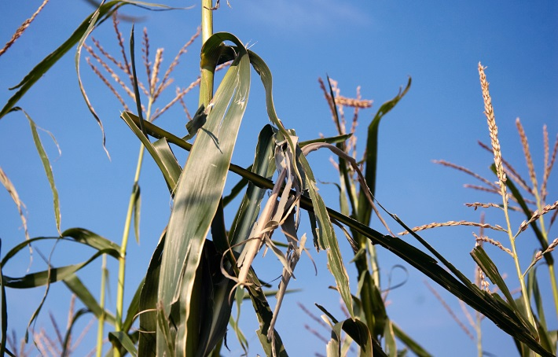

Emerging contextual shifts
As life expectancy continues to expand so does the proportion of life lived with disease and disability
Increasing shift to city based living aligned with mobilisation of sustainable tech harmonised living.
Climate change and ecological stability
Potential for instability in water/food resources
Globalised multi-nationals working with ‘crowd sourced’ businesses
Collective decision making influencing policy
Potential for increasing inequalities and social division

Slide 26
Physiological impacts of ageing
Ageing
CVD decline
Vascular dysfunction
Cognitive decline
Loss of muscle & bone density
Reduced gut motility
Reduced liver & kidney efficiency
Physical activity
Diet & nutrition
Mental wellbeing
Smoking cessation
Alcohol moderation

Slide 27
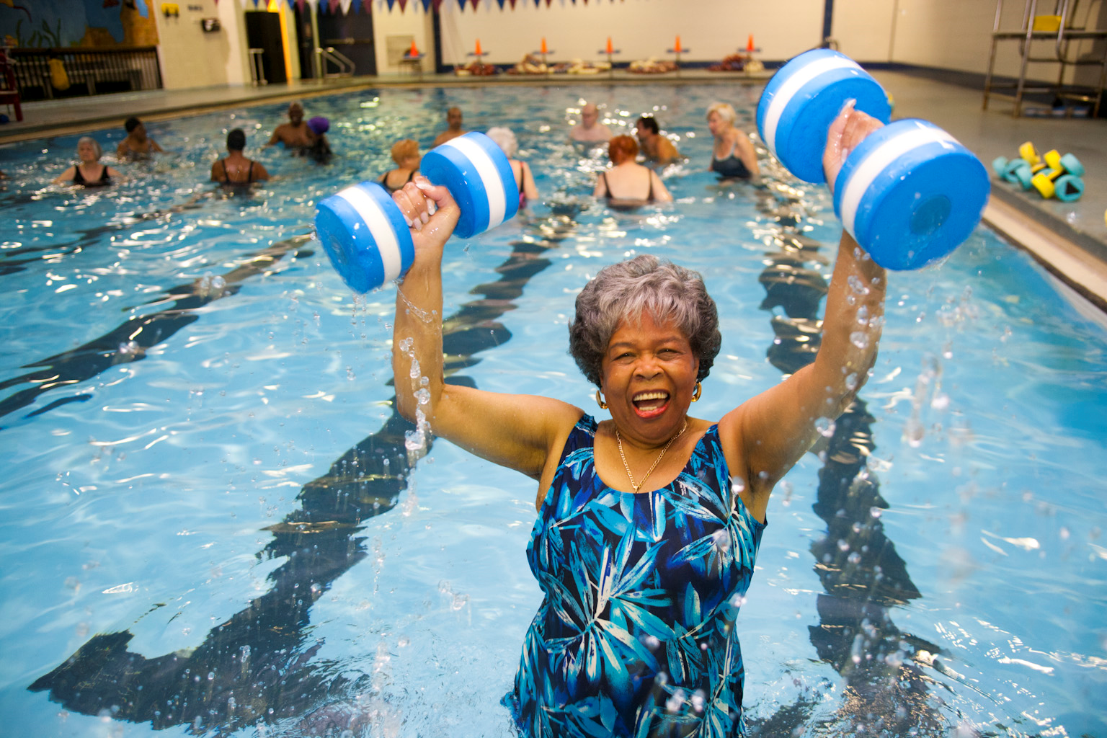
Investing in prevention is key at an individual level to being able to enjoy life, remain economically active and independent into later life.
For the public sector, ensuring individuals are active across the life course and investing in their own health is essential to the economic viability of local communities and the sustainability of the public sector.

Slide 28
Next Steps

Slide 29
WHO Global Action Plan on Physical Activity
Global Action Plan on Physical Activity has been developed based on consultation responses and is being submitted into the ratification pathway in October 2017 with an aim of final publication in May 2018 supported by a suite of regional implementation toolkits.
The ambition of GAPPA is:
To increase political interest, action and investment in physical activity in all countries
To enable engagement of all relevant sectors in joint actions to secure the multiple benefits of active living for health, environment, economy and society
To provide a set of effective feasible policy actions to guide national planning and accelerate implementation – relevant and useable by all countries
To stimulate development of the supporting systems at national level to improve policy and practice
To create a global social movement to support all countries to support all countries to reach the vision and goals of GAPPA

Slide 30
Ask of NPHI
NPHI step towards the opportunity of GAPPA to move at scale and pace across government and across the whole system and support greater action by all civic agencies.
Key opportunities for NPHI:
Convene cross-system/sector partnerships for action
Matrix across government departments to find the opportunities in joined up policy
Use Policy Assessment Tools to help shine a light on gaps and opportunities for action
Help visualise inequalities and where investment in physical activity pays back to different system partners
Develop cross-sectoral capacity building, using physical activity as a vector for system wide action on behaviour change

Slide 31
Discussion Questions
How can IANPHI support NPHIs to have a strong voice on physical activity as a public health issue for NPHI globally?
How can IANPHI support members to take action on physical activity?
What would success look like for IANPHI and NPHI members in terms of physical activity?

Slide 32
