Slide 1
Physical Activity
The golden thread to weave across policy
Dr Justin Varney
National Lead for Adult Health and Wellbeing
Public Health England
Justin.varney@phe.gov.uk

Slide 2
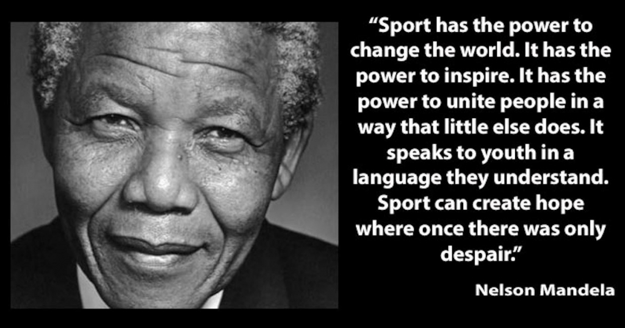

Slide 3
What is physical activity?
Physical activity
Active living
Active travel
Active recreation
Informal sport
Organised sport
Active sport
Active Play
Utility transport
Schools
Homes
Workplaces
Important at every age across the life-course

Slide 4
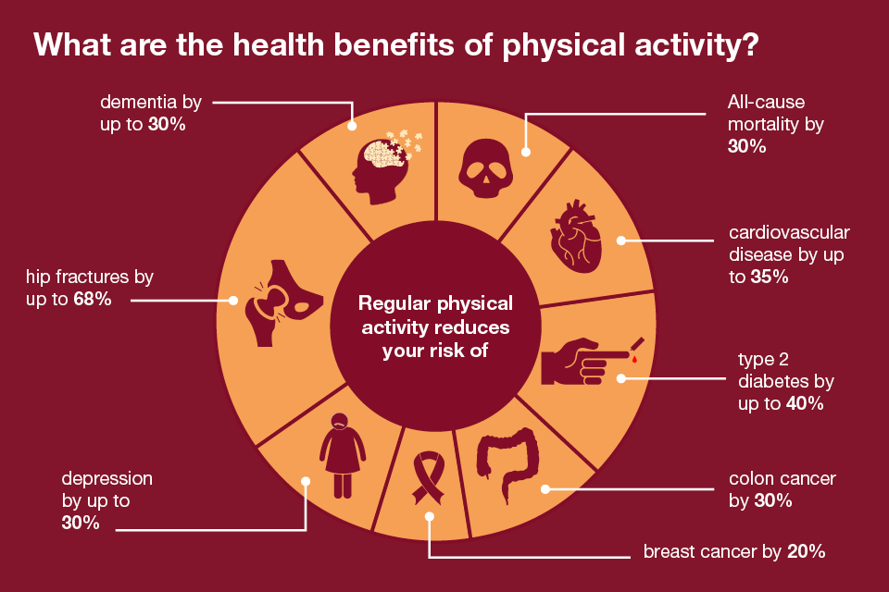

Slide 5
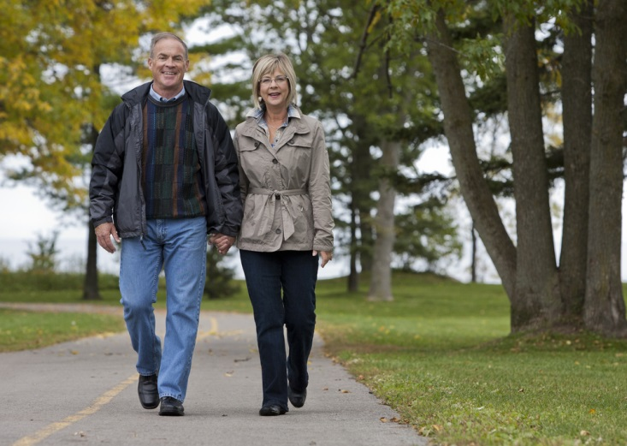
Context of physical activity
All of us move every day for functional and recreational reasons
There is a strong and growing evidence base that moderate and vigorous physical activity, in many forms from dance to decathlon, can impact on health and wellbeing from pre-conception to death.
However most movement is not active enough to impact on health and wellbeing.
The motivation to increase physical activity is varied, both between different individuals and across the life course.
There are major inequalities between different population groups and across the life course.
Being active is essential for individuals to achieve their potential in life and to reduce their potential burden on the State.

Slide 6
Wider benefits to State & Society
More active citizens
Increased economic productivity & sustainability
Environmental benefits of active travel
Reduced burden on social care
Improved educational outcomes
Increased business investm ent & development
Viable working population for employment
Increased integration of business & community
Increased viability of high streets
Increased academic attainment
More sustainable local communities
Reduced burden on youth justice & support services
Reduced traffic congestion
Improved air quality
Increased duration of working life
Maximised utilisation of public transport infrastructure
Reduced burden on state welfare
Increased duration of independent living
Reduced social isolation

Slide 7
Embedding a system wide approach
Improving population physical activity requires action across the breadth of civic society working with national and local government, employers, health providers, voluntary and community sector agencies and engaging the public directly.
Key factors in embedding a system wide approach to physical activity:
Data and evidence
Cross-sector partnership
Industrial scale action across the whole system
Recognition of the breadth and diversity of types of physical activity across the life course
Focus on addressing inactivity as well as increasing physical activity to health enhancing levels

Slide 8
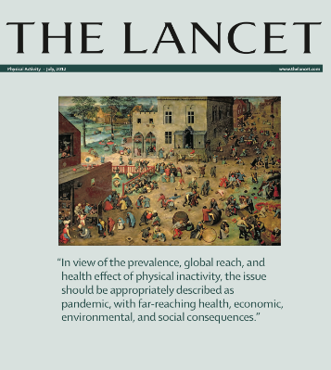

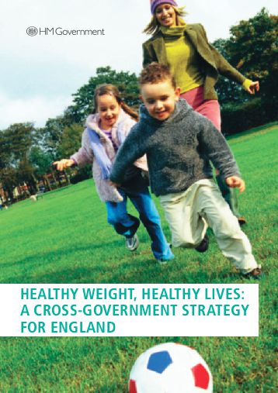

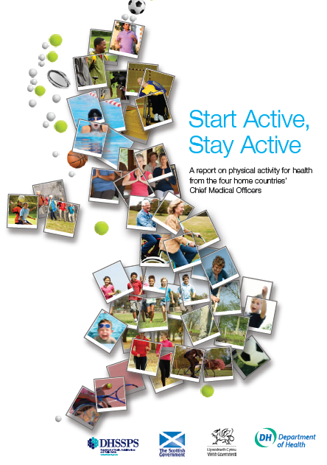

Strong Foundations

Slide 9
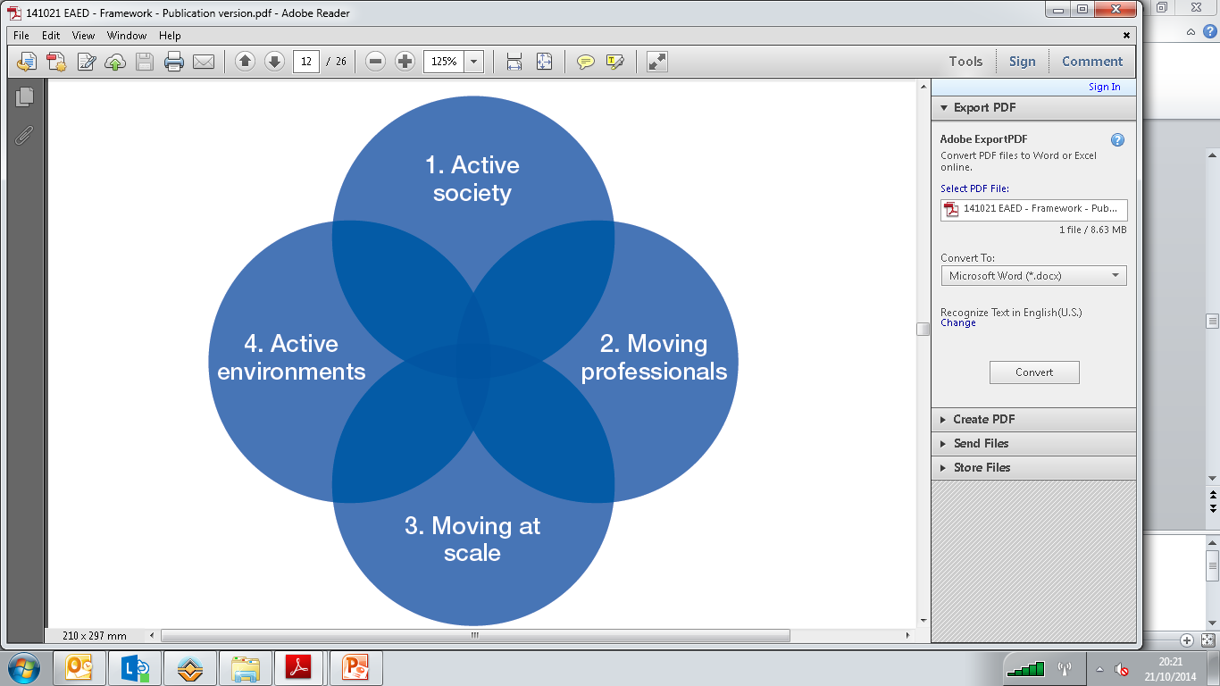
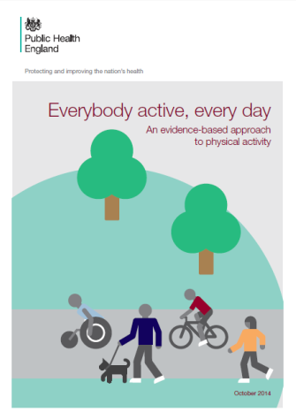
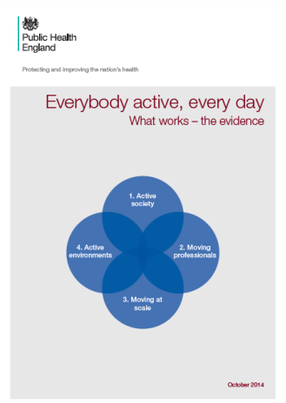
Everybody Active, Every Day (2014)
National framework for reducing inactivity and promoting physical activity in England.
Consolidated international evidence and co-produced with over 1,000 local and national stakeholders
Supports local and national leaders to reframe, refocus and provide leadership on embedding physical activity into policy and action
  Four domains for national and local action

Slide 10
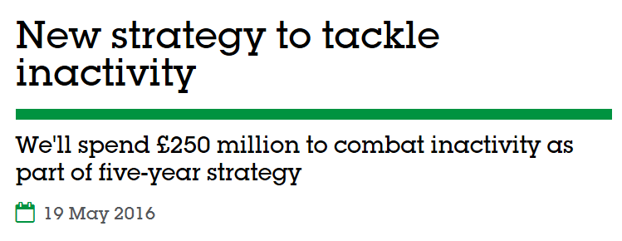

Sporting Future (2016)
We want everyone in England
regardless of age, background or level of ability to feel able to engage in sport and physical activity. Some will be young fit and talented, but most will not. We need a sport sector that welcomes everyone – meets their needs, treats them
as individuals and values them
as customers.
.

Slide 11
Creating a leadership narrative
Built strong national partnerships mirrored by local partnerships flexed to local landscape
Supported action by MPs through a specific toolkit for leadership on physical activity in their constituency
Embedding of physical activity into multiple pieces of government policy and strategy e.g. Department for Work & Pensions Green Paper on Health and Work
Department of Transport
Department for Education
Department of Work & Pensions
Department of Communities & Local Government
Department of Health
Department of Culture, Media & Sport
National Health Service
Public Health England
Sport England
Arts Council England
Local Government
National Governing Bodies for Sport
Creative arts sector
County Sport Partnerships
Voluntary and Community Sector
Sport & Rec Alliance
Trade & professional bodies
Private sector
Schools & Higher Education Sector
UKActive
Sport and Leisure Providers

Slide 12
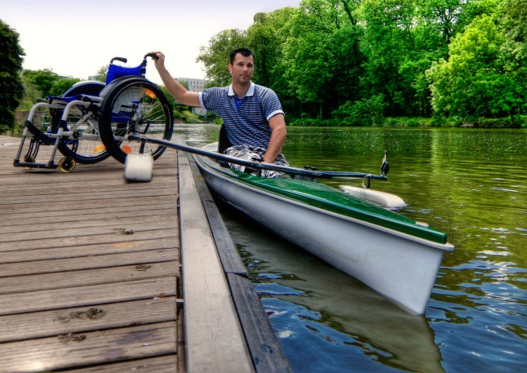
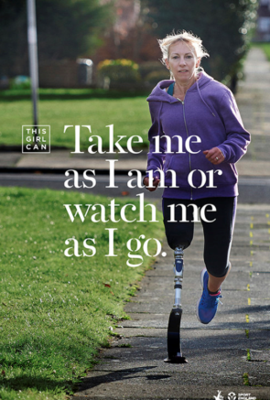


Creating an active society
Focus on changing general attitudes to make physical activity the expectation or social norm
Working across sectors in the places we live and work to change the social and professional narrative
Developing a common vision of:
“Everybody Active, Every Day”
For everybody, in every community

Slide 13
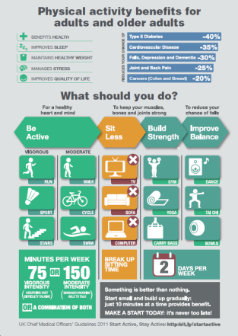
Moving Professionals
Utilising existing network of influencers on the public, the public & voluntary sector workforce
‘Making every contact count’ across sectors and disciplines
Starting with expertise & leadership in key sectors:
      Education
      Sports & leisure
      Health & social care
      Planning, design, transport

Slide 14
Moving Healthcare Professionals Programme
9 condition specific modules of free e-learning
>80,000 modules completed to date
Undergraduate education
Post-graduate education
Continuing professional development
Co-developed with HCP professional bodies.
Co-delivered with Sport England
E-learning
Peer2Peer
Infographics
To date over 5,000 healthcare professionals have received face2face training on PA very brief advice
4 age group specific graphics of CMO guidelines distributed in BMJ to all doctors in England
Resources embedded in 17/34 medical schools to date
Working with FSEM to develop medical college specific educational resources
Professional accreditation process
e.g. exams
Spiral Curriculum
Professional Standards

Slide 15
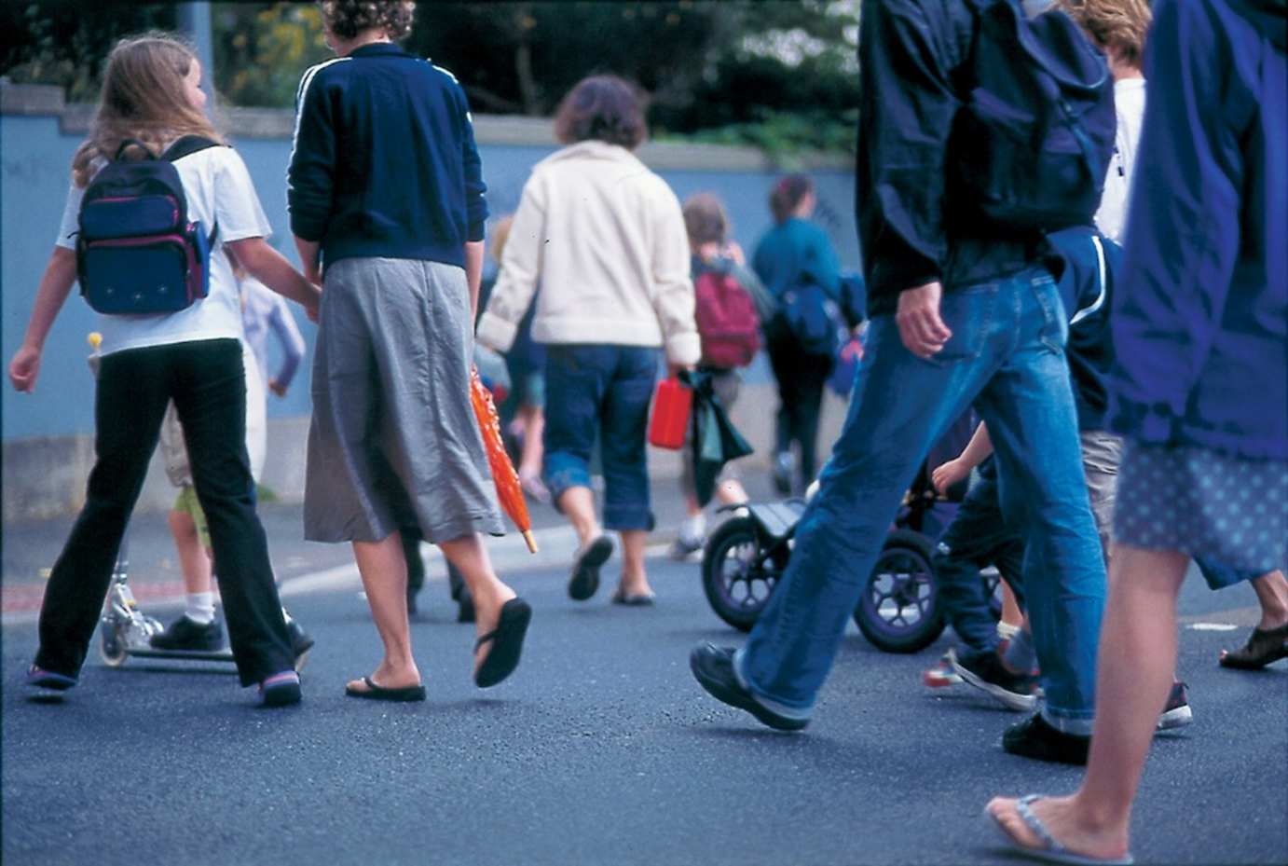
Creating Active Environments
Developing ‘healthy’ cities, villages, towns and communities
Linking across disciplines through planning and policy:
      ‘Active’ infrastructure planning
      Capital funding investments
Embedding activity for all:
      Age-friendly
      Disability-friendly
Joint Planning Guidance & Tools
Strong links to sustainability & environmental sector

Slide 16
Moving at Scale
What works’ evidence consolidation supported the development of Everybody Active, Every Day
NESTA quality criteria based case study collation of interventions to reduce inactivity in 2014/15 done in partnership with UKActive Research Institute and National Centre for Sport & Exercise Medicine. Repeated in 16/17 and showed significant increase in evidence based practice.
Regional series of data and evidence workshops for commissioners and providers.
Sport England has significantly strengthened evidence collection/ evaluation as core funding criteria into grant schemes.
Positive change must happen at every level and must be measurable, permanent and consistent
Implement ‘what works’ at scale
Maximise existing assets:
      Human
      Physical

Slide 17
Reflections and learning
Strong evidence base for physical activity as golden thread across government
There has to be a whole system approach to tackling inactivity and promoting physical activity
Focusing on those doing less than 30 mins of activity a week has driven stronger connection from health sector and focus
Using physical activity in its broadest sense enables buy-in from other government departments and policy areas in a way sport doesn’t on its own
Safe politically as low media risk of controversy
Timescale to impact is a challenge but with good annual data collection it is possible to demonstrate increased participation in sport and utility based cycling and walking.
Important to have totemic landmarks as well as slow burn strategic shifts e.g. quality improvement payment for NHS organisations on physical activity of staff was totemic shift on several levels, while data consolidation into single access platform represents a strategic shift move.

Slide 18
What might we have done differently?
Strengthened the focus to be primarily on those not achieving 30 minutes of physical activity rather than just those not achieving 150mins per week
Brought together the data into a single fingertips tool earlier, this has been particularly powerful to support local action.
Strengthened narrative and engagement with economic development partners, particularly to weave into local economic development and regeneration plans and build employer led narrative for working age adults.
Thought more about dance and cultural interventions as part of the spectrum of the activity offer, especially for youth.

Slide 19
Looking to the future

Slide 20
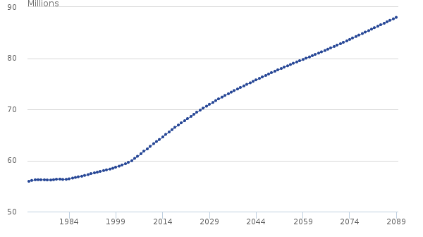
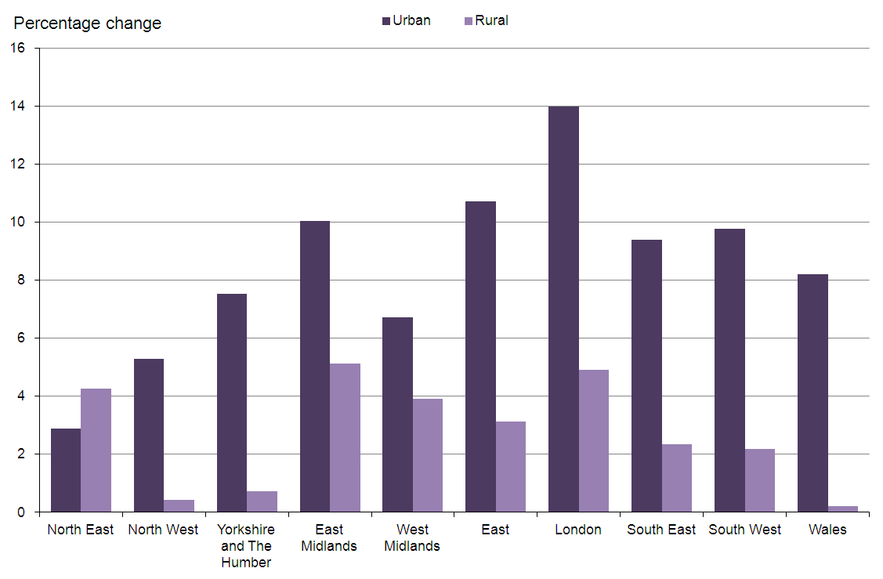
Looking ahead
Life expectancy continues to expand but so does the proportion of life lived with disease and disability.
Fertility rates remain relatively constant and although migration patterns may change the overall picture is of population growth.
Increasing shift to city based living aligned with mobilisation of sustainable tech harmonised living.
Estimated and projected total population, UK, year ending mid-1971 to year ending mid-2089 (ONS 2015)
Percentage change in the size of the usual resident population in urban and rural areas 2001 to 2011 (ONS)
Notes:
Reference for images
ONS National Population Projects (2015) - https://www.ons.gov.uk/peoplepopulationandcommunity/populationandmigration/populationprojections/compendium/nationalpopulationprojections/2015-10-29/summaryresults
Rural/Urban % change in size of usual resident population
http://webarchive.nationalarchives.gov.uk/20160105160709/http://www.ons.gov.uk/ons/rel/census/2011-census-analysis/rural-urban-analysis/comparing-rural-and-urban-areas-of-england-and-wales.html

Slide 21
Physiological impacts of ageing
Ageing
CVD decline
Vascular dysfunction
Cognitive decline
Loss of muscle & bone density
Reduced gut motility
Reduced liver & kidney efficiency
Physical activity
Diet & nutrition
Mental wellbeing
Smoking cessation
Alcohol moderation

Slide 22


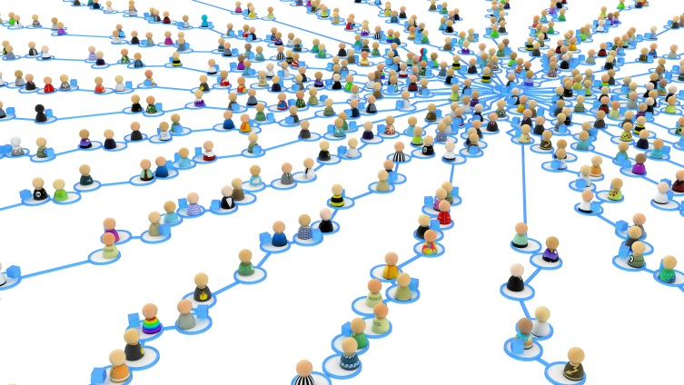
Emerging contextual shifts
Climate change and ecological stability
Potential for instability in water/food resources
Globalised multi-nationals working with ‘crowd sourced’ businesses
Collective decision making influencing policy
Potential for increasing inequalities and social division

Slide 23
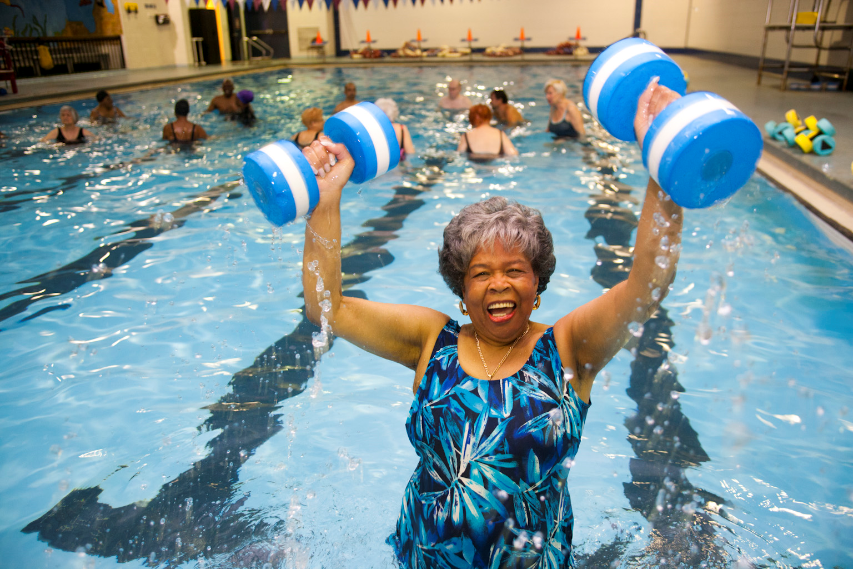
Investing in prevention is key at an individual level to being able to enjoy life, remain economically active and independent into later life.
For the public sector, ensuring individuals are active across the life course and investing in their own health is essential to the economic viability of local communities and the sustainability of the public sector.

Slide 24
