Slide 1
CHAMPS and Data-to-Action: Mozambique experience
Eduardo Samo Gudo, MD PhD
2017 IANPHI Annual Meeting
October 24, Rome, Italy

Slide 2
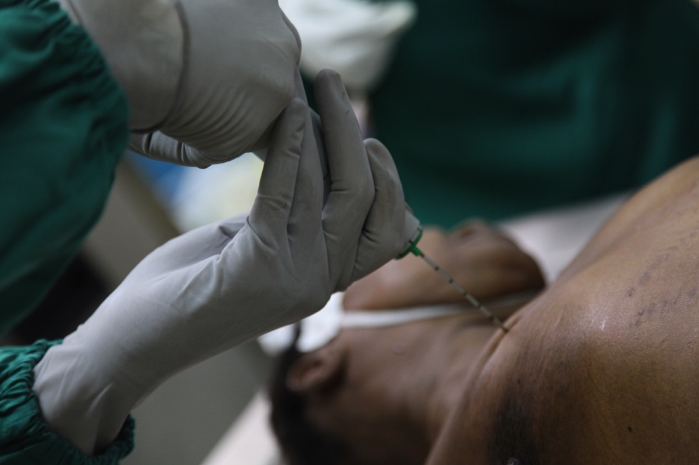
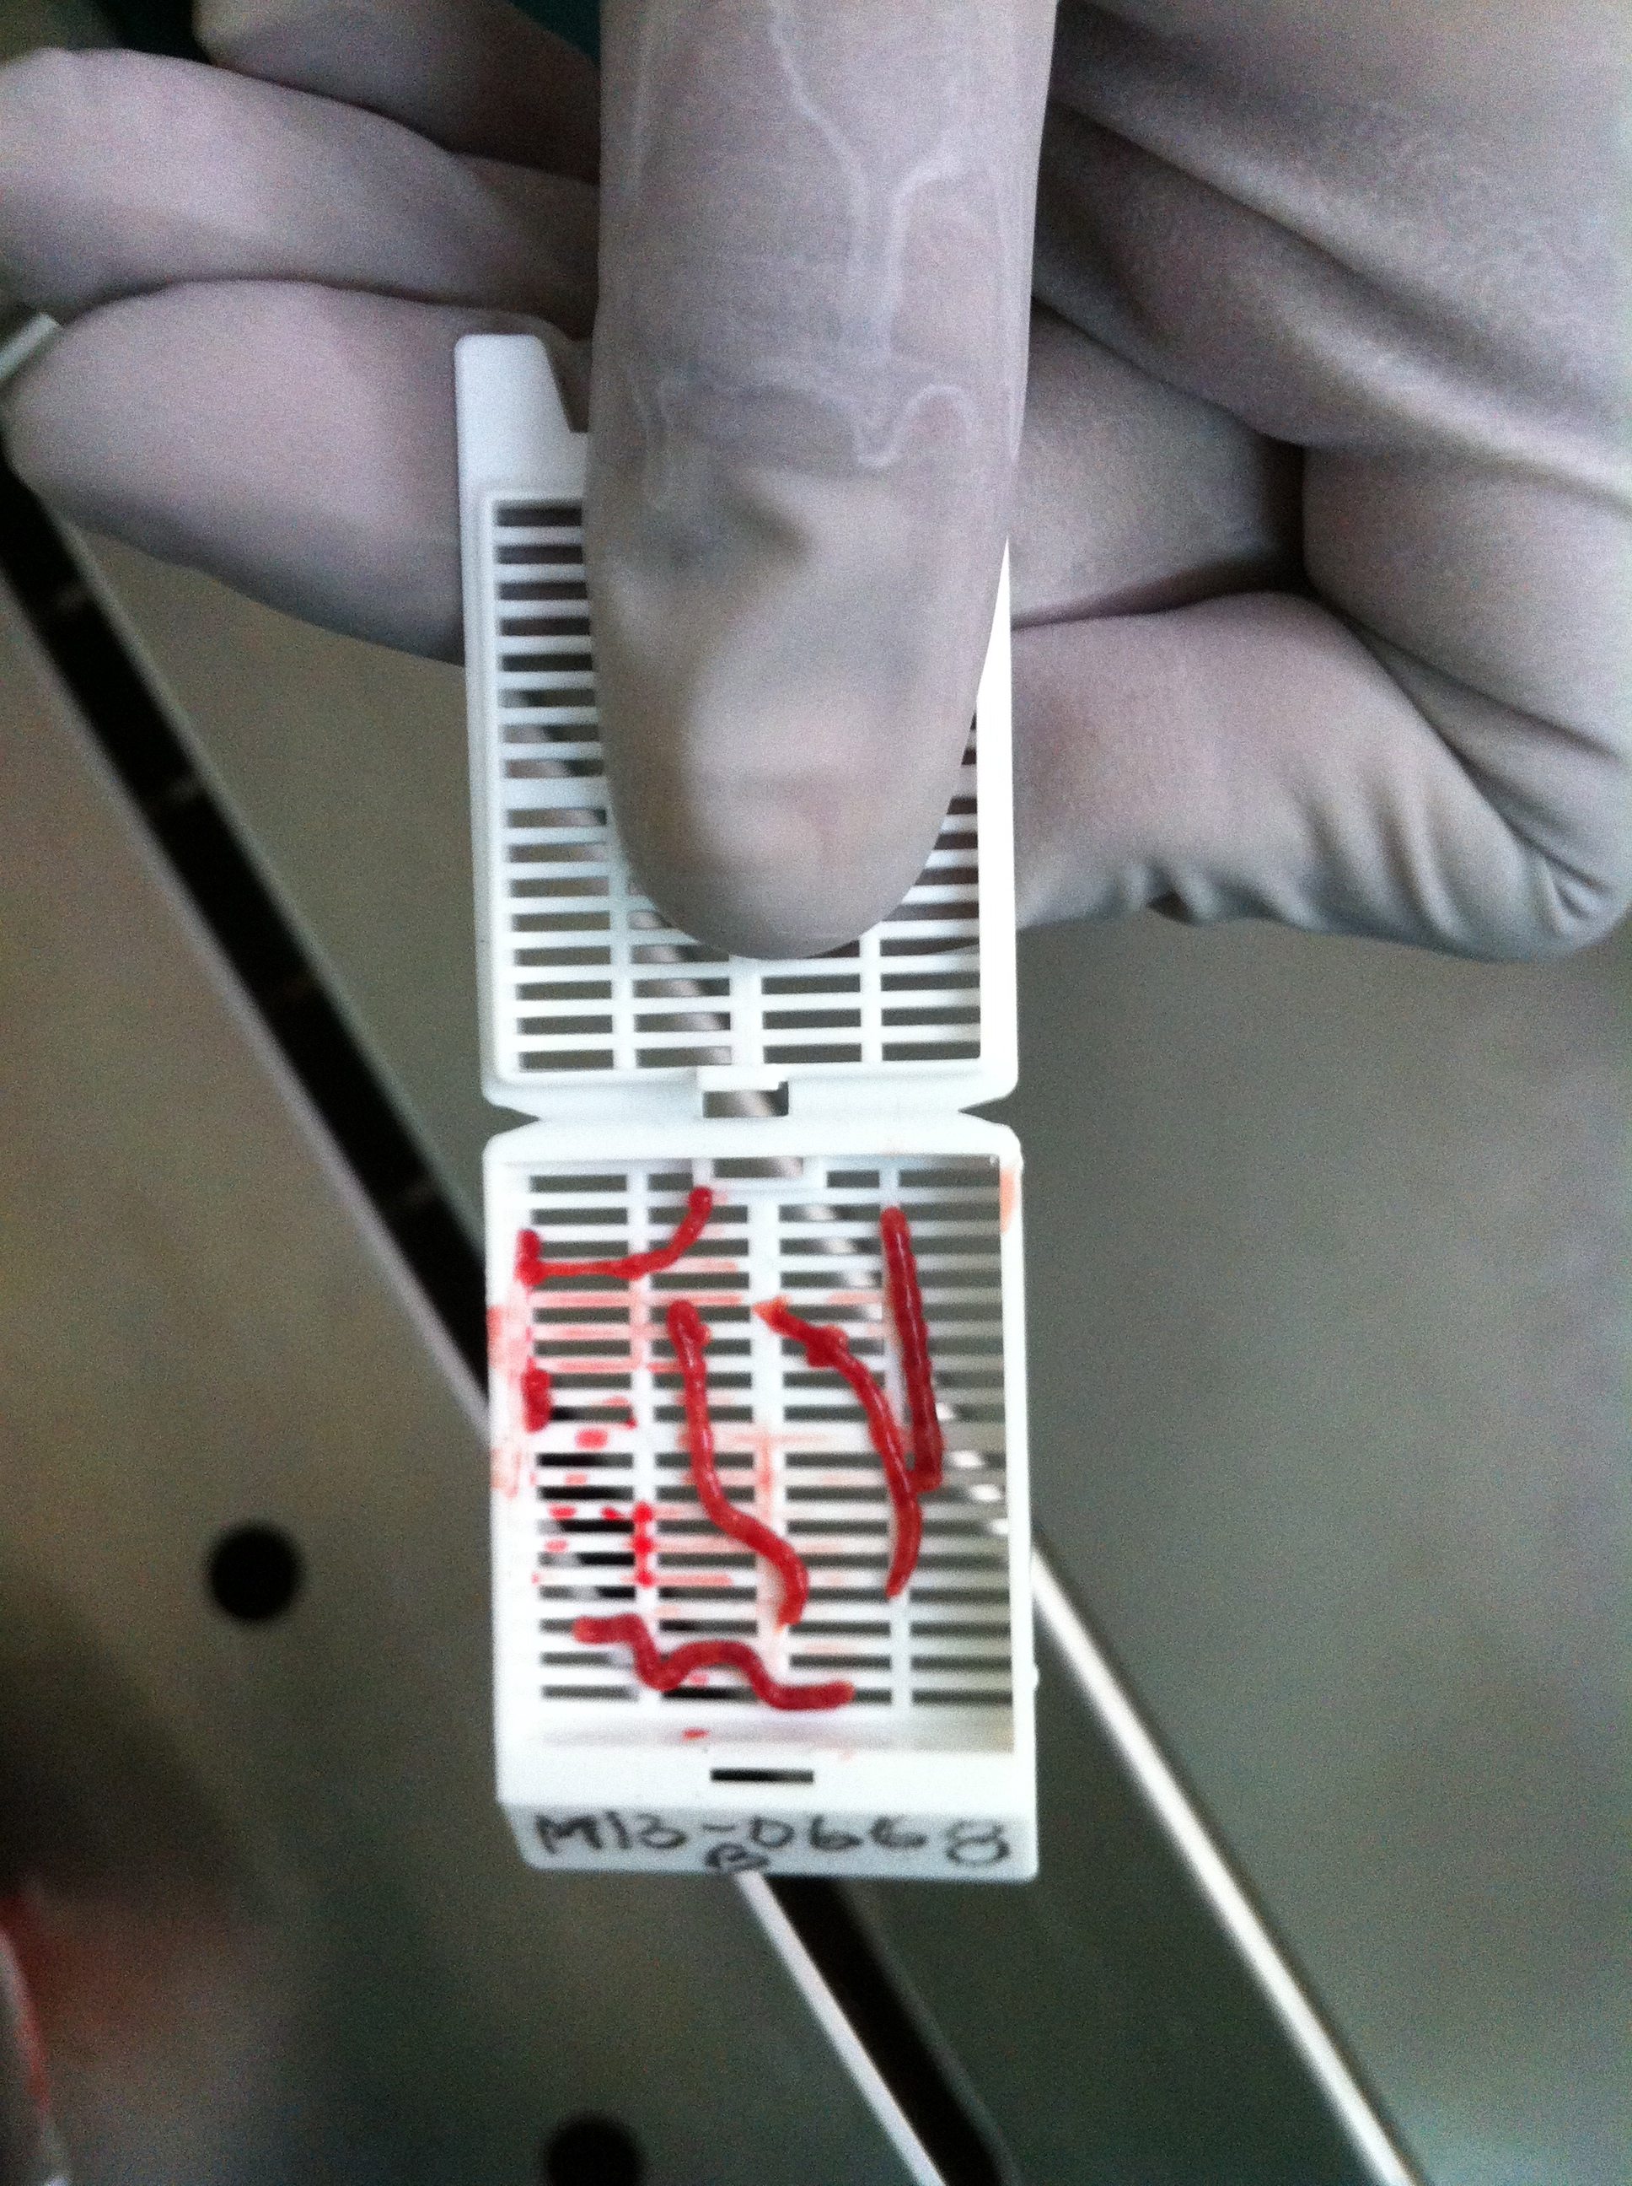
Introducing the “MIA” – validation
Bassat Q, et. al. PLoS Med. 2017: 14(6):e1002317; Menendez C, et. al. PLoS Med. 2017: 14(6):e1002318;
Castillo P, et. al. PLoS Med. 2016: 13(11):e1002171

Slide 3
CHAMPS Journey: From Assessment, to DeCoDe, to Action
Data to
Action
DeCoDe
Panel
Help inform a range of policies and public health actions to reduce child mortality
Local & Central Histopath Analysis
Review all findings and assign cause of death
Microbiology, Real-Time PCR Analysis
Analyze tissues to understand pathogens associated with cellular changes; compare central and site findings
Clinical Data Verbal Autopsy
Identify pathogens in specimens that may have caused death
Specimen Collection
Gather other information around terminal state to improve context for DeCoDe panel
Mortality and Pregnancy Surveillance
Collect tissue (through MITS) and non-tissue specimens for further laboratory analysis
Social Behavioral Science
Identify deaths for MITS and collection of additional data
Understand acceptability of proposed processes
Notes:
Assigning a cause of death involves a series of steps to collect, analyze and interpret relevant data. The primary objective of CHAMPS is to track the causes of childhood mortality. This will be a steep journey to ascertain the cause of death in each of our surveillance sites. Here is a simplified overview of the processes that CHAMPS encompasses.
As you can imagine, because of the sensitivity of this subject and CHAMPS procedures, the starting step and foundation for this whole process is community assessment and engagement, which is a function of our Social Behavioral Sciences team.

Slide 4
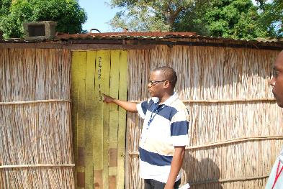
Mortality Surveillance – Started December 1st, 2016
HEALTH FACILITY
COMMUNITY
Study staff
Informants
Evaluate eligibility: Any stillbirth or child death <60 months, residence in CHAMPS catchment area during surveillance period
Call centre
MITS procedure
Manhiça Disctrict Hospital
Hospital Rural de Xinavane
Notes:
Goals:
Notify CHAMPS surveillance team to enable completion of MITS within 24 hours of death
Within 2-4 weeks of child’s death, conduct caregiver interview (verbal autopsy), collect clinical information on child, mother
Health facility-based
Map entry points for labor and delivery, neonatal intensive care, pediatric admissions, morgue, surgery, etc.
CHAMPS surveillance team establishes daily presence, screens all potential cases
Daily enumeration of under-5 child deaths and stillbirths
Community-based
Develop system of community informants who are capable of notifying stillbirths and under-5 deaths (informed by social behavioral science)
e.g. community health workers, trained birth attendants, community or religious leaders, influential women
Informants use cell phone or SMS to notify CHAMPS surveillance team

Slide 5
147 deaths reported (07th Dec-30th June)
6 deaths not eligible (no study area or incorrect age)
85 (%) verbal autopsies conducted
141 deaths eligible
66 deaths not eligible (reports of community deaths)
77 in-hospital deaths eligible for MITS
8 deaths MITS consent refused
19 deaths could not even be approached (had left)
80 clinical data from mother collected (%)
71 clinical data from child collected (%)
50 MITS conducted (64.9%)
9 not eligible because >1 year of age
16 not eligible because stillborns
16 (%) stilborns
17 (%) neonatal deaths
8 (%) infants
9 (%) children 1-<5y

Slide 6
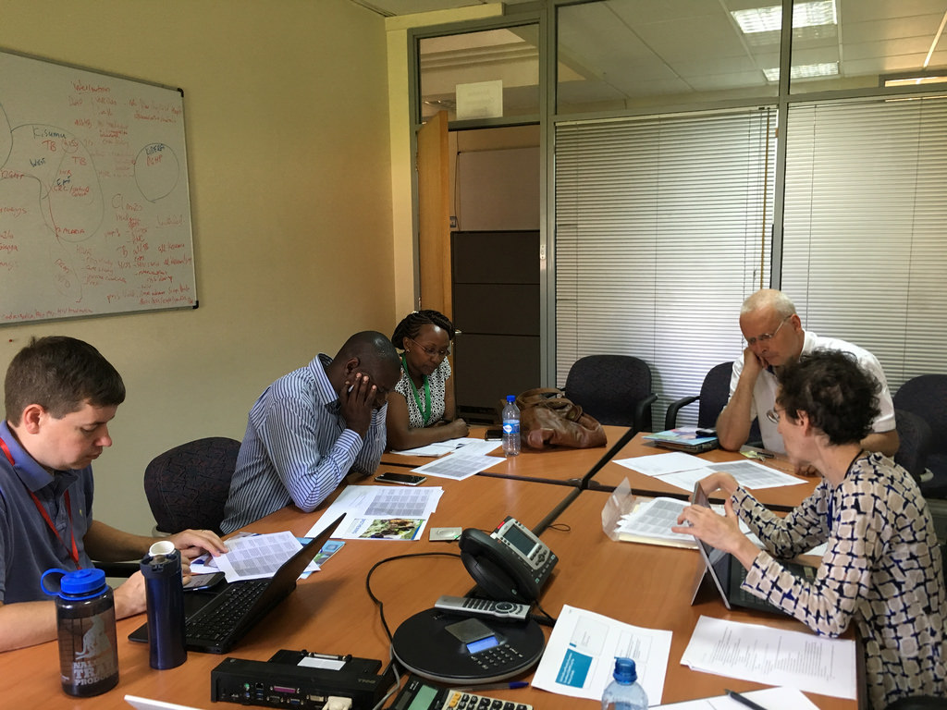
DeCoDe Panel meeting: July 24-26th, 2017
Paola Castilo, Pathologist, ISGlobal
Juan Carlos Hurtado, Microbiologist, ISGlobal
Mikel Martinez, Microbiologist, ISGlobal
Quique Bassat, Pediatrician, ISGlobal
Tacilta Nhampossa, Pediatrician, CISM
Inácio Mandomando, Microbiologist, CISM
Virginia Evaristo, Infectologist, INS
Sibone Mocumbi, Obstetrician Gynecologist, HCM
Zara Jaze, Obstetrician Gynecologist, HCM
Fabiola Fernandez, Pathologist, HCM?
Angela Lopez or Dalila Rego, Pediatrician, HCM?
Jahit Sacarlal, Public Health Specialist, UEM
Paula Vaz, Ariel Foundation?
Dianna Blau, Emory University
Mischka Garel, Emory University
Next Decode Panel meetings: Week of September 25th

Slide 7
CHAMPS data sharing strategy
Feedback of CHAMPS findings to the family
How, when and to who provide the feedback – sensitive results?
Religious council
Feedback to local stakeholders
Local and provincial governors
Data sharing and use of data to improving child health:
National Health Observatory
Created by Ministerial decree
INS acts as technical secretariat
Mortality platform
Communication strategy under development with support from Emory and CDC

Slide 8
NHO is a multidisciplinary platform for integration and use of data
NHO
Government
NGO’s
Civil Society
Universities
Research Institutions

Slide 9
Mortality Platform of the NHO triangulate all source of data of cause of deaths
Mortality
Hospital Deaths
CRVS
Research
Deaths in the Community
Surveys and Census
Notes:
Sample framework (comunidade, hospitalar, registo de morte)
Retrospectivo vs propsectivo
Diferentes formatos
Difrerent cobertura
Diferente plataforma tecnológica para colheita e manuseio dos dados
Diferentes Objectivos

Slide 10
Mortality Platform of the National Health Observatory
CRVS
DHSI2

Slide 11
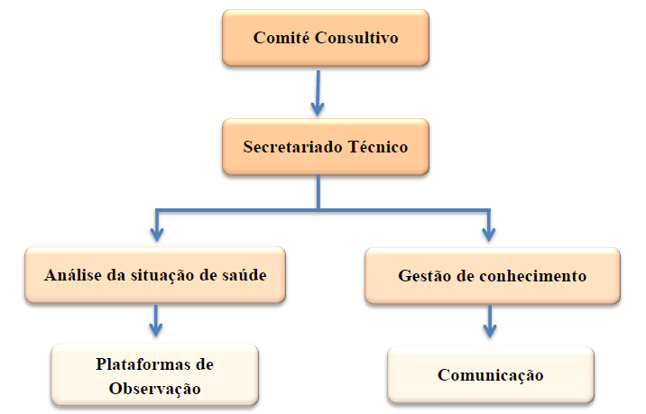
Organizational Structure of the NHO

Slide 12
NHO is actively engaging stakeholders for use of Data to Action

