Slide 1
HERRAMIENTA SOBRE LOS NIVELES DE DESARROLLO (SDT, POR SUS SIGLAS EN INGLÉS)
PARA LOS INSTITUTOS NACIONALES
DE SALUD PÚBLICA
Revisado en febrero de 2021
Notes:
Staged Development Tool (SDT) for National Public Health Institutes (NPHIs)
The notes accompanying the slides provide additional details about the SDT and its use.
The SDT was developed by the U.S. Centers for Disease Control and Prevention (CDC) and the International Association of National Public Health Institutes (IANPHI) with the assistance of a consultative group of NPHI leaders from around the world. It is designed to help NPHIs assess their capacities and identify gaps, prioritize gaps, and plan for how to move to a higher level of functioning. It is based in part on the CYPRESS methodology developed by Deloitte Consulting, USA. Over the years, several changes were made to the SDT, for example, addition of new Discussion Guides and adaptation for virtual use. This slide-set was revised in February 2021.

Slide 2
Temas
Modelos de madurez y Guías de Discusión
Talleres de SDT
Pasos de SDT
Notes:
This slide-set contains a brief overview of the SDT. This slide-set does not contain sufficient information for an untrained individual to run an SDT workshop. A successful workshop requires facilitation by someone with in-depth understanding of the SDT. If you are interested in having an SDT workshop, please contact CDC or IANPHI (see last slide) for further information.

Slide 3
Modelos de Madurez
El marco conceptual de la SDT es el modelo de madurez.
Un modelo de madurez describe los niveles de desarrollo: Básico, En desarrollo, Avanzado y A la vanguardia
La SDT ayuda a los a aplicar modelos de madurez a temas o áreas que son una prioridad para el INSP.
Básico
En desarrollo
Avanzado
De vanguardia
Notes:
The maturity model is based on the idea that for a given topic, NPHIs exhibit different stages of “maturity” or development. By providing examples of what these different maturity stages “look like,” the SDT process provokes in-depth conversations, in which participants clarify their current stage in a given topical area, their desired stage, and major gaps that need to be addressed to move to the desired stage.

Slide 4
Guías de Discusión (DG)
Se han diseñado 30 Guías de Discusión específicamente para los INSP.
11 cubren temas de enfoque interno, tales como liderazgo y gestión y comunicación interna
19 cubren temas de enfoque externo, tales como vigilancia y colaboraciones multisectoriales
Las 30 Guías de Discusión están disponibles en inglés, francés, español y portugués en el sitio web ianphi.org/tools-resources/sdt.html
Las Guías de Discusión describen cómo podría “verse” un INSP en los diferentes niveles de madurez:
Básico
En desarrollo
Avanzado
De vanguardia
Notes:
Often, NPHI planning focuses on Core Public Health Functions. However, sometimes internal issues, such as leadership and management or issues related to the NPHI workforce, are major barriers to accomplishing public health functions. Therefore, the SDT includes Discussion Guides (DGs) that relate to internal-facing issues, such as leadership and management, and external-facing issues, like surveillance.

Slide 5
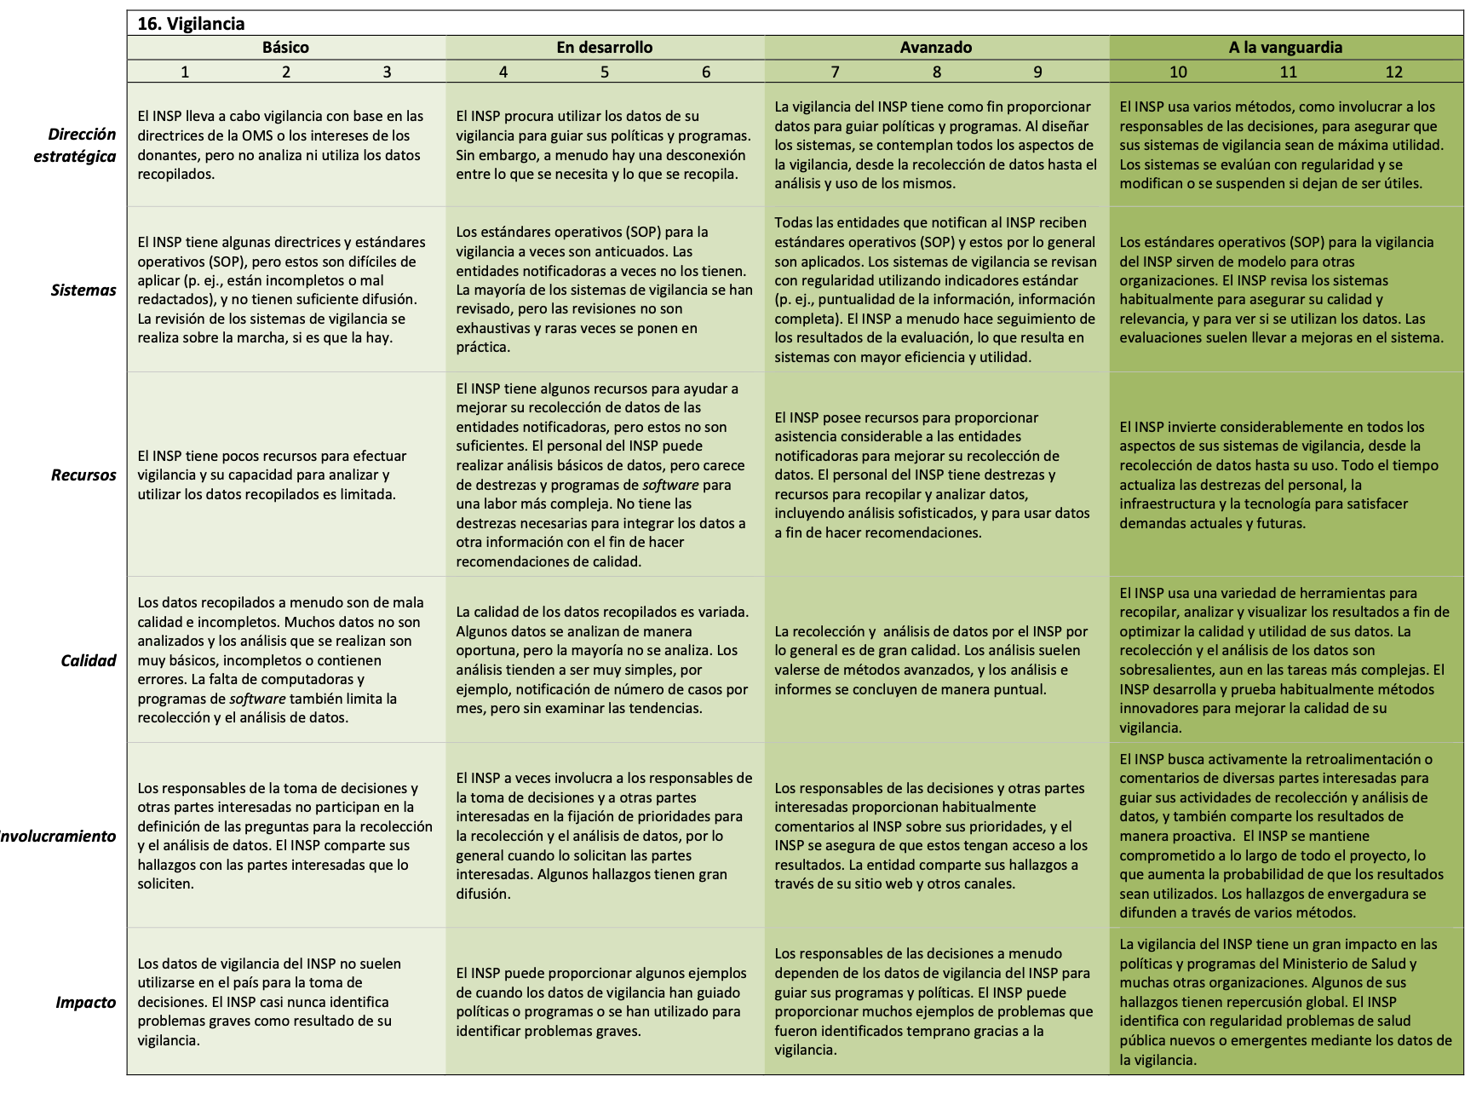
Ejemplo de Guía de Discusión
Notes:
This is a picture of the Surveillance Discussion Guide.
The DG content is divided into four columns, one for each of the developmental stages (Basic, Developing, Advanced, Leading Edge). Each DG also contains six rows, which we call "Domains." The six Domains reflect factors, like Strategic Direction and Resources, that contribute to NPHI's achieving their desired futures. Typically, discussions start with participants discussing the overall stage of the NPHI on that DG, and then they get into detail about each of the Domains.
The numeric scores under each stage provide the option for facilitators to encourage more detailed discussion about the current and desired status in each of the Domains. The actual scores are less important than the discussion that is prompted as participants justify their responses.

Slide 6
Guías de Discusión: Dominios
Hay 6 ámbitos o dominios de la SDT: cada uno es una fila en la Guía de Discusión. Estos son:
Dirección estratégica o Strategic Direction (SD): ¿Las prioridades son claras y estratégicas?
Sistemas: ¿El INSP tiene las herramientas, procesos, etc. necesarios para realizar su trabajo?
Recursos: ¿Los recursos humanos y materiales son adecuados?
Calidad: ¿Se mide la calidad y se cumplen los estándares?
Compromiso: ¿Las partes interesadas clave están comprometidas con el INSP y lo ayudan a lograr sus objetivos?
Impacto: Para las Guías de Discusión de enfoque interno: ¿Funciona el INSP de manera eficaz? Para las Guías de Discusión de enfoque externo: ¿El INSP contribuye a mejorar la salud?
Notes:
Each of the DGs has the same structure, with the 4 developmental stages defining the columns and the 6 Domains defining the rows. The slide above provides abbreviated definitions of the Domains.
The more complete definitions that were used in developing the DGs are:
Strategic Direction: Degree to which the NPHI works strategically in setting priorities and in allocating and using resources, including staff time
Systems: Degree to which the NPHI has systems, processes, and tools that enable it to carry out the described effort
Resources: Degree to which the NPHI has assets (e.g., staff capacity, supplies, transportation, infrastructure) to support the described effort
Quality: Degree to which the NPHI is able to carry out the described effort in a high-quality manner.
An additional component for external-facing DGs is: Degree to which the NPHI supports quality in the efforts of those contributing to the achievement of the described effort (e.g., subnational entities, stakeholders, partners)
Engagement:
Internal-facing only: Degree to which staff are committed to contributing to the NPHI’s vision and goals. Degree to which staff contribute to improving the NPHI’s strategies or performance
External-facing only: Degree to which stakeholders (partners, beneficiaries, contributors, donors, sub-national actors, and communities) are invited to provide input or feedback, or are engaged by the NPHI as partners/advisors
Impact:
Internal-facing only: Degree to which the NPHI is able to perform or achieve results
External-facing only: Degree to which the NPHI is able to perform or achieve its goals and deliver high-quality products and services. Extent to which the products and services have an impact on public health

Slide 7
Talleres de SDT
Los talleres de SDT pueden ser presenciales (si las circunstancias lo permiten) o virtuales.
Talleres presenciales: normalmente 3 días y 5 a 8 Guías de Discusión
Sesiones virtuales: normalmente hasta 5 horas por sesión, incluidos los descansos, con el número de Guías de Discusión dependiendo de diversos factores
Ya sea de forma personal o virtual, es mejor tener un facilitador y registrador capacitado en la SDT que gestione el proceso y registre la información clave en los formularios de SDT.
Notes:
The SDT was originally designed to be conducted as an in-person workshop over several days. With the COVID-19 pandemic and other logistical challenges, IANPHI and CDC have adapted the SDT to provide a virtual option as well.
In-person workshops typically last 3 days and cover 5-8 DGs. Virtual sessions typically last around 5 hours, including breaks. Virtual workshops take longer for a variety of reasons. Technical issues include limited bandwidth for some participants and disruptions (e.g., pets, family members, phone calls, visitors), since often people are working from sub-optimal locations. Without being in a shared space, it is harder for the facilitator and participants to know when discussion of a particular topic has reached a natural end. It can be hard to determine if all who want to contribute to a particular discussion topic have had their opportunity; therefore, the discussion may be more repetitive or recursive than in an in-person setting.

Slide 8
Preparación para un taller
Al planificar un taller de SDT, se requiere una reflexión cuidadosa para decidir cuáles son las mejores Guías de Discusión a utilizar y seleccionar a los participantes adecuados.
No se necesita preparación especial o desarrollo de documentos por parte de los participantes.
La SDT se basa en el conocimiento y las experiencias de los participantes y su sabiduría combinada.
Los roles del facilitador y del registrador son:
Guiar a los participantes para que evalúen minuciosamente la situación y los problemas subyacentes antes de encontrar “soluciones”
Captar y organizar los aportes
Notes:
Planning a workshop requires thoughtful consideration about which DGs to use and who to invite. CDC and IANPHI can help leadership define which DGs will address their priorities and what mix of individuals will be best able to develop a plan that is likely to be implemented and achieve the desired impact.
The SDT does not require significant up-front efforts from participants. It relies on what they know and think to create a plan they can "own."
An issue frequently encountered during planning is that participants decide on courses of action before they thoroughly understand the underlying issues. For example, if data quality is poor, a common "solution" is to do training. However, if the people collecting data do not have time to ensure quality or turn over quickly, training may not solve the problem.

Slide 9
El proceso de SDT implica 3 pasos
1. EVALUAR
2. PRIORIZAR
3. PLANIFICAR
Durante la evaluación, las Guías de Discusión se utilizan para impulsar el Discusión.
Una buena evaluación es fundamental para un buen plan.
El facilitador utiliza las Guías de Discusión para ayudar a los participantes a “profundizar”.
Luego se priorizan los problemas para el seguimiento.
El paso final es identificar los pasos siguientes específicos para los esfuerzos prioritarios.
Notes:
Because the DGs are designed for NPHIs, they include details that reflect the capacities and experiences of NPHIs from around the world. Particularly for NPHIs that are new or are at earlier stages of development, the content under Advanced and Leading Edge stages may suggest activities and options they had not previously considered. Depending on the workshop, planning may stop at defining next steps for follow-up on priority areas or may include full work-planning for specific projects.

Slide 10
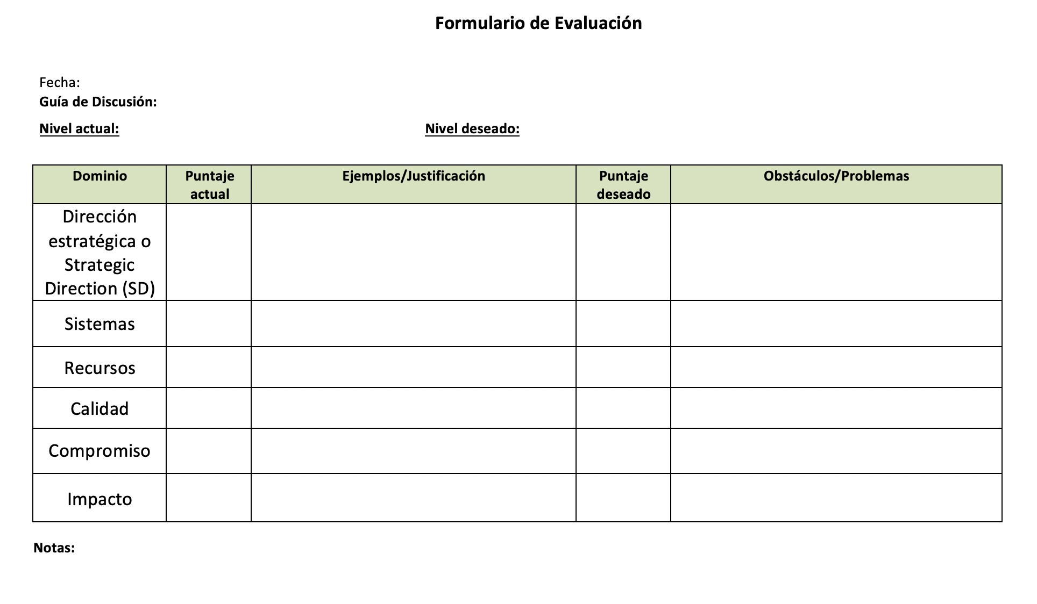
Paso 1: Evaluación
Los participantes utilizan la Guía de Discusión para evaluar el nivel actual general del INSP y el nivel en el que les gustaría estar dentro de un tiempo, por ejemplo, en un año.
Luego los participantes analizan dominio por dominio.
Las Guías de Discusión ayudan a los participantes a identificar obstáculos específicos y formas de avanzar.
La Discusión se registra en el Formulario de Evaluación.
Notes:
The Assessment Form is used to capture the key points from discussion. It has places for the current and desired stages for the NPHI as a whole at the top, and places to capture more detailed information about the various Domains in the table.
Note to recorders: Remember to customize the form so that it works for your preferred approaches. This includes changing column widths; setting margins for best display on a screen; and, if you intend to use bullets, setting up indents and other features.

Slide 11
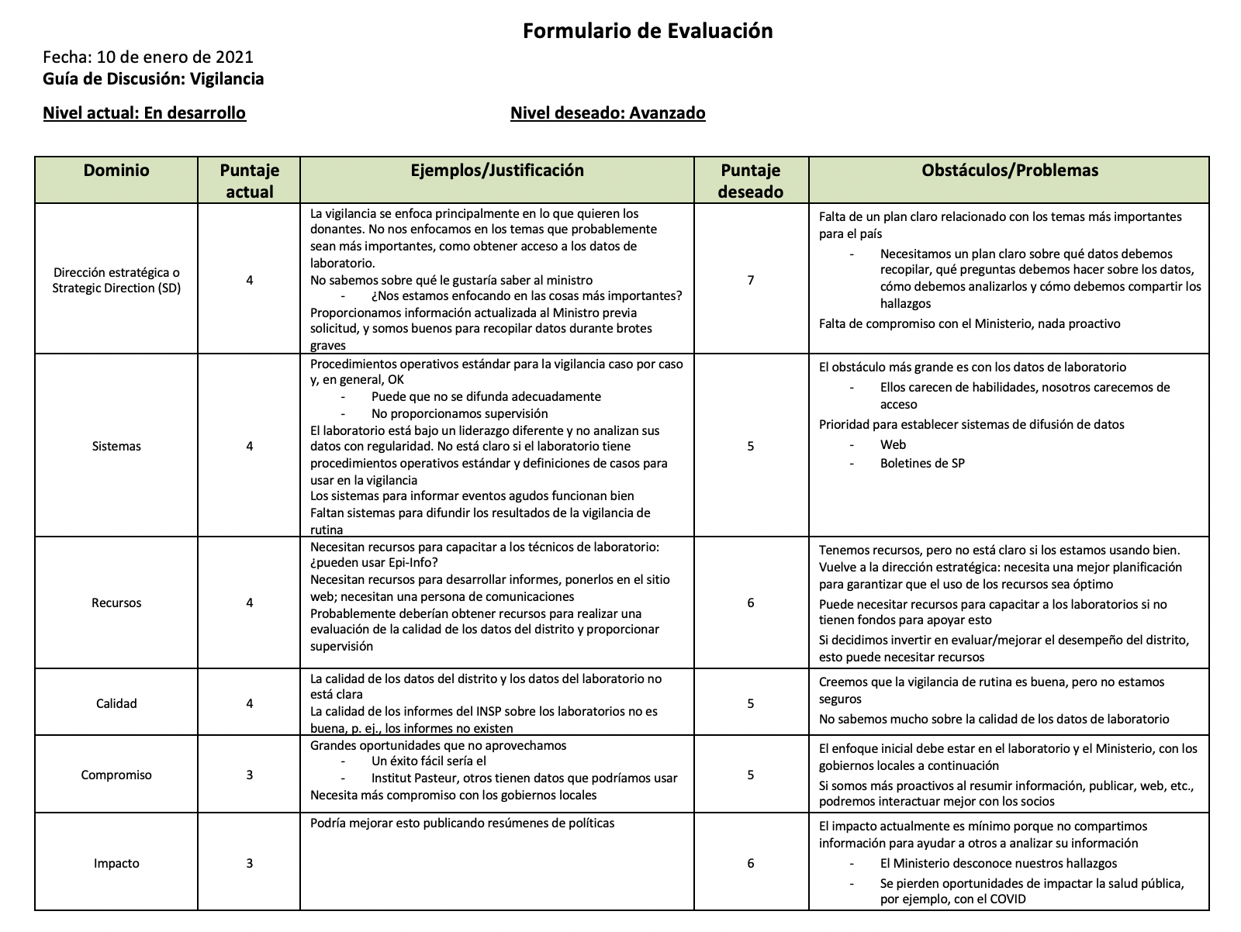
Formulario de Evaluación: Ejemplo
Notes:
This is an example of a completed Assessment Form. This NPHI is currently in the "Developing" Stage, and it aims to be "Advanced" in a year. Participants have agreed on scores for each of the Domains and identified some of the gaps and issues that need to be addressed to move from their current scores in each Domain to their desired scores.

Slide 12
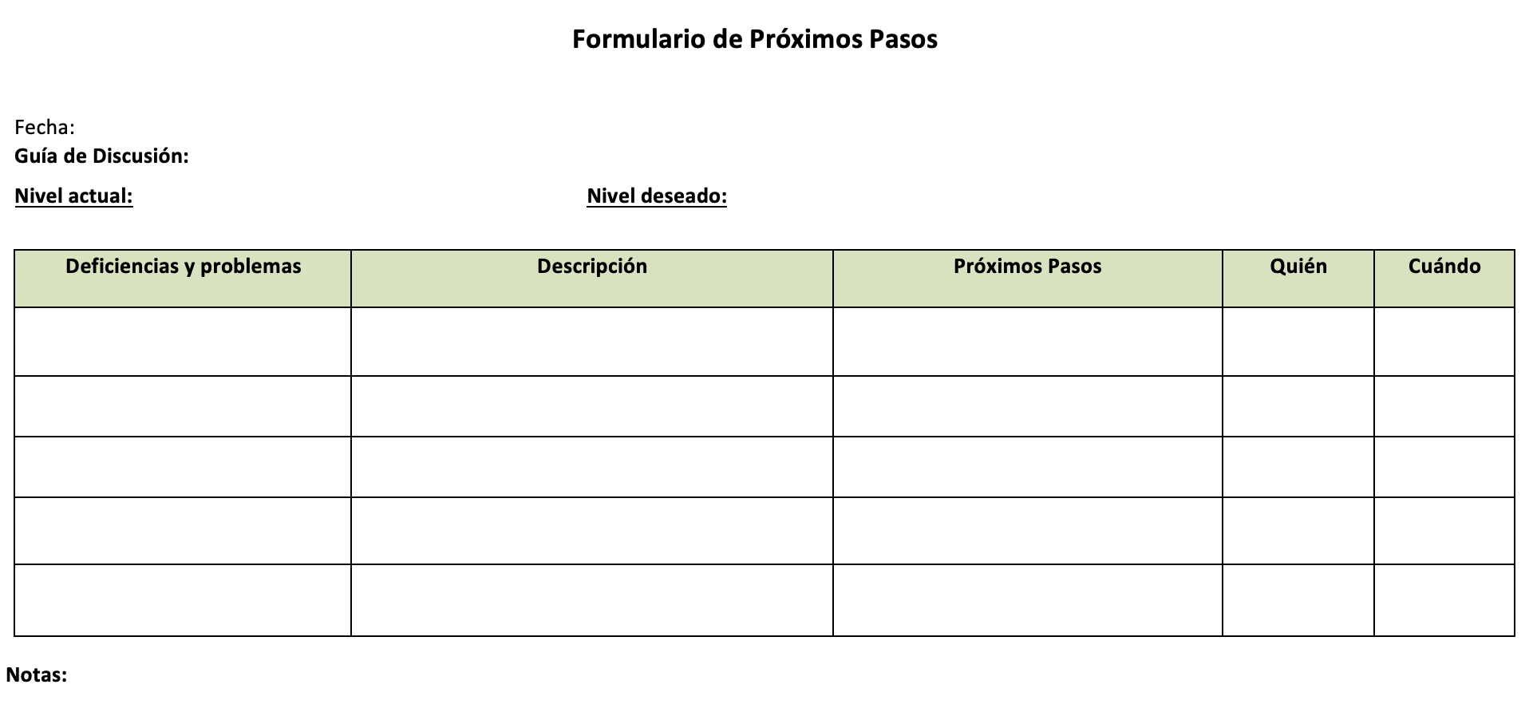
El Formulario de Pasos Siguientes
El Formulario de Próximos pasos se utiliza para los pasos 2 y 3 de la SDT.
Incluye:
Obstáculos y problemas de la Evaluación
Descripción: detalles sobre las brechas que ayudarán a definir los pasos siguientes
Pasos Siguientes: acciones específicas que se tomarán después del taller
Notes:
During a break, the facilitator and recorder organize the information collected on the Assessment Form into categories or "buckets" to make the remaining discussion easier. Similar topics discussed under different Domains are placed together. The "description" includes information discussed during the Assessment step that might be useful in identifying the next steps. If next steps have already been identified for some items, they can be placed in the Next Steps column.

Slide 13
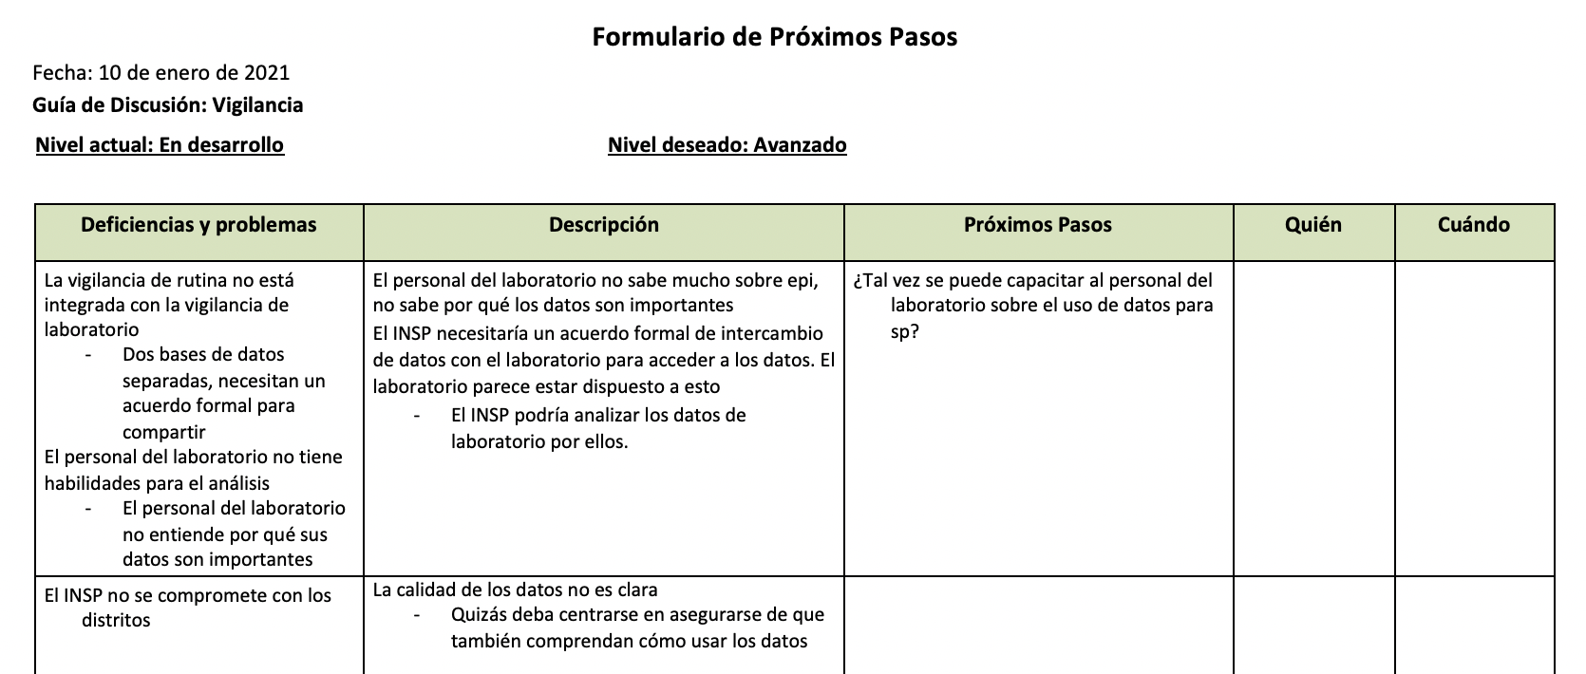
Pasar a la Priorización y Planificación
Los participantes se toman un descanso después de la Evaluación, mientras el facilitador y el registrador organizan la información del Formulario de Evaluación en el Formulario de Pasos Siguientes.
Se consolidan las ideas sobre problemas que abarcan más de un Dominio.
Notes:
This slide shows a partially completed Next Steps Form, such as might be generated during the break by the facilitator and recorder. More information will be needed to develop a robust plan. The recorder has chosen to put an item into the Next Steps column for further discussion if this is a priority.

Slide 14
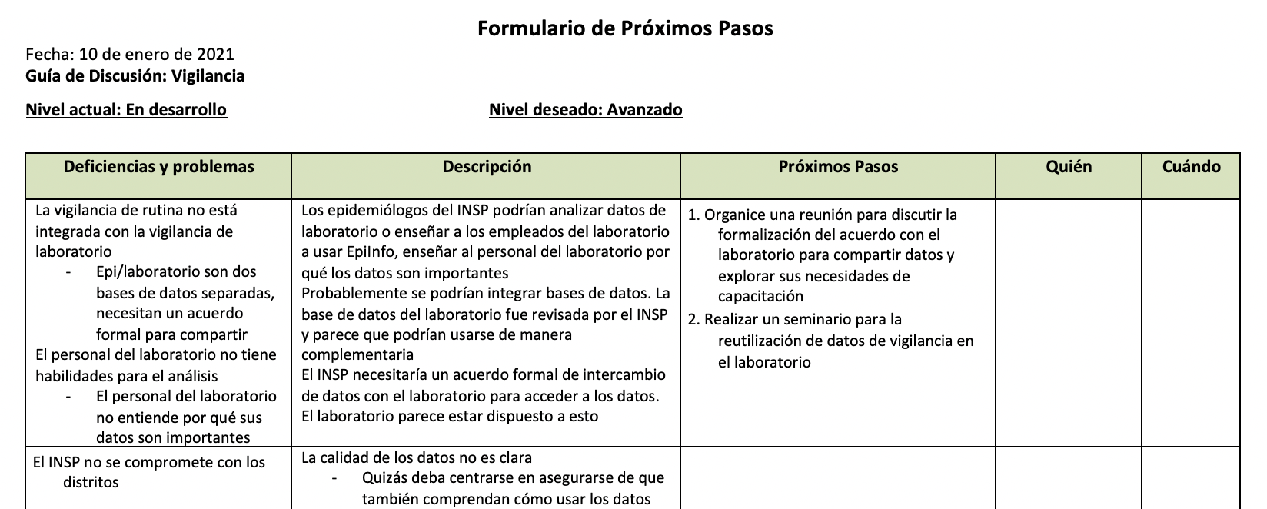
Los participantes revisan el Formulario de Próximos Pasos
El grupo analiza cada elemento de la columna de Obstáculos y Problemas y completa los detalles necesarios para hacer un buen plan.
¿Se necesita más información para comprender los obstáculos que impiden que el INSP llegue a los niveles deseados?
¿Abordar los obstáculos identificados tendrá el efecto deseado?, ¿faltan problemas importantes?
Notes:
After the break, the group reviews the Next Steps Form. After a quick overview by the facilitator, the group discusses each item in the Gaps and Issues column to ensure common understanding and add information that may be critical in the Prioritization step. Next steps that arise at any time during the discussions can be captured in the Next Steps column.

Slide 15
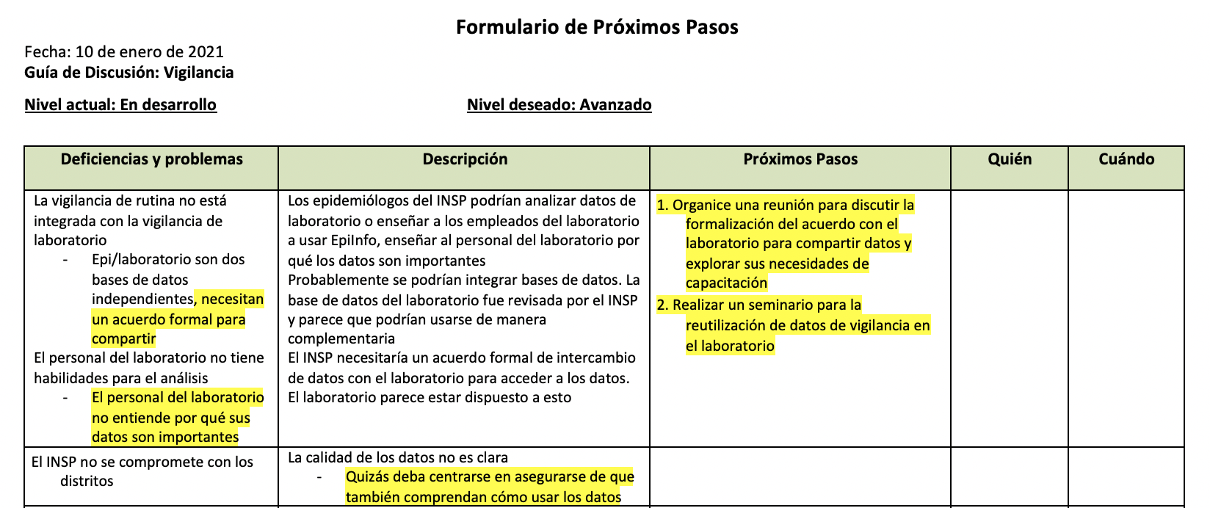
Paso 2: Priorizar
Luego el grupo revisa la columna Obstáculos y Problemas, problema por problema.
Identifican prioridades y el registrador las resalta.
Una vez que se discuten todos los obstáculos y problemas, se revisan los elementos resaltados.
¿Se captaron las prioridades? ¿Falta algo? ¿Se deber eliminar algo?
Notes:
If new gaps and issues are identified, these can be added. It is also possible that some gaps and issues will be found to be too broad. For example, a gap may be split into two, one of which is a priority and one of which is not.

Slide 16
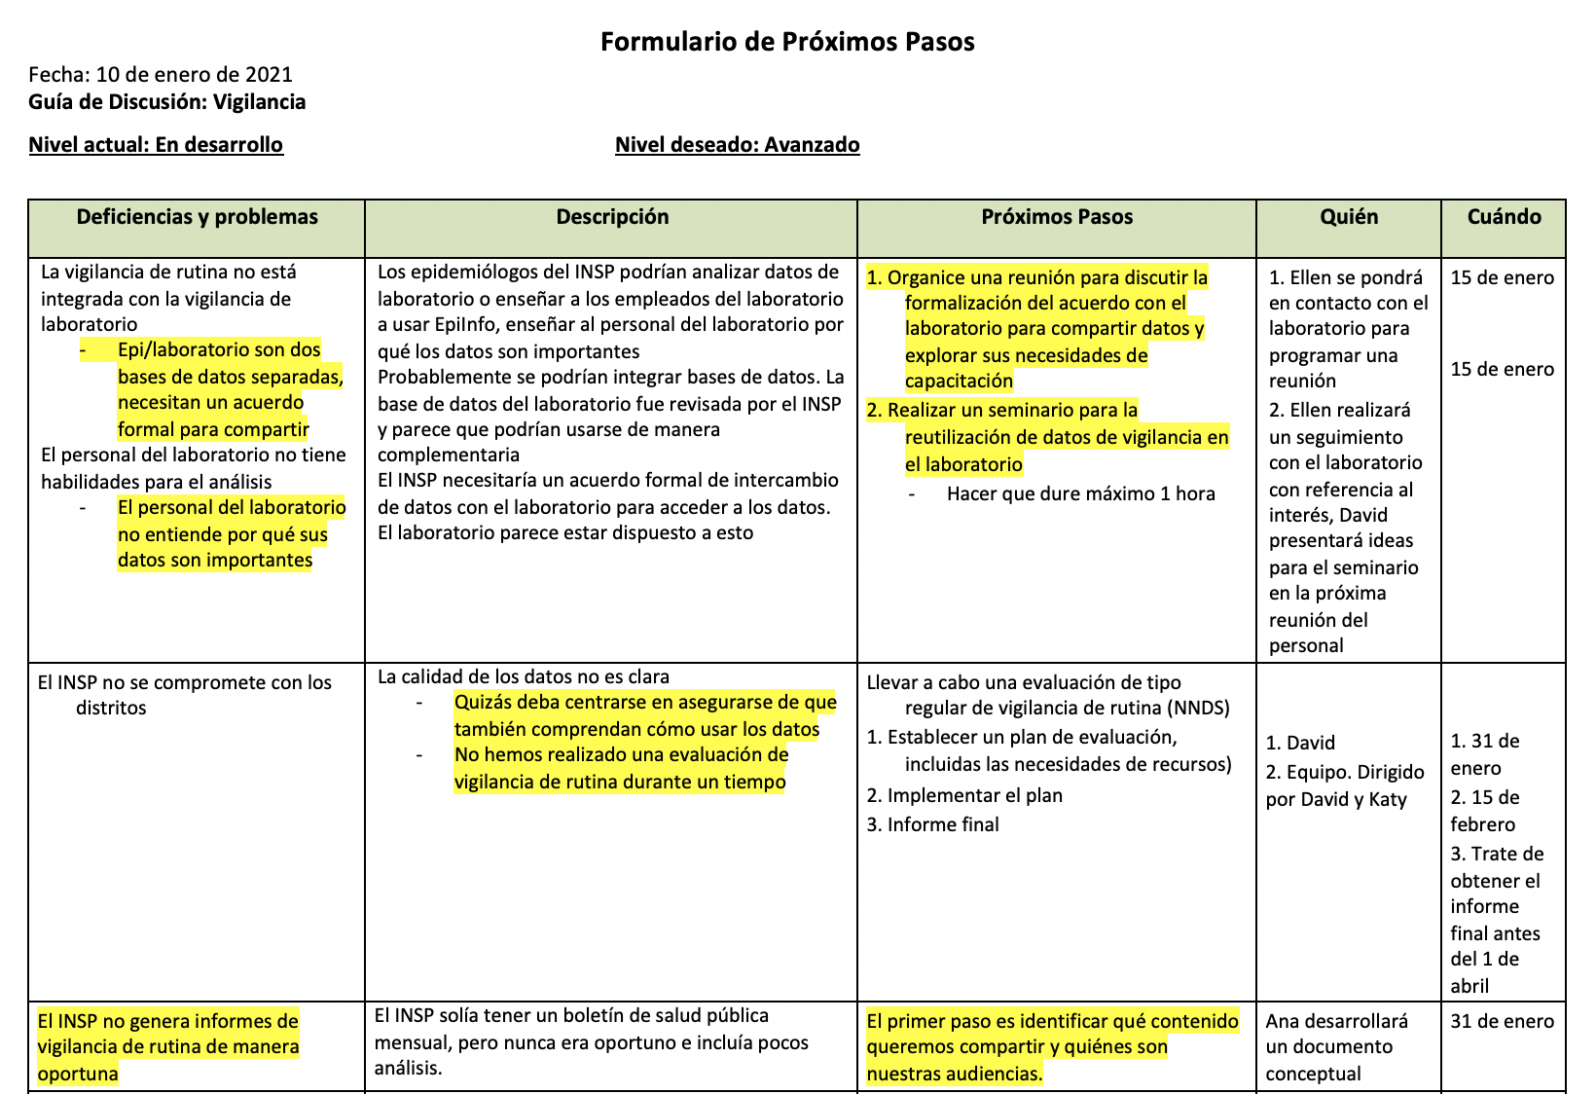
Paso 3: Planificación
Los Próximos Pasos, incluido quién es responsable y una línea de tiempo, se describen para todas las prioridades.
Notes:
In this next part of the SDT process, participants develop plans for their highest priorities. It is critical to clearly define who is responsible for which actions, and the timeline for achieving them. If work-planning does not immediately follow prioritization, some NPHIs may choose to conduct work-planning during the subsequent weeks.

Slide 17
Finalmente, identifique la posibilidad factible
Las posibilidades factibles son actividades que se pueden realizar con relativa facilidad y que tendrán un gran impacto.
Primero, se revisan los Próximos Pasos. ¿Algunas de estas son posibilidades factibles?
Luego se pueden generar ideas adicionales.
Es posible que estas ideas no sean específicas de la Guía de Discusión utilizada en el taller, pero son triunfos fáciles de considerar.
Cada posibilidad factible debe tener un plan de próximos pasos: quién es responsable y cuál es la línea de tiempo.
Notes:
Often, participants have additional ideas beyond those in the DG topic about high-priority activities that could achieve results quickly. Capturing these and developing next steps may not help the NPHI achieve a higher stage in the area covered by the DG, but it can help the NPHI achieve a higher overall level of functioning and/or effectiveness

Slide 18
Antes de terminar, revise los planes
Si el INSP aborda las prioridades, ¿logrará el progreso deseado para lograr el nivel deseado?
¿Se necesitan recursos adicionales? ¿Cuál es el plan para obtenerlos?
¿Están claros los próximos pasos? ¿Todo el personal clave comprende sus roles en la implementación del plan?
¿Cómo se monitoreará el progreso?
Notes:
A potential pitfall in any planning is that participants develop detailed plans for what is easy to do, but not necessarily what is most impactful. Before declaring the plan complete, it is essential to review it to determine if it is likely to have the desired impact, and to revise it if necessary.

Slide 19
Buena suerte a medida que avance hacia su futuro preferido
Si tiene algún comentario o pregunta sobre este material, comuníquese con:
Programa INSP de los CDC de EE. UU.: nphisdt@cdc.gov
AIINSP: info@ianphi.org

