Slide 1
FERRAMENTA DE DESENVOLVIMENTO FASEADO (FDF)
PARA INSTITUTOS NACIONAIS DE SAÚDE PÚBLICA
Revisto em Fevereiro de 2021
Notes:
Staged Development Tool (SDT) for National Public Health Institutes (NPHIs)
The notes accompanying the slides provide additional details about the SDT and its use.
The SDT was developed by the U.S. Centers for Disease Control and Prevention (CDC) and the International Association of National Public Health Institutes (IANPHI) with the assistance of a consultative group of NPHI leaders from around the world. It is designed to help NPHIs assess their capacities and identify gaps, prioritize gaps, and plan for how to move to a higher level of functioning. It is based in part on the CYPRESS methodology developed by Deloitte Consulting, USA. Over the years, several changes were made to the SDT, for example, addition of new Discussion Guides and adaptation for virtual use. This slide-set was revised in February 2021.

Slide 2
Tópicos
Modelos de maturidade e guias de debate
Workshops sobre a FDF
Passos da FDF
Notes:
This slide-set contains a brief overview of the SDT. This slide-set does not contain sufficient information for an untrained individual to run an SDT workshop. A successful workshop requires facilitation by someone with in-depth understanding of the SDT. If you are interested in having an SDT workshop, please contact CDC or IANPHI (see last slide) for further information.

Slide 3
Modelos de maturidade
O quadro conceptual da FDF é o modelo de maturidade
Um modelo de maturidade descreve as fases de desenvolvimento: Básico, Em desenvolvimento, Avançado e De vanguarda
A FDF ajuda os INSP na aplicação de modelos de maturidade a tópicos ou áreas que constituem uma prioridade para o INSP
Básico
Em desenvolvimento
Avançado
De vanguarda
Notes:
The maturity model is based on the idea that for a given topic, NPHIs exhibit different stages of “maturity” or development. By providing examples of what these different maturity stages “look like,” the SDT process provokes in-depth conversations, in which participants clarify their current stage in a given topical area, their desired stage, and major gaps that need to be addressed to move to the desired stage.

Slide 4
Guias de debate (GD)
Foram concebidos 30 GD especificamente para os INSP
11 abordam temas internos, como a liderança e gestão e a comunicação interna
19 abordam temas externos, como a vigilância e as colaborações multissectoriais
Todos os 30 GD estão disponíveis em inglês, francês, espanhol e português em ianphi.org/tools-resources/sdt.html
Os GD descrevem o “aspecto” que um INSP pode ter nas diferentes fases de maturidade:
Básico
Em desenvolvimento
Avançado
De vanguarda
Notes:
Often, NPHI planning focuses on Core Public Health Functions. However, sometimes internal issues, such as leadership and management or issues related to the NPHI workforce, are major barriers to accomplishing public health functions. Therefore, the SDT includes Discussion Guides (DGs) that relate to internal-facing issues, such as leadership and management, and external-facing issues, like surveillance.

Slide 5
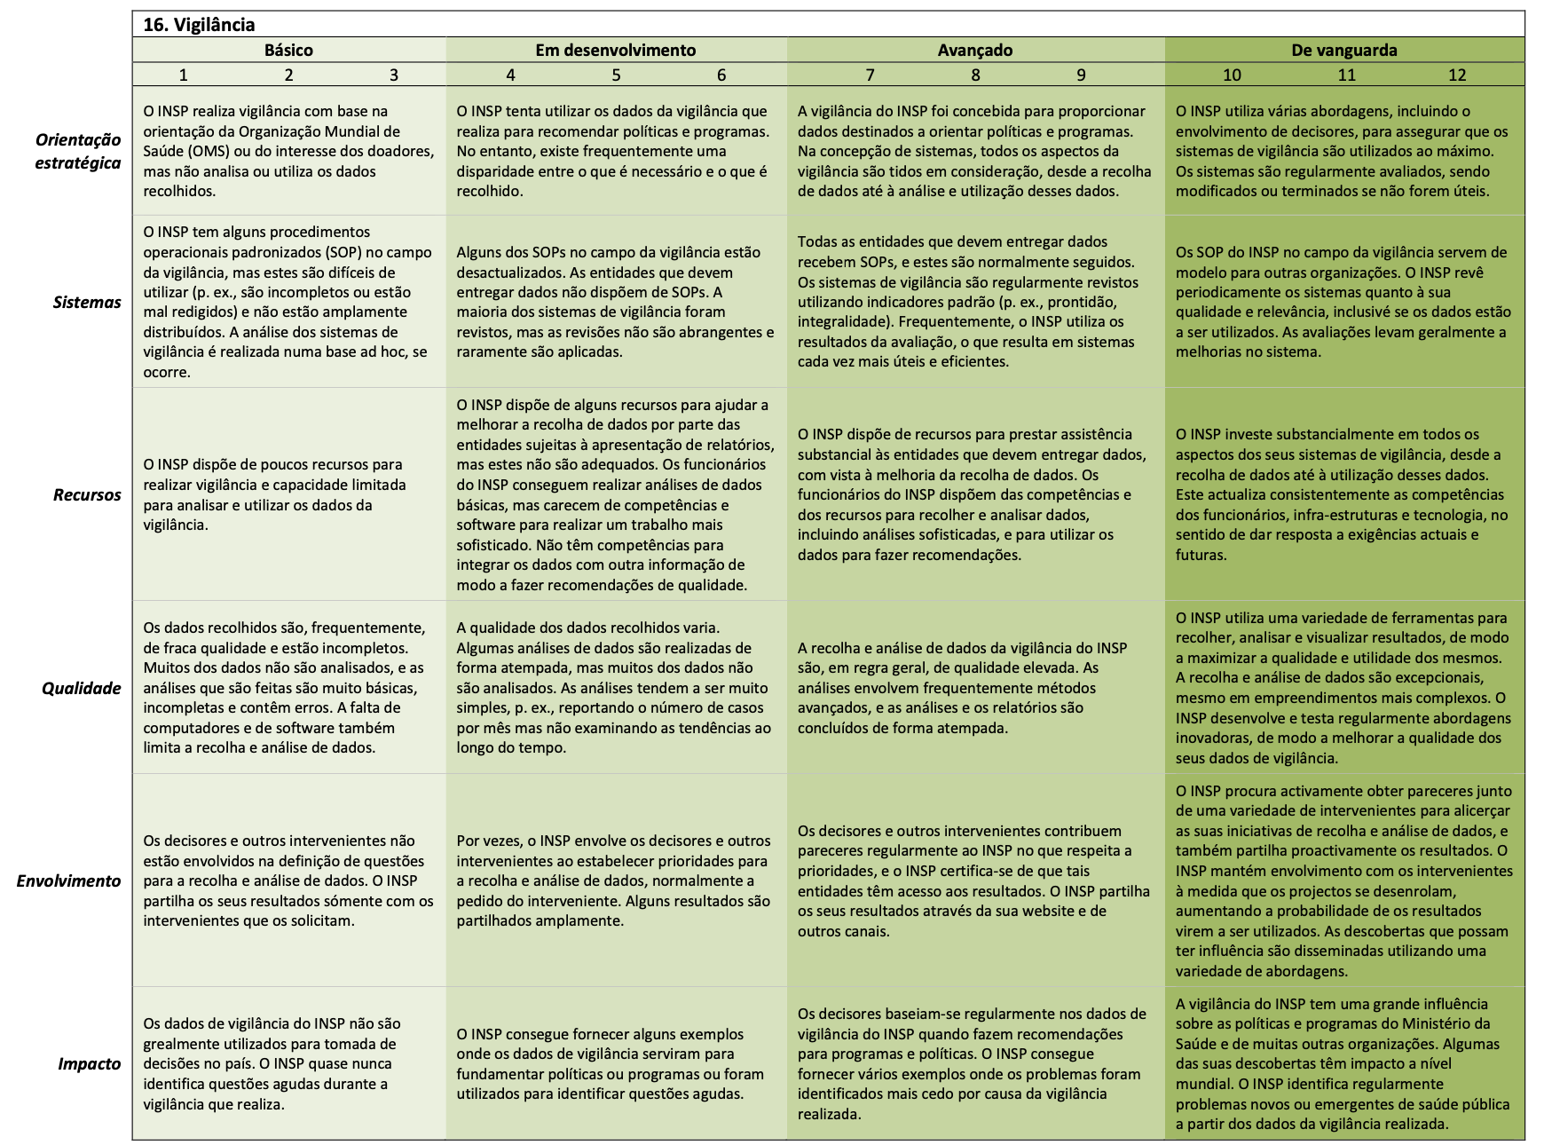
Exemplo de guia de debate
Notes:
This is a picture of the Surveillance Discussion Guide.
The DG content is divided into four columns, one for each of the developmental stages (Basic, Developing, Advanced, Leading Edge). Each DG also contains six rows, which we call "Domains." The six Domains reflect factors, like Strategic Direction and Resources, that contribute to NPHI's achieving their desired futures. Typically, discussions start with participants discussing the overall stage of the NPHI on that DG, and then they get into detail about each of the Domains.
The numeric scores under each stage provide the option for facilitators to encourage more detailed discussion about the current and desired status in each of the Domains. The actual scores are less important than the discussion that is prompted as participants justify their responses.

Slide 6
Guias de debate: domínios
Existem seis domínios na FDF, ocupando cada um deles uma linha no GD. São os seguintes:
Orientação estratégica: as prioridades são claras e estratégicas?
Sistemas: o INSP dispõe do necessário em termos de ferramentas, processos, etc. para realizar o seu trabalho?
Recursos: os recursos humanos e materiais são adequados?
Qualidade: a qualidade é medida e os padrões são cumpridos?
Envolvimento: as partes interessadas fulcrais envolvem-se com o INSP e ajudam-no a atingir os seus objectivos?
Impacto: para GD de natureza interna, o INSP está a funcionar com eficácia? Para GD de natureza externa, o INSP está a contribuir para uma saúde melhor?
Notes:
Each of the DGs has the same structure, with the 4 developmental stages defining the columns and the 6 Domains defining the rows. The slide above provides abbreviated definitions of the Domains.
The more complete definitions that were used in developing the DGs are:
Strategic Direction: Degree to which the NPHI works strategically in setting priorities and in allocating and using resources, including staff time
Systems: Degree to which the NPHI has systems, processes, and tools that enable it to carry out the described effort
Resources: Degree to which the NPHI has assets (e.g., staff capacity, supplies, transportation, infrastructure) to support the described effort
Quality: Degree to which the NPHI is able to carry out the described effort in a high-quality manner.
An additional component for external-facing DGs is: Degree to which the NPHI supports quality in the efforts of those contributing to the achievement of the described effort (e.g., subnational entities, stakeholders, partners)
Engagement:
Internal-facing only: Degree to which staff are committed to contributing to the NPHI’s vision and goals. Degree to which staff contribute to improving the NPHI’s strategies or performance
External-facing only: Degree to which stakeholders (partners, beneficiaries, contributors, donors, sub-national actors, and communities) are invited to provide input or feedback, or are engaged by the NPHI as partners/advisors
Impact:
Internal-facing only: Degree to which the NPHI is able to perform or achieve results
External-facing only: Degree to which the NPHI is able to perform or achieve its goals and deliver high-quality products and services. Extent to which the products and services have an impact on public health

Slide 7
Workshops sobre a FDF
Os workshops sobre a FDF podem ser presenciais (se as circunstâncias o permitirem) ou virtuais
Workshops presenciais: habitualmente, 3 dias e 5-8 GD
Sessões virtuais: habitualmente, até 5 horas por sessão, incluindo pausas, com o número de GD a depender de vários factores
Quer sejam presenciais ou virtuais, é melhor ter um dinamizador e registador com formação sobre a FDF a gerir o processo e a registar as principais informações sobre os formulários da FDF
Notes:
The SDT was originally designed to be conducted as an in-person workshop over several days. With the COVID-19 pandemic and other logistical challenges, IANPHI and CDC have adapted the SDT to provide a virtual option as well.
In-person workshops typically last 3 days and cover 5-8 DGs. Virtual sessions typically last around 5 hours, including breaks. Virtual workshops take longer for a variety of reasons. Technical issues include limited bandwidth for some participants and disruptions (e.g., pets, family members, phone calls, visitors), since often people are working from sub-optimal locations. Without being in a shared space, it is harder for the facilitator and participants to know when discussion of a particular topic has reached a natural end. It can be hard to determine if all who want to contribute to a particular discussion topic have had their opportunity; therefore, the discussion may be more repetitive or recursive than in an in-person setting.

Slide 8
Preparar um workshop
Ao planear um workshop sobre a FDF, é necessário dedicar uma atenção especial à decisão sobre os melhores GD a utilizar e à escolha dos participantes certos
Não são necessárias preparação especial ou elaboração de documentos por parte dos participantes
A FDF depende do conhecimento e das experiências dos participantes, bem como da sua sabedoria agregada
As funções do dinamizador e registador são:
Orientar os participantes no sentido de uma avaliação meticulosa da situação e das questões subjacentes antes da apresentação de “soluções”
Registar e organizar os contributos
Notes:
Planning a workshop requires thoughtful consideration about which DGs to use and who to invite. CDC and IANPHI can help leadership define which DGs will address their priorities and what mix of individuals will be best able to develop a plan that is likely to be implemented and achieve the desired impact.
The SDT does not require significant up-front efforts from participants. It relies on what they know and think to create a plan they can "own."
An issue frequently encountered during planning is that participants decide on courses of action before they thoroughly understand the underlying issues. For example, if data quality is poor, a common "solution" is to do training. However, if the people collecting data do not have time to ensure quality or turn over quickly, training may not solve the problem.

Slide 9
O processo da FDF envolve 3 passos
1. AVALIAR
2. DEFINIR PRIORIDADES
3. PLANEAR
Durante a avaliação, os GD são utilizados para suscitar o debate
Uma boa avaliação é crucial para um bom plano
O dinamizador utiliza os GD para ajudar os participantes a “irem mais fundo”
É depois definida a prioridade das questões para seguimento
A etapa final é a identificação dos passos seguintes específicos para os esforços prioritários
Notes:
Because the DGs are designed for NPHIs, they include details that reflect the capacities and experiences of NPHIs from around the world. Particularly for NPHIs that are new or are at earlier stages of development, the content under Advanced and Leading Edge stages may suggest activities and options they had not previously considered. Depending on the workshop, planning may stop at defining next steps for follow-up on priority areas or may include full work-planning for specific projects.

Slide 10
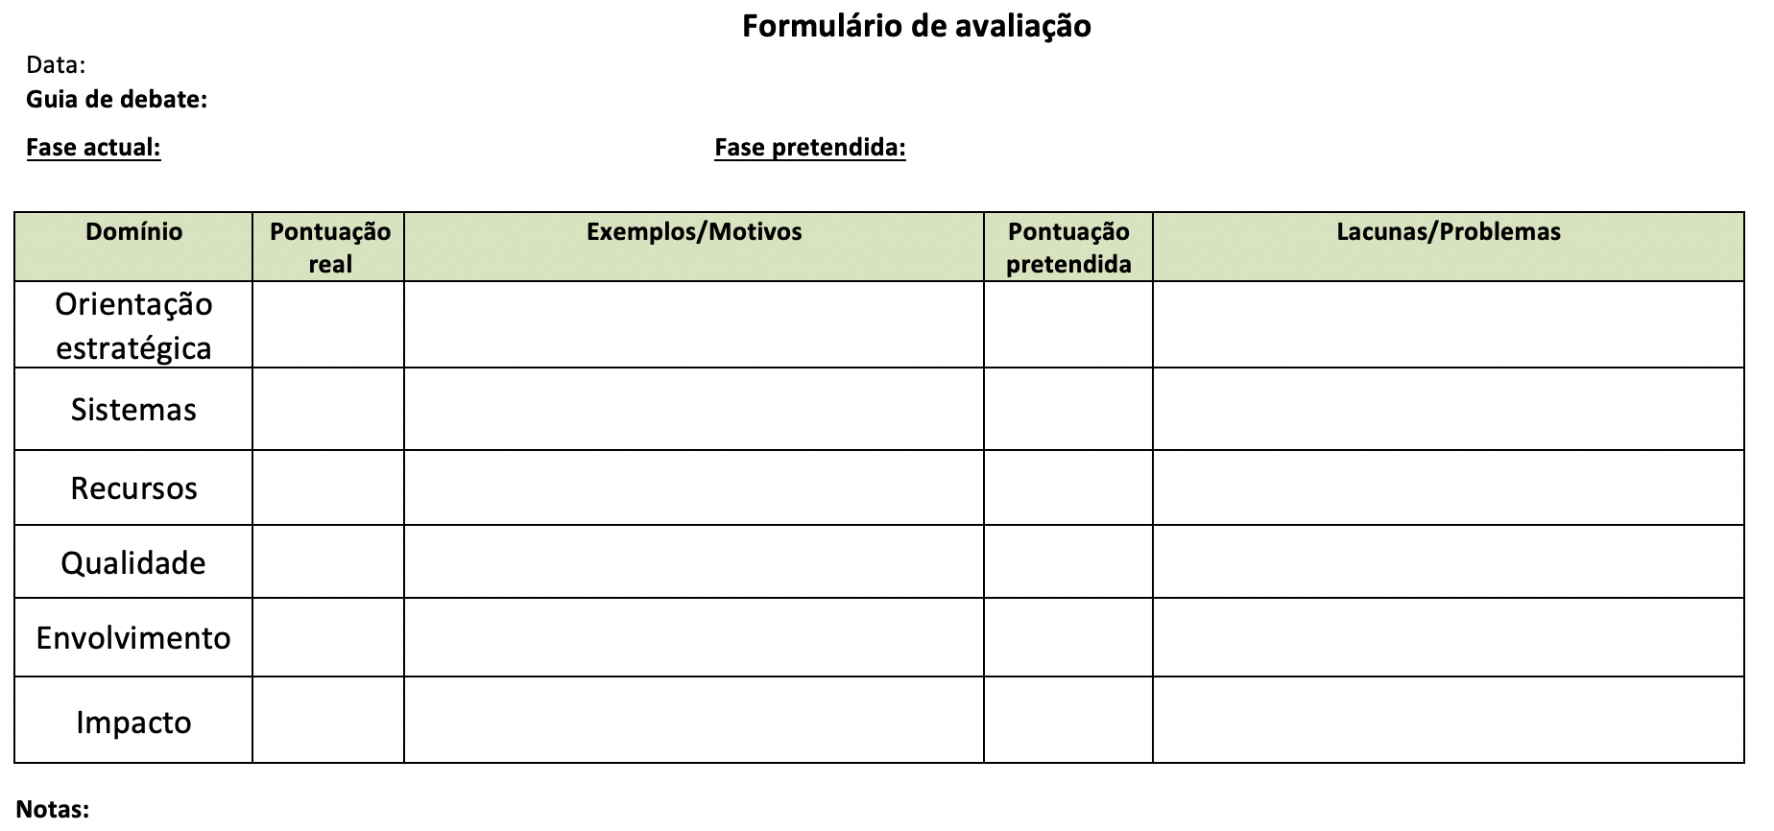
Passo 1: avaliação
Os participantes utilizam os GD para avaliar a fase actual geral do INSP e a fase em que o mesmo gostaria de estar num dado período de tempo, por exemplo, um ano
Em seguida, os participantes debatem domínio a domínio
Os GD ajudam os participantes a identificar lacunas específicas e formas de avançar
O debate é registado no Formulário de avaliação
Notes:
The Assessment Form is used to capture the key points from discussion. It has places for the current and desired stages for the NPHI as a whole at the top, and places to capture more detailed information about the various Domains in the table.
Note to recorders: Remember to customize the form so that it works for your preferred approaches. This includes changing column widths; setting margins for best display on a screen; and, if you intend to use bullets, setting up indents and other features.

Slide 11
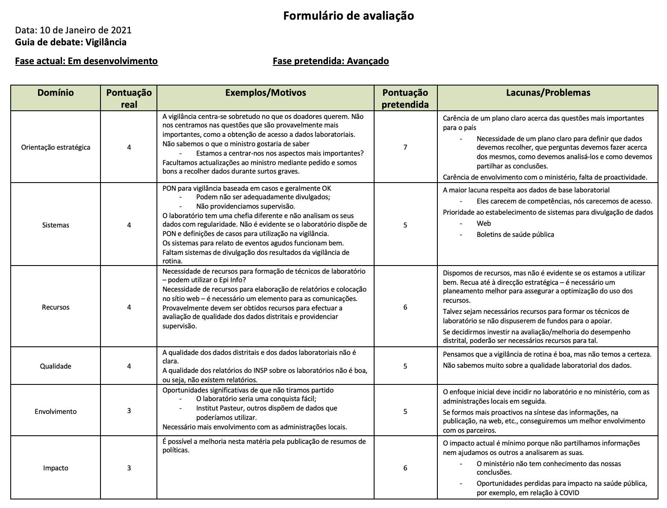
Formulário de avaliação: exemplo
Notes:
This is an example of a completed Assessment Form. This NPHI is currently in the "Developing" Stage, and it aims to be "Advanced" in a year. Participants have agreed on scores for each of the Domains and identified some of the gaps and issues that need to be addressed to move from their current scores in each Domain to their desired scores.

Slide 12
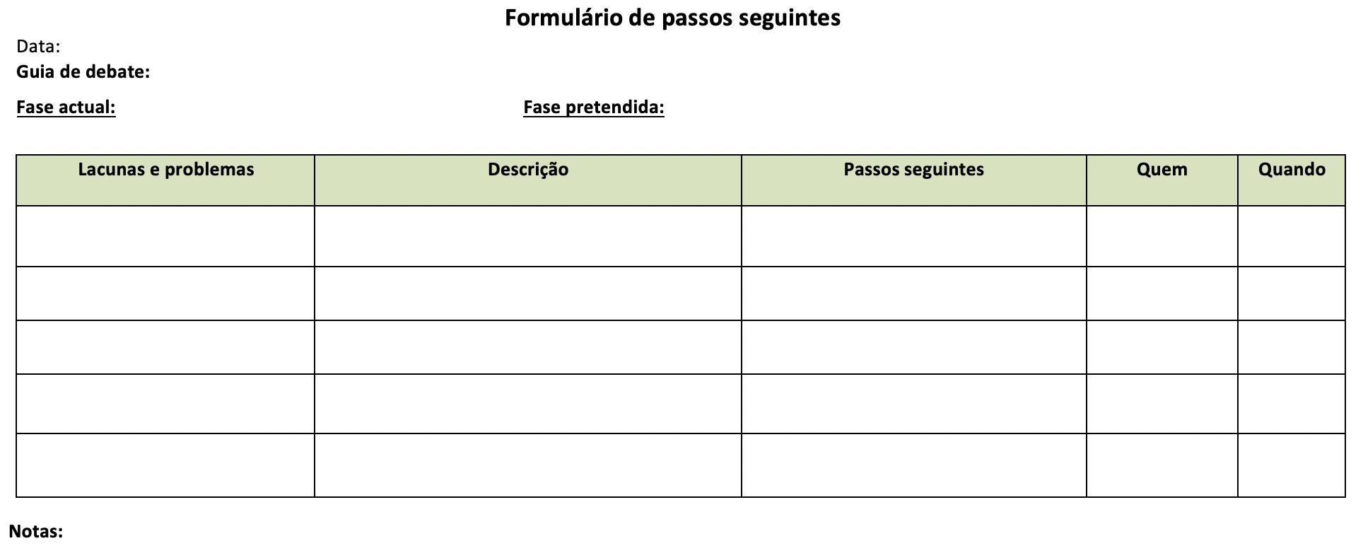
O Formulário de passos seguintes
O Formulário de passos seguintes é utilizado para os passos 2 e 3 da FDF
Inclui:
Lacunas e problemas da avaliação
Descrição – pormenores sobre as lacunas que ajudarão a definir os passos seguintes
Passos seguintes – medidas específicas a tomar após o workshop
Notes:
During a break, the facilitator and recorder organize the information collected on the Assessment Form into categories or "buckets" to make the remaining discussion easier. Similar topics discussed under different Domains are placed together. The "description" includes information discussed during the Assessment step that might be useful in identifying the next steps. If next steps have already been identified for some items, they can be placed in the Next Steps column.

Slide 13
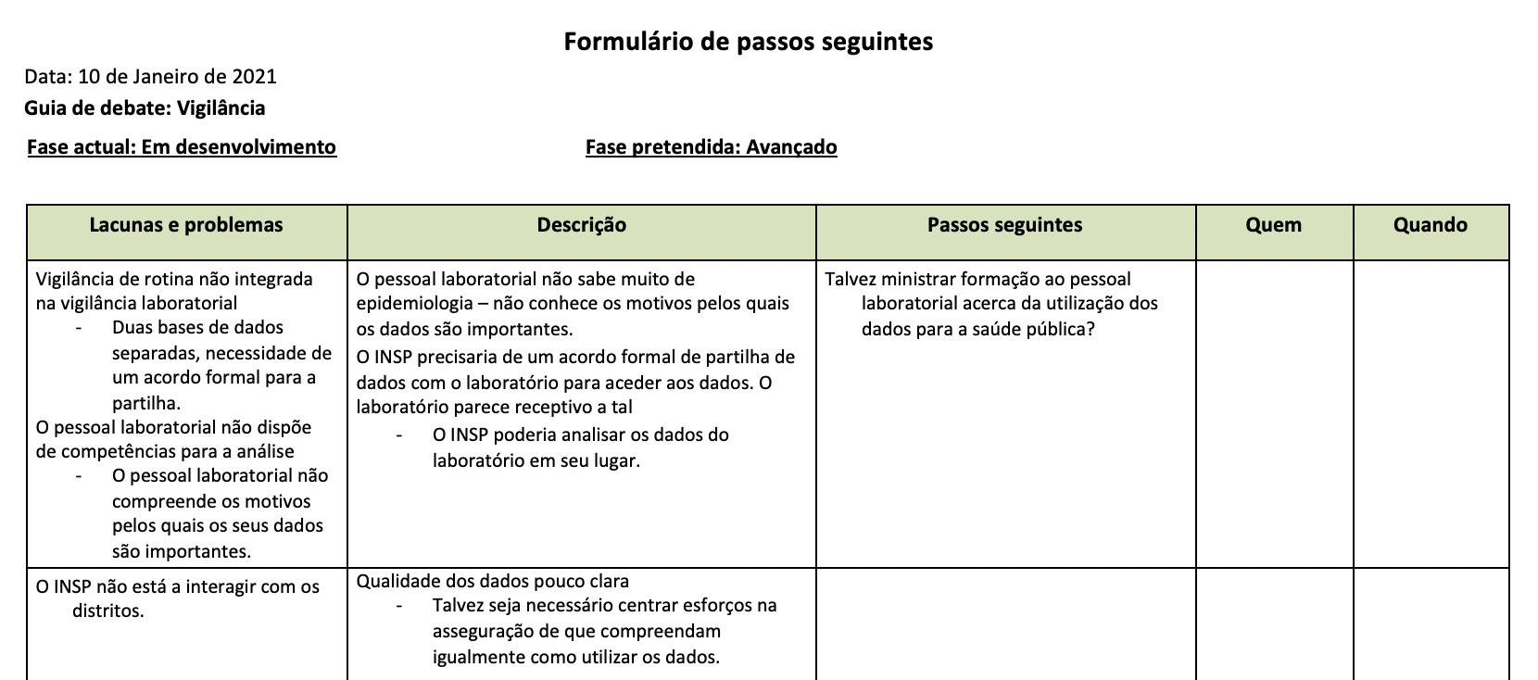
Avançar para a definição de prioridades e o planeamento
Os participantes fazem uma pausa após a avaliação, enquanto o dinamizador e registador organiza as informações do Formulário de avaliação no Formulário de passos seguintes
São consolidadas ideias transversais a vários domínios
Notes:
This slide shows a partially completed Next Steps Form, such as might be generated during the break by the facilitator and recorder. More information will be needed to develop a robust plan. The recorder has chosen to put an item into the Next Steps column for further discussion if this is a priority.

Slide 14
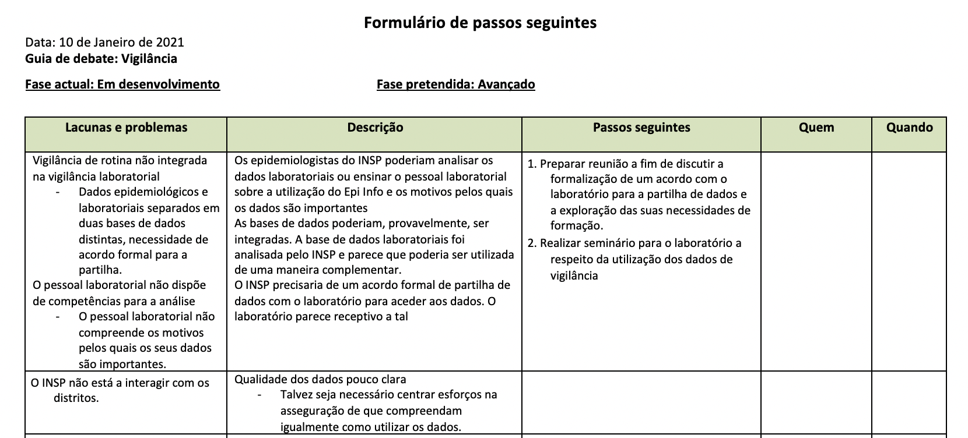
Os participantes analisam o Formulário de passos seguintes
O grupo discute cada item da coluna de lacunas e problemas e preenche com os pormenores necessários para fazer um bom plano
São necessárias mais informações para compreender as lacunas que impedem o INSP de chegar às fases pretendidas?
A resolução das lacunas identificadas terá o efeito pretendido? Há questões importantes em falta?
Notes:
After the break, the group reviews the Next Steps Form. After a quick overview by the facilitator, the group discusses each item in the Gaps and Issues column to ensure common understanding and add information that may be critical in the Prioritization step. Next steps that arise at any time during the discussions can be captured in the Next Steps column.

Slide 15
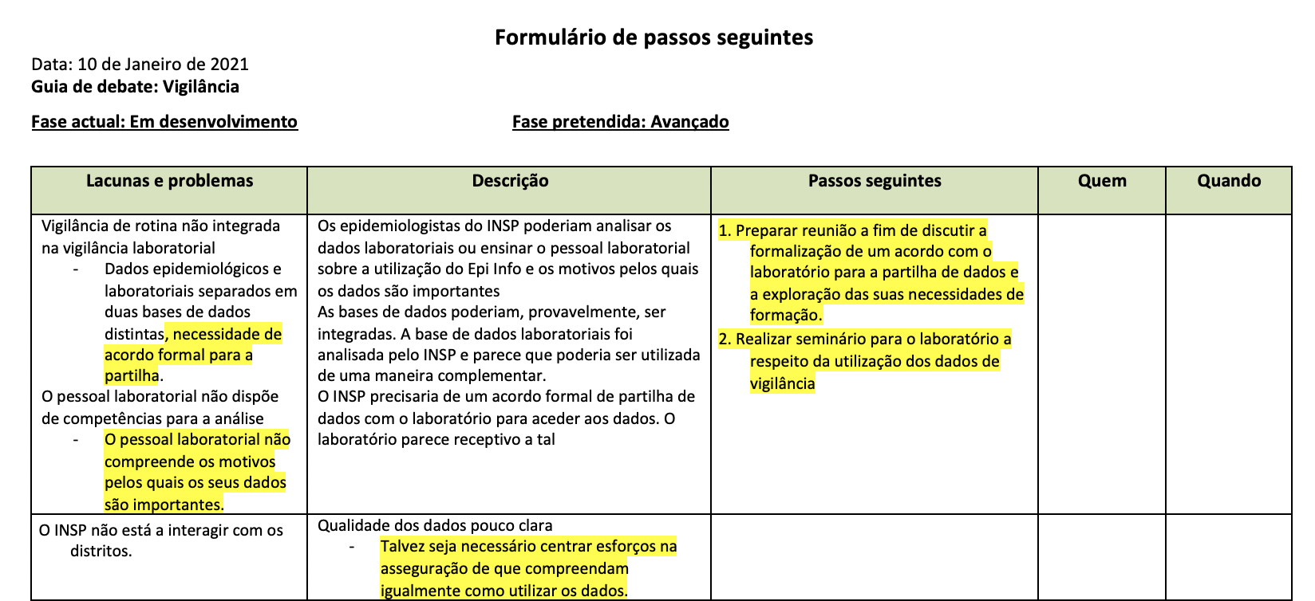
Passo 2: Definir prioridades
Em seguida, o grupo analisa a coluna de lacunas e problemas, questão a questão
Os participantes identificam as prioridades e o registador destaca-as
Uma vez concluída a discussão da totalidade de lacunas e problemas, os itens destacados são revistos
As prioridades foram registadas? Falta alguma coisa? Deve ser retirada alguma coisa?
Notes:
If new gaps and issues are identified, these can be added. It is also possible that some gaps and issues will be found to be too broad. For example, a gap may be split into two, one of which is a priority and one of which is not.

Slide 16
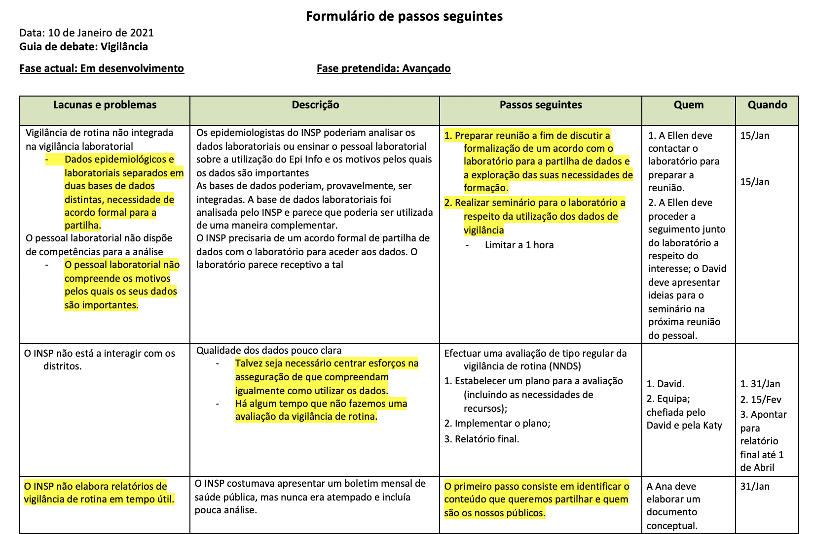
Passo 3: Planeamento
São descritos os passos seguintes, incluindo a identificação dos responsáveis e um calendário, para todas as prioridades
Notes:
In this next part of the SDT process, participants develop plans for their highest priorities. It is critical to clearly define who is responsible for which actions, and the timeline for achieving them. If work-planning does not immediately follow prioritization, some NPHIs may choose to conduct work-planning during the subsequent weeks.

Slide 17
Por fim, identificar os “frutos fáceis
de colher”
Os “frutos fáceis de colher” são as actividades que podem ser efectuadas com relativa facilidade e que terão um impacto elevado
Primeiro, os passos seguintes são analisados. Algum deles constitui um “fruto fácil de colher”?
Depois, podem ser geradas ideias adicionais
Tais ideias podem não ser específicas do guia de debate utilizado no workshop, mas são conquistas fáceis que se deve ponderar levar a cabo
Cada “fruto fácil de colher” deve ter um plano de passos seguintes: identificação dos responsáveis e calendário
Notes:
Often, participants have additional ideas beyond those in the DG topic about high-priority activities that could achieve results quickly. Capturing these and developing next steps may not help the NPHI achieve a higher stage in the area covered by the DG, but it can help the NPHI achieve a higher overall level of functioning and/or effectiveness

Slide 18
Antes de terminar, analise os planos
Se o INSP abordar as prioridades, obterá o progresso pretendido no sentido de alcançar a fase pretendida?
São necessários recursos adicionais? Qual é o plano para os obter?
Os passos seguintes são claros? Todos os elementos essenciais do pessoal compreendem as suas funções na execução do plano?
Como será monitorizado o progresso?
Notes:
A potential pitfall in any planning is that participants develop detailed plans for what is easy to do, but not necessarily what is most impactful. Before declaring the plan complete, it is essential to review it to determine if it is likely to have the desired impact, and to revise it if necessary.

Slide 19
Desejamos-lhe boa sorte no avanço para o seu futuro preferido
Se tiver comentários ou dúvidas sobre este material, contacte:
Programa de INSP dos CDC dos EUA: nphisdt@cdc.gov
IANPHI: info@ianphi.org

