Slide 1
OUTIL DE DÉVELOPPEMENT
PAR STADES (SDT)
POUR LES INSTITUTS NATIONAUX
DE SANTÉ PUBLIQUE
Version : Février 2021
Notes:
Staged Development Tool (SDT) for National Public Health Institutes (NPHIs)
The notes accompanying the slides provide additional details about the SDT and its use.
The SDT was developed by the U.S. Centers for Disease Control and Prevention (CDC) and the International Association of National Public Health Institutes (IANPHI) with the assistance of a consultative group of NPHI leaders from around the world. It is designed to help NPHIs assess their capacities and identify gaps, prioritize gaps, and plan for how to move to a higher level of functioning. It is based in part on the CYPRESS methodology developed by Deloitte Consulting, USA. Over the years, several changes were made to the SDT, for example, addition of new Discussion Guides and adaptation for virtual use. This slide-set was revised in February 2021.

Slide 2
Thèmes
Modèles de maturité et Guides de discussion (GD)
Ateliers SDT
Étapes SDT
Notes:
This slide-set contains a brief overview of the SDT. This slide-set does not contain sufficient information for an untrained individual to run an SDT workshop. A successful workshop requires facilitation by someone with in-depth understanding of the SDT. If you are interested in having an SDT workshop, please contact CDC or IANPHI (see last slide) for further information.

Slide 3
Modèles de maturité
Le modèle de maturité est le cadre conceptuel du SDT
Un modèle de maturité présente les stades de développement : Élémentaire, Intermédiaire, Avancé, et Avant-garde
Le SDT aide les INSP à appliquer les modèles de maturité à des thèmes ou domaines prioritaires pour l’INSP
Élémentaire
Intermédiaire
Avancé
Avant-garde
Notes:
The maturity model is based on the idea that for a given topic, NPHIs exhibit different stages of “maturity” or development. By providing examples of what these different maturity stages “look like,” the SDT process provokes in-depth conversations, in which participants clarify their current stage in a given topical area, their desired stage, and major gaps that need to be addressed to move to the desired stage.

Slide 4
Guides de discussion (GD)
30 GD ont été conçus spécifiquement pour les INSP
11 couvrent des fonctions tournées vers l’intérieur, comme le leadership et management, hygiène et sécurité, communication interne
19 couvrent des fonctions tournées ver l’extérieur, comme la surveillance et les collaborations multisectorielles
Les 30 GD sont disponibles en anglais, français, espagnol et portugais ianphi.org/tools-resources/sdt.html
Les GD décrivent les INSP à chacun des différents stades de maturité :
Élémentaire
Intermédiaire
Avancé
Avant-garde
Notes:
Often, NPHI planning focuses on Core Public Health Functions. However, sometimes internal issues, such as leadership and management or issues related to the NPHI workforce, are major barriers to accomplishing public health functions. Therefore, the SDT includes Discussion Guides (DGs) that relate to internal-facing issues, such as leadership and management, and external-facing issues, like surveillance.

Slide 5
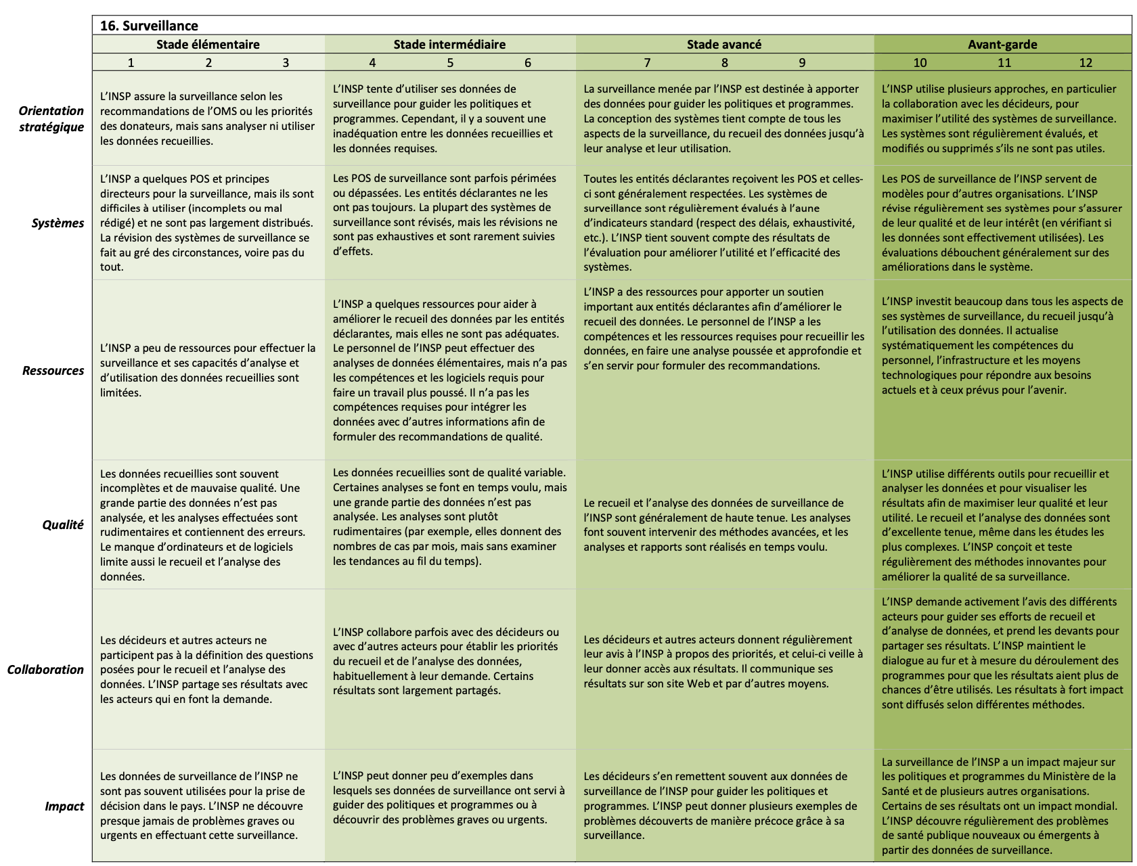
Exemple de Guide de discussion
Notes:
This is a picture of the Surveillance Discussion Guide.
The DG content is divided into four columns, one for each of the developmental stages (Basic, Developing, Advanced, Leading Edge). Each DG also contains six rows, which we call "Domains." The six Domains reflect factors, like Strategic Direction and Resources, that contribute to NPHI's achieving their desired futures. Typically, discussions start with participants discussing the overall stage of the NPHI on that DG, and then they get into detail about each of the Domains.
The numeric scores under each stage provide the option for facilitators to encourage more detailed discussion about the current and desired status in each of the Domains. The actual scores are less important than the discussion that is prompted as participants justify their responses.

Slide 6
Guides de discussion : Domaines
Le SDT comporte 6 domaines – dont chacun occupe une rangée du GD. Les domaines sont :
Orientation stratégique : Les priorités sont-elles claires et stratégiques ?
Systèmes : L’INSP a-t-il les systèmes, processus et outils nécessaires pour mener à bien son travail ?
Ressources: Les ressources humaines et matérielles sont-elles adéquates ?
Qualité : La qualité est-elle mesurée et les normes sont-elles atteintes ?
Collaboration : Les parties prenantes clés collaborent-elles avec l’INSP et l’aident-il à atteindre ses objectifs ?
Impact : Pour les GD tournés vers l’intérieur : L’INSP fonctionne-t-il efficacement ? Pour les GD tournés vers l’extérieur : L’INSP contribue-t-il à une meilleure santé ?
Notes:
Each of the DGs has the same structure, with the 4 developmental stages defining the columns and the 6 Domains defining the rows. The slide above provides abbreviated definitions of the Domains.
The more complete definitions that were used in developing the DGs are:
Strategic Direction: Degree to which the NPHI works strategically in setting priorities and in allocating and using resources, including staff time
Systems: Degree to which the NPHI has systems, processes, and tools that enable it to carry out the described effort
Resources: Degree to which the NPHI has assets (e.g., staff capacity, supplies, transportation, infrastructure) to support the described effort
Quality: Degree to which the NPHI is able to carry out the described effort in a high-quality manner.
An additional component for external-facing DGs is: Degree to which the NPHI supports quality in the efforts of those contributing to the achievement of the described effort (e.g., subnational entities, stakeholders, partners)
Engagement:
Internal-facing only: Degree to which staff are committed to contributing to the NPHI’s vision and goals. Degree to which staff contribute to improving the NPHI’s strategies or performance
External-facing only: Degree to which stakeholders (partners, beneficiaries, contributors, donors, sub-national actors, and communities) are invited to provide input or feedback, or are engaged by the NPHI as partners/advisors
Impact:
Internal-facing only: Degree to which the NPHI is able to perform or achieve results
External-facing only: Degree to which the NPHI is able to perform or achieve its goals and deliver high-quality products and services. Extent to which the products and services have an impact on public health

Slide 7
Ateliers SDT
Les ateliers SDT peuvent se tenir en personne (si les circonstances le permettent) ou virtuellement
Ateliers en personne : En général 3 jours ; 5-8 GD
Sessions virtuelles : En général 5 heures par session, pauses comprises ; le nombre de GD dépend de divers facteurs
Que ce soit en personne ou virtuellement, il est préférable de confier le processus à un animateur et un rapporteur formés au STD et de consigner les informations clés sur les formulaires STD
Notes:
The SDT was originally designed to be conducted as an in-person workshop over several days. With the COVID-19 pandemic and other logistical challenges, IANPHI and CDC have adapted the SDT to provide a virtual option as well.
In-person workshops typically last 3 days and cover 5-8 DGs. Virtual sessions typically last around 5 hours, including breaks. Virtual workshops take longer for a variety of reasons. Technical issues include limited bandwidth for some participants and disruptions (e.g., pets, family members, phone calls, visitors), since often people are working from sub-optimal locations. Without being in a shared space, it is harder for the facilitator and participants to know when discussion of a particular topic has reached a natural end. It can be hard to determine if all who want to contribute to a particular discussion topic have had their opportunity; therefore, the discussion may be more repetitive or recursive than in an in-person setting.

Slide 8
Préparer l’atelier
Pour planifier un atelier de TSD, il faut choisir soigneusement les GD à utiliser et les participants appropriés
Aucune préparation spéciale ou rédaction de document n’est nécessaire de la part des participants
Le SDT s’appuie sur les connaissances et les expériences des participants et sur leur sagesse collective
Les rôles de l’animateur et du rapporteur sont les suivants :
Guider les participants à évaluer en détail la situation et les problèmes sous-jacents avant de proposer des « solutions ».
Recueillir et organiser les observations
Notes:
Planning a workshop requires thoughtful consideration about which DGs to use and who to invite. CDC and IANPHI can help leadership define which DGs will address their priorities and what mix of individuals will be best able to develop a plan that is likely to be implemented and achieve the desired impact.
The SDT does not require significant up-front efforts from participants. It relies on what they know and think to create a plan they can "own."
An issue frequently encountered during planning is that participants decide on courses of action before they thoroughly understand the underlying issues. For example, if data quality is poor, a common "solution" is to do training. However, if the people collecting data do not have time to ensure quality or turn over quickly, training may not solve the problem.

Slide 9
Le processus de SDT comprend 3 étapes
1. ÉVALUER
2. PRIORISER
3. PLANIFIER
Durant l’évaluation, les GD sont utilisées pour susciter la discussion
Une bonne évaluation est essentielle pour un bon plan
L’animateur utilise les DG pour aider les participants à « creuser en profondeur ».
Les questions à approfondir sont ensuite classées par ordre de priorité
La dernière étape consiste à identifier les prochaines étapes spécifiques pour les mesures prioritaires
Notes:
Because the DGs are designed for NPHIs, they include details that reflect the capacities and experiences of NPHIs from around the world. Particularly for NPHIs that are new or are at earlier stages of development, the content under Advanced and Leading Edge stages may suggest activities and options they had not previously considered. Depending on the workshop, planning may stop at defining next steps for follow-up on priority areas or may include full work-planning for specific projects.

Slide 10
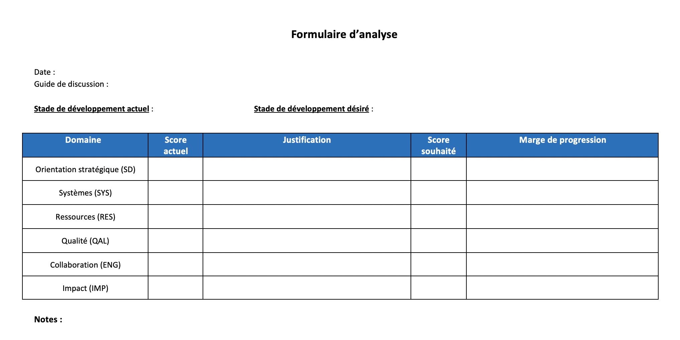
Étape 1 : Évaluation
Les participants utilisent le GD pour évaluer le stade actuel de l’INSP et le stade souhaité dans un délai donné, p. ex., un an
Les participants discutent ensuite de chaque domaine
Les GD aident les participants à identifier les lacunes spécifiques et les solutions possibles
La discussion est rapportée sur le formulaire d’évaluation
Notes:
The Assessment Form is used to capture the key points from discussion. It has places for the current and desired stages for the NPHI as a whole at the top, and places to capture more detailed information about the various Domains in the table.
Note to recorders: Remember to customize the form so that it works for your preferred approaches. This includes changing column widths; setting margins for best display on a screen; and, if you intend to use bullets, setting up indents and other features.

Slide 11
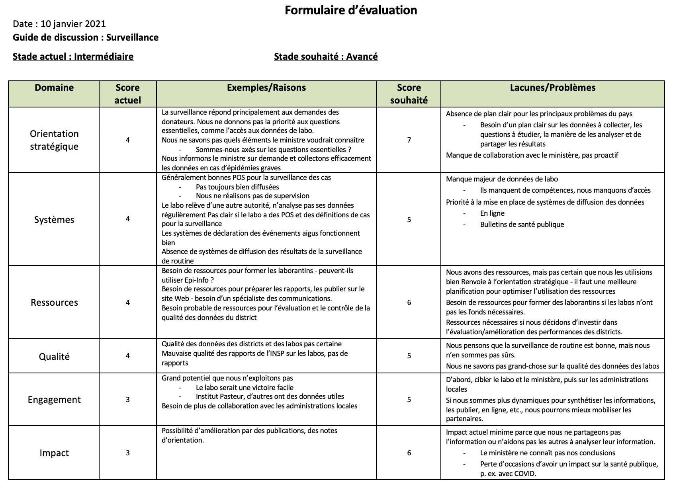
Formulaire d’évaluation : Exemple
Notes:
This is an example of a completed Assessment Form. This NPHI is currently in the "Developing" Stage, and it aims to be "Advanced" in a year. Participants have agreed on scores for each of the Domains and identified some of the gaps and issues that need to be addressed to move from their current scores in each Domain to their desired scores.

Slide 12
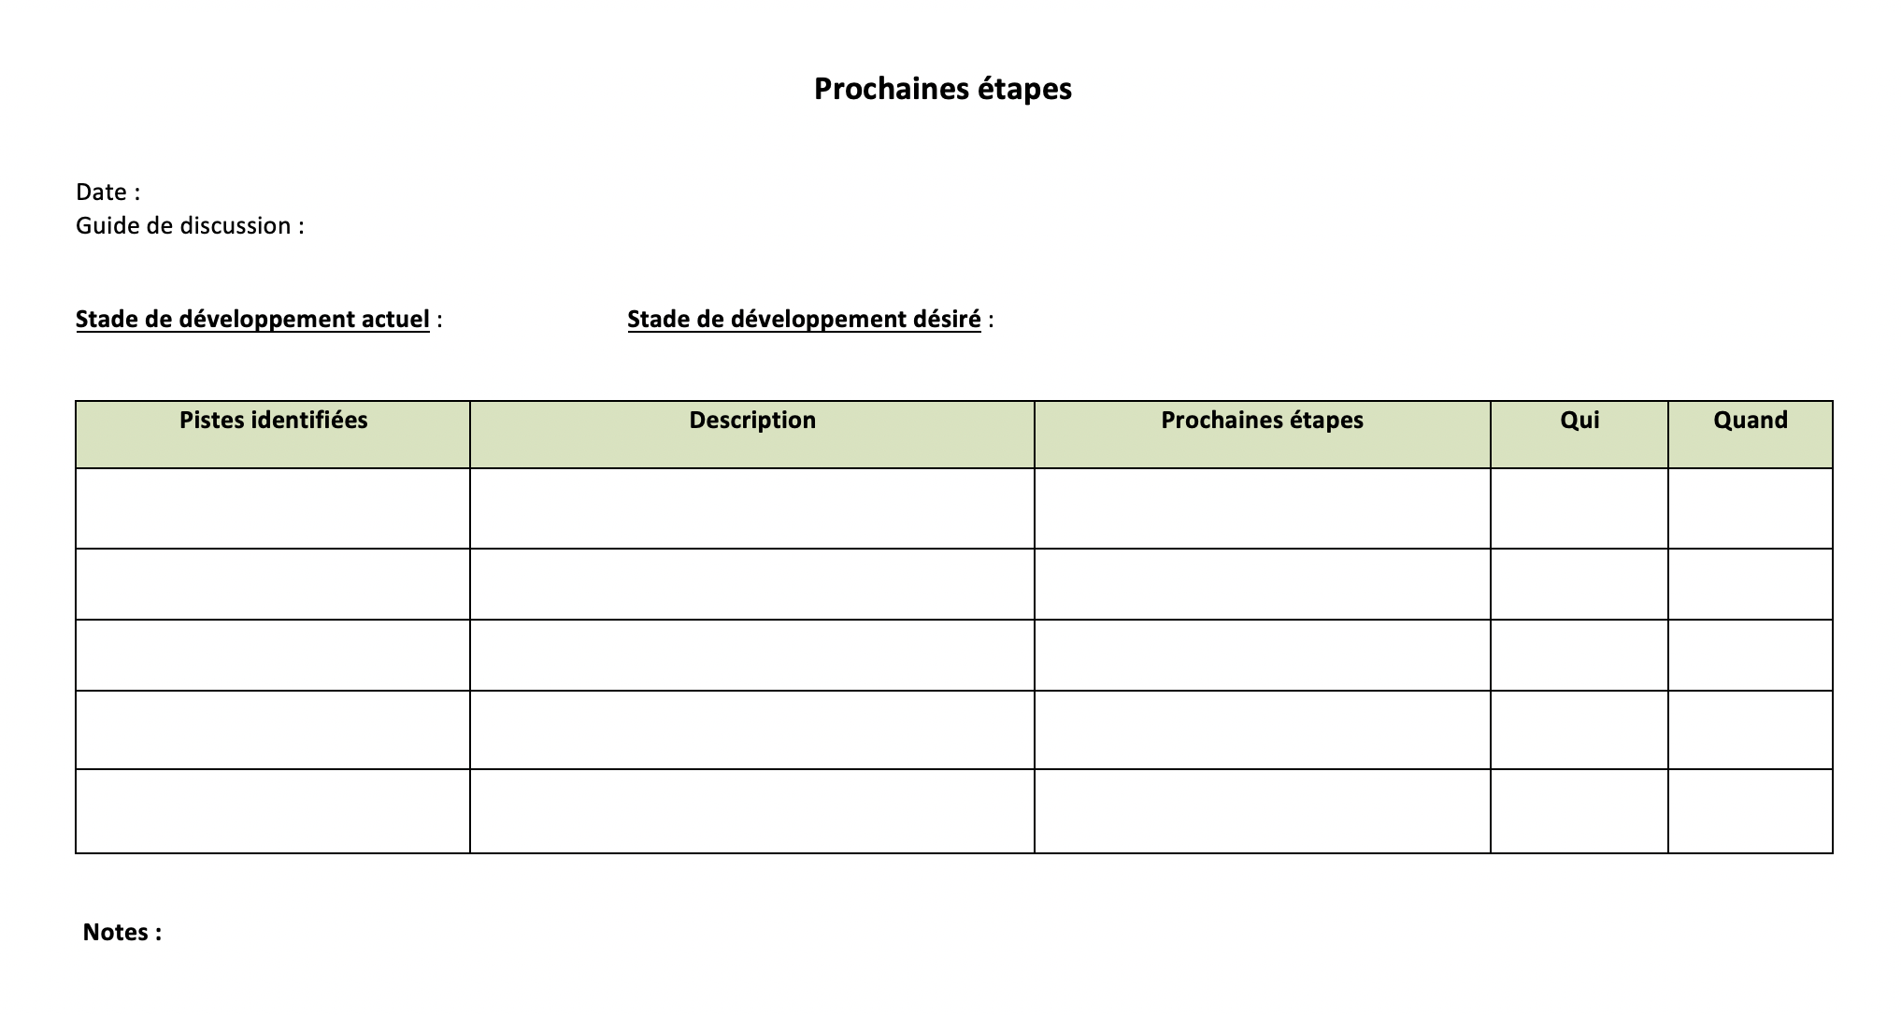
Le formulaire Prochaines étapes
Le formulaire « Prochaines étapes » est utilisé pour les étapes 2 et 3 du SDT
Il comprend :
Les lacunes et les problèmes relevés par l’évaluation
Description – détails sur les lacunes qui aideront à définir les prochaines étapes
Etapes suivantes – mesures spécifiques à prendre après l’atelier
Notes:
During a break, the facilitator and recorder organize the information collected on the Assessment Form into categories or "buckets" to make the remaining discussion easier. Similar topics discussed under different Domains are placed together. The "description" includes information discussed during the Assessment step that might be useful in identifying the next steps. If next steps have already been identified for some items, they can be placed in the Next Steps column.

Slide 13
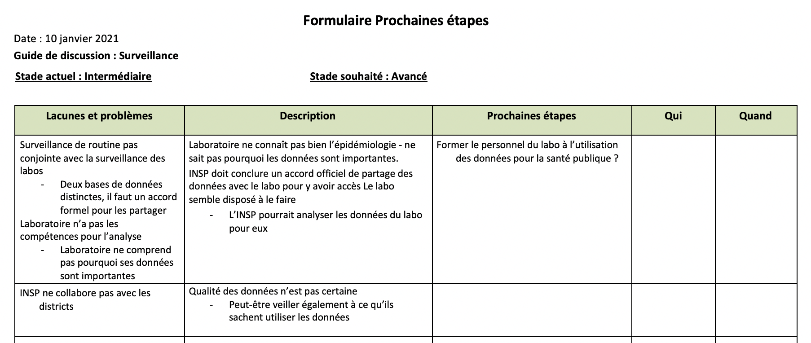
Passage à la priorisation et à la planification
Les participants font une pause après l’évaluation, tandis que l’animateur et le rapporteur organisent les informations du formulaire d’évaluation dans le formulaire Prochaines étapes
Les idées sur des sujets qui recoupent plusieurs domaines sont consolidées
Notes:
This slide shows a partially completed Next Steps Form, such as might be generated during the break by the facilitator and recorder. More information will be needed to develop a robust plan. The recorder has chosen to put an item into the Next Steps column for further discussion if this is a priority.

Slide 14
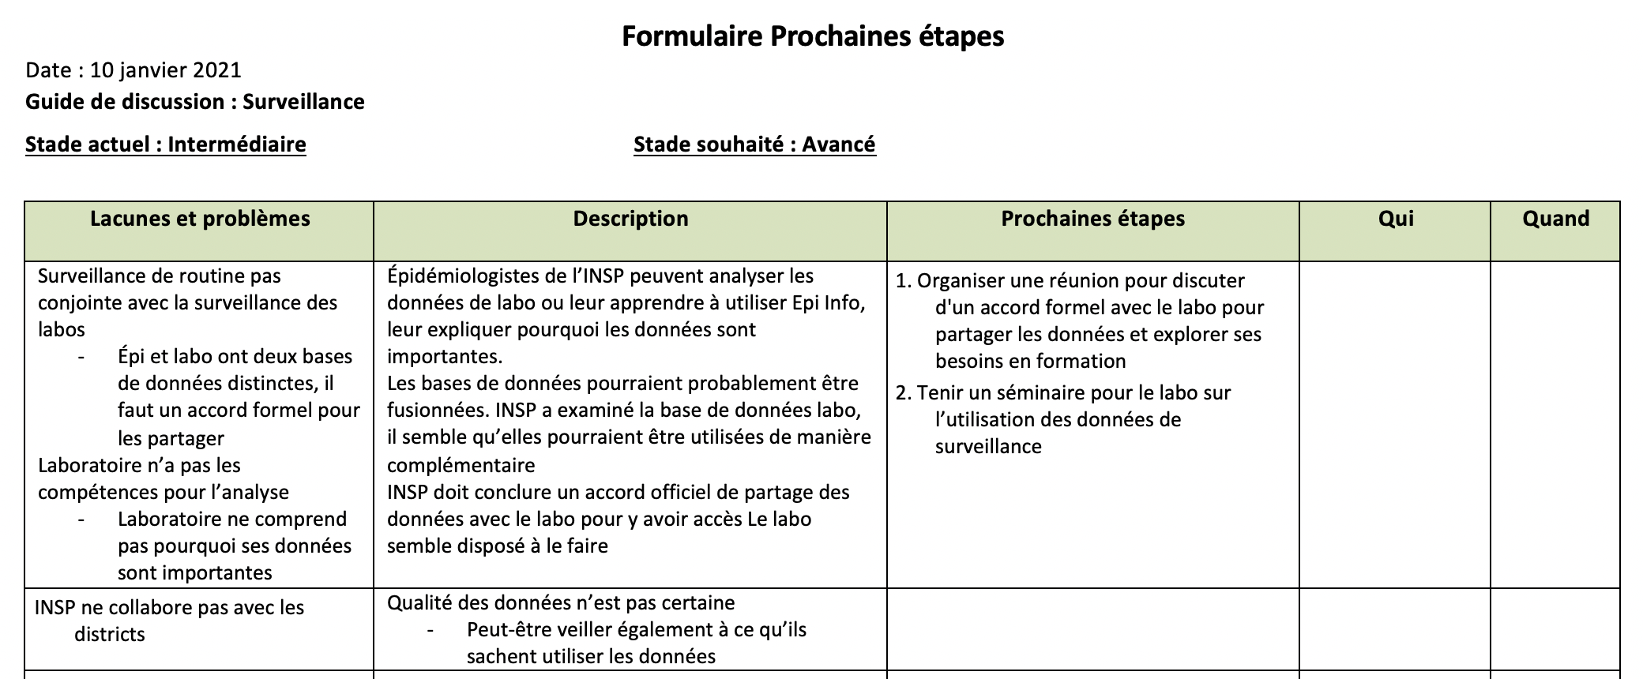
Les participants examinent le formulaire Prochaines étapes
Le groupe discute de chaque point de la colonne Lacunes et problèmes et fournit les détails nécessaires à l’élaboration d’un plan approprié
Faut-il plus d’informations pour comprendre les lacunes qui empêchent l’INSP d’atteindre les stades souhaités ?
Le fait de combler les lacunes identifiées aura-t-il l’effet désiré ? Y a-t-il des problèmes importants qui ne sont pas abordés ?
Notes:
After the break, the group reviews the Next Steps Form. After a quick overview by the facilitator, the group discusses each item in the Gaps and Issues column to ensure common understanding and add information that may be critical in the Prioritization step. Next steps that arise at any time during the discussions can be captured in the Next Steps column.

Slide 15
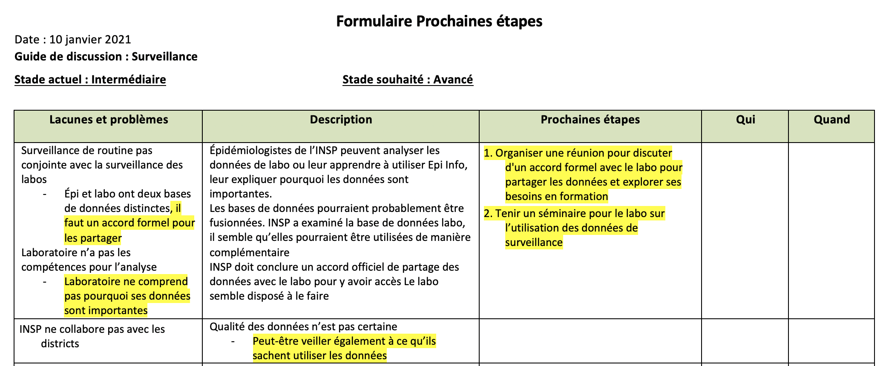
Étape 2 : Prioriser
Le groupe passe ensuite en revue la colonne « Lacunes et problèmes », point par point
Ils identifient les priorités, et le rapporteur les souligne.
Une fois toutes les lacunes et problèmes discutés, les points soulignés sont réexaminés
Les priorités ont-elles été définies ? Manque-t-il quelque chose ? Faudrait-il éliminer quelque chose ?
Notes:
If new gaps and issues are identified, these can be added. It is also possible that some gaps and issues will be found to be too broad. For example, a gap may be split into two, one of which is a priority and one of which is not.

Slide 16
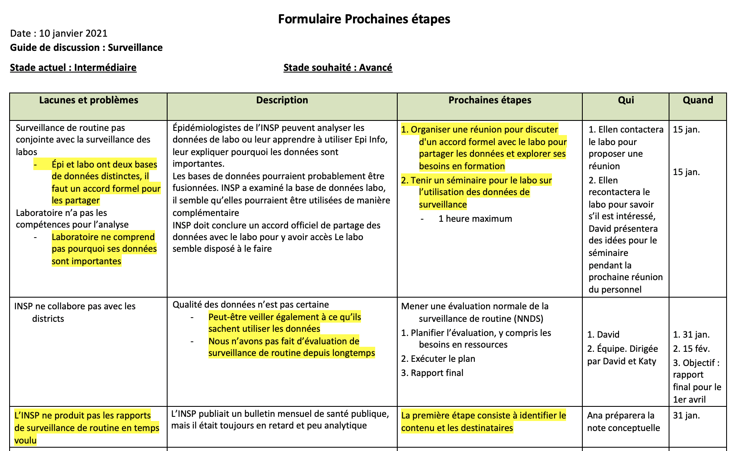
Étape 3 : Planifier
Les prochaines étapes – y compris les responsables et un calendrier – sont décrites pour toutes les priorités
Notes:
In this next part of the SDT process, participants develop plans for their highest priorities. It is critical to clearly define who is responsible for which actions, and the timeline for achieving them. If work-planning does not immediately follow prioritization, some NPHIs may choose to conduct work-planning during the subsequent weeks.

Slide 17
Enfin, identifier les solutions faciles
Les solutions faciles sont relativement aisées et auront un impact important
Tout d’abord, les Prochaines étapes sont passées en revue. Y a-t-il des solutions faciles ?
Ensuite, des idées supplémentaires peuvent être dégagées
Ces idées ne sont peut-être pas spécifiques au Guide de discussion utilisé lors de l’atelier, mais elles constituent des gains faciles à envisager
Chaque solution facile doit avoir un plan pour les prochaines étapes : qui en est responsable, et quel est le calendrier
Notes:
Often, participants have additional ideas beyond those in the DG topic about high-priority activities that could achieve results quickly. Capturing these and developing next steps may not help the NPHI achieve a higher stage in the area covered by the DG, but it can help the NPHI achieve a higher overall level of functioning and/or effectiveness

Slide 18
Avant de terminer, passer en revue les plans
Si l’INSP aborde les priorités, réalisera-t-il les progrès nécessaires pour atteindre le stade souhaité ?
Des ressources supplémentaires sont-elles nécessaires ? Quel est le plan pour les obtenir ?
Les prochaines étapes sont-elles claires ? Tous les membres clés du personnel comprennent-ils leur rôle dans la réalisation du plan ?
Comment les progrès seront-ils suivis ?
Notes:
A potential pitfall in any planning is that participants develop detailed plans for what is easy to do, but not necessarily what is most impactful. Before declaring the plan complete, it is essential to review it to determine if it is likely to have the desired impact, and to revise it if necessary.

Slide 19
Bonne chance
Si vous avez des commentaires ou des questions concernant ce document, veuillez contacter :
Programme INPS du CDC américain : nphisdt@cdc.gov
IANPHI : info@ianphi.org

