Slide 1
Overview of the Africa CDC NPHI Monitoring Score Card
IANPHI annual conference
4-7 November 2018
London, UK

Slide 2
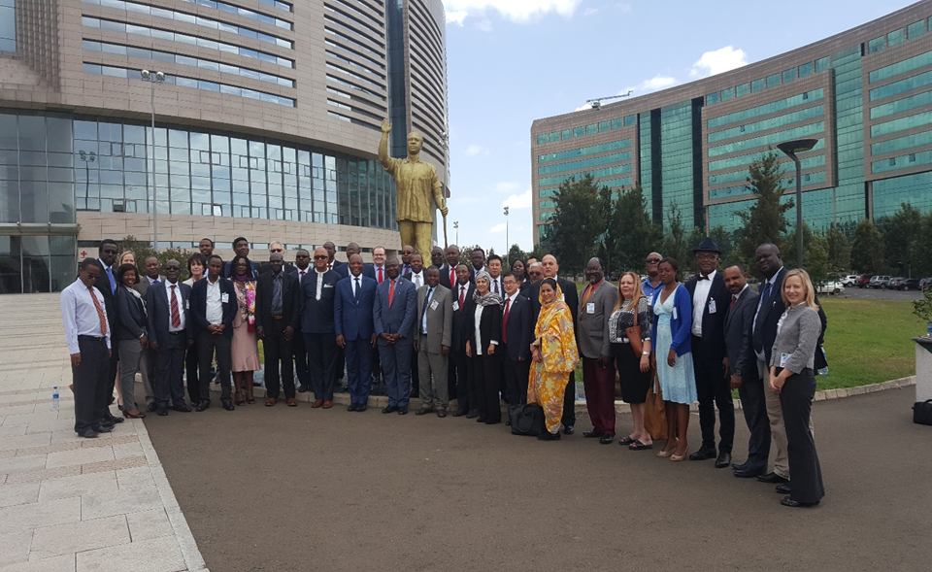
Endorsement of the Africa CDC NPHI Scorecard ( 28-29 March 2017)
Collectively agreed to:
Reaffirm and commit to strengthen networking between Africa CDC, RCCs, NPHIs, and Universities
Reaffirm the need for multi-sectoral Continental strategies
Recognize role of NPHIs to accelerate IHR implementation
Acknowledge the need for a standardized monitoring and evaluation framework
Advocate for the establishment of NPHIs
Notes:
The Africa CDC will promote and strengthen these functional capacities with the Member States in collaboration with the Africa CDC Regional Collaborating Centres (RCC). To ensure that the Functional Pillars are effectively implemented, cross-cutting enablers will provide the backbone for the operations of the Africa CDC (Workforce, Partnership, Innovation, Finance and Leadership and Management).

Slide 3
Objectives of the Africa CDC NPHI Scorecard
Assess and measure progress
Identify most urgent needs and track progress over time,
Provide information for Africa CDC and NPHIs to advocate for resources to support ongoing development
If a country already has an NPHI, the Scorecard helps to
Identify most urgent needs and prioritize areas for improvement
If a country doesn’t have a NPHI, it helps to
Guide the NPHI development process.
Notes:
The Africa CDC will promote and strengthen these functional capacities with the Member States in collaboration with the Africa CDC Regional Collaborating Centres (RCC). To ensure that the Functional Pillars are effectively implemented, cross-cutting enablers will provide the backbone for the operations of the Africa CDC (Workforce, Partnership, Innovation, Finance and Leadership and Management).

Slide 4
Implementation Process
Independent Assessment team reviews
Prepare final assessment report
Initial Self Assessment
Facilitated In-depth discussion and site visits
Notes:
The Africa CDC will promote and strengthen these functional capacities with the Member States in collaboration with the Africa CDC Regional Collaborating Centres (RCC). To ensure that the Functional Pillars are effectively implemented, cross-cutting enablers will provide the backbone for the operations of the Africa CDC (Workforce, Partnership, Innovation, Finance and Leadership and Management).

Slide 5
Outcome/outputs of the NPHI Assessment
First Assessment
Establish a baseline measurement of the NPHI’s capacity and capabilities
Subsequent Assessments
Monitor progress
Final report
Identify the NPHI’s existing capacities, strengths, gaps and challenges
Results from implementing the scorecard will be used to inform NPHI development and strengthening
Notes:
The Africa CDC will promote and strengthen these functional capacities with the Member States in collaboration with the Africa CDC Regional Collaborating Centres (RCC). To ensure that the Functional Pillars are effectively implemented, cross-cutting enablers will provide the backbone for the operations of the Africa CDC (Workforce, Partnership, Innovation, Finance and Leadership and Management).

Slide 6
Assessment Indicators
Surveillance & Disease Intelligence (12)
Information Systems (6)
Laboratory Systems & Networks (13)
Preparedness and response (11)
Public health research and Institutes (6)
Legislation (7)
Planning (3)
Management (2)
Work Force development and Human resource Management(4)
Financial Systems & Resource Mobilization (3)
Infrastructure (1)
Notes:
The Africa CDC will promote and strengthen these functional capacities with the Member States in collaboration with the Africa CDC Regional Collaborating Centres (RCC). To ensure that the Functional Pillars are effectively implemented, cross-cutting enablers will provide the backbone for the operations of the Africa CDC (Workforce, Partnership, Innovation, Finance and Leadership and Management).

Slide 7
Scoring
Based on the NPHI’s current capacity, each indicator in the scorecard receives a unique score ranging 0-2.
Score “0”:
Absolutely no capacity and key attributes are completely absent.
Score “1”:
Some capacity and meets some of the attributes specified in an indicator
Score”2”:
NPHI completely meets all the requirements and key attributes specified in the indicator.
Note: All the responses should be supported by documentation as indicated in the scorecard.
Notes:
The Africa CDC will promote and strengthen these functional capacities with the Member States in collaboration with the Africa CDC Regional Collaborating Centres (RCC). To ensure that the Functional Pillars are effectively implemented, cross-cutting enablers will provide the backbone for the operations of the Africa CDC (Workforce, Partnership, Innovation, Finance and Leadership and Management).

Slide 8
Scoring
NPHI performance score by function
X = Sum of scores for items within a function
Y = Total possible points that can be earned for the function
NPHI score by function (%) = X/Y *100
Color Scoring
Minimal Performance (Red) – 0-59%
Average performance (Yellow) – 60 -79%
Optimal performance (Green) – 80-100%
NPHI overall performance score
X = Sum of total points from all functions
Y = Sum of maximum possible points from all functions
Overall NPHI score (%) = X/Y *100
Notes:
The Africa CDC will promote and strengthen these functional capacities with the Member States in collaboration with the Africa CDC Regional Collaborating Centres (RCC). To ensure that the Functional Pillars are effectively implemented, cross-cutting enablers will provide the backbone for the operations of the Africa CDC (Workforce, Partnership, Innovation, Finance and Leadership and Management).

Slide 9
Communalities and Differences Between NPHI Score Card, STD, and JEE,,
Description | NPHI Score card | STD | JEE
Purpose and Use | Assist Africa CDC in advocacy efforts with Heads of State and Government, and ministerial leaders to obtain sufficient resources for ongoing NPHI development in Africa. Track progress of NPHI strengthening in Africa over time. | Develop concrete work-plans for addressing gaps in capacity at NPHIs. Track progress of NPHI strengthening over time. | Measure country specific status and progress in achieving the core capacities under IHR
Scope | Assessment focuses on the five Africa CDC strategic pillars and cross cutting enablers. | Assess NPHI capacity in priority operational and public health functions | Assess country capacity to prevent, detect, and rapidly respond to public health threats
Implementation | External characterization based on a rating scale developed by Africa CDC with input from NPHI leaders | Facilitated self-assessment based on the Capability Maturity Model | A voluntary multi-sectoral external evaluation process
Outcome | NPHI-specific strengths and gaps in the five Africa CDC strategic pillars and cross-cutting enablers Africa CDC and its Regional Collaborating Centers have snapshot of regional and continental progress in NPHI development | Strengths and gaps in priority areas identified by NPHIs. Critical NPHI gaps prioritized for strengthening. Concrete work plans developed by NPHIs to address critical gaps. | Health system capacities and limitations identified based on a One Health approach. Priority actions for capacity development in disease prevention, detection, and response described. Information used to develop action plans to guide allocation of national resources and engagement of current and prospective
Notes:
The Africa CDC will promote and strengthen these functional capacities with the Member States in collaboration with the Africa CDC Regional Collaborating Centres (RCC). To ensure that the Functional Pillars are effectively implemented, cross-cutting enablers will provide the backbone for the operations of the Africa CDC (Workforce, Partnership, Innovation, Finance and Leadership and Management).

Slide 10
A safer, healthier, integrated and prosperous Africa!

